Slide 1

27 Contribution
Peter H. Chen

Slide 2
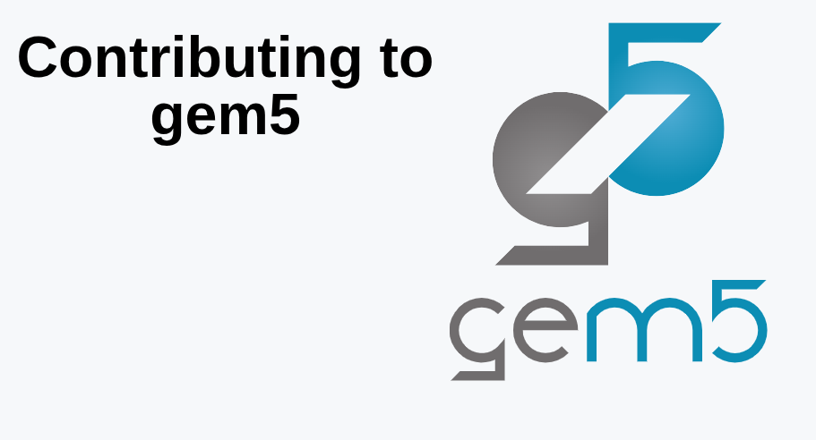
27 Contribution
https://www.youtube.com/watch?v=xbeIU-MQJJk&list=PL_hVbFs_loVR_8ntTTmmG6YEq3Po_4snu&index=27
Contribution (0:00 - 0:30/1:18:33)
We already know how to use gem5. Now, we want to know how to make contribution to gem5.
gem5 is an open-source project. The github is the repo for the community.

Slide 3
27.0 Contribution Topics

Slide 4
27.0 Contribution Topics
https://www.youtube.com/watch?v=xbeIU-MQJJk&list=PL_hVbFs_loVR_8ntTTmmG6YEq3Po_4snu&index=27
Contribution Topics (0:31 – 1:32/1:18:33)
Contribute Topics:

Slide 5
27.1 Introduction

Slide 6
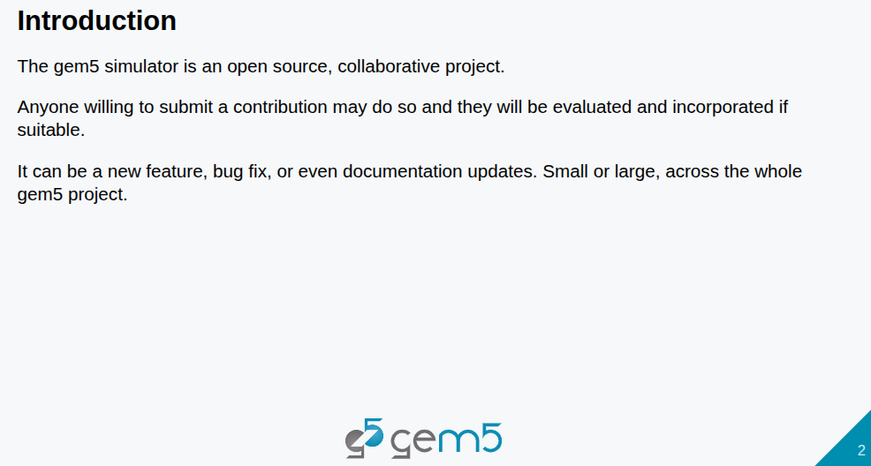
27.1 Introduction
https://www.youtube.com/watch?v=xbeIU-MQJJk&list=PL_hVbFs_loVR_8ntTTmmG6YEq3Po_4snu&index=27
Introduction (0:33 – 1:10/1:18:33)
1. gem5 is an open-source, collaborative project.
2. Anyone can submit contribution and they will be evaluated and incorporated if they are suitable.
3. They submission can be anything. We cannot always focus on code, bug fixes, or documentation updates are all welcome.

Slide 7
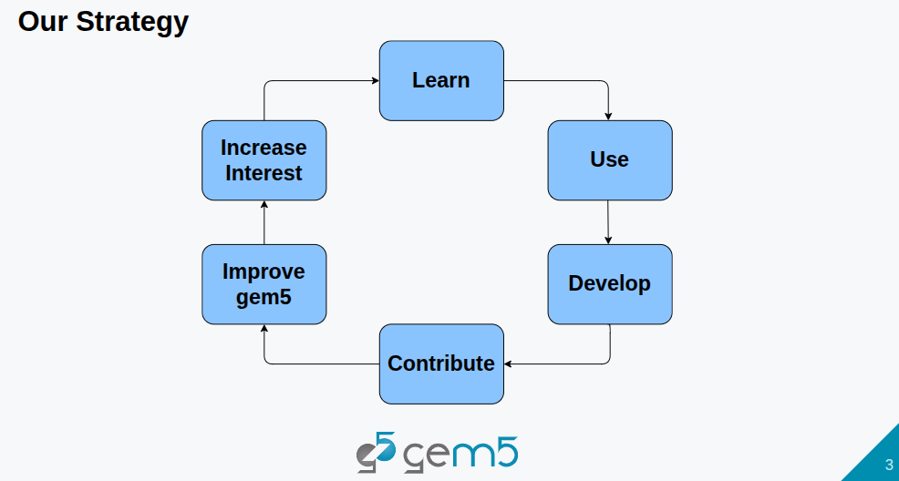
27.1 Introduction
https://www.youtube.com/watch?v=xbeIU-MQJJk&list=PL_hVbFs_loVR_8ntTTmmG6YEq3Po_4snu&index=27
Introduction (1:11 – 1:55/1:18:33)
1. The gem5 strategy is: we learn, use, then through the use of gem5, we develop new things.
2. Then through the develop the new things, we we make contribtion to gem5.
3. Then, through the contribution of gem5, we improve gem5 and increase interest.
4. Then we have more people to learn
5. In the bootcamp. We have more people in the first cycle, then we have more user and developer to make contribution, improve gem5, and increase intertest, etc.

Slide 8
End

