Slide 1

1.1 Computer Architecture Simulator
Peter H. Chen

Slide 2
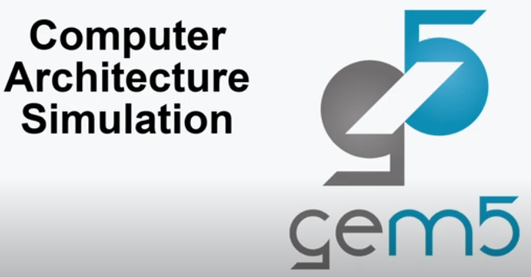
1.1 Computer Architecture Simulator
https://www.youtube.com/watch?v=6ThcR6jKwkc&list=PL_hVbFs_loVR_8ntTTmmG6YEq3Po_4snu
Computer Architecture Simulator (0:00-0:13/34:40)
We talked about the General Computer Architecture Simulation with Gem5.

Slide 3
1.2 Topics

Slide 4
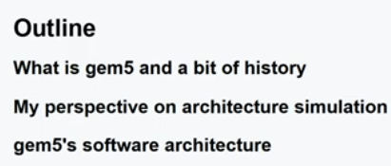
1.2 Topics
https://www.youtube.com/watch?v=6ThcR6jKwkc&list=PL_hVbFs_loVR_8ntTTmmG6YEq3Po_4snu
Topics (0:14-0:32/34:30)
1. What is Gem5 and Gem5 history?
2. Perspective of Computer Architecture Simulation
3. Gem5 Software Architecture

Slide 5
1.3 Gem5 History

Slide 6
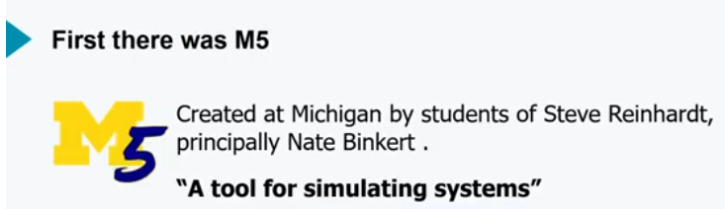
1.3 Gem5 History
https://www.youtube.com/watch?v=6ThcR6jKwkc&list=PL_hVbFs_loVR_8ntTTmmG6YEq3Po_4snu
Gem5 History (0:33-1:04/34:30)
Gem5 come from M5.
M5 (University of Michigan Version 5) is created by Steve Reinhardt and his students, mostly by Nate Binkert.
M5 is a put together for the software simulation system since August 2011.
M5 is a a tool for simulating system.

Slide 7
1.4 M5 at ISCA 2005

Slide 8
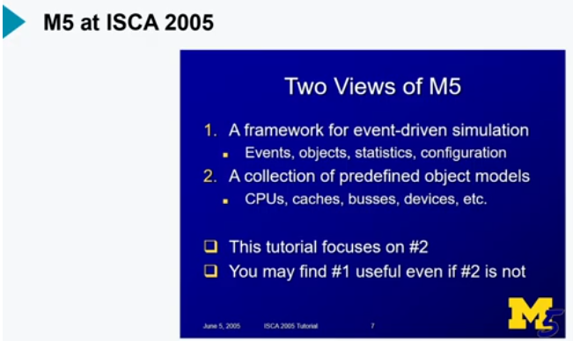
1.4 M5 at ISCA 2005
https://www.youtube.com/watch?v=6ThcR6jKwkc&list=PL_hVbFs_loVR_8ntTTmmG6YEq3Po_4snu
M5 at ISCA (1:05-1:55/34:30)
In ISCA (International Symposium on Computer Architecture) 2005, M5 has a talk.
M5 is for CPU, caches, busses, devices simulation.

Slide 9
1.5 Multi-facet Gems

Slide 10
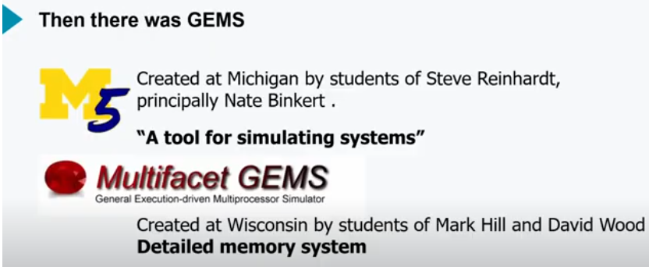
1.5 Multi-facet Gems
https://www.youtube.com/watch?v=6ThcR6jKwkc&list=PL_hVbFs_loVR_8ntTTmmG6YEq3Po_4snu
Multi-facet Gems (1:56-2:09/34:30)
1. M5 is create at Michigan by students of Steve Reinhardt, primary by Nate Binkert.
2. Wisconsin has a project called Multi-facet Gems. Gems are created at Wisconsin by students of Mark Hill and David Wood. The name is “Detailed Memory System.”

Slide 11
1.6 Gems at ISCA 2005

Slide 12
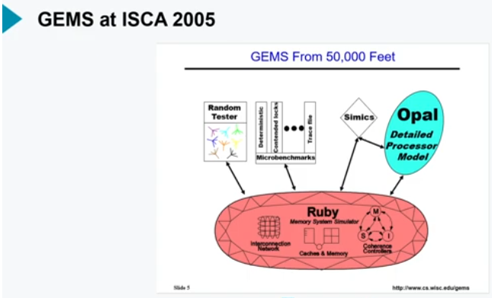
1.6 Gems at ISCA 2005
https://www.youtube.com/watch?v=6ThcR6jKwkc&list=PL_hVbFs_loVR_8ntTTmmG6YEq3Po_4snu
Gems at ISCA 2005 (2:10-2:41/34:30)
Gem5 and M5 project is 50,000 feet distance.
Gem5 have memory architecture and processor model with Ruby.
Ruby is a memory system.

Slide 13
1.7 M5 and Gems

Slide 14
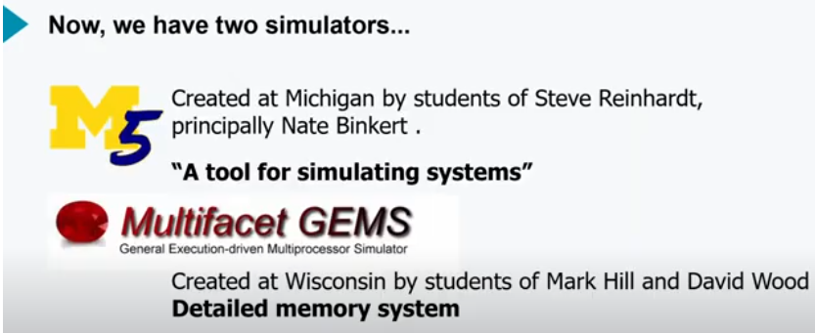
1.7 M5 and Gems
https://www.youtube.com/watch?v=6ThcR6jKwkc&list=PL_hVbFs_loVR_8ntTTmmG6YEq3Po_4snu
M5 and Gems (2:42-3:03/34:30)
Now, we have two simulators M5 and Gems. They are combined together in 2011 to make Gem5.
We took most of the simulation infrastructure from M5 and combine it with Ruby memory system from Gems.
We got the Gem5.

Slide 15
1.8 What is Gem5?

Slide 16
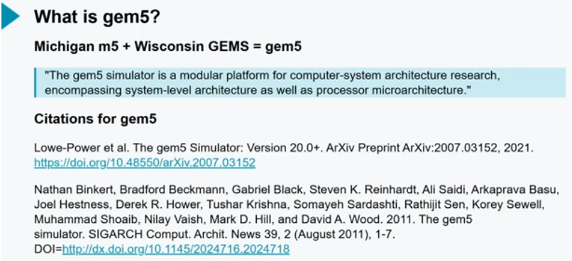
1.8 What is Gem5?
https://www.youtube.com/watch?v=6ThcR6jKwkc&list=PL_hVbFs_loVR_8ntTTmmG6YEq3Po_4snu
What is Gemn5? (3:05-3:38/34:30)
What is Gem5? Gem5 is Michigan M5 + Wisconsin Gems.
Gem5 is a simulator. Gem5 simulator is a modular platform for computer-system architecture research. Gem5 includes system-level architecture and processor micro-architecture.
Below is two canonical citations for Gem5.
1. by Lowe-Power, “Gem5 Simulator: Version 20.0+ (2021)”
2. Nathan Binkert, “Gem5 Simulator (2011)”

Slide 17
1.9 Gem5-20+

Slide 18
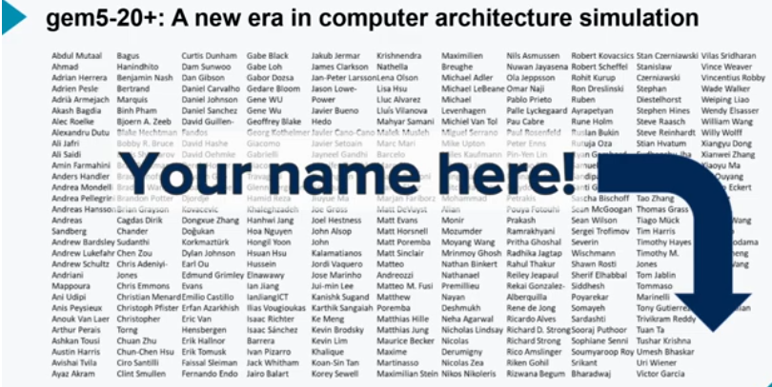
1.9 Gem5-20+
https://www.youtube.com/watch?v=6ThcR6jKwkc&list=PL_hVbFs_loVR_8ntTTmmG6YEq3Po_4snu
Gem5-20+ (3:39-4:18/34:30)
In 2020, we have gem50-20. There are a lot of Gem5-20+ contributors. Everybody is recognized.
Gem5.20+ papers are more than 70 authors on the gem5.20 paper.
The community is growing.

Slide 19
1.10 Gem5 Goal

Slide 20
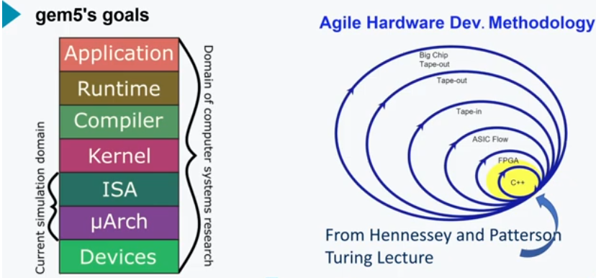
1.10 Gem5 Goal
https://www.youtube.com/watch?v=6ThcR6jKwkc&list=PL_hVbFs_loVR_8ntTTmmG6YEq3Po_4snu
Gem5 Goal (4:19-5:00/34:30)
Now, Nate and Steve are back to Gem5. Below, we have two goals: the main focus is in the ISA (Instruction Set Architecture) and microarchitecture.
1. The first goal of Gem5 is to enable the research. We are able to do the research of the technology layers of stack.

Slide 21
1.10 Gem5 Goal
https://www.youtube.com/watch?v=6ThcR6jKwkc&list=PL_hVbFs_loVR_8ntTTmmG6YEq3Po_4snu
Gem5 Goal (5:01-5:41/34:30)
2. The second goal:
2.1 From Hennessey and Patterson Turing lecture, “Agile Hardware Development Methodology.”
2.2 We want to make the hardware development like the software development.
2.3 We do DSE (Design Space Exploration) for new hardware design.
2.4 We take FPGA for ASIC Design.
2.5 Gem5 focus on C++ level for easiest and quickest iteration in the Agile Hardware Design.

Slide 22
1.11 Gem5 Community Goal

Slide 23
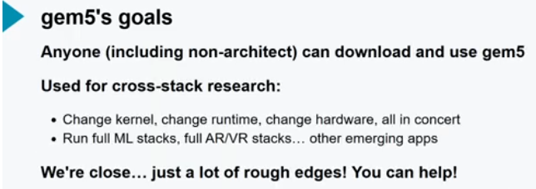
1.11 Gem5 Community Goal
https://www.youtube.com/watch?v=6ThcR6jKwkc&list=PL_hVbFs_loVR_8ntTTmmG6YEq3Po_4snu
Gem5 Community Goal (5:42-6:40/34:30)
1. Anyone for Computer Architect and Researcher can download
2. Cross-Stack Research for Computer Architect:
2.1 Different Kernel, different runtime, different Hardware design.
2.2 Machine Learning Stack, AR/VR stack

Slide 24
1.12 Gem5 Community

Slide 25
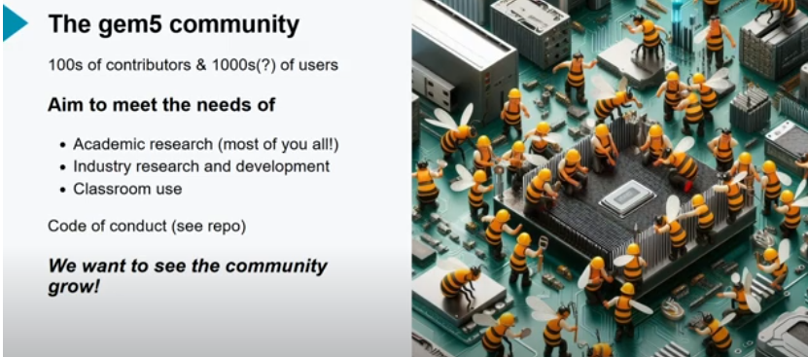
1.12 Gem5 Community
https://www.youtube.com/watch?v=6ThcR6jKwkc&list=PL_hVbFs_loVR_8ntTTmmG6YEq3Po_4snu
Gem5 Community (6:41-8:11/34:30)
In 6 months, we want to have 100s contributor and 1000s users for Gem5 computer architects.
Meet the need:
1. University Research
2. Company R&D: Google. AMD, ARM, Samsung, Micron, Rambus, etc.
3. Students

Slide 26
1.13 Gem5 Simulation

Slide 27

1.13 Gem5 Simulation
https://www.youtube.com/watch?v=6ThcR6jKwkc&list=PL_hVbFs_loVR_8ntTTmmG6YEq3Po_4snu
Gem5 Simulation (8:12-8:24/34:30)
We already discussed
1. Gem5 history
2. Gem5 community
Now, we talks about Gem5 Simulation.

Slide 28
1.14 Scientific vs. System Research

Slide 29
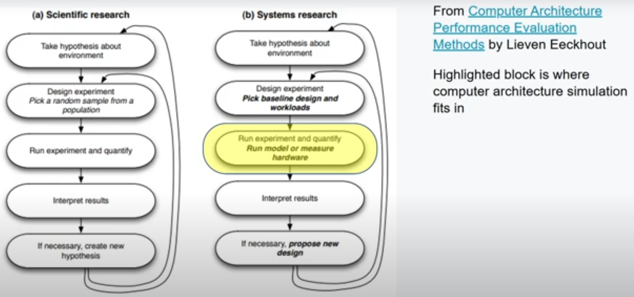
1.14 Scientific vs. System Research
https://www.youtube.com/watch?v=6ThcR6jKwkc&list=PL_hVbFs_loVR_8ntTTmmG6YEq3Po_4snu
Scientific vs. System Research (8:25-8:03/34:30)
We already discussed
1. Gem5 history
2. Gem5 community
Now, we talks about Gem5 Simulation.

Slide 30
End

