Slide 1

10.1 Full System Simulation: Slides
Peter H. Chen

Slide 2

10.1 Full System Simulation: Slides
https://gem5bootcamp.github.io/2024/#02-Using-gem5/07-full-system
Full System Simulation: Slides

Slide 3
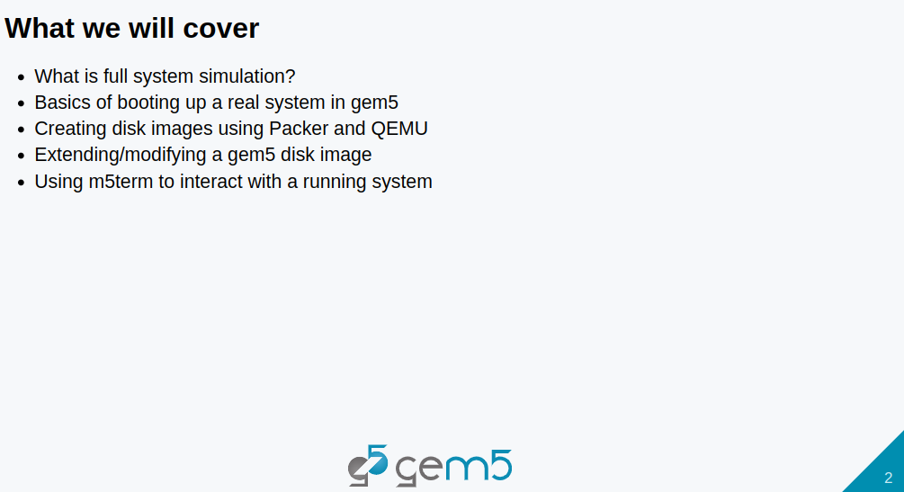
10.1 Full System Simulation: Slides
https://gem5bootcamp.github.io/2024/#02-Using-gem5/07-full-system
Full System Simulation: Slides

Slide 4
End

