Slide 1

1.1 McPAT
Peter H. Chen

Slide 2
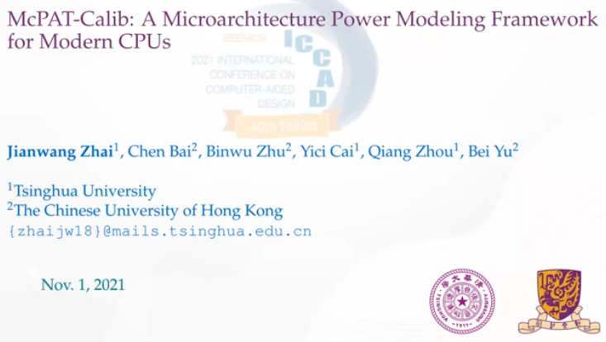
1.1 McPAT
https://www.youtube.com/watch?v=Lwt2YxlFutA
McPAT (0:00-0:29/21:59)
McPAT (Multi-core Power, Area, Timing)-Calib, 2021
Jianwang Zhai from Tsinghua University. talks about the McPAT-Calib, A Micro architecture Power Modeling Framework for Modern CPUs.
This paper presents the CPU design with PAT (Power, Area, Timing) Modeling Framework McPAT-Calib:
1. McPAT: PAT Simulation with McPAT and
2. Calib: ML (Machine Learning) Calibration with Algorithm XGBoost.

Slide 3
1.2 Topic

Slide 4
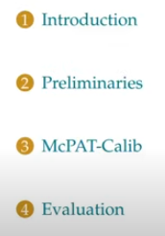
1.2 Topic
https://www.youtube.com/watch?v=L2e-55iSA_8&list=PLfrN7RIcMe6g2LBRJLTHTdhyj5s8ag0Rg&index=1
Topic (0:30-0:52/21:59)
1. Introduction: Background
2. Preliminaries: Preliminary risk and problem for mission
3. McPAT-Calib: details of McPAT-Calib
4. Evaluation: Show evaluation result.
5. Conclusion

Slide 5
1.3 CPU Design and Power Modeling

Slide 6
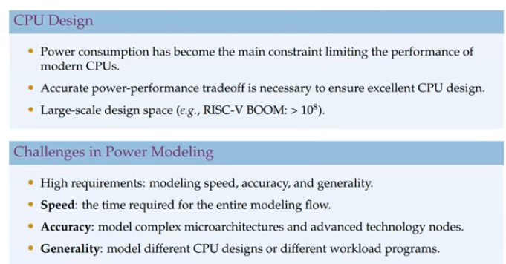
1.3 CPU Design and Power Modeling
https://www.youtube.com/watch?v=L2e-55iSA_8&list=PLfrN7RIcMe6g2LBRJLTHTdhyj5s8ag0Rg&index=1
CPU Design and Power Modeling (0:53-2:08/21:59)
1. Power consumption is the main constraint which limit the performance of modern CPUs Design.
2. We need to evaluate the power vs. performance trade-off at the early design phase to ensure the the optimal CPUs design.
3. Design space of modern CPU become very large.
4. Design Space Exploration and Optimization for power modeling for speed, accuracy, and generality are required.
5. We need accurate model multi-core power, area, and timing/performance.
6. The generality model the power for different CPU design and different workload programs.

Slide 7
1.4 Power Model Comparison

Slide 8
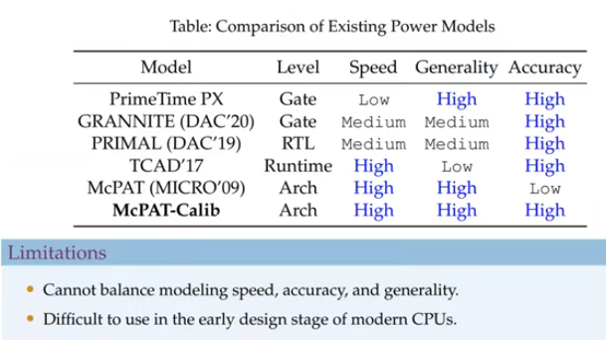
1.4 Power Model Comparison
https://www.youtube.com/watch?v=L2e-55iSA_8&list=PLfrN7RIcMe6g2LBRJLTHTdhyj5s8ag0Rg&index=1
Power Model Comparison (2:09-2:27/21:59)
1. Below, we compare PrimeTime, Granite, Primal, TCAD, McPAT, and McPAT-Calib.
2. Our hardware designs which switch the power model in gate or RTL level. The PrimeTime and GRANITE are based on Gate level. Primal is based on RTL. These Analytical Model and very slow. They are used in high Generality and very high accuracy simulation. PrimeTime is commercial tool from Synopsys for power and STA (Static Timing Analysis). These models are based on feature engineering and Machine Learning methods.
3. These models require design netlist and simulation which also time consuming. These models are design specific and cannot model the non-CPU design.
4. The TCAD 17 is based on runtime power module is also slow. It is not for CPU design.
5. At higher micro-architecture level, power models use micro-architectural design parameters and use statistics from power modeling which have the highest modeling speed,

Slide 9
1.4 Power Model Comparison
https://www.youtube.com/watch?v=L2e-55iSA_8&list=PLfrN7RIcMe6g2LBRJLTHTdhyj5s8ag0Rg&index=1
Power Model Comparison (Continue) (3:28-5:58/21:59)
6. However, the analytical power model makes McPAT with high generality and usable.
7. In PrimeTime, GRANITE, Primal, TCAD’17, we need the Gate or RTL Models.
8. McPAT-Calib uses TCAD 17 runtime model for power model for transformation. McPAT-Calib has both speed and accuracy and can be used in architecture level.
9. It is difficult to balance model speed, accuracy, and generality.
10. McPAT-Calib can be a good fit for CPU design, in the early design period, and for DSE (Design Space Exploration).

Slide 10
1.5 McPAT vs. McPAT-Calib

Slide 11
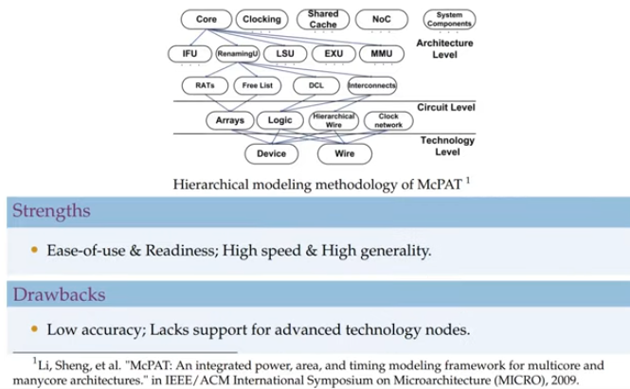
1.5 McPAT vs. McPAT-Calib
https://www.youtube.com/watch?v=L2e-55iSA_8&list=PLfrN7RIcMe6g2LBRJLTHTdhyj5s8ag0Rg&index=1
McPAT vs. McPAT-Calib (3:59-4:39/21:59)
1. Below is the McPAT paper for very fast power modeling.
2. In the early design period, we don’t have the Gate-Level/RTL Model for Verilog/VHDL.
3. Due to easy of use, McPAT gains the popularity in the early design period/DSE (Design Space Exploration). McPAT is used in hierarchical and analytical power modeling.

Slide 12
1.5 McPAT vs. McPAT-Calib
https://www.youtube.com/watch?v=L2e-55iSA_8&list=PLfrN7RIcMe6g2LBRJLTHTdhyj5s8ag0Rg&index=1
McPAT vs. McPAT-Calib (4:40-4:53/21:59)
4. We can do DSE (Design Space exploration) by passing different design parameters and get result for event statistics without RTL Design and simulation.
5. However, there are two drawbacks in McPAT for CPU design.
6. First, the modeling accuracy is very low.
7. Second, McPAT does not support for advanced technology.
8. McPAT-Calib improve the McPAT have accuracy problem.

Slide 13
1.6 Problem Formulation

Slide 14
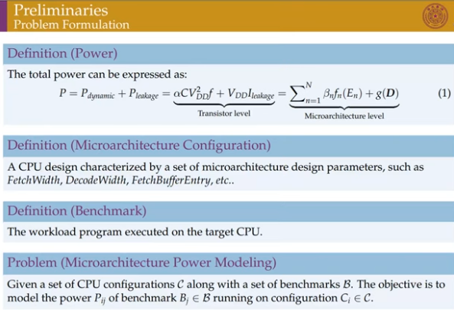
1.6 Problem Formulation
https://www.youtube.com/watch?v=L2e-55iSA_8&list=PLfrN7RIcMe6g2LBRJLTHTdhyj5s8ag0Rg&index=1
McPAT Model (5:54-6:00/21:59)
1. The total Power is sum of dynamic (switching) power and static (leakage) power.
2. First, we expressed in well-known Transistor level power definition. This is very expensive to run for CPU design with Verilog Gate/RTL level. We cannot capture the hardware details at the early design states.
3. Second, in order to model the power model, we model at higher level, the micro-architecture level. The this level, the dynamic power is the sum of functions of event statistics. The leakage power is a function of design parameters.
2
3

Slide 15
1.6 Problem Formulation
https://www.youtube.com/watch?v=L2e-55iSA_8&list=PLfrN7RIcMe6g2LBRJLTHTdhyj5s8ag0Rg&index=1
McPAT Model (6:01-6:12/21:59)
4. Then, we have two different definitions.
5. First, micro-architecture configuration. It is CPU design which is characterized by size or micro-architecture design parameters, such as, fetch width, decoder width, fetch buffer entry, etc.
6. Second is benchmark. Benchmark refers to workload (program) executed/run on the target CPU. Even in the same CPU design, different executed program will have different event statistics and power consumption.
5
6

Slide 16
1.6 Problem Formulation
https://www.youtube.com/watch?v=L2e-55iSA_8&list=PLfrN7RIcMe6g2LBRJLTHTdhyj5s8ag0Rg&index=1
McPAT Model (6:13-6:33/21:59)
7. Therefore, our micro-architecture power modeling problem can be defined as:
Given a set of CPU configurations (fetch width, decoder width, and fetch buffer entry) and benchmarks (program executed), find the power model.
8. The open-source Stanford University Hypermapper and OpenTuner can be used for find the power model.
7

Slide 17
1.7 RISCV

Slide 18
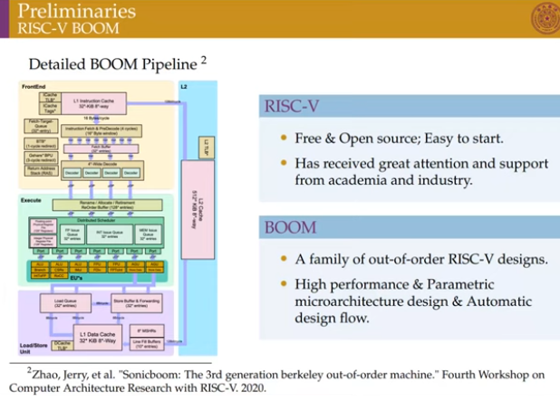
1.7 RISCV
https://www.youtube.com/watch?v=L2e-55iSA_8&list=PLfrN7RIcMe6g2LBRJLTHTdhyj5s8ag0Rg&index=1
RISCV (6:34-7:16/21:59)
Below is the Boom RTL automatic design flow for RISCV.
Zhao, Jerry, “Sonicboom: The third generation out-of-order machine.” Fourth Workshop on Computer Architecture Research with RISC-V (2020).

Slide 19
1.8 McPAT-Calib: Overview

Slide 20
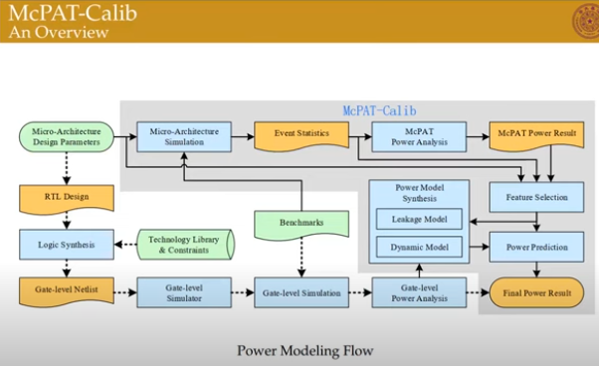
1.8 McPAT-Calib: Overview
https://www.youtube.com/watch?v=L2e-55iSA_8&list=PLfrN7RIcMe6g2LBRJLTHTdhyj5s8ag0Rg&index=1
McPAT-Calib: Overview (7:17-8:30/21:59)
1. Below is McPAT-Calib for Power Modeling flow. Here, the configurations and benchmarks are given.
2. The commercial flow is shown by a dotted lines. The RTL and Logic Synthesis are required to obtain a gate level netlist. At the end, the gate level simulation and power analysis are performed.
3. The flow of McPAT-Calib framework is shown in solid line. McPAT-Calib complete the power modeling in a few seconds.
4. Gem5 is the architecture simulator. Gem5 5 is used to complete a simulation of RISCV Boomwith event statistics. Then, McPAT-Calib is used to complete the fast preliminary power modeling.
5. Finally, ML Model are used to calibrate the dynmaic and leage to obtain more accuare results.

Slide 21
1.9 McPAT-Calib: McPAT-7nm

Slide 22
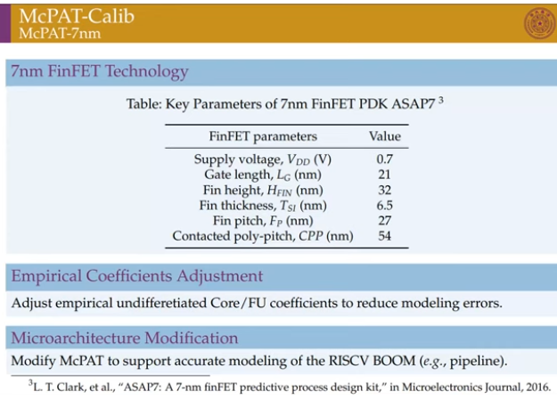
1.9 McPAT-Calib: McPAT-7nm
https://www.youtube.com/watch?v=L2e-55iSA_8&list=PLfrN7RIcMe6g2LBRJLTHTdhyj5s8ag0Rg&index=1
McPAT-Calib: McPAT-7nm (8:31-9:12/21:59)
1. The original McPAT does not support advanced technology, such as, 7nm FinFET PDK ASAP7.
2. The FinFET key parameter as shown in below table.
3. We also adjust the empirical coefficients to reduce modeling error.
L.T. Clark, “ASAP7: A 7-nm finFET predictive modification process design kit,” in Microelectronics Journal (2016)

Slide 23
1.9 McPAT-Calib: McPAT-7nm
https://www.youtube.com/watch?v=L2e-55iSA_8&list=PLfrN7RIcMe6g2LBRJLTHTdhyj5s8ag0Rg&index=1
McPAT-Calib: McPAT-7nm (9:13-9:29/21:59)
4. We also made some micro-architecture to support RISC-V Boom modeling.
5. Through these improvements, we can model of a 7-nm Boom with an error of 13%.
6. McPAT is a hardware analysis based on statistics.
L. T. Clark, “ASAP7: A 7-nm finFET predictive modification process design kit,” in Microelectronics Journal (2016)

Slide 24
1.10 McPAT-Calib: ML Calibration

Slide 25
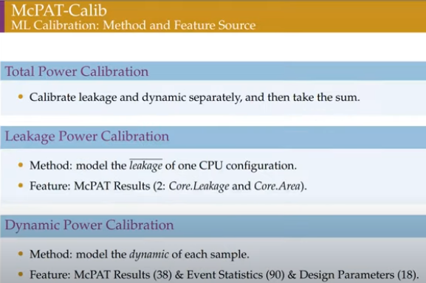
1.10 McPAT-Calib: ML Calibration
https://www.youtube.com/watch?v=L2e-55iSA_8&list=PLfrN7RIcMe6g2LBRJLTHTdhyj5s8ag0Rg&index=1
McPAT-Calib: ML Calibration (9:30-10:20/21:59)
1. Below, we use Machine Learning calibration technique to improve accuracy.
2. We calibrate leakage and dynamic power and take the sum to get total power leakage.
3. The result will not change with different benchmark because we only take the average for all the configurations for a specific CPU design. The fix configuration reduce the the sample number.
3. In ML calibration, we only choose two features for modeling the results from McPAT. These two features are core leakage and core area.

Slide 26
1.10 McPAT-Calib: ML Calibration
https://www.youtube.com/watch?v=L2e-55iSA_8&list=PLfrN7RIcMe6g2LBRJLTHTdhyj5s8ag0Rg&index=1
McPAT-Calib: ML Calibration (10:21-11:55/21:59)
4.The leakage and dynamic are related to configuration and benchmark. Even samples under same configuration, the dynamic power may be different. Therefore, the dynamic of each sample must be accurate modeled.
5. Basic McPAT results are statistics. The different design parameters and different dynamic mode are model features.
6. We have extensive features and result for model of machine learning.

Slide 27
1.11 McPAT-Calib: Feature Selection

Slide 28
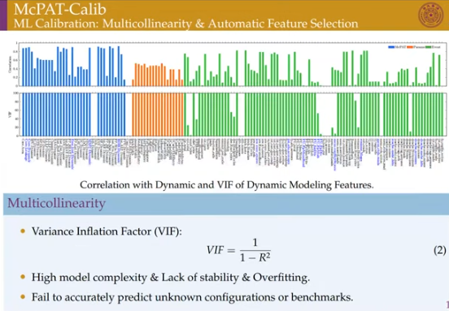
1.11 ML Calibration: Feature Selection
https://www.youtube.com/watch?v=L2e-55iSA_8&list=PLfrN7RIcMe6g2LBRJLTHTdhyj5s8ag0Rg&index=1
ML Calibration: Feature Selection (10:56-11:30/21:59)
1. Below diagrams, we have dynamic loading features, modeling features.
2. Blue colors are McPAT results from different feature parameters.
3. Orange colors are micro-architecture results from different feature parameters of Boom project.
4. Green colors are even statistics obtained from Gem5 feature parameters.
6. The correlation between of the dynamic power results and features are very high.

Slide 29
1.11 ML Calibration: Feature Selection
https://www.youtube.com/watch?v=L2e-55iSA_8&list=PLfrN7RIcMe6g2LBRJLTHTdhyj5s8ag0Rg&index=1
ML Calibration: Feature Selection (11:31-12:22/21:59)
7. To use the statistics power results for correlated features, we need to know the variance. The variance is correlation between features.
8. We use the regression to model the features and results.
9. The accuracy is measured equation (2), VIF (Variance Inflation Factor): VIF = 1/(1 – R^2). R is the correlation.
10. This model is to find the power results of existing samples. We use the automatic feature selection to select a small number of features that reflect different configurations and benchmarks.
VIF

Slide 30
1.12 ML Calibration: Automatic Feature Selection

Slide 31
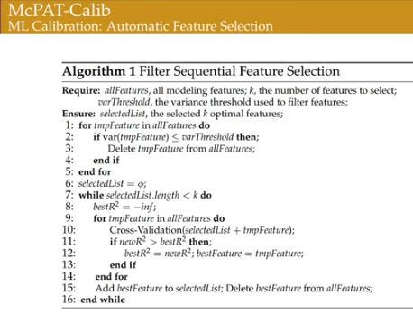
1.12 ML Calibration: Automatic Feature Selection
https://www.youtube.com/watch?v=L2e-55iSA_8&list=PLfrN7RIcMe6g2LBRJLTHTdhyj5s8ag0Rg&index=1
ML Calibration: Automatic Feature Selection (12:23-12:48/21:59)
1. Automatic Feature Selection can reduce space. It uses greedy strategy to sequentially select the current best feature obtained by cross-validation for all the number of selected filters.
2. Each feature uses a set of value.
3. Automatic Feature Selection algorithm is simple and effective.

Slide 32
1.13 ML Calibration: Regression Model

Slide 33
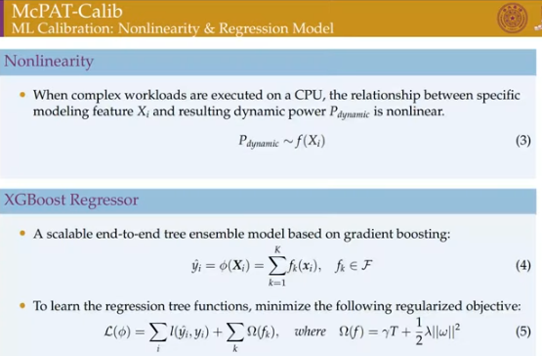
1.13 ML Calibration: Regression Model
https://www.youtube.com/watch?v=L2e-55iSA_8&list=PLfrN7RIcMe6g2LBRJLTHTdhyj5s8ag0Rg&index=1
ML Calibration: Regression Model (12:23-13:50/21:59)
1. Now, the problem is non-linear and solved.
2. When complex workloads are executed on a CPU, a relationship between features and resulting dynamic and in non-linear as eq (3).
3. We use advanced non-linear model XGBoost Regressor to directly solve this problem. XGBoost is widely used to achieve the SOTA (State-of-the-Art) result for machine learning modeling.

Slide 34
1.13 ML Calibration: Regression Model
https://www.youtube.com/watch?v=L2e-55iSA_8&list=PLfrN7RIcMe6g2LBRJLTHTdhyj5s8ag0Rg&index=1
ML Calibration: Regression Model (13:51-14:20/21:59)
4. XGBoost uses a set of features and training functions to predict the output.
5. Below, we have the objective function, the regularization objective function, i.e., L is loss function which we want to minimized. Loss function can be expressed into two terms: I and Omega. The first term I is the major term. The first term measures the difference between the prediction and their target. The second term is Omega. Omega is the life of the model. Here, we have the linear combination polynomial of power model. We sum of square-coefficient of polynomial equations.
4
5

Slide 35
1.14 Power Model Flow

Slide 36
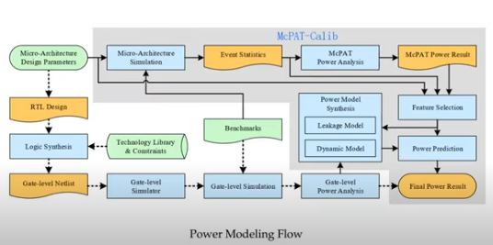
1.14 Power Model Flow
https://www.youtube.com/watch?v=L2e-55iSA_8&list=PLfrN7RIcMe6g2LBRJLTHTdhyj5s8ag0Rg&index=1
Power Model Flow (14:21-16:20/21:59)
1.

Slide 37
End

