Slide 1

13 Gem5 Sample Simulation
Peter H. Chen

Slide 2

13 Gem5 Sample Simulation
https://www.youtube.com/watch?v=5V57XGFjUy8&list=PL_hVbFs_loVR_8ntTTmmG6YEq3Po_4snu&index=13
Gem5 Sample Simulation (0:00-0:05/39:44)
In this discussion, we are going to talk about the Gem5 Sample Simulation.

Slide 3
12.1 Topics

Slide 4
13.1 Topics
https://www.youtube.com/watch?v=5V57XGFjUy8&list=PL_hVbFs_loVR_8ntTTmmG6YEq3Po_4snu&index=13
Topics (0:06-0:07/39:44)
Topics:
1. Review of Question “What If ROI is too large?”
2. Sampling: Targeted Sampling and Statistical Sampling
3. Gem5 Targeted sampling
4. Gem5 SimPoint
5. simpoint example
6. Summary of simpoint
7. Gem5 LoopPoint and ELFies
8. LoopPoint and ELFies example
9. Summary of LoopPoint and ELFies
10. Gem5 Statistical Sampling Example
11. SMARTS (System-Level Memory Access Reporting, Tracking, and Simulation) example
12. Summary of Target Sampling and Statistical Sampling

Slide 5
12.2 What If ROI Is Too Large?

Slide 6
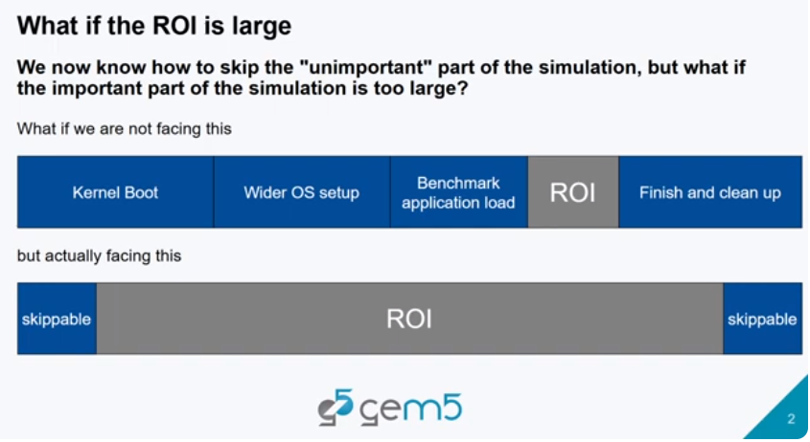
12.2 What If ROI Is Too Large?
https://www.youtube.com/watch?v=5V57XGFjUy8&list=PL_hVbFs_loVR_8ntTTmmG6YEq3Po_4snu&index=13
What If ROI Is Too Large? (0:08-0:16/39:44)
In the end of the last discussion, we raise the question about “What if our ROI is too large?”

Slide 7
12.3 Sampling

Slide 8
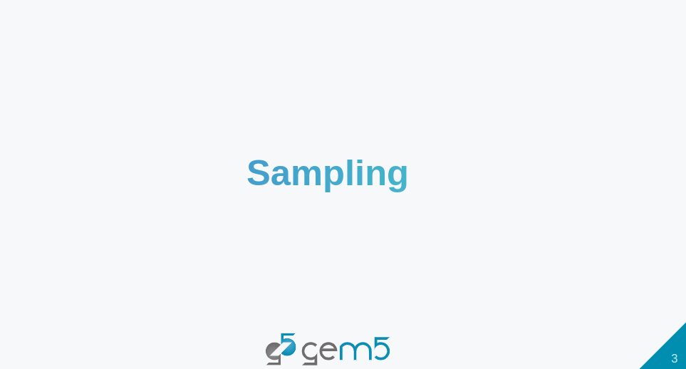
12.3 Sampling
https://www.youtube.com/watch?v=5V57XGFjUy8&list=PL_hVbFs_loVR_8ntTTmmG6YEq3Po_4snu&index=13
Sampling (0:17-0:20/39:44)
One of the solution to this problem (If the ROI is too large) is that we can do sample the simulation.

Slide 9
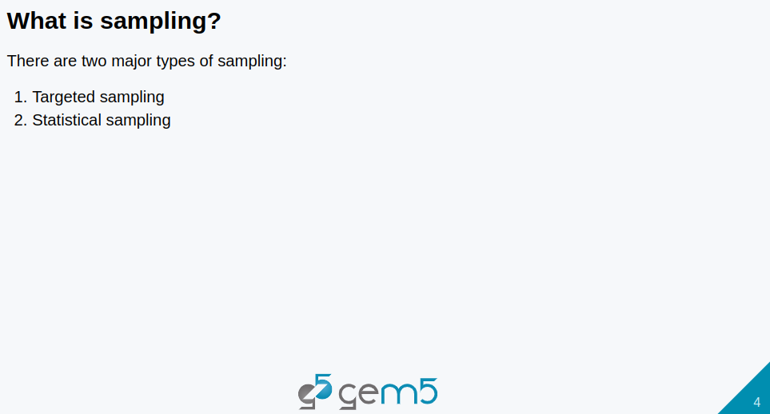
12.3 Sampling
https://www.youtube.com/watch?v=5V57XGFjUy8&list=PL_hVbFs_loVR_8ntTTmmG6YEq3Po_4snu&index=13
Sampling (0:21-0:33/39:44)
We can do sampling for very large ROI (Region of Interest).
There are two major types of sampling.
First one is targeted sampling
Second one is statistical code sampling.

Slide 10
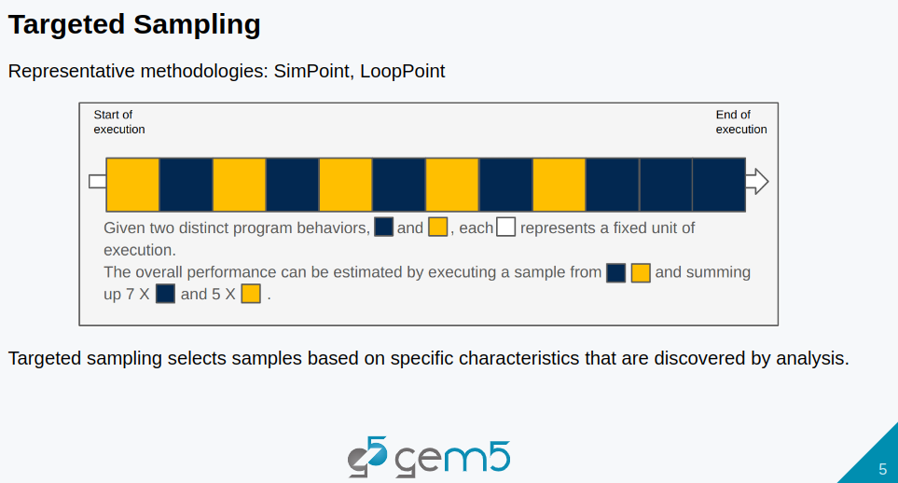
12.3 Sampling
https://www.youtube.com/watch?v=5V57XGFjUy8&list=PL_hVbFs_loVR_8ntTTmmG6YEq3Po_4snu&index=13
Gem5 Targeted Sampling (0:34-1:17/39:44)
What is Targeted Sampling?
Targeted Sampling selected the sample based on a specific characteristics that are discovered bu the analysis.
Below example is how Targeted Sampling works.
Given an execution as below, if there is two extinct program behaviors, the blue block and yellow block.
We can find out the this behavior through analysis and only simulate the blue block and yellow block.
Then, we multiple by the number of time it appear in the execution for the targeted sampling.

Slide 11
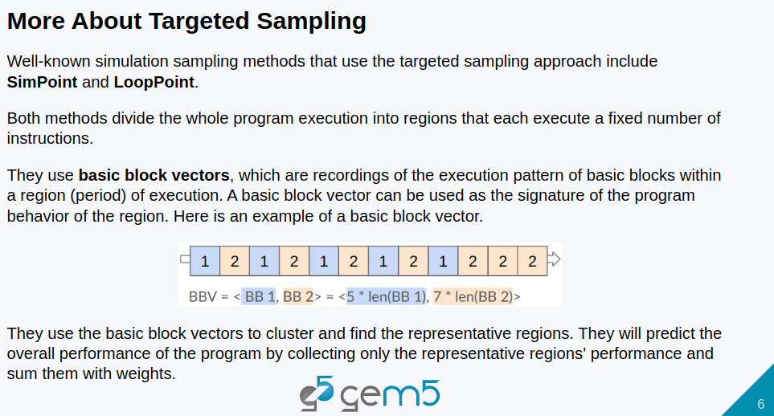
12.3 Sampling
https://www.youtube.com/watch?v=5V57XGFjUy8&list=PL_hVbFs_loVR_8ntTTmmG6YEq3Po_4snu&index=13
Gem5 Targeted Sampling (1:18-2:51/39:44)
There is two well-known targeted methods which are SimPoint and LoopPoint.
Both SimPoint and LoopPoint divide the whole program execution into regions that each execute a fixed number of instruction.
Below, we explain an oversimplified LoopPoint.
The LoopPoint uses a Basic Block Vector to classify the characteristic of the program behavior.
Assume the program only has two basic block. We execute some pattern here. We got a vector with 5 of block one and 7 of the block two. The vector does not record the order but record the frequency of block that has been executed.

Slide 12
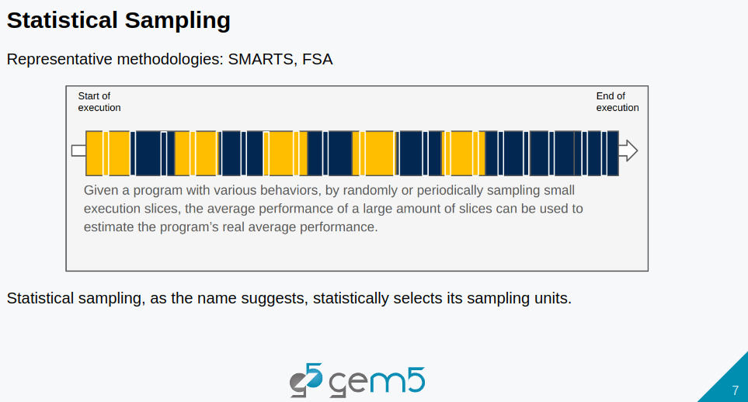
12.3 Sampling
https://www.youtube.com/watch?v=5V57XGFjUy8&list=PL_hVbFs_loVR_8ntTTmmG6YEq3Po_4snu&index=13
Gem5 Statistical Sampling (2:52-3:30/39:44)
The statistical sampling is the statistically select the sampling units. Below is the example of how it work.
When we have a program, we can slice into a small chunk of execution. We randomly select small chunk of slices and only do detailed simulation in this small chunk of execution instead of run the whole execution.
Then, we average the performance of the large amount of randomly selected slices. Between the selected slices (detailed simulation), we use Fast-Forward Simulation.
We predict the performance by average the results of randomly selected slices instead of run the whole program.

Slide 13
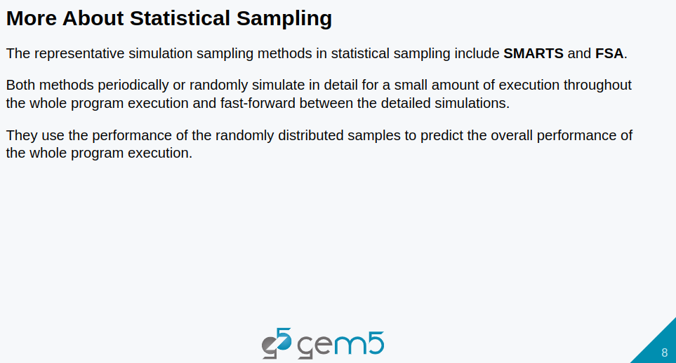
12.3 Sampling
https://www.youtube.com/watch?v=5V57XGFjUy8&list=PL_hVbFs_loVR_8ntTTmmG6YEq3Po_4snu&index=13
Gem5 Statistical Sampling (3:31-3:59/39:44)
The typical statistical sampling are SMARTS (Sampling Micro-Architecture Simulation) and FSA (Full Speed Ahead).
Both methods sampling periodically and randomly select for a small amount of execution (throughout a whole program execution) for detailed simulation.
Then, fast-forward between the detailed simulation.
Then, we use the performance of average the randomly distributed samples to predict the overall performance instead of the whole program execution.

Slide 14
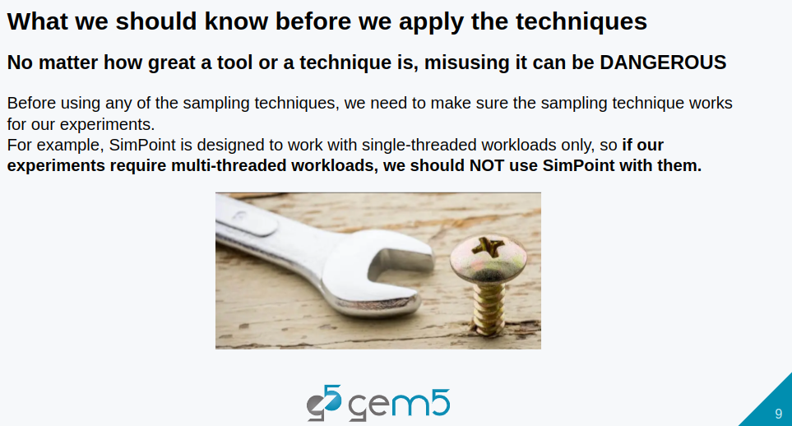
12.3 Sampling
https://www.youtube.com/watch?v=5V57XGFjUy8&list=PL_hVbFs_loVR_8ntTTmmG6YEq3Po_4snu&index=13
Gem5 Statistical Sampling (4:00-4:29/39:44)
No matter how great of the tool, misuse it can be dangerous.
Before we use any of the sampling techniques, we need to make sure the sampling technique works for our experiments.
For example, SimPoint os designed to work with single-threaded workload only.
So, if our experiment require multi-threaded workloads, we should not choose SimPoint as our sampling technique.

Slide 15
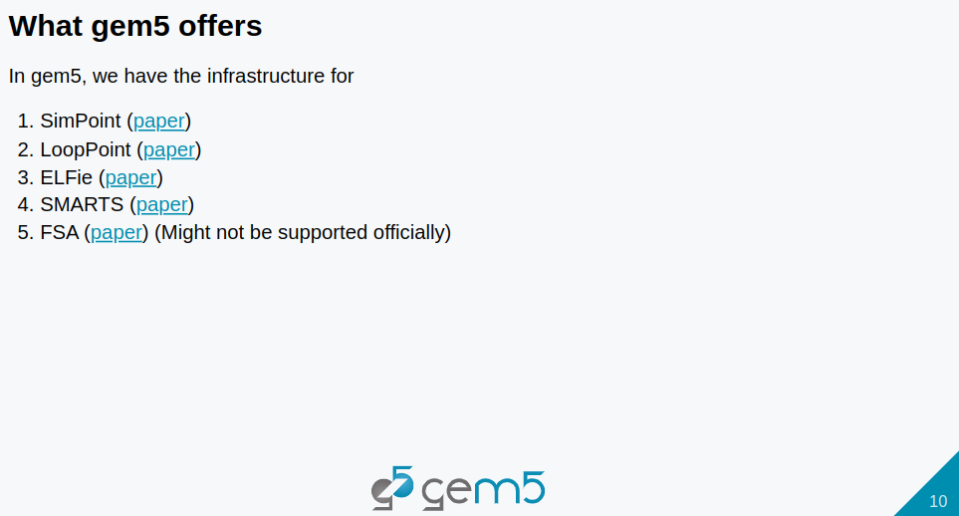
12.3 Sampling
https://www.youtube.com/watch?v=5V57XGFjUy8&list=PL_hVbFs_loVR_8ntTTmmG6YEq3Po_4snu&index=13
Gem5 Statistical Sampling (4:30-4:46/39:44)
In Gem5, we have infrastructure for
1. SimPoint
2. LoopPoint
3. ELFie (Executable and Link Format + fie: Specific Portion of Linked Binary of a large binary)
4. SMARTS (Sampling Micro-Architecture Simulation)
5. FSA(Full Speed Ahead): FSA is not support officially. Others, Gem5 supported.

Slide 16
12.4 Gem5 Targeted Sampling

Slide 17
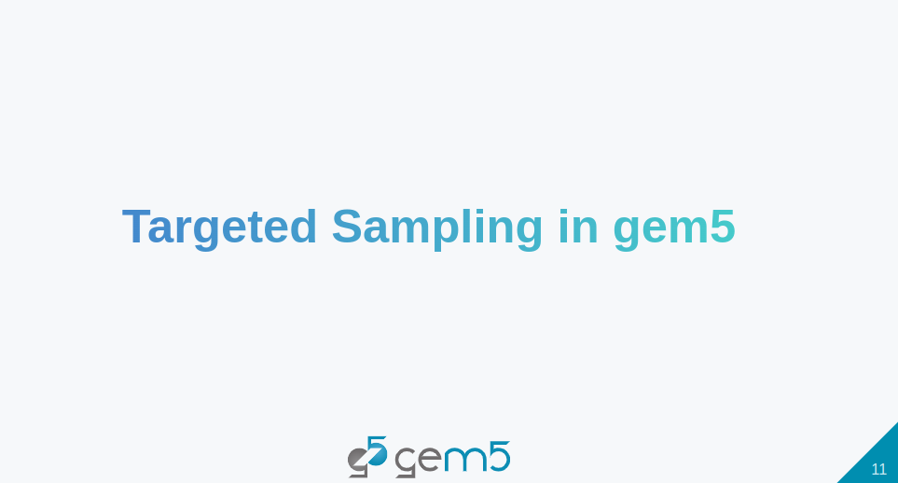
12.4 Gem5 Targeted Sampling
https://www.youtube.com/watch?v=5V57XGFjUy8&list=PL_hVbFs_loVR_8ntTTmmG6YEq3Po_4snu&index=13
Gem5 Targeted Sampling (4:47-4:49/39:44)
We start with Targeted Sampling in Gem5.

Slide 18
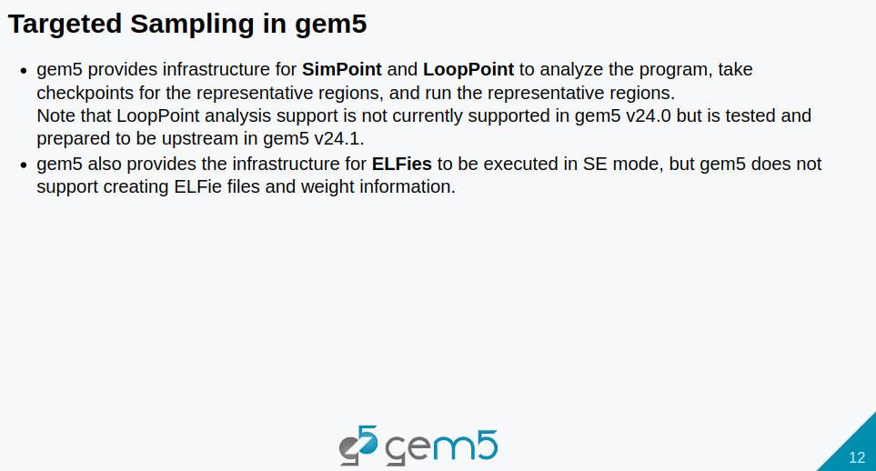
12.4 Gem5 Targeted Sampling
https://www.youtube.com/watch?v=5V57XGFjUy8&list=PL_hVbFs_loVR_8ntTTmmG6YEq3Po_4snu&index=13
Gem5 Targeted Sampling (4:50-5:28/39:44)
Gem5 provides infrastructure for SimPoint and LoopPoint to analyze the program, take checkpoint for the the representative regions, and run the representative regions.
LoopPoint is not in Gem5 24 version but will be in Gem5 24.1 version.
Gem5 also provide the infrastructure for ELFies (Executable and Link Format for smaller binary) to be executed in SE (System-call Emulation) Mode only. However, Gem5 integrates external tools, such as, intel/pinball2elf, to generate the ELFies. Gem5 internally does not support to generate the ELFie or associated weight information within gem5 framework.

Slide 19
12.5 Gem5 SimPoint

Slide 20
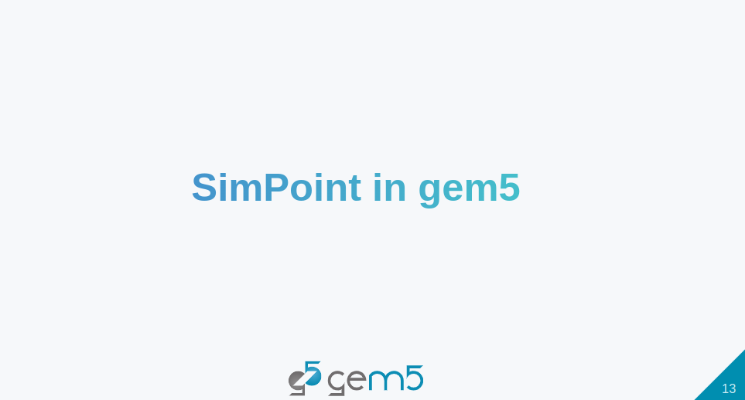
12.5 Gem5 SimPoint
https://www.youtube.com/watch?v=5V57XGFjUy8&list=PL_hVbFs_loVR_8ntTTmmG6YEq3Po_4snu&index=13
Gem5 SimPoint (5:29-5:31/39:44)
We start at SimPoint.

Slide 21
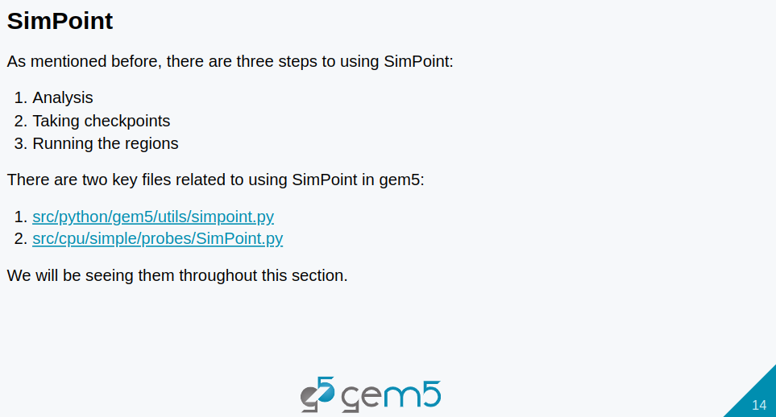
12.5 Gem5 SimPoint
https://www.youtube.com/watch?v=5V57XGFjUy8&list=PL_hVbFs_loVR_8ntTTmmG6YEq3Po_4snu&index=13
Gem5 SimPoint (5:32-6:32/39:44)
We have three steps to use SimPoint
1. Analysis: We need to analyze the program.
2. Take Checkpoint: We need to take checkpoints for the region that we picked for the detail simulation.
3. Run the regions: We need to run those representative regions.
There are two key files that related to use SimPoint in Gem5.
1. simpoint.py: This file is under the directory python/gem5/utils. This file is the standard library interface to use the SimPoint.
2. SimPoint,py: This other file is SimPoint.py file under cpu/simple/probes. This file is a Simple probe point with feature to analyze basic block vectors for SimPoint.
We will see them throughout this section.

Slide 22
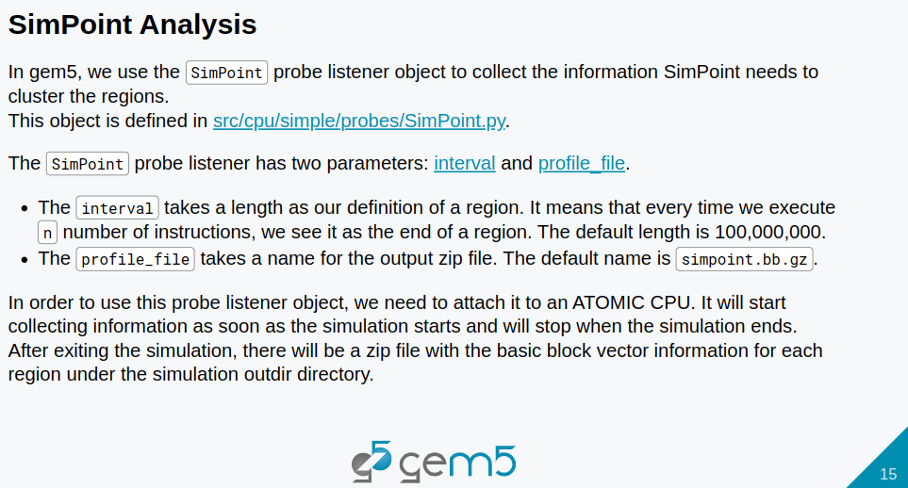
12.5 Gem5 SimPoint
https://www.youtube.com/watch?v=5V57XGFjUy8&list=PL_hVbFs_loVR_8ntTTmmG6YEq3Po_4snu&index=13
Gem5 SimPoint (6:33-7:47/39:44)
In Gem5, We use SimPoint Probe listener object to collect the information for SimPoint to cluster the regions. We will discuss more later on.
The SimPoint Probe has two parameters: one is interval, the other is profile_file.
1. The interval takes the length for our definition of the region. It means every time we execute n number of instructions. We see it as the end of a region. The default length is 100 Million instructions.
2. The profile_file takes the name for the output zip file. The default name is simpoint.bb.zip.
In order to use the probe listener object, we need to attach SimPoint object to an atomic CPU. The SimPoint object will start to collect information as soon as simulation starts and will stop when the simulation ends.
After exiting the simulation, there will be a zip file with the basic block vector information for each region under the simulation output directory.

Slide 23
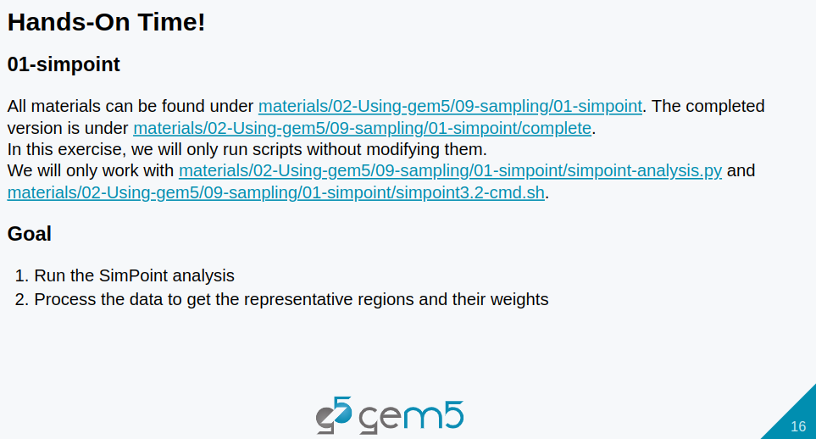
12.5 Gem5 SimPoint
https://www.youtube.com/watch?v=5V57XGFjUy8&list=PL_hVbFs_loVR_8ntTTmmG6YEq3Po_4snu&index=13
Gem5 SimPoint (7:48-8:27/39:44)
Let’s try to do SimPoint analysis with Gem5.
All the codes can be found under directory:
> ~/materials/02-Using-gem5/09-sampling/01-simpoint
The complete implemented codes are under:
In this exercise, we will not modify any code and script. We will see the details, explanation, and check the output .
> ~/materials/02-Using-gem5/09-sampling/01-simpoint/complete/simpoint-analysis.py
> ~/materials/02-Using-gem5/09-sampling/01-simpoint/complete/simpoint3.2-cmd.sh
Our goal is to
1. Run the SimPoint analysis with Gem5 and
2. Process the data to get the representative regions and their weights we need.

Slide 24
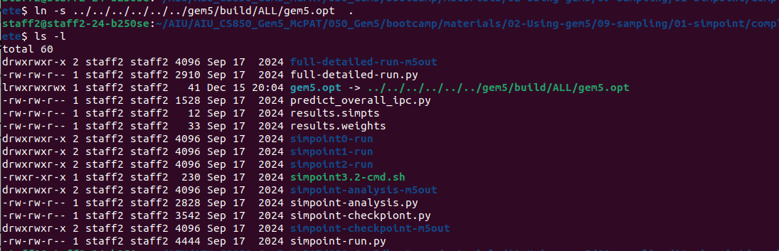
12.5 Gem5 SimPoint
https://www.youtube.com/watch?v=5V57XGFjUy8&list=PL_hVbFs_loVR_8ntTTmmG6YEq3Po_4snu&index=13
Gem5 SimPoint (8:28-8:29/39:44)
Because the profiling and getting the baseline performance might take a while, we will first run the simulation with the following command.
> cd ~/materials/02-Using-gem5/09-sampling/01-simpoint/complete/
> ln -s ../../../../../../gem5/build/ALL/gem5.opt .
> ls -l

Slide 25
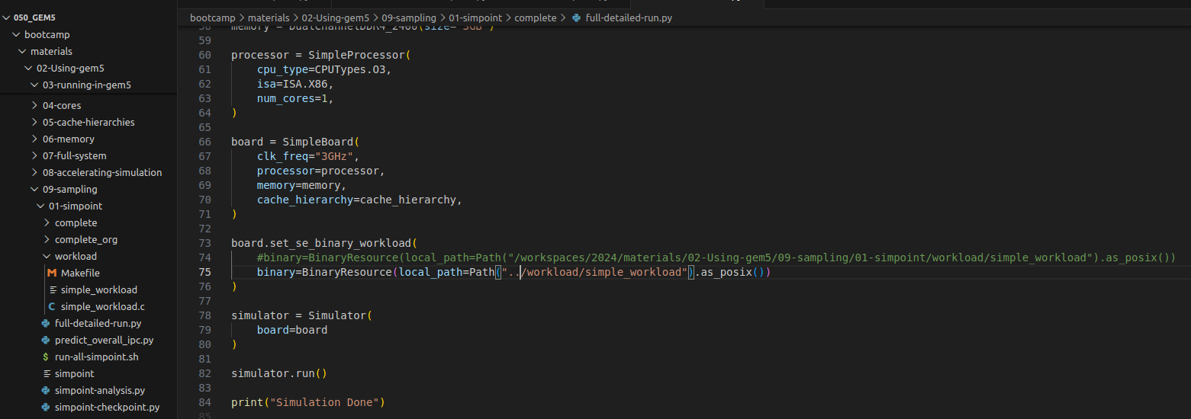
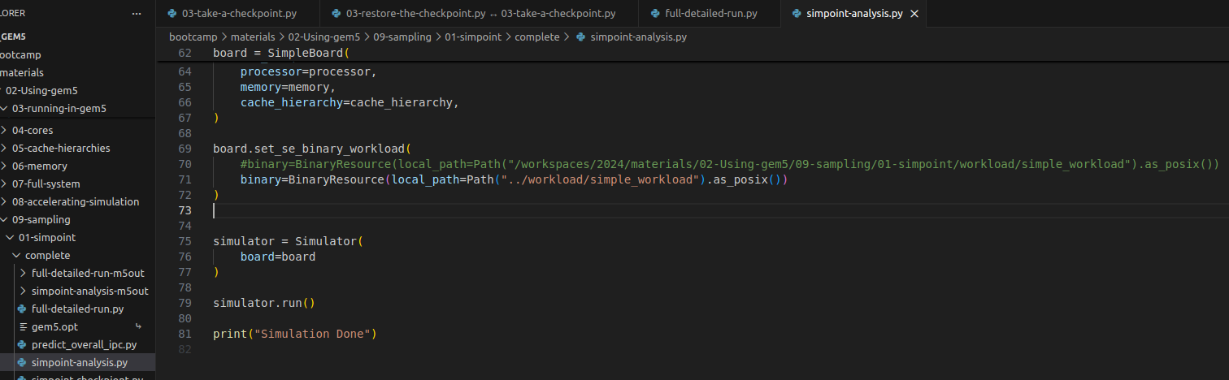
12.5 Gem5 SimPoint
https://www.youtube.com/watch?v=5V57XGFjUy8&list=PL_hVbFs_loVR_8ntTTmmG6YEq3Po_4snu&index=13
Gem5 SimPoint (8:30-8:31/39:44)
Modify the binary saving path in both
1. full-detailed-run.py and
2. simpoint-analysis.py.

Slide 26
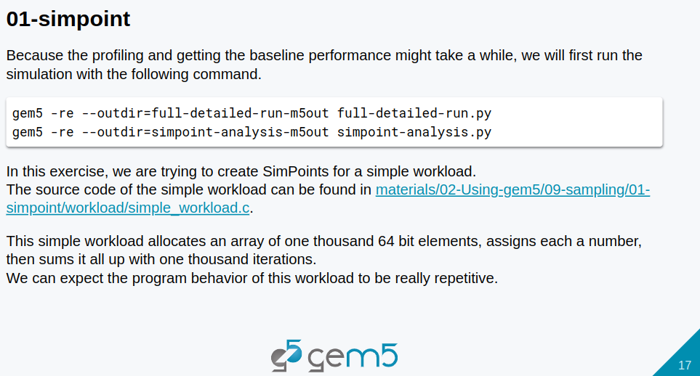
12.5 Gem5 SimPoint
https://www.youtube.com/watch?v=5V57XGFjUy8&list=PL_hVbFs_loVR_8ntTTmmG6YEq3Po_4snu&index=13
Gem5 SimPoint (8:31-10:00/39:44)
Because the profiling and getting the baseline performance might take a while, we will first run the simulation with the following command.
> ./gem5.opt -re --outdir=full-detailed-run-m5out full-detailed-run.py
> ./gem5.opt -re --outdir=simpoint-analysis-m5out simpoint-analysis.py
It will take a while. Check if there any error in *m5out/simerr.txt.
Ignore the warning message of the memory out of range now.

Slide 27
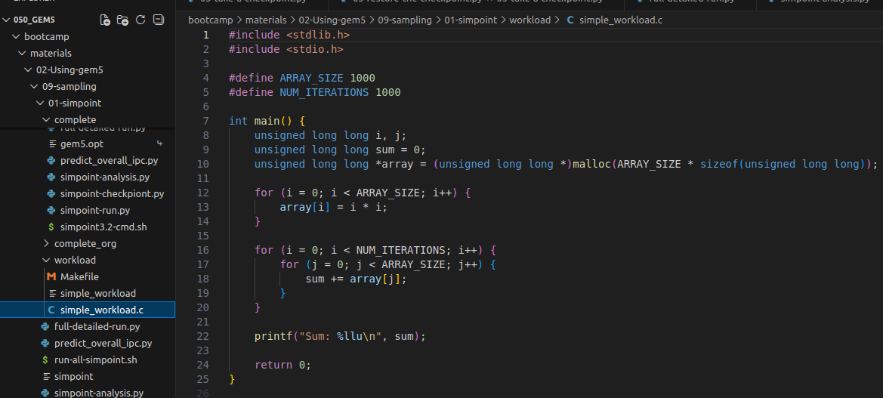
12.5 Gem5 SimPoint
https://www.youtube.com/watch?v=5V57XGFjUy8&list=PL_hVbFs_loVR_8ntTTmmG6YEq3Po_4snu&index=13
Gem5 SimPoint (10:01-10:40/39:44)
In this exercise, we are trying to create SimPoint for a simple workload.
The source code of simple workload are in the directory
> ~/materials/02-Using-gem5/09-sampling/01-simpoint/workload/simple_workload.c
This workload allocates an array of 1000 of 64 bit element
> #define ARRAY_SIZE 1000
> malloc (ARRAY_SIZE * sizeof (unsigned long long)
> Note: Google search “unsigned long long”
> An unsigned long long is a data type in C/C++ is used for very large positive integers.

Slide 28
12.5 Gem5 SimPoint
https://www.youtube.com/watch?v=5V57XGFjUy8&list=PL_hVbFs_loVR_8ntTTmmG6YEq3Po_4snu&index=13
Gem5 SimPoint (10:41-10:52/39:44)
1. We assign the a number to this array
2. Next, we add all the array element with j index into a variable sum.
3. Then, wee loop 1000 loop with index i to add all variable sum and then put into variable sum.
4. Print the result sum
5. Return the result sum

Slide 29
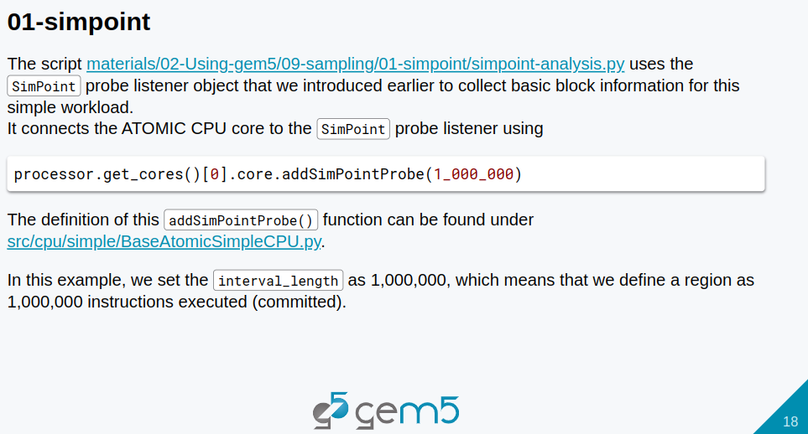
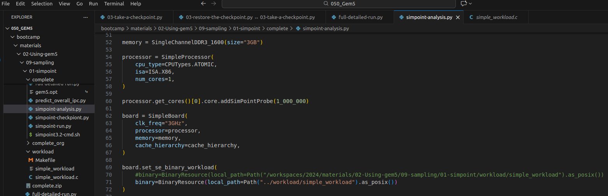
12.5 Gem5 SimPoint
https://www.youtube.com/watch?v=5V57XGFjUy8&list=PL_hVbFs_loVR_8ntTTmmG6YEq3Po_4snu&index=13
Gem5 SimPoint (10:53-11:24/39:44)
Let’s look at simpoint-analysis.py.
> simpoint-analysis.py
We can see the workload we just saw the source code simple_workload.c and the important part is that we connected our SimPoint() probe listener object to the ATOMIC

Slide 30
12.5 Gem5 SimPoint
https://www.youtube.com/watch?v=5V57XGFjUy8&list=PL_hVbFs_loVR_8ntTTmmG6YEq3Po_4snu&index=13
Gem5 SimPoint (11:25-11:30/39:44)
We use the addSimPointProbe() function to connect ATOMIC CPU core the SimPoint() probe listener object.

Slide 31
12.5 Gem5 SimPoint
https://www.youtube.com/watch?v=5V57XGFjUy8&list=PL_hVbFs_loVR_8ntTTmmG6YEq3Po_4snu&index=13
Gem5 SimPoint (11:31-12:00/39:44)
We can find addSimPointProbe() function definition under the gem5/src/cpu/simple/BaseAtomicSimpleCPU.py.
It takes in a million instruction as the interval.

Slide 32
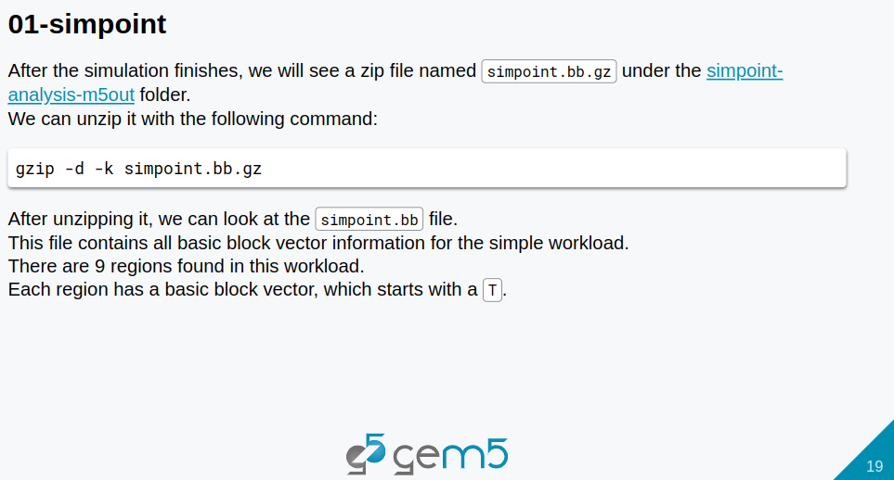
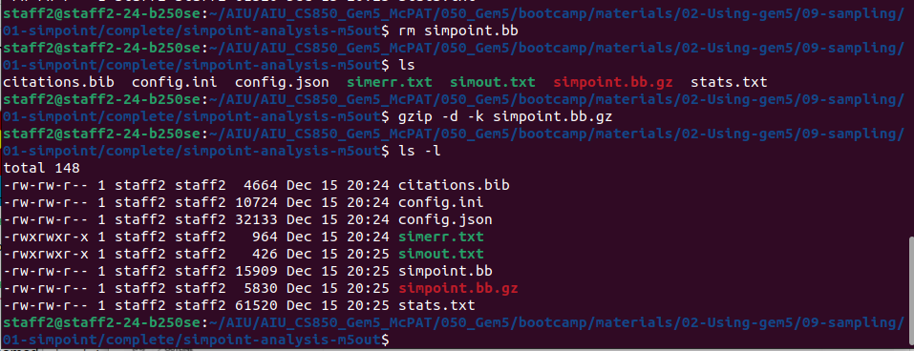
12.5 Gem5 SimPoint
https://www.youtube.com/watch?v=5V57XGFjUy8&list=PL_hVbFs_loVR_8ntTTmmG6YEq3Po_4snu&index=13
Gem5 SimPoint (12:01-13:00/39:44)
After the simulation is done, we go to the directory simpoint-analysis-m5out and unzip the simpoint.bb.gz
> gzip -d -k simpoint.bb.gz # -d: decompress, -k: keep (do not delete) the input file simpoint.bb.gz

Slide 33
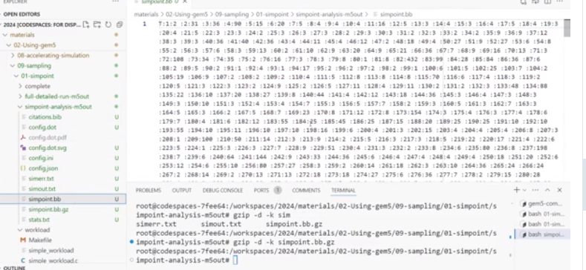
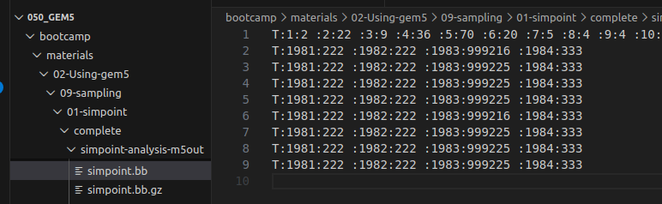
12.5 Gem5 SimPoint
https://www.youtube.com/watch?v=5V57XGFjUy8&list=PL_hVbFs_loVR_8ntTTmmG6YEq3Po_4snu&index=13
Gem5 SimPoint (12:01-12:50/39:44)
After the simulation is done, we go to the directory simpoint-analysis-m5out and unzip the simpoint.bb.gz
> gzip -d -k simpoint.bb.gz # -d: decompress, -k: keep (do not delete) the input file simpoint.bb.gz
The simpoint.bb file contains all the analysis information that simpoint probe listener collects for our workflow.
The “T” means the new start for the Region’s basic block vector.

Slide 34
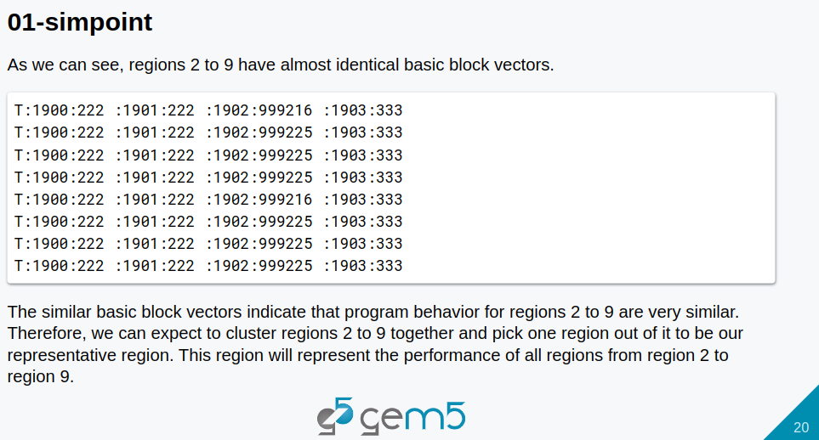
12.5 Gem5 SimPoint
https://www.youtube.com/watch?v=5V57XGFjUy8&list=PL_hVbFs_loVR_8ntTTmmG6YEq3Po_4snu&index=13
Gem5 SimPoint (12:51-13:14/39:44)
The “T” means the new start for the Region’s basic block vector.
The first “T” (first basic block vector) here is really big and different from the rest.
In this part, we are doing all the allocation initialization.
When we get to the 1,000 iteration, the basic block vector is really short.
Others are identical to each other.

Slide 35
12.5 Gem5 SimPoint
https://www.youtube.com/watch?v=5V57XGFjUy8&list=PL_hVbFs_loVR_8ntTTmmG6YEq3Po_4snu&index=13
Gem5 SimPoint (13:15-13:40/39:44)
In the simple method,we can
1. Cluster the basic block vector together and
2. Pick one region out of it to be our representative region.
This region will represent the performance of all regions from region 2 to region 9.

Slide 36
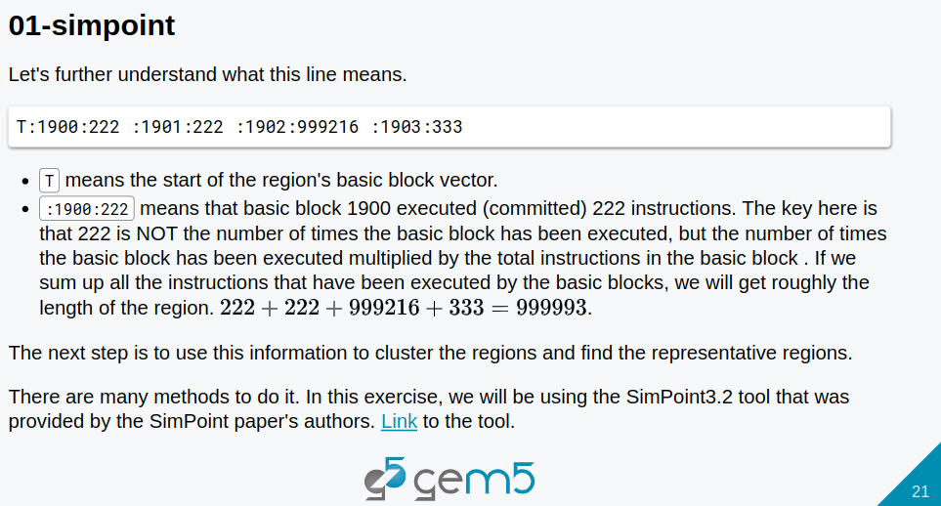
12.5 Gem5 SimPoint
https://www.youtube.com/watch?v=5V57XGFjUy8&list=PL_hVbFs_loVR_8ntTTmmG6YEq3Po_4snu&index=13
Gem5 SimPoint (13:41-14:50/39:44)
1. T: means the start of the region’s basic block.
2. The left side of colon (e.g., “1900”, “1901”, “1902”, “1903”) are the ID of basic block vector.
3. The right side of colon (e.g., “222”, “999216”, “333”) are NOT the frequency of basic block vector. The number means the frequency of this basic block execution multiply by the total instructions in that basic block.
4. If we sum up all the right side of colon (:) together, we have 222 + 222 + 999216 + 333 = 000003. It is close to the interval (length of the region) that we set up for the SimPoint probe.
5. Now, we have the analysis data.

Slide 37
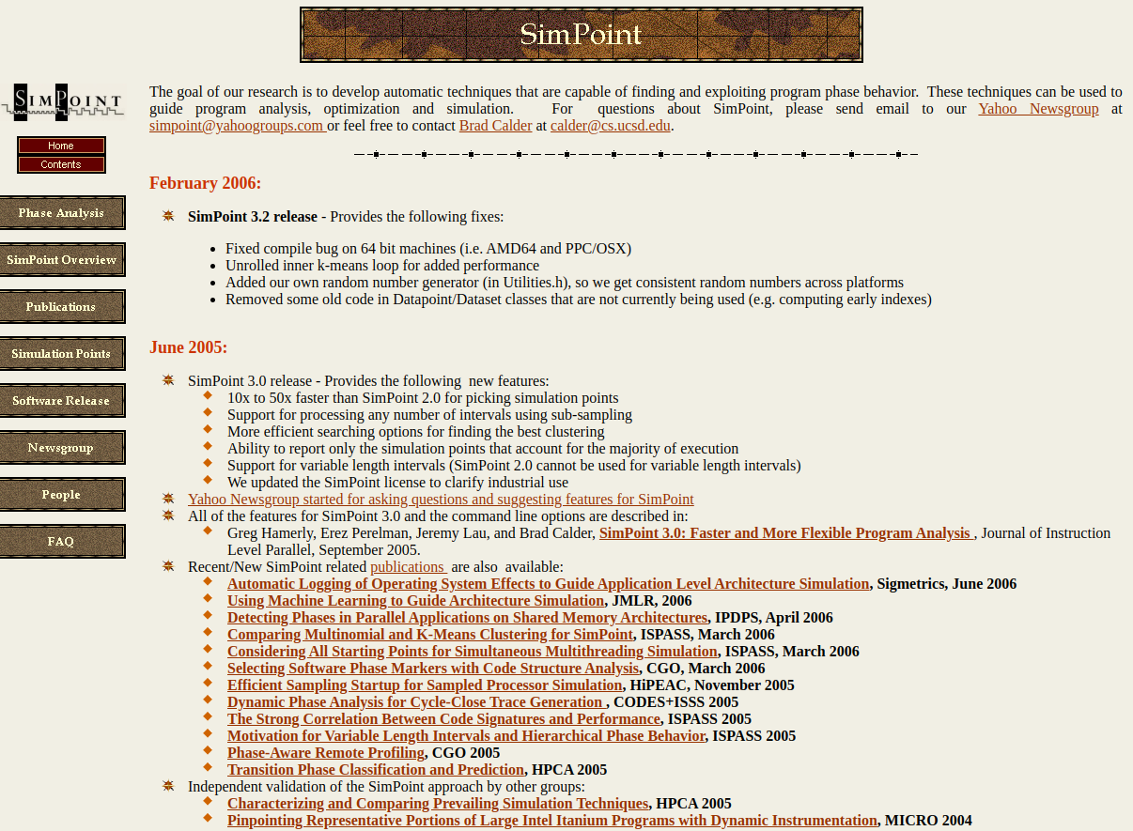
12.5 Gem5 SimPoint
https://www.youtube.com/watch?v=5V57XGFjUy8&list=PL_hVbFs_loVR_8ntTTmmG6YEq3Po_4snu&index=13
Gem5 SimPoint (14:41-15:20/39:44)
We will need a way to cluster this data and find our representative region.
In this exercise, we will use SimPoint 3.2 tool that is provided by SimPoint Paper author.
We can find more this tool in their actual web site.
https://cseweb.ucsd.edu/~calder/simpoint/

Slide 38
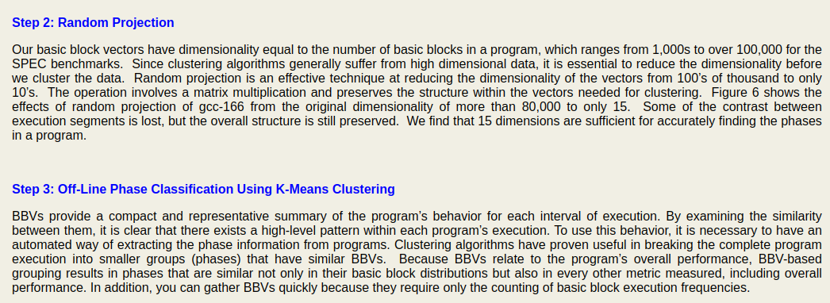
12.5 Gem5 SimPoint
https://www.youtube.com/watch?v=5V57XGFjUy8&list=PL_hVbFs_loVR_8ntTTmmG6YEq3Po_4snu&index=13
Gem5 SimPoint (15:21-15:40/39:44)
https://cseweb.ucsd.edu/~calder/simpoint/
https://cseweb.ucsd.edu/~calder/simpoint/phase_analysis.htm
We can click SimPoint web site to see more explanation:
The random projection: The SimPoint will linear project the basic block vector to 15 dimension and then cluster it with a k-man cluster

Slide 39
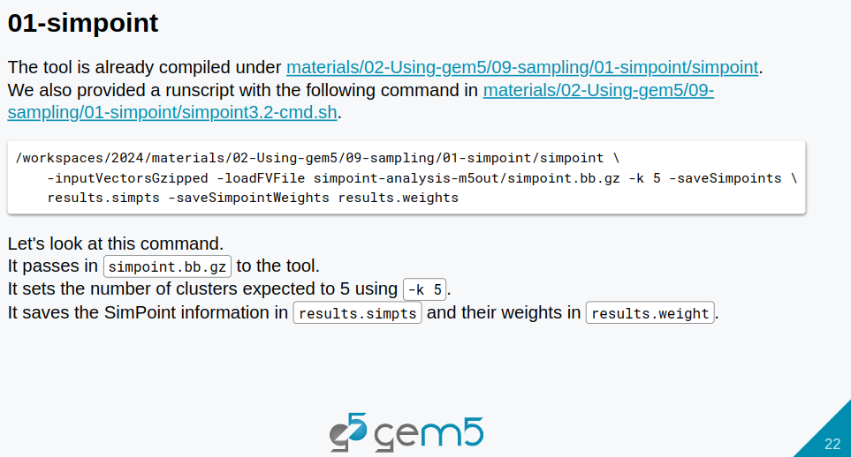
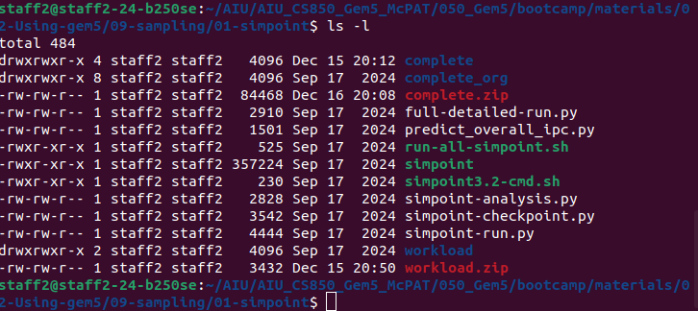
12.5 Gem5 SimPoint
https://www.youtube.com/watch?v=5V57XGFjUy8&list=PL_hVbFs_loVR_8ntTTmmG6YEq3Po_4snu&index=13
Gem5 SimPoint (15:21-15:40/39:44)
There is compiled file (executable binary) simpoint under
> ~bootcamp/materials/02-Using-gem5/09-sampling/01-simpoint

Slide 40
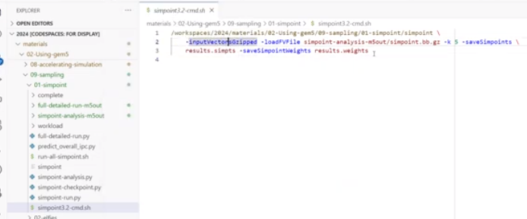
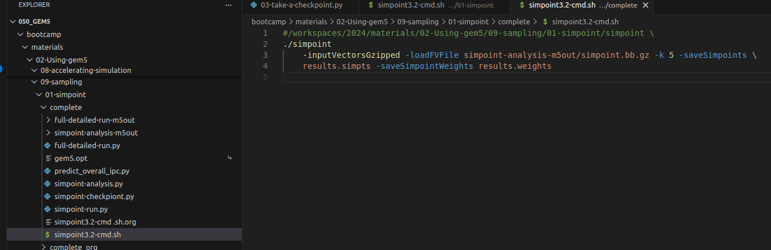
12.5 Gem5 SimPoint
https://www.youtube.com/watch?v=5V57XGFjUy8&list=PL_hVbFs_loVR_8ntTTmmG6YEq3Po_4snu&index=13
Gem5 SimPoint (15:41-16:00/39:44)
There is also a script file simpoint3.20-cmd.sh under
> ~bootcamp/materials/02-Using-gem5/09-sampling/01-simpoint
The simpoint3.2-cmd.sh as below uses simpoint to run.
> ./simpoint3.20-cmd.sh
Below, we loadFVFile from simpoint=analysis-m5ouy/simpoint.bb.gz

Slide 41
12.5 Gem5 SimPoint
https://www.youtube.com/watch?v=5V57XGFjUy8&list=PL_hVbFs_loVR_8ntTTmmG6YEq3Po_4snu&index=13
Gem5 SimPoint (16:01-16:10/39:44)
In the simpoint3.2-cmd.sh, we use option -loadFVFile (Load Feature Vector File) to load bb (basic block) from simpoint=analysis-m5ouy/simpoint.bb.gz

Slide 42
12.5 Gem5 SimPoint
https://www.youtube.com/watch?v=5V57XGFjUy8&list=PL_hVbFs_loVR_8ntTTmmG6YEq3Po_4snu&index=13
Gem5 SimPoint (16:11-16:35/39:44)
We use “-k 5” to ask tool to find five representative regions out of the 9 regions that we got from out analysis from the workload.
Then,we use -saveSimpoints to save our SimPoint information into a file called “results.simpts”

Slide 43
12.5 Gem5 SimPoint
https://www.youtube.com/watch?v=5V57XGFjUy8&list=PL_hVbFs_loVR_8ntTTmmG6YEq3Po_4snu&index=13
Gem5 SimPoint (16:36-16:42/39:44)
Then, we use the option -saveSimpointWeights to save the weight information for each region to the file “results.weights”.
We will save the weight information for each region in this resource weight file.

Slide 44
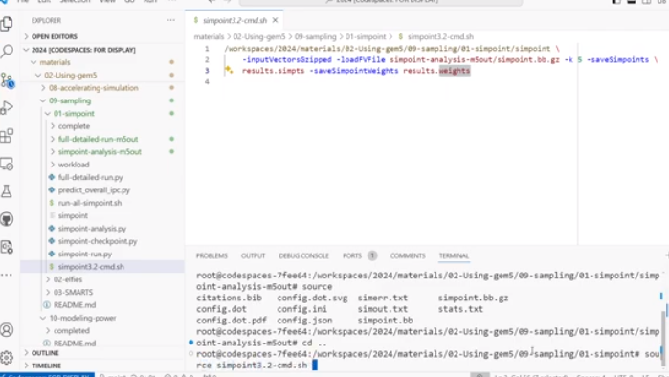
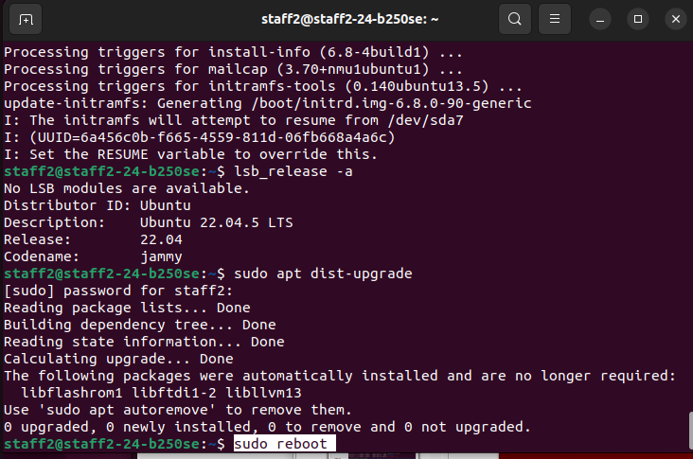
12.5 Gem5 SimPoint
https://www.youtube.com/watch?v=5V57XGFjUy8&list=PL_hVbFs_loVR_8ntTTmmG6YEq3Po_4snu&index=13
Gem5 SimPoint (16:43-16:55/39:44)
Let’s run the script simpoint3.2-cmd.sh on Ubuntu Terminal.
> source sumpoint3.2-cmd.sh
Error message: GNU C Library (GLIBC 2.38)
./simpoint: /lib/x86_64-linux-gnu/libc.so.6: version `GLIBC_2.38' not found (required by ./simpoint)
./simpoint: /lib/x86_64-linux-gnu/libstdc++.so.6: version `GLIBCXX_3.4.32' not found (required by ./simpoint)
We need to upgrade the newest Ubuntu OS with newest libraries.
> sudo apt update #Update Ubuntu. Some error
> wget https://dl.google.com/linux/direct/google-chrome-stable_current_amd64.deb
> sudo dpkg -i google-chrome-stable_current_amd64.deb
> sudo apt update #OK
> sudo apt upgrade # Upgrade newest libraries
> sudo apt dist-upgrade
> sudo reboot
Above does not update the Ubuntu OS.
Note: We need to re-install Ubuntu OS.

Slide 45
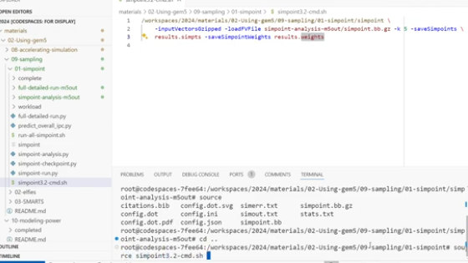
12.5 Gem5 SimPoint
https://www.youtube.com/watch?v=5V57XGFjUy8&list=PL_hVbFs_loVR_8ntTTmmG6YEq3Po_4snu&index=13
Gem5 SimPoint (16:56-17:05/39:44)
We run simpoint with script.
> source simpoint3.2-cmd.sh
Simpoint will generate results.simpts.

Slide 46
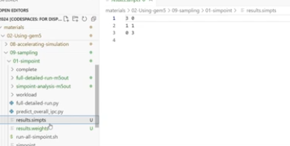
12.5 Gem5 SimPoint
https://www.youtube.com/watch?v=5V57XGFjUy8&list=PL_hVbFs_loVR_8ntTTmmG6YEq3Po_4snu&index=13
Gem5 SimPoint (17:06-17:20/39:44)
In the results.simpts file, we have three representative groups.
Sim File picked three representative regions instead of five because the algorithm found out three regions would be enough to represent the all the behavior that can be found in this workload.

Slide 47
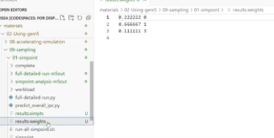
12.5 Gem5 SimPoint
https://www.youtube.com/watch?v=5V57XGFjUy8&list=PL_hVbFs_loVR_8ntTTmmG6YEq3Po_4snu&index=13
Gem5 SimPoint (17:21-19:00/39:44)
In the results.weights file, we found the weight (on the left side), we needed for the prediction of the overall performance for each region.
On the right size, such as, 0, 1, 3, these are not the SimPoint number. These indexes are not continuous. These are not the SimPoint region index. These are the cluster index in the SimPoint Tool.

Slide 48

12.5 Gem5 SimPoint
https://www.youtube.com/watch?v=5V57XGFjUy8&list=PL_hVbFs_loVR_8ntTTmmG6YEq3Po_4snu&index=13
Gem5 SimPoint (18:01-19:00/39:44)
We compare the results.weights and results.simpts.
In the results.simpts file, SimPoint algorithm finds regions 3, 1, 0 are the representative region.
1. In the results.simpts file, for region 3, we have the cluster index 0. In the results.weights file, for the cluster index 0, we can find the performance 0.222222.
2. In the results.simpts file, for region 1, we have cluster index 1. In the results.weights file, for the cluster index 1, we can find the performance 0.666667.
3. In the results.simpts file, for region 0, we have cluster index 3. In the results.weights file, for the cluster index 3, we can find the performance 0.111111.
Now, we found the representative region and their associated weight of each region.
https://www.youtube.com/watch?v=5V57XGFjUy8&list=PL_hVbFs_loVR_8ntTTmmG6YEq3Po_4snu&index=13

Slide 49
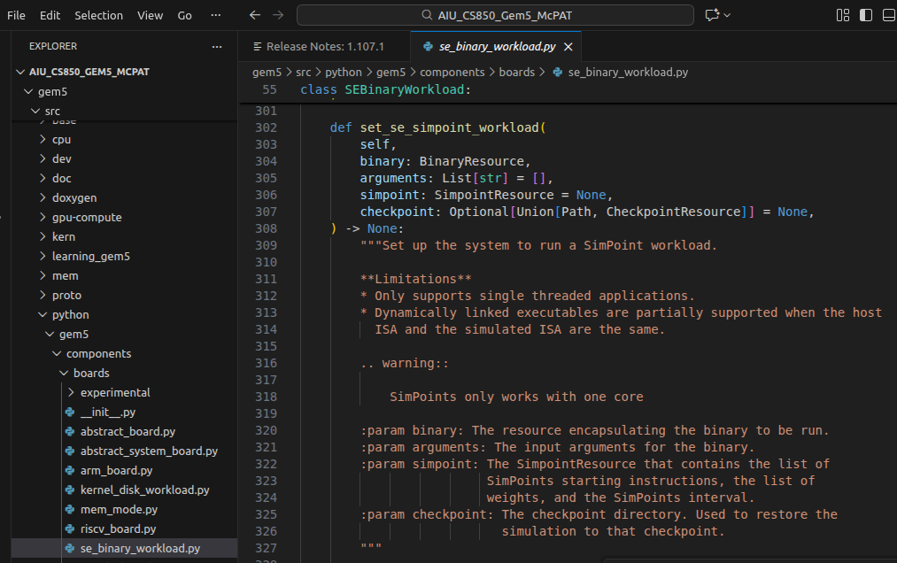
12.5 Gem5 SimPoint
https://www.youtube.com/watch?v=5V57XGFjUy8&list=PL_hVbFs_loVR_8ntTTmmG6YEq3Po_4snu&index=13
Gem5 SimPoint (19:01-20:00/39:44)
In the last checkpoint discussion, we use Set SE SimPoint workload. In the Gem5 Standard Library and SimPoint Class we discussed, we use Standard Library Interface to run SimPoint.
The SimPoint save checkpoint generator. That is also provided in the Standard Library.
In the
> code ./gem5/src/python/gem5/components/boards/se_binary_workload.py
We can find function set_simpoint_workload().
https://www.youtube.com/watch?v=5V57XGFjUy8&list=PL_hVbFs_loVR_8ntTTmmG6YEq3Po_4snu&index=13

Slide 50
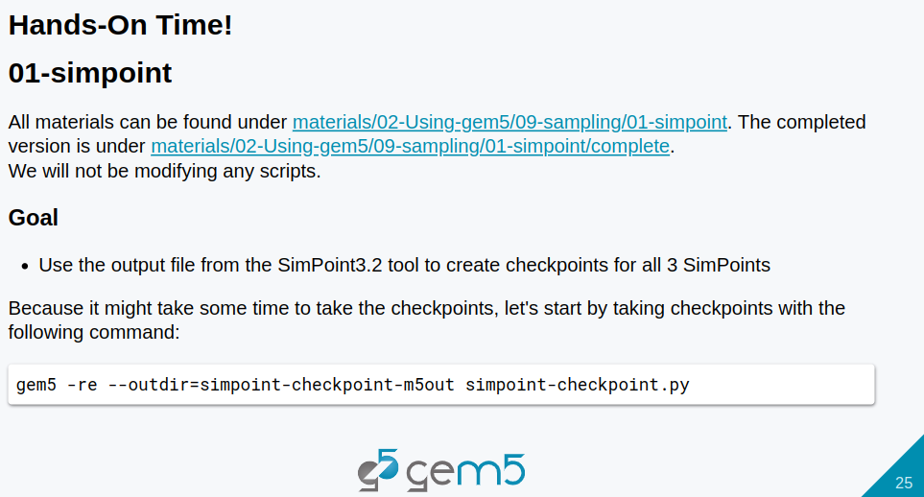
12.5 Gem5 SimPoint
https://www.youtube.com/watch?v=5V57XGFjUy8&list=PL_hVbFs_loVR_8ntTTmmG6YEq3Po_4snu&index=13
Gem5 SimPoint (20:01-20:20/39:44)
Let’s look checkpoint for the representative region.
https://www.youtube.com/watch?v=5V57XGFjUy8&list=PL_hVbFs_loVR_8ntTTmmG6YEq3Po_4snu&index=13

Slide 51
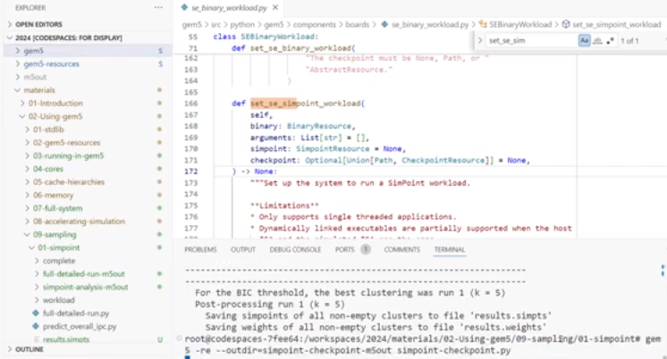
12.5 Gem5 SimPoint
https://www.youtube.com/watch?v=5V57XGFjUy8&list=PL_hVbFs_loVR_8ntTTmmG6YEq3Po_4snu&index=13
Gem5 SimPoint (20:21-20:34/39:44)
We can use the SimPoint3.2 tool to create checkpoint for all 3 SimPoints.
> ./gem5.opt --outdir=simppoint-chekpoint-m5out simpoint-checkpoint.py
https://www.youtube.com/watch?v=5V57XGFjUy8&list=PL_hVbFs_loVR_8ntTTmmG6YEq3Po_4snu&index=13

Slide 52
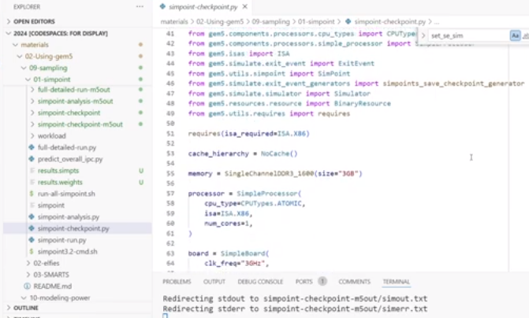
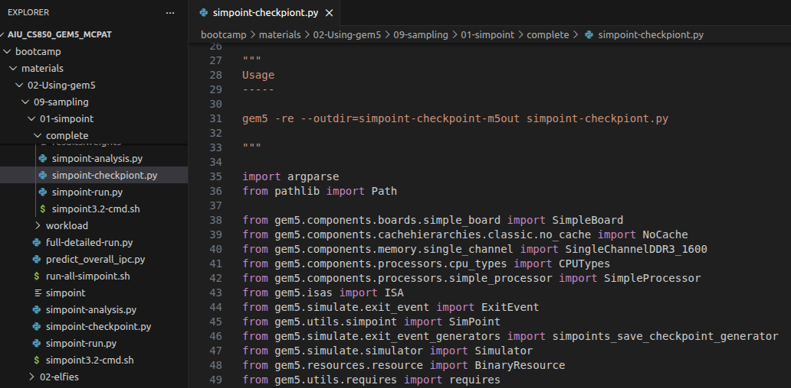
12.5 Gem5 SimPoint
https://www.youtube.com/watch?v=5V57XGFjUy8&list=PL_hVbFs_loVR_8ntTTmmG6YEq3Po_4snu&index=13
Gem5 SimPoint (20:21-20:45/39:44)
Look at simpoint-checkpoint.py
> code ./materials/02-Using-gem5/01-simpoint/complete/simpoint-checkpoint.py
In code, we
1. Import the SimPoint Module from the Standard Library.
2. Use simpoints_save_checkpoint_generator
https://www.youtube.com/watch?v=5V57XGFjUy8&list=PL_hVbFs_loVR_8ntTTmmG6YEq3Po_4snu&index=13

Slide 53
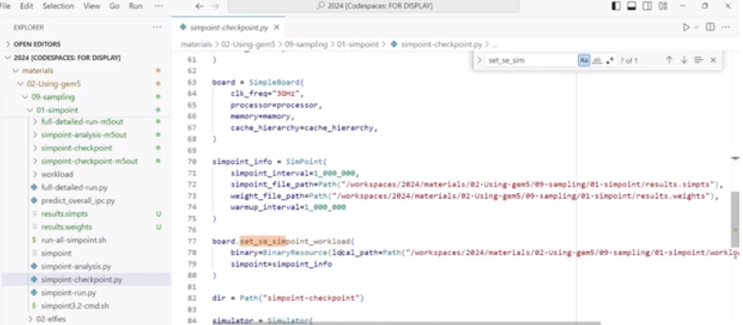
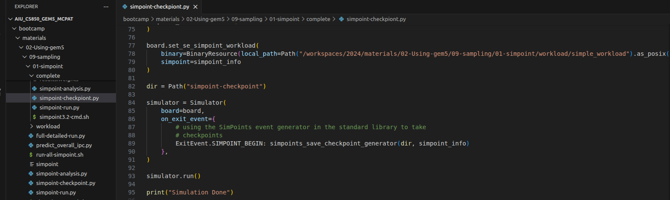
12.5 Gem5 SimPoint
https://www.youtube.com/watch?v=5V57XGFjUy8&list=PL_hVbFs_loVR_8ntTTmmG6YEq3Po_4snu&index=13
Gem5 SimPoint (20:46-21:00/39:44)
We will save checkpoint by board.set_se_simpoint_workload ()
We will take the checkpoint and save se simpoint workload.
https://www.youtube.com/watch?v=5V57XGFjUy8&list=PL_hVbFs_loVR_8ntTTmmG6YEq3Po_4snu&index=13

Slide 54
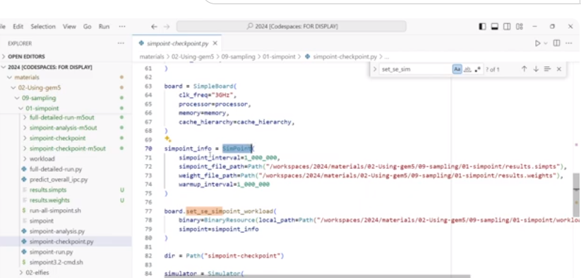
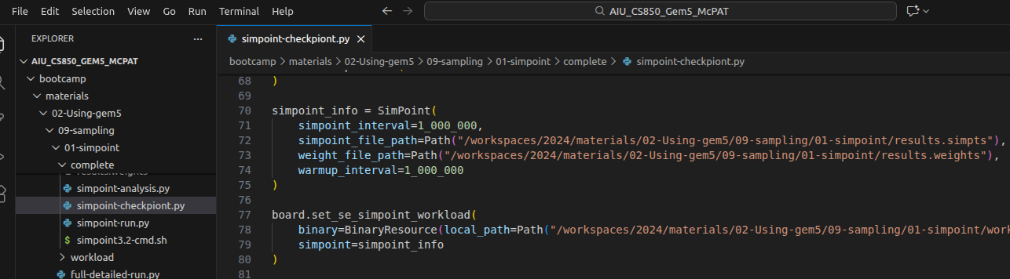
12.5 Gem5 SimPoint
https://www.youtube.com/watch?v=5V57XGFjUy8&list=PL_hVbFs_loVR_8ntTTmmG6YEq3Po_4snu&index=13
Gem5 SimPoint (21:01-22:50/39:44)
We take the all the simpoint information from SimPoint(). The information includes:
1. simpoint interval: 1 million intervals
2. simpoint file path
3. weight file path
4. warm up interval: 1 million intervals for the micro-architectural states of the system. When we restore a checkpoint, we can expect to have a length of simulation to warm up the micro-architectural state. We expect the 1 million intervals from the last region.
https://www.youtube.com/watch?v=5V57XGFjUy8&list=PL_hVbFs_loVR_8ntTTmmG6YEq3Po_4snu&index=13

Slide 55
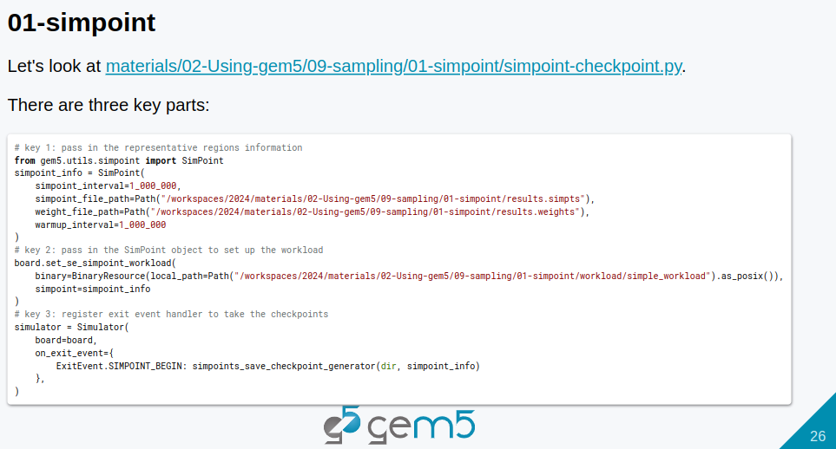
12.5 Gem5 SimPoint
https://www.youtube.com/watch?v=5V57XGFjUy8&list=PL_hVbFs_loVR_8ntTTmmG6YEq3Po_4snu&index=13
Gem5 SimPoint (22:51-22:55/39:44)
We have three key parts in the simpoint-checkpoint.py
https://www.youtube.com/watch?v=5V57XGFjUy8&list=PL_hVbFs_loVR_8ntTTmmG6YEq3Po_4snu&index=13

Slide 56
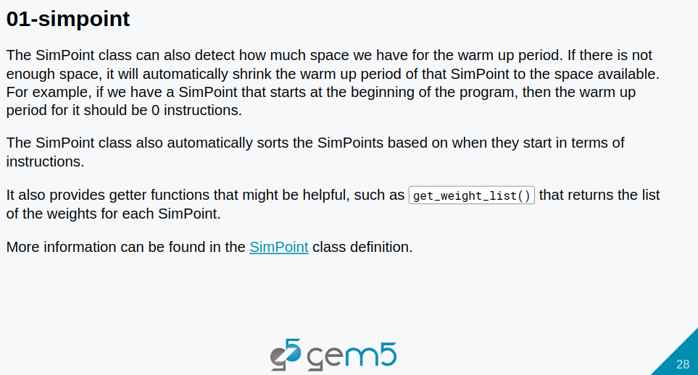
12.5 Gem5 SimPoint
https://www.youtube.com/watch?v=5V57XGFjUy8&list=PL_hVbFs_loVR_8ntTTmmG6YEq3Po_4snu&index=13
Gem5 SimPoint (22:56-23:30/39:44)
The SimPoint class also detect how much space we have for the warm up period.
If there is not enough space, it will automatically shrink the warm up period of that SimPoint to the space that is available.
For example, if we have a SimPoint that starts at the beginning of the program, then the warm up period for it should be zero instructions.
The SimPoint class also automatically sorts the SimPoints based on they start in terms of instructions.
The Simpoint class also provides a lot of gather functions that might be helpful, such as, get_weight_list() that we can get the weight for the SimPoint that we are running.
https://www.youtube.com/watch?v=5V57XGFjUy8&list=PL_hVbFs_loVR_8ntTTmmG6YEq3Po_4snu&index=13

Slide 57

12.5 Gem5 SimPoint
https://www.youtube.com/watch?v=5V57XGFjUy8&list=PL_hVbFs_loVR_8ntTTmmG6YEq3Po_4snu&index=13
Gem5 SimPoint (23:31-23:55/39:44)
We can find more information of SimPoint class under
> code gem5/src/python/gem5/utils/simpoint.py.
It is the SimPoint Module file in the standard library.
https://www.youtube.com/watch?v=5V57XGFjUy8&list=PL_hVbFs_loVR_8ntTTmmG6YEq3Po_4snu&index=13

Slide 58


12.5 Gem5 SimPoint
https://www.youtube.com/watch?v=5V57XGFjUy8&list=PL_hVbFs_loVR_8ntTTmmG6YEq3Po_4snu&index=13
Gem5 SimPoint (23:56-24:15/39:44)
Now. We look at the SimPoint Generator.
> code bootcamp/material/02-Using-gem5/09-sampling/01-simploint/simpoint-checkpoint.py
https://www.youtube.com/watch?v=5V57XGFjUy8&list=PL_hVbFs_loVR_8ntTTmmG6YEq3Po_4snu&index=13

Slide 59
12.5 Gem5 SimPoint
https://www.youtube.com/watch?v=5V57XGFjUy8&list=PL_hVbFs_loVR_8ntTTmmG6YEq3Po_4snu&index=13
Gem5 SimPoint (24:16-25:15/39:44)
> code bootcamp/material/02-Using-gem5/09-sampling/01-simploint/simpoint-checkpoint.py
First, it will take in the directory where we will store the simpoint checkpoint, then we will take in the simpoint information we just created using the simpoint standard library module.
https://www.youtube.com/watch?v=5V57XGFjUy8&list=PL_hVbFs_loVR_8ntTTmmG6YEq3Po_4snu&index=13

Slide 60
End

