Slide 1

3.1 SimObject: Slides
Peter H. Chen

Slide 2
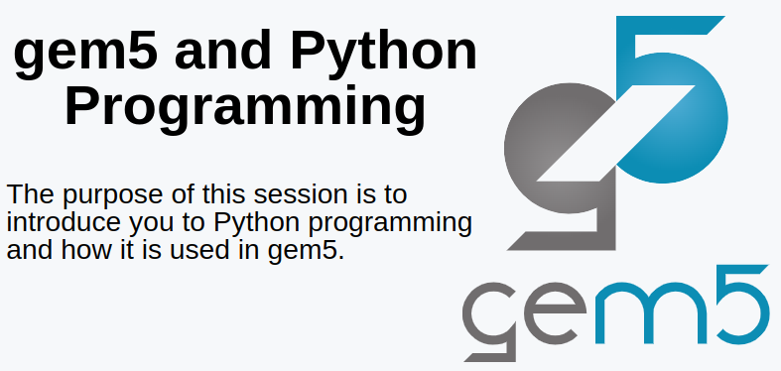
3.1 SimObject: Slides
https://gem5bootcamp.github.io/2024/#01-Introduction/03-python-background
SimObject: Slides

Slide 3
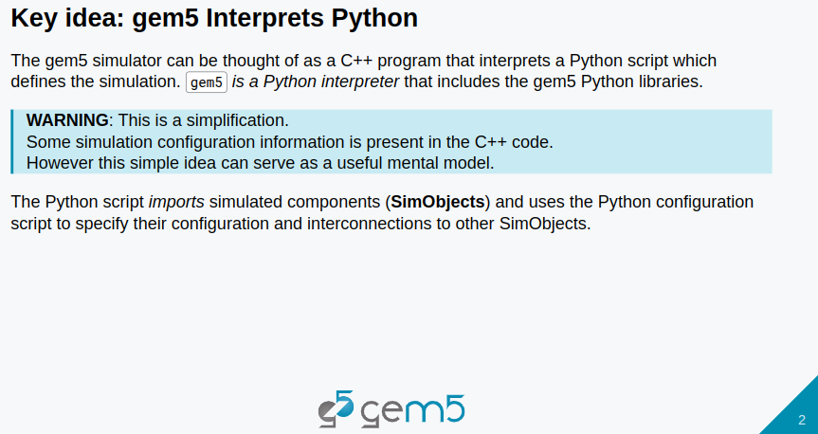
3.1 SimObject: Slides
https://gem5bootcamp.github.io/2024/#01-Introduction/03-python-background
SimObject: Slides

Slide 4
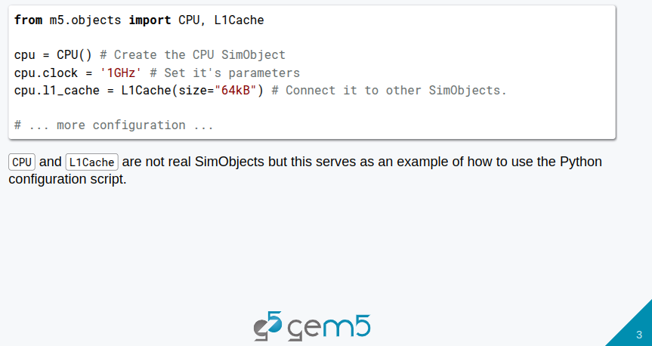
3.1 SimObject: Slides
https://gem5bootcamp.github.io/2024/#01-Introduction/03-python-background
SimObject: Slides

Slide 5
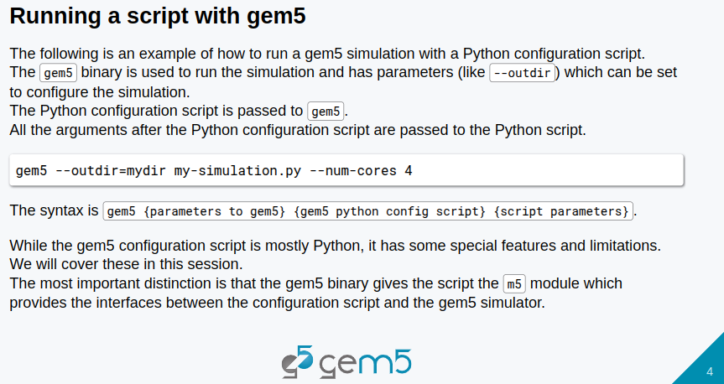
3.1 SimObject: Slides
https://gem5bootcamp.github.io/2024/#01-Introduction/03-python-background
SimObject: Slides

Slide 6
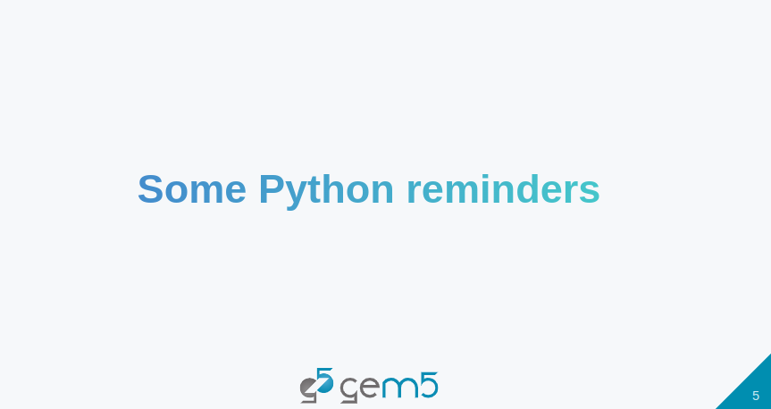
3.1 SimObject: Slides
https://gem5bootcamp.github.io/2024/#01-Introduction/03-python-background
SimObject: Slides

Slide 7
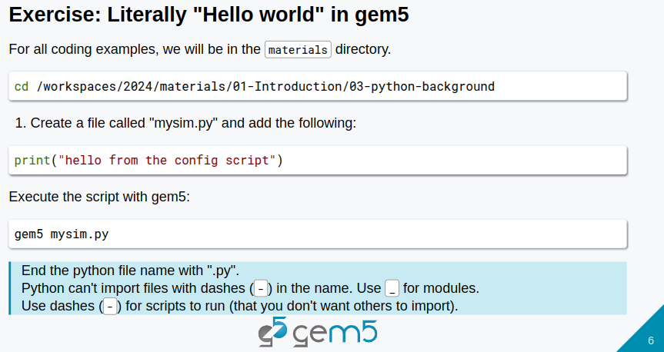
3.1 SimObject: Slides
https://gem5bootcamp.github.io/2024/#01-Introduction/03-python-background
SimObject: Slides

Slide 8
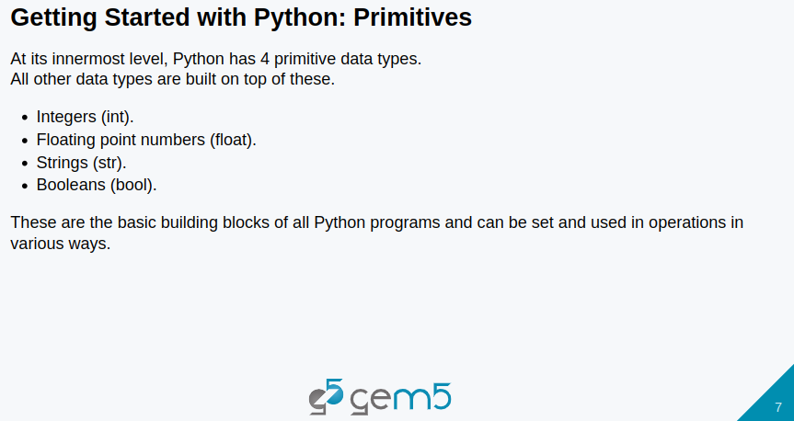
3.1 SimObject: Slides
https://gem5bootcamp.github.io/2024/#01-Introduction/03-python-background
SimObject: Slides

Slide 9
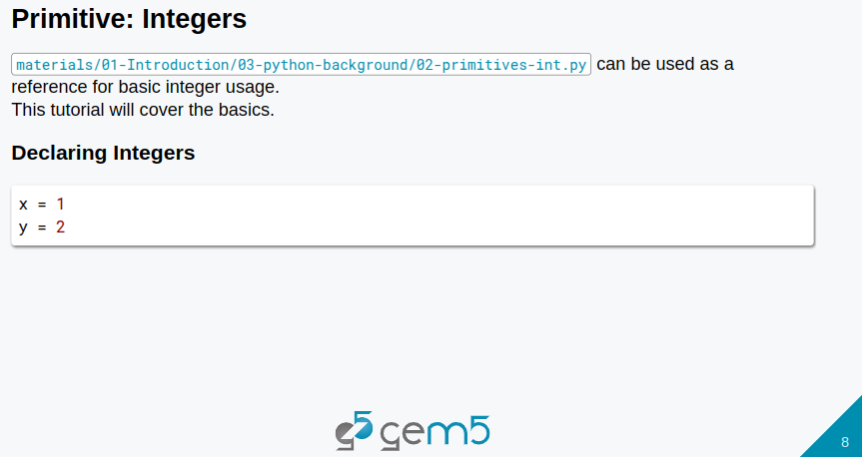
3.1 SimObject: Slides
https://gem5bootcamp.github.io/2024/#01-Introduction/03-python-background
SimObject: Slides

Slide 10
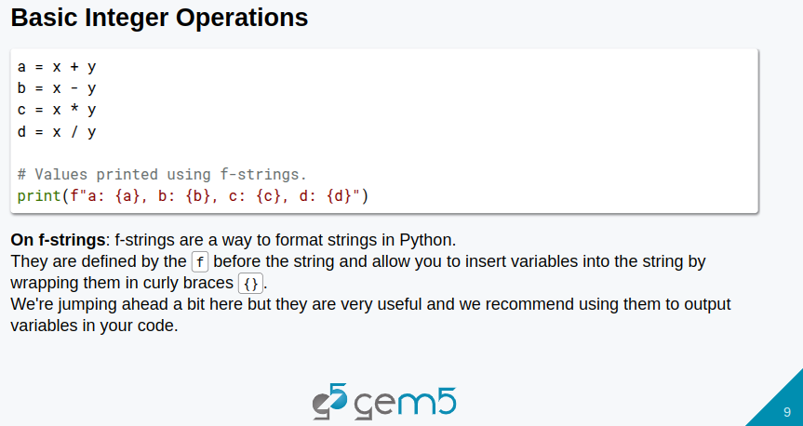
3.1 SimObject: Slides
https://gem5bootcamp.github.io/2024/#01-Introduction/03-python-background
SimObject: Slides

Slide 11
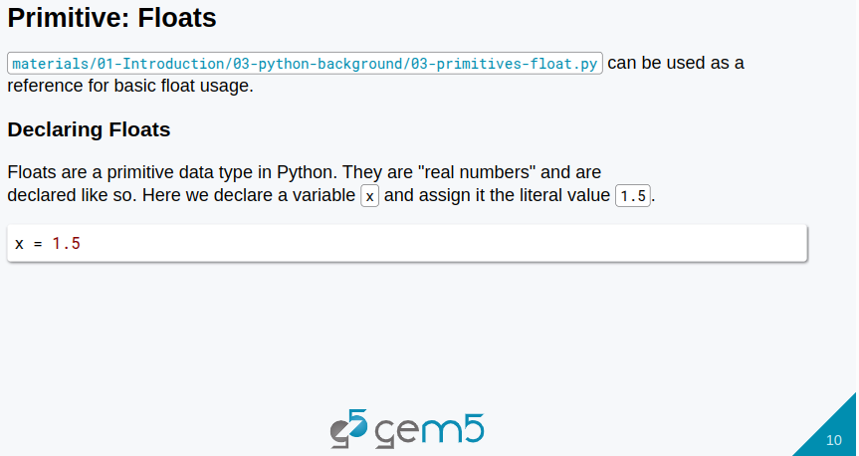
3.1 SimObject: Slides
https://gem5bootcamp.github.io/2024/#01-Introduction/03-python-background
SimObject: Slides

Slide 12
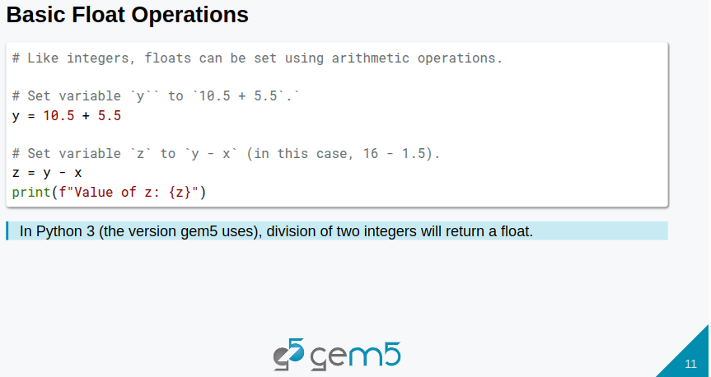
3.1 SimObject: Slides
https://gem5bootcamp.github.io/2024/#01-Introduction/03-python-background
SimObject: Slides

Slide 13
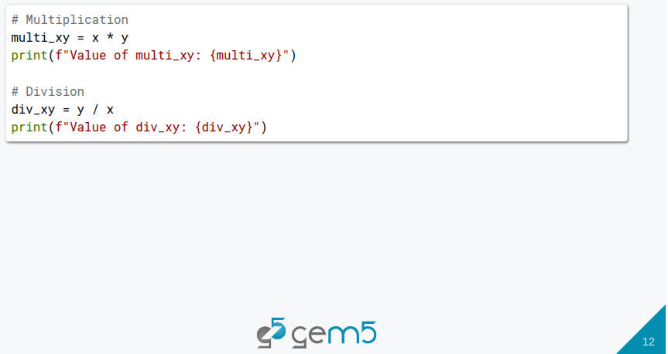
3.1 SimObject: Slides
https://gem5bootcamp.github.io/2024/#01-Introduction/03-python-background
SimObject: Slides

Slide 14
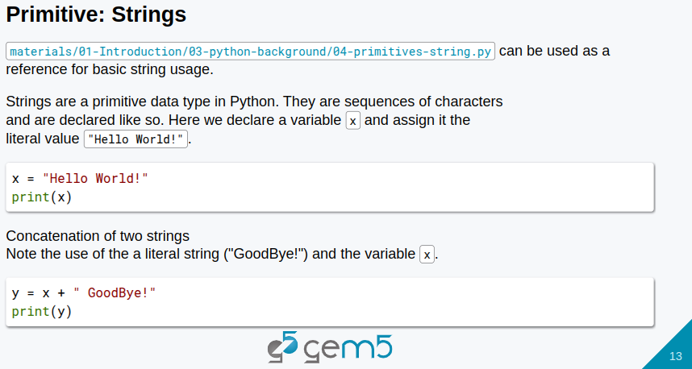
3.1 SimObject: Slides
https://gem5bootcamp.github.io/2024/#01-Introduction/03-python-background
SimObject: Slides

Slide 15
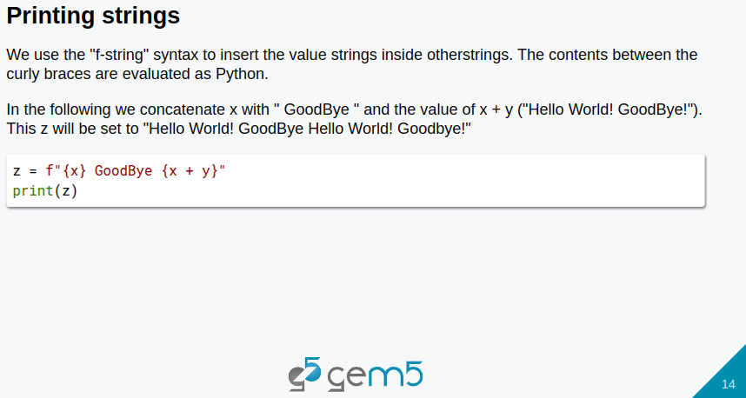
3.1 SimObject: Slides
https://gem5bootcamp.github.io/2024/#01-Introduction/03-python-background
SimObject: Slides

Slide 16
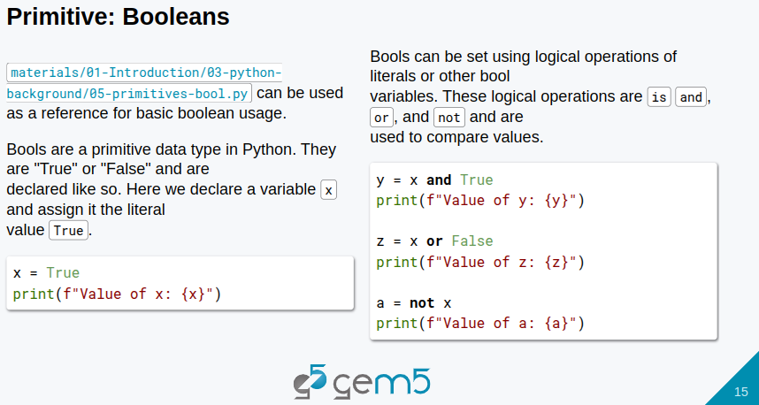
3.1 SimObject: Slides
https://gem5bootcamp.github.io/2024/#01-Introduction/03-python-background
SimObject: Slides

Slide 17
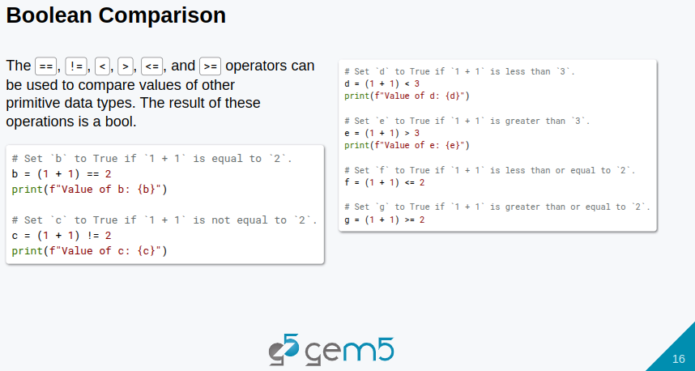
3.1 SimObject: Slides
https://gem5bootcamp.github.io/2024/#01-Introduction/03-python-background
SimObject: Slides
s

Slide 18
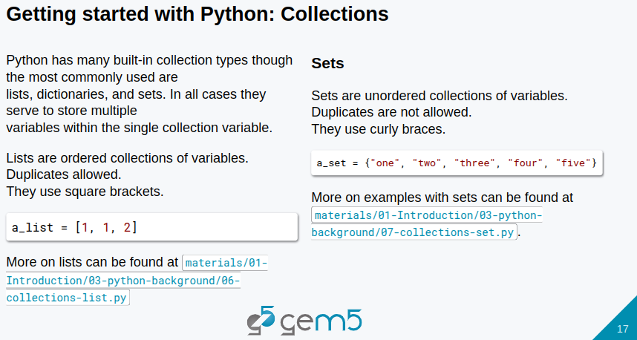
3.1 SimObject: Slides
https://gem5bootcamp.github.io/2024/#01-Introduction/03-python-background
SimObject: Slides

Slide 19
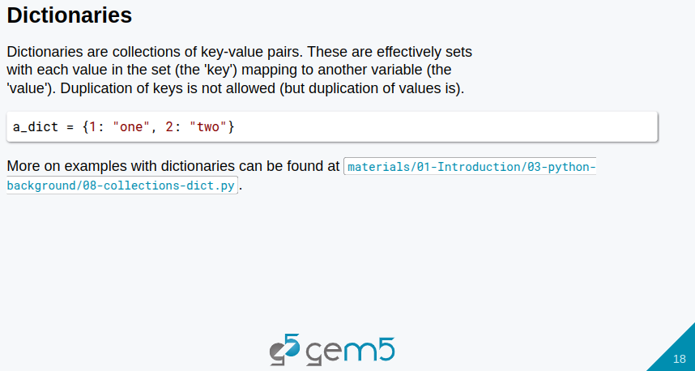
3.1 SimObject: Slides
https://gem5bootcamp.github.io/2024/#01-Introduction/03-python-background
SimObject: Slides

Slide 20
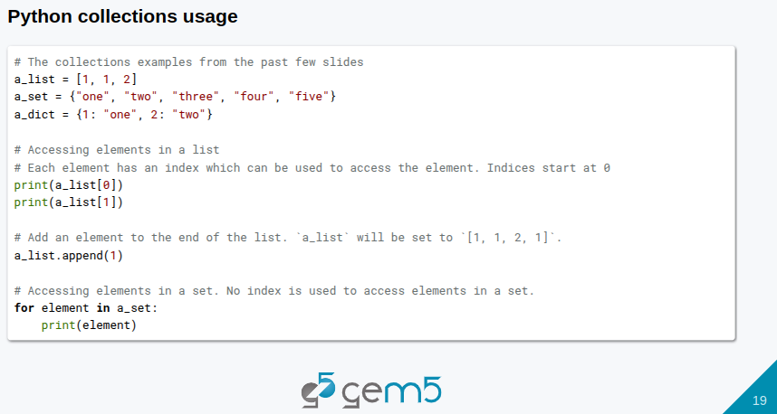
3.1 SimObject: Slides
https://gem5bootcamp.github.io/2024/#01-Introduction/03-python-background
SimObject: Slides

Slide 21
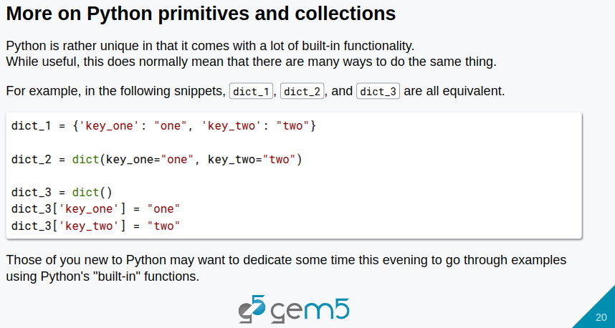
3.1 SimObject: Slides
https://gem5bootcamp.github.io/2024/#01-Introduction/03-python-background
SimObject: Slides

Slide 22
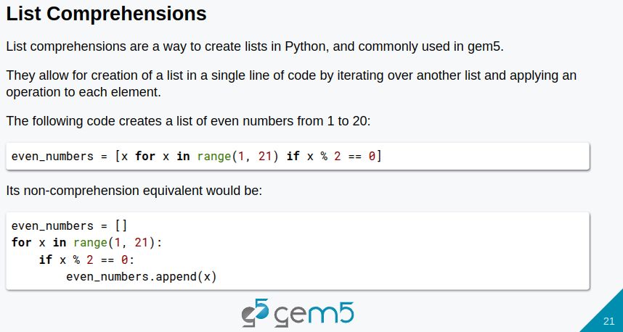
3.1 SimObject: Slides
https://gem5bootcamp.github.io/2024/#01-Introduction/03-python-background
SimObject: Slides

Slide 23
End

