Slide 1

7 Gem5 CPU Model
Peter H. Chen

Slide 2
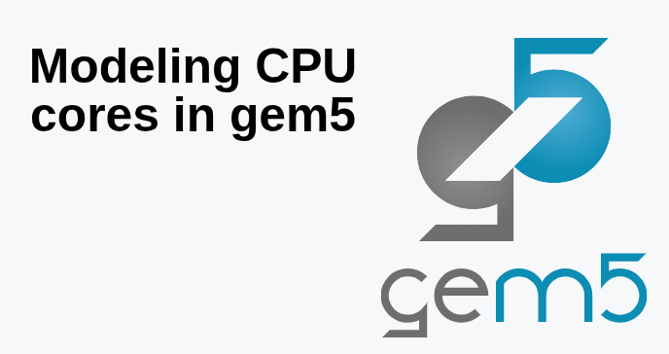
7 Gem5 CPU Model
https://www.youtube.com/watch?v=vfj0-n6JQOE&list=PL_hVbFs_loVR_8ntTTmmG6YEq3Po_4snu&index=7
Gem5 CPU Model (0:02-0:23/25:27)
We talk how to model the core in Gem5.

Slide 3
6.1 Topics

Slide 4
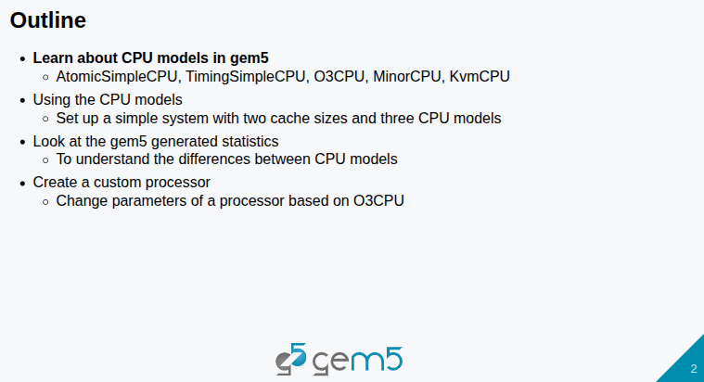
6.1 Topics
https://www.youtube.com/watch?v=vfj0-n6JQOE&list=PL_hVbFs_loVR_8ntTTmmG6YEq3Po_4snu&index=7
Topics (0:24-0:47/25:27)
1. How to use CPU Model: AtomicSimpleCPU, TimingSimpleCPU, O3CPU, MinorCPU, and KvmCPU.
2. Setup a simple system with 2 cache size and 3 CPU models.
3. Look at Gem5 generated statistics.
4. Create custom processor based on O3CPU.
5. Big/Little Processors

Slide 5
6.2 Gem5 CPU Model

Slide 6
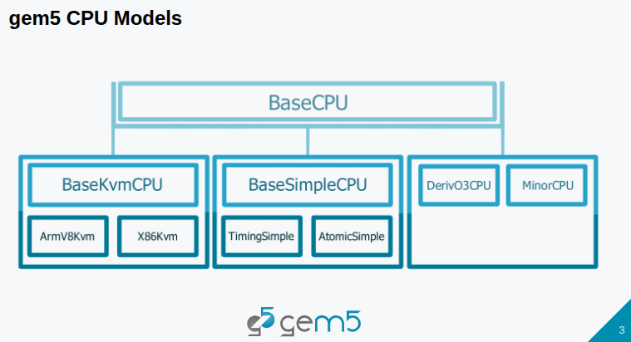
6.2 Gem5 CPU Model
https://www.youtube.com/watch?v=vfj0-n6JQOE&list=PL_hVbFs_loVR_8ntTTmmG6YEq3Po_4snu&index=7
Gem5 CPU Model (0:48-1:19/25:27)
Below is Gem5 standard library for CPU Model. We are talking about SimObjects.
We have the base CPU with four different types of CPU: KVM CPU, Simple CPU, O3 CPU, and Minor CPU.
1. Base KVM CPU is specialized for ARM and X86.
2. Base Simple CPU is specialized for Timing or Atomic.

Slide 7
6.3 Simple CPU

Slide 8
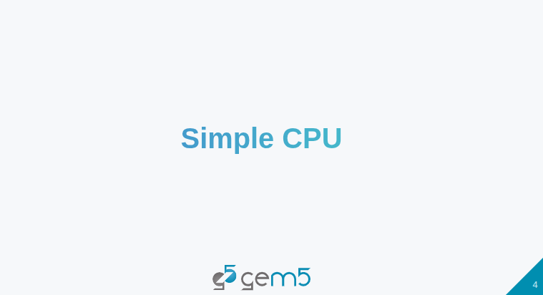
6.3 Simple CPU
https://www.youtube.com/watch?v=vfj0-n6JQOE&list=PL_hVbFs_loVR_8ntTTmmG6YEq3Po_4snu&index=7
Simple CPU (1:20-1:21/25:27)

Slide 9
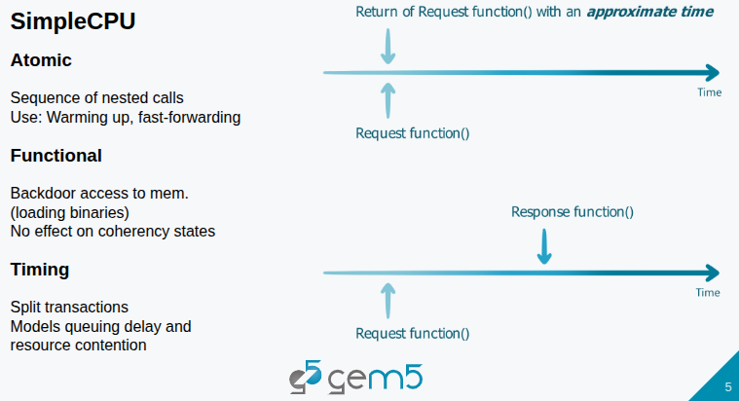
6.3 Simple CPU
https://www.youtube.com/watch?v=vfj0-n6JQOE&list=PL_hVbFs_loVR_8ntTTmmG6YEq3Po_4snu&index=7
Simple CPU (1:22-4:00/25:27)
Simple CPU includes Atomic, Functional, and Timing options.
1. Atomic model prevent data race, complete multi-threading run, and ensure the data integrity. CPU Atomic model handles Atomic Operations (indivisible and uninterruptible instructions) without interfered by other processes or threads. There is no split transactions.
2. Functional: Execute instruction without timing/Pipeline. Functional access is for debugging.
3. Timing: for accurate simulation with timing and power. We cannot mix use of timing, functional, and atomic at the same time.

Slide 10
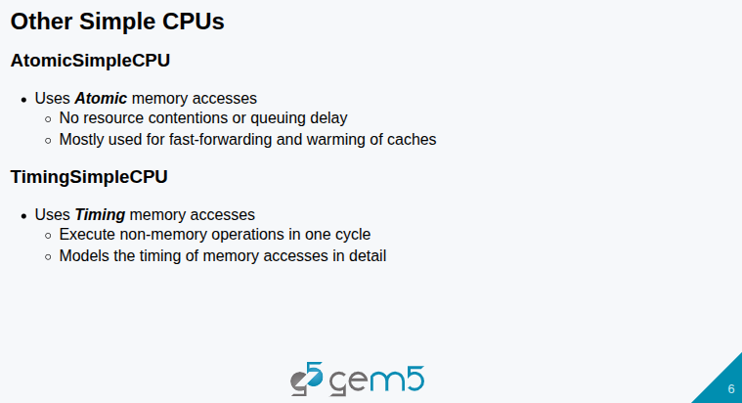
6.3 Simple CPU
https://www.youtube.com/watch?v=vfj0-n6JQOE&list=PL_hVbFs_loVR_8ntTTmmG6YEq3Po_4snu&index=7
Simple CPU (4:01-5:00/25:27)

Slide 11
End

