Slide 1

15 Gem5 Multi-Sim
Peter H. Chen

Slide 2

15 Gem5 Multi-Sim
https://www.youtube.com/watch?v=dJz8u70vyfM&list=PL_hVbFs_loVR_8ntTTmmG6YEq3Po_4snu&index=15
Gem5 Multi-Sim (0:00-0:10/16:59)
We talk about Multi-Sim which is multi-processing for Gem5. There are some new features.

Slide 3
15.0 Topics

Slide 4
15.0 Topics
https://www.youtube.com/watch?v=dJz8u70vyfM&list=PL_hVbFs_loVR_8ntTTmmG6YEq3Po_4snu&index=15
Power Model Topic (l0:11-0:15/16:59)
Gem5 core simulator is shingle thread. Multi-thread share code, data, and heap memory. Multi-Process does not share code, data, and heap memory.
Gem5 Multisim implement multi-processing. Multisim does not implement multi-thread simulation.
Gem5 Multisim uses script and configuration to produce the consistent output format.
Topics:
1. Gem5 Single thread Problem
2. Gem5 Insight
3. Multi-Processing by Script
4. Multi-Processing by Script vs. Multisim
5. Implement Multi-Processing by Multisim
6. Construct/Define multiple Simulation
7. Add Multi-Sim Object
8. Run Multi-Sim

Slide 5
15.1 Gem5 Single Thread Problem

Slide 6
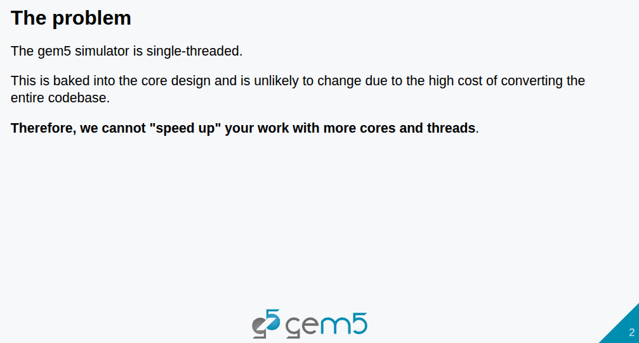
15.1 Gem5 Single Thread Problem
https://www.youtube.com/watch?v=dJz8u70vyfM&list=PL_hVbFs_loVR_8ntTTmmG6YEq3Po_4snu&index=15
Gem5 Single Thread Problem (0:16-1:05/16:59)
1. Original Gem5 simulator is developed with a single-threaded.
2. Gem5 is run under a single core.
We cannot speed up the multi-tasks simulation with more cores and threads.
Since Gem5 was for single thread, it is very difficult to change the Gem5 core from single thread into multi-thread. Therefore, we cannot “speed up” Gem5 from single core/thread into multi-thread.
So, can we improve the single thread Gem5 simulator into multi-thread Gem5 simulator?

Slide 7
15.2 Gem5 Insight

Slide 8
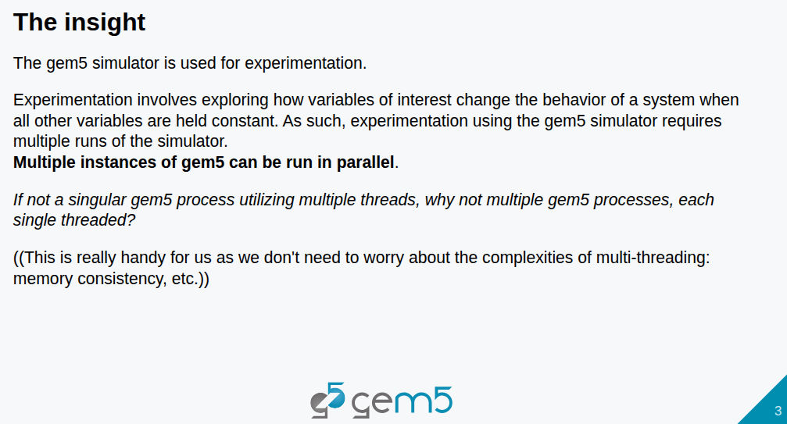
15.2 Gem5 Insight
https://www.youtube.com/watch?v=dJz8u70vyfM&list=PL_hVbFs_loVR_8ntTTmmG6YEq3Po_4snu&index=15
Gem5 Insight (1:06-2:05/16:59)
Q. What are different of multi-process and multi-thread?
Ans:
1. Multi-Processes: Each tasks are big and independent. Each task does not share code, data, and heap memory.
2. Multi-Threads: Each tasks share code, data, and heap memory.
Since Gem5 is not multi-thread, we explore and experiment the Gem5 with multi-process (not multi-thread), i.e., we can duplicated run more than one Gem5 instances/processes.
Then we can gather more than one experiment data we need.
We cannot run Gem5 multi-thread simulator with share code, data, and heap but we run multi-processes/instances in parallel/independently with big memory consumption to get multiple data.

Slide 9
15.3 Multi-Processing by Script

Slide 10
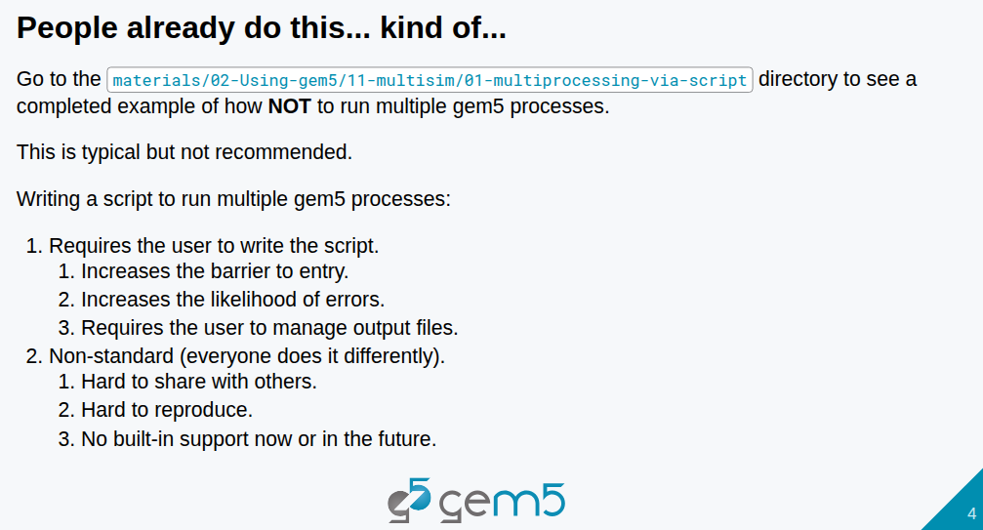
15.3 Multi-Processing by Script
https://www.youtube.com/watch?v=dJz8u70vyfM&list=PL_hVbFs_loVR_8ntTTmmG6YEq3Po_4snu&index=15
Multi-Processing by Script (2:06-2:07/16:59)
We use single script for Gem5 multi-processioning
Below example is to use script to run multiple runs of gem5 simulations. Those simulation are sequentially run.

Slide 11
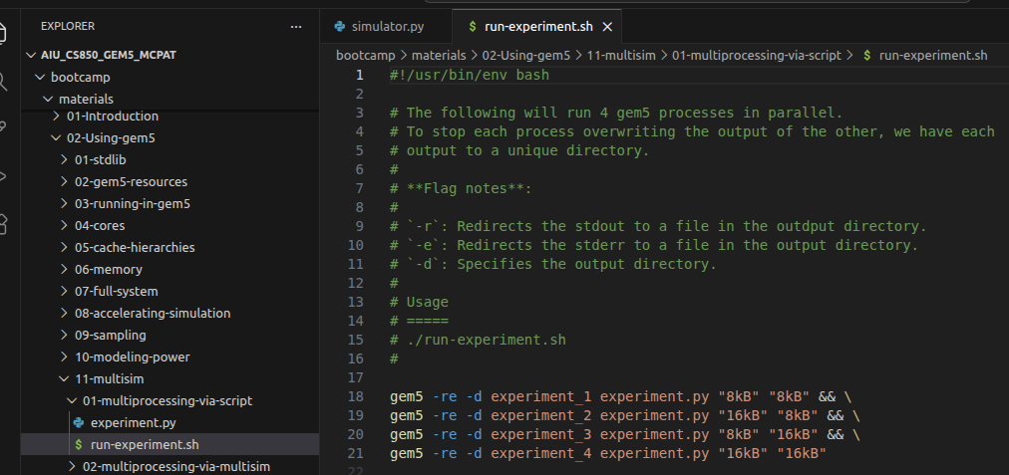
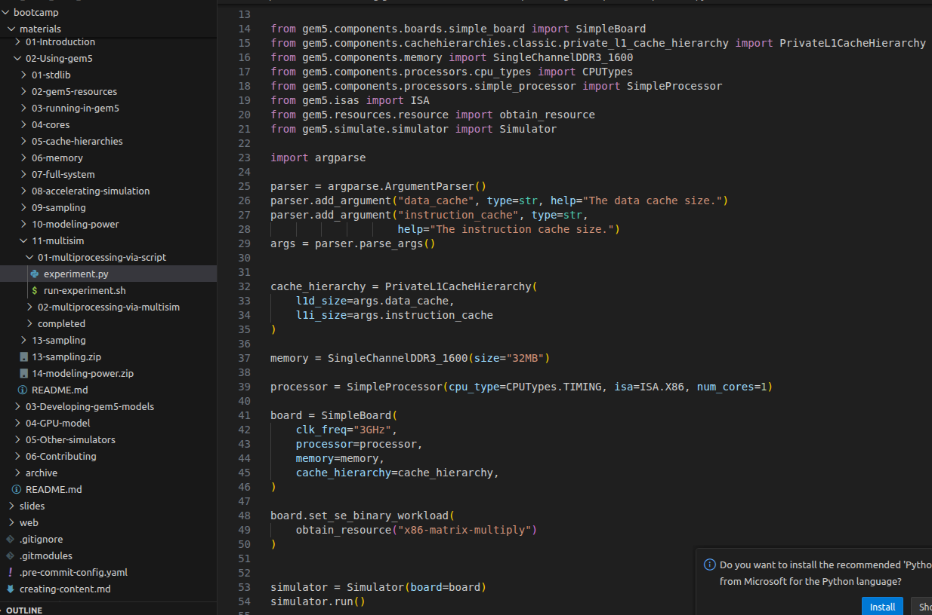
15.3 Multi-Processing by Script
https://www.youtube.com/watch?v=dJz8u70vyfM&list=PL_hVbFs_loVR_8ntTTmmG6YEq3Po_4snu&index=15
Multi-Processing by Script (2:08-3:20/16:59)
Below script, we run c-shell script to run Multi-Process with “&&” to put the batch process to the background run.
This script passed in different parameters to run experiment.py
In the experiment.py, we use Python argparse.ArgumentParser() to get different passing parameter.

Slide 12
15.3 Multi-Processing by Script
https://www.youtube.com/watch?v=dJz8u70vyfM&list=PL_hVbFs_loVR_8ntTTmmG6YEq3Po_4snu&index=15
Multi-Processing by Script (3:21-3:30/16:59)
Below, we
1. Put the process run in background by “&&”
2. Use ‘-d” and specify the experiment_1, experiment_2, experiment_3, etc to store different results.

Slide 13
15.3 Multi-Processing by Script
https://www.youtube.com/watch?v=dJz8u70vyfM&list=PL_hVbFs_loVR_8ntTTmmG6YEq3Po_4snu&index=15
Multi-Processing by Script (3:31-4:20/16:59)
We can see the complete example in directory:
> materials/02-Using-gem5/11-multisim/01-multiprocessing-via-script
There are some problems:
1. Users have to post process multiple outputs by themselves and
2. There is no standard and hard to share and support to others.

Slide 14
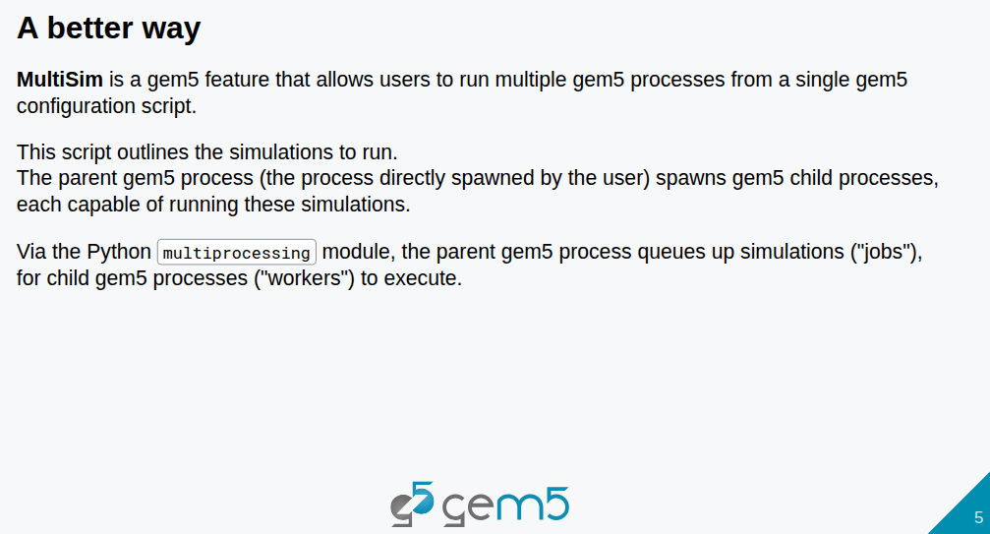
15.3 Multi-Processing by Script
https://www.youtube.com/watch?v=dJz8u70vyfM&list=PL_hVbFs_loVR_8ntTTmmG6YEq3Po_4snu&index=15
Multi-Processing by Script (4:21-5:30/16:59)
It is better to run multiple gem5 processes with configuration script.
1. The script outlines the simulation to run
2. The parent gem5 process spawns gem5 child processes. Each child process run the simulation.
3. Gem5 submit queue for simulation by Python multiprocessing. The child processes are the workers processor to run gem5 simulation.

Slide 15
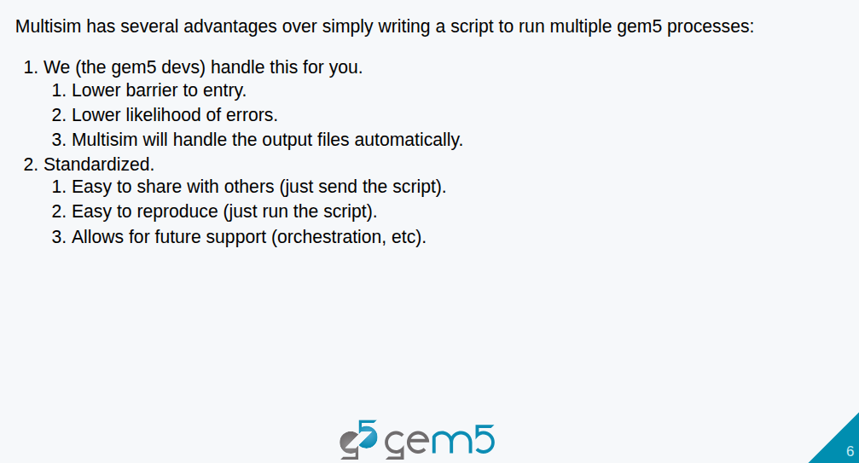
15.3 Multi-Processing by Script
https://www.youtube.com/watch?v=dJz8u70vyfM&list=PL_hVbFs_loVR_8ntTTmmG6YEq3Po_4snu&index=15
Multi-Processing by Script (5:31-6:40/16:59)
Gem5 Multisim provides:
1. Easier use, prevent mistakes, and output
2. Standard output format, reproduce result, future API support.

Slide 16
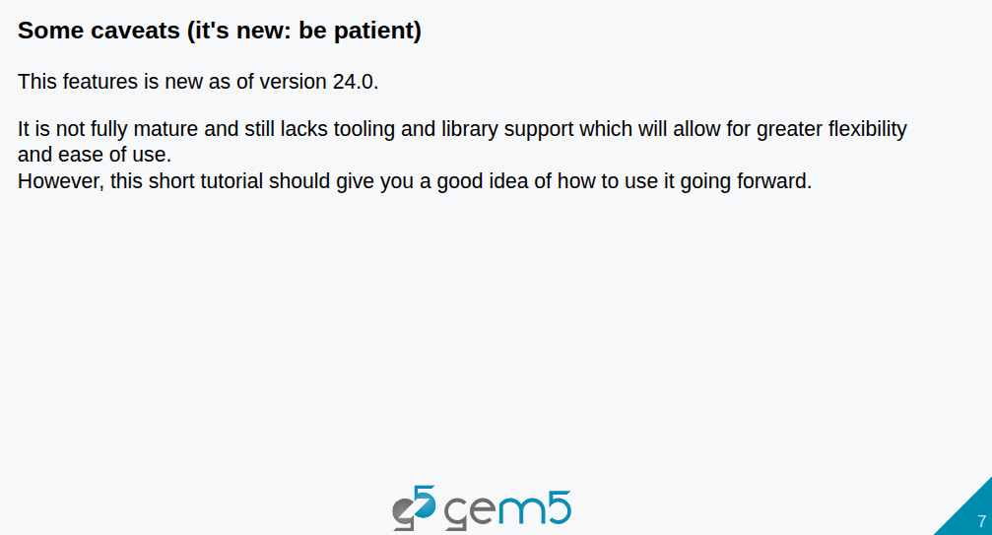
15.3 Multi-Processing by Script
https://www.youtube.com/watch?v=dJz8u70vyfM&list=PL_hVbFs_loVR_8ntTTmmG6YEq3Po_4snu&index=15
Multi-Processing by Script (6:41-7:10/16:59)
Multisim is new.

Slide 17
15.4 Multi-Processing by Script vs. Multisim

Slide 18
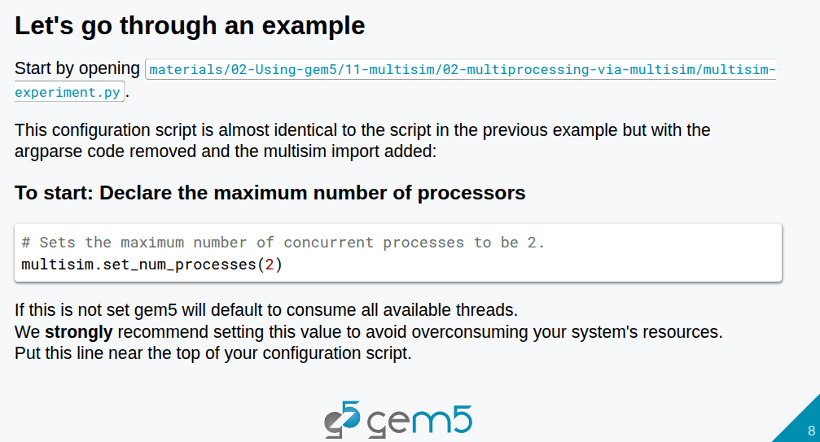
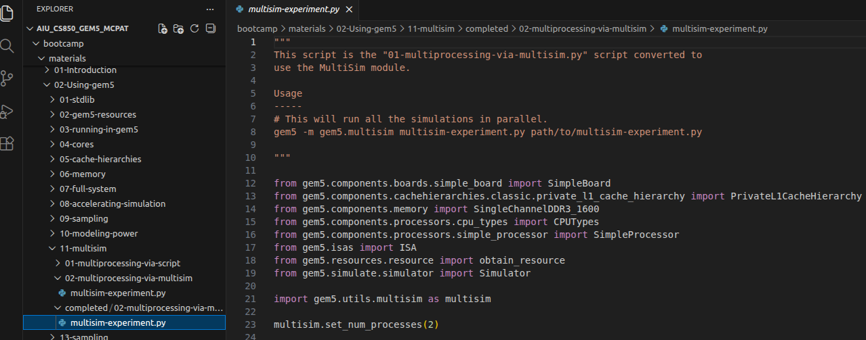
15.4 Multi-Processing by Script vs. Multisim
https://www.youtube.com/watch?v=dJz8u70vyfM&list=PL_hVbFs_loVR_8ntTTmmG6YEq3Po_4snu&index=15
Multi-Processing by Script vs. Multisim (7:11-7:20/16:59)
We compare the multi-processing by script and by multisim.
Let’s look at the multisim complete code first:
> code ./materials/02-Using-gem5/11-multisim/02-multiprocessing-via-multisim/multisim-experiemnt.py
Below code
> multisim.set_num_process(02)
We set the number of processor to 2. We DO NOT set the number of thread to 2.

Slide 19
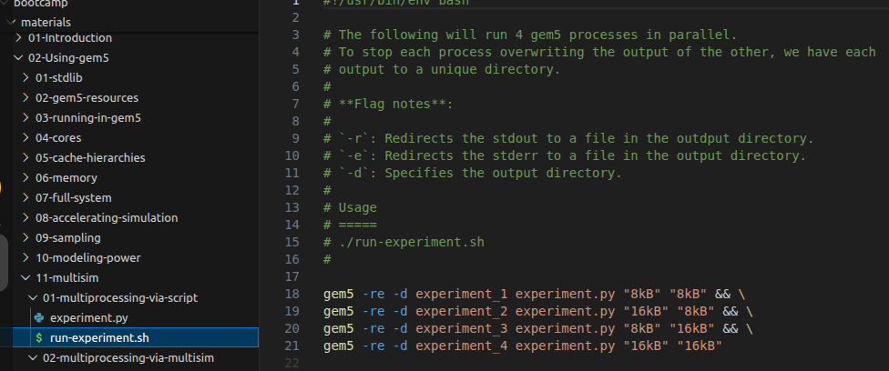
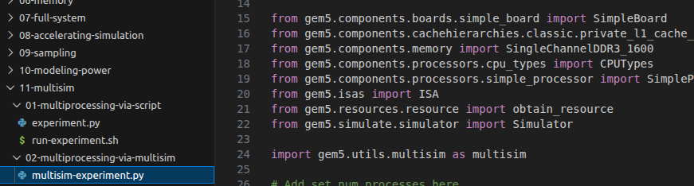
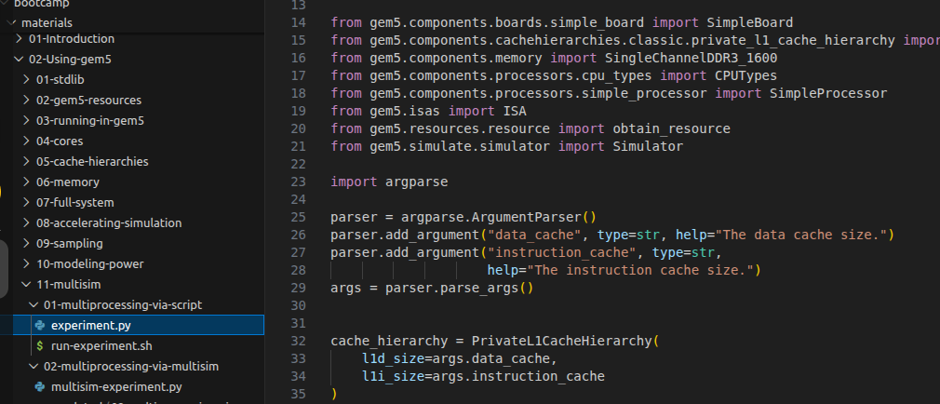
15.4 Multi-Processing by Script vs. Multisim
https://www.youtube.com/watch?v=dJz8u70vyfM&list=PL_hVbFs_loVR_8ntTTmmG6YEq3Po_4snu&index=15
Multi-Processing by Script vs. Multisim (7:21-8:50/16:59)
Now, we compare the difference between the multi-processing by script and by multisim utility.
1. multi-processing by Script:
> code ./materials/02-Using-gem5/11-multisim/02-multiprocessing-via-script/[run-experiemnt.sh, experiment.py]
2. multi-processing by multi-sim: We need to import gem5.utils.multisim and call multisim API.
> code ./materials/02-Using-gem5/11-multisim/02-multiprocessing-via-multisim/multisim-experiemnt.py
1
2

Slide 20
15.5 Implement Multi-Processing by Multisim

Slide 21
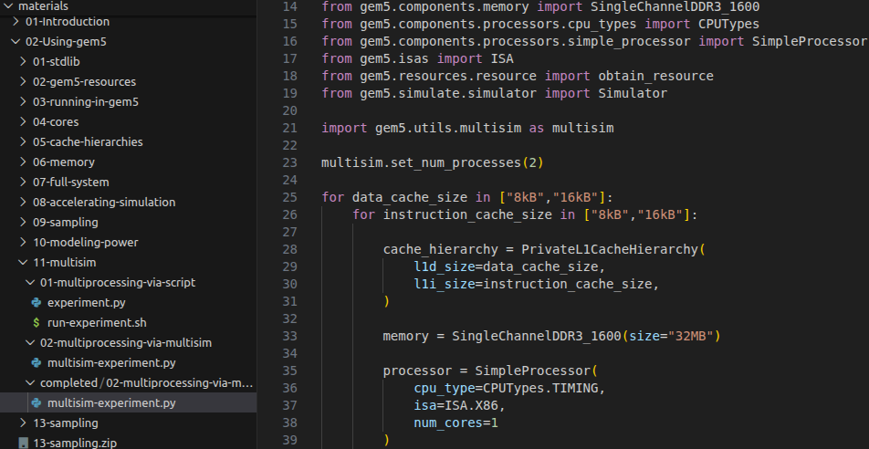
15.5 Implement Multi-Processing by Multisim
https://www.youtube.com/watch?v=dJz8u70vyfM&list=PL_hVbFs_loVR_8ntTTmmG6YEq3Po_4snu&index=15
Implement Multi-Processing by Multisim (8:51-9:30/16:59)
Now, we implement Multi-Processing by multisim.
> code ./materials/02-Using-gem5/11-multisim/02-multiprocessing-via-multisim/complete/multisim-experiemnt.py
First, we import and setup the number of processor.
1. import the multisim utility
2. Set up number of processors: multisim.set_num_processor(2).

Slide 22
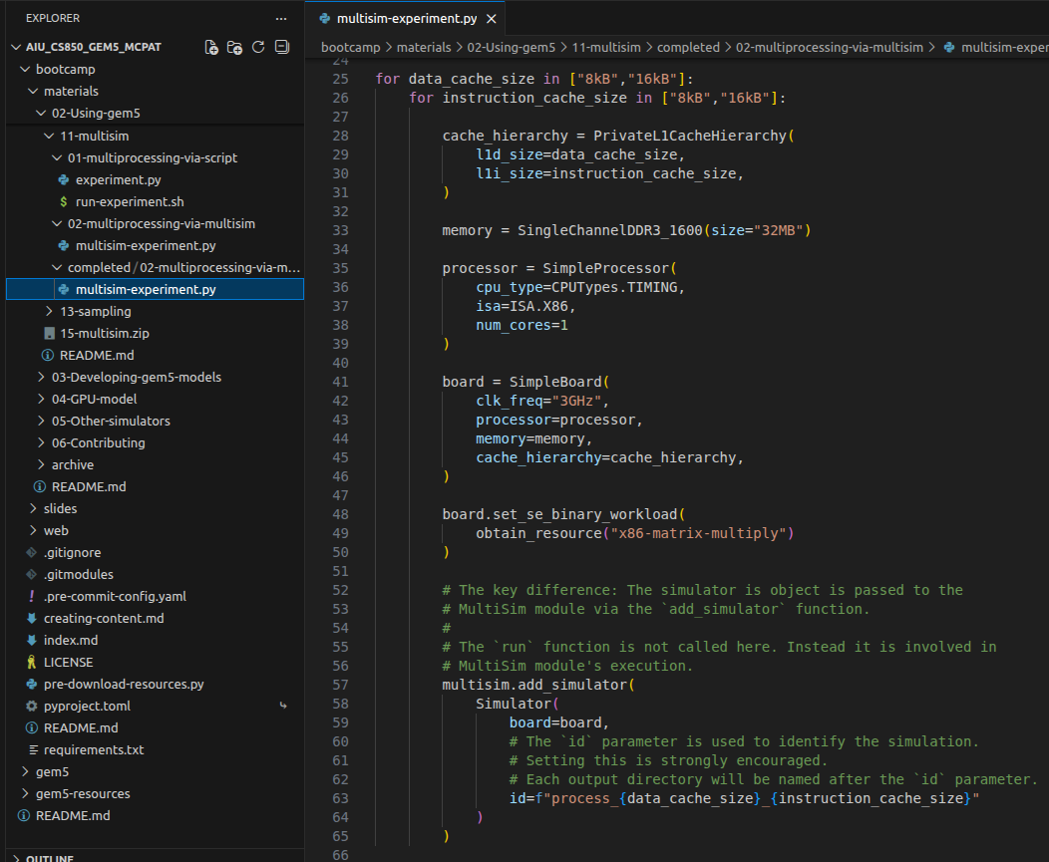
15.5 Implement Multi-Processing by Multisim
https://www.youtube.com/watch?v=dJz8u70vyfM&list=PL_hVbFs_loVR_8ntTTmmG6YEq3Po_4snu&index=15
Implement Multi-Processing by Multisim (9:31-10:40/16:59)
Now, we implement Multi-Processing by multisim.
> code ./materials/02-Using-gem5/11-multisim/02-multiprocessing-via-multisim/complete/multisim-experiemnt.py
Second, we setup the loop for data cache and instruction cache.
1. Setup data cache: for data_cache_size in [“8kB”, 16KB”]:
2. Setup Instruction cache size: for instruction_cache_size in [“8kB”, “16kB”]:

Slide 23
15.5 Implement Multi-Processing by Multisim
https://www.youtube.com/watch?v=dJz8u70vyfM&list=PL_hVbFs_loVR_8ntTTmmG6YEq3Po_4snu&index=15
Implement Multi-Processing by Multisim (10:41-11:00/16:59)
Now, we implement Multi-Processing by multisim.
> code ./materials/02-Using-gem5/11-multisim/02-multiprocessing-via-multisim/complete/multisim-experiemnt.py
Third, we setup the cache_hierarchy: L1D size and L1I size
cache_hierarchy = PrivateL1CacheHierarchy(
lid_size = data_cache_size,
l1i_size = instruction_cache_size,
)

Slide 24
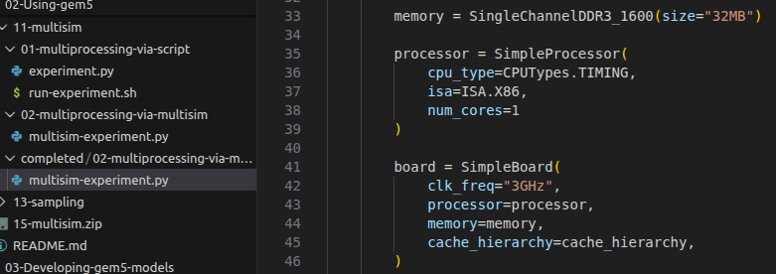
15.5 Implement Multi-Processing by Multisim
https://www.youtube.com/watch?v=dJz8u70vyfM&list=PL_hVbFs_loVR_8ntTTmmG6YEq3Po_4snu&index=15
Implement Multi-Processing by Multisim (11:01-11:50/16:59)
We need to add memory, processor, and board.
> code ./materials/02-Using-gem5/11-multisim/02-multiprocessing-via-multisim/complete/multisim-experiemnt.py
> 1. memory = SingleChannelDDR3_1600 (size = 32MB)
> 2. processor = SimpleProcessor (CPU type (TIMING), ISA type (X86), memory, cache hierarchy)

Slide 25
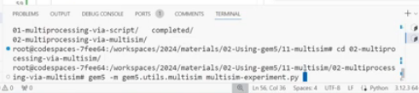

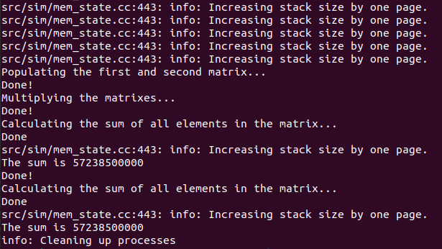
15.5 Implement Multi-Processing by Multisim
https://www.youtube.com/watch?v=dJz8u70vyfM&list=PL_hVbFs_loVR_8ntTTmmG6YEq3Po_4snu&index=15
Implement Multi-Processing by Multisim (11:51-13:20/16:59)
We need to add the simulator for board and for data cache and instruction cache..
> code ./materials/02-Using-gem5/11-multisim/02-multiprocessing-via-multisim/complete/multisim-experiemnt.py
> ./gem5.opt -m gem5.utilts.multisim multisim-experiment.py

Slide 26
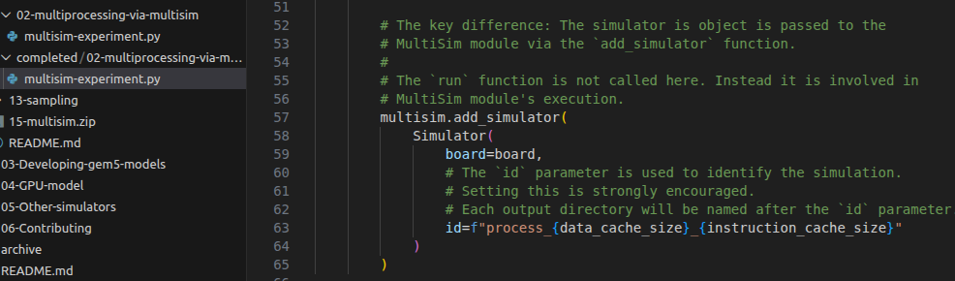
15.5 Implement Multi-Processing by Multisim
https://www.youtube.com/watch?v=dJz8u70vyfM&list=PL_hVbFs_loVR_8ntTTmmG6YEq3Po_4snu&index=15
Implement Multi-Processing by Multisim (11:51-13:20/16:59)
We need to add the simulator for board and for data cache and instruction cache..
> code ./materials/02-Using-gem5/11-multisim/02-multiprocessing-via-multisim/complete/multisim-experiemnt.py
> multisim.add_simulator (board, id)
Id is used to identify the process. What process is running. Process ID is ordered by 1, 2, 3, etc.

Slide 27
End

