Slide 1

9.1 Memory Model: Slides
Peter H. Chen

Slide 2
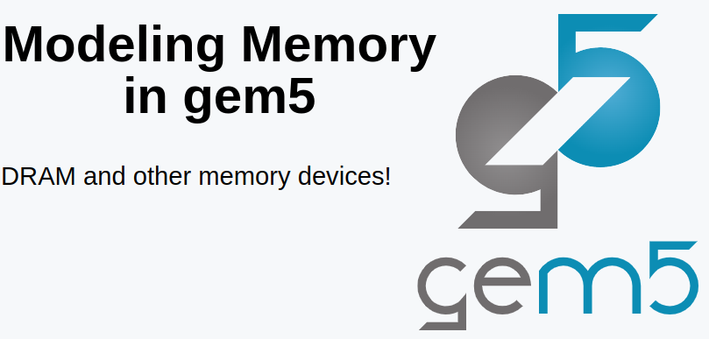
9.1 Memory Model: Slides
https://gem5bootcamp.github.io/2024/#02-Using-gem5/06-memory
Memory Model: Slides

Slide 3
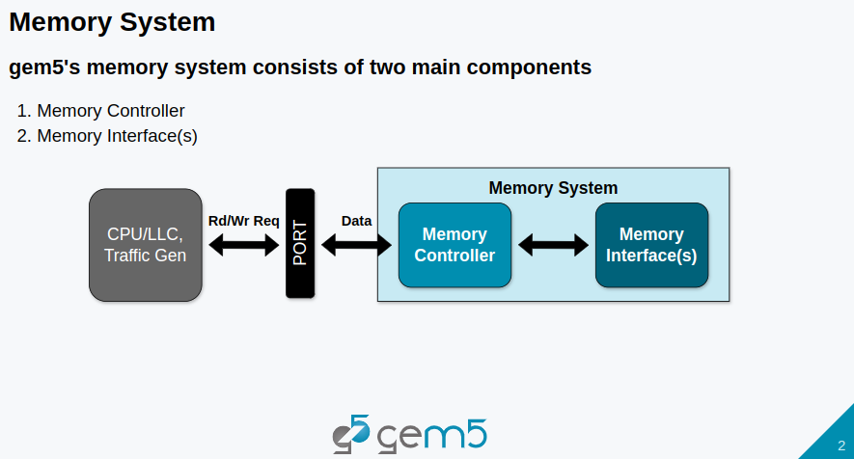
9.1 Memory Model: Slides
https://gem5bootcamp.github.io/2024/#02-Using-gem5/06-memory
Memory Model: Slides

Slide 4
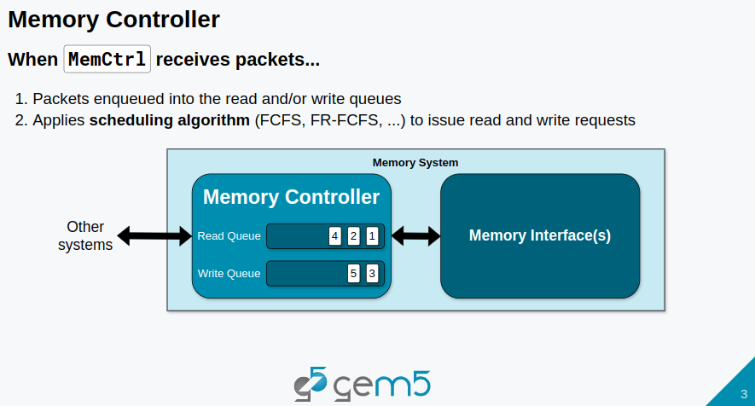
9.1 Memory Model: Slides
https://gem5bootcamp.github.io/2024/#02-Using-gem5/06-memory
Memory Model: Slides

Slide 5
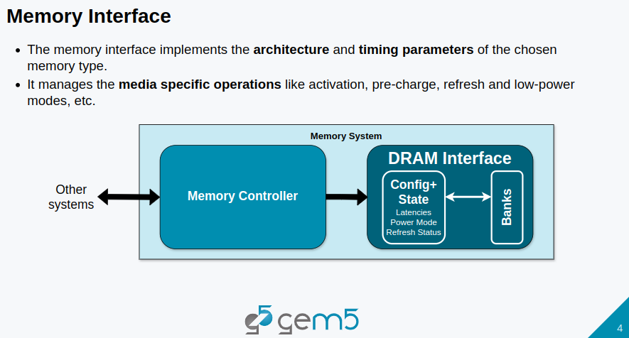
9.1 Memory Model: Slides
https://gem5bootcamp.github.io/2024/#02-Using-gem5/06-memory
Memory Model: Slides

Slide 6
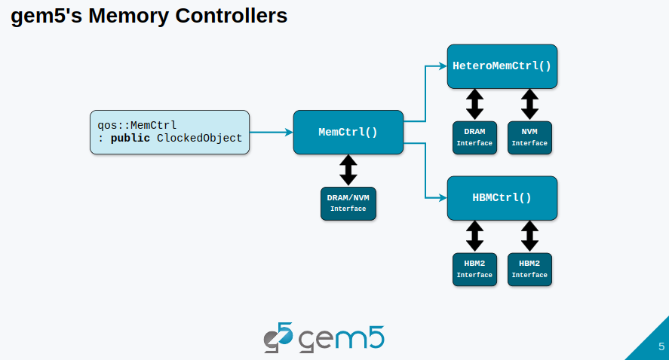
9.1 Memory Model: Slides
https://gem5bootcamp.github.io/2024/#02-Using-gem5/06-memory
Memory Model: Slides

Slide 7
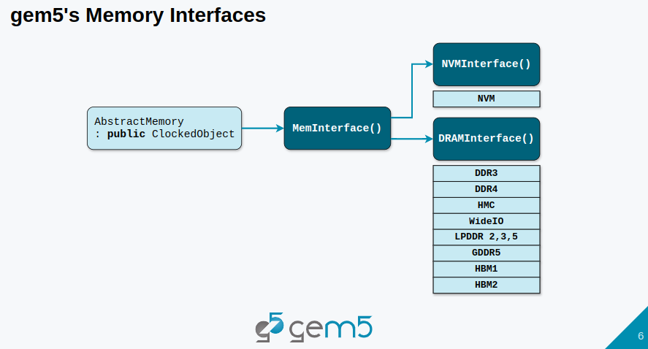
9.1 Memory Model: Slides
https://gem5bootcamp.github.io/2024/#02-Using-gem5/06-memory
Memory Model: Slides

Slide 8
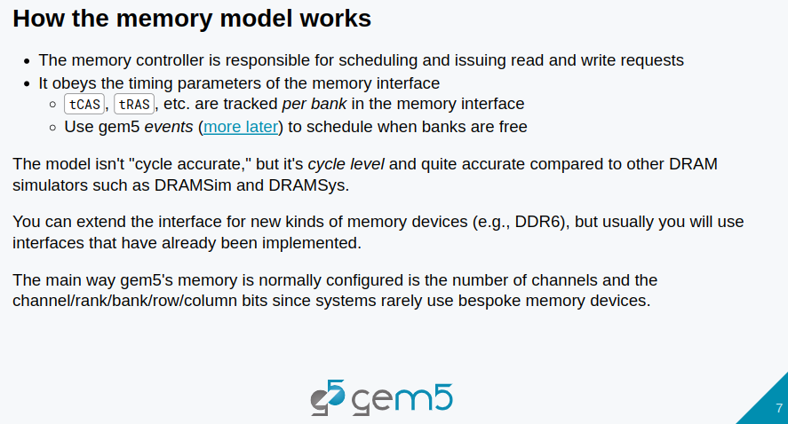
9.1 Memory Model: Slides
https://gem5bootcamp.github.io/2024/#02-Using-gem5/06-memory
Memory Model: Slides

Slide 9
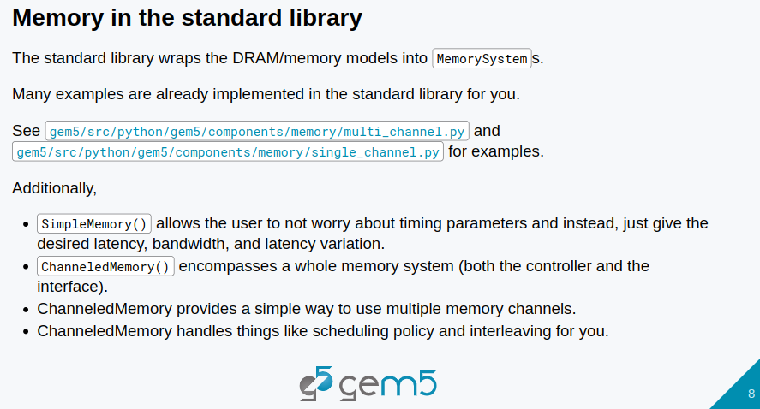
9.1 Memory Model: Slides
https://gem5bootcamp.github.io/2024/#02-Using-gem5/06-memory
Memory Model: Slides

Slide 10
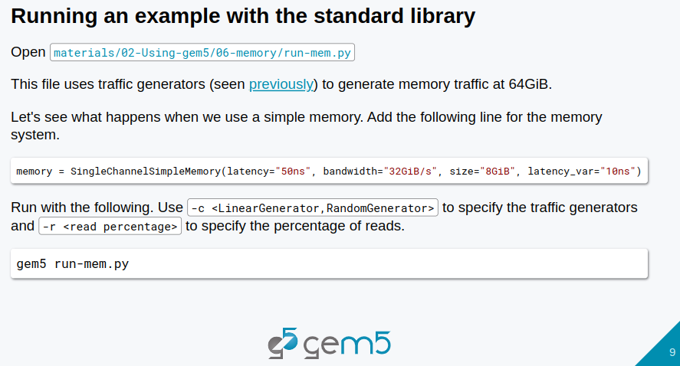
9.1 Memory Model: Slides
https://gem5bootcamp.github.io/2024/#02-Using-gem5/06-memory
Memory Model: Slides

Slide 11
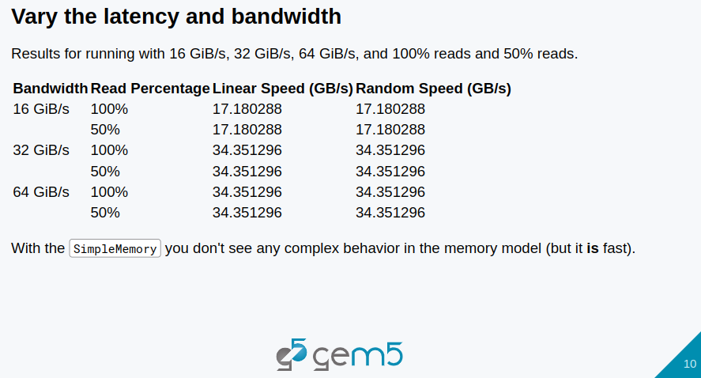
9.1 Memory Model: Slides
https://gem5bootcamp.github.io/2024/#02-Using-gem5/06-memory
Memory Model: Slides

Slide 12
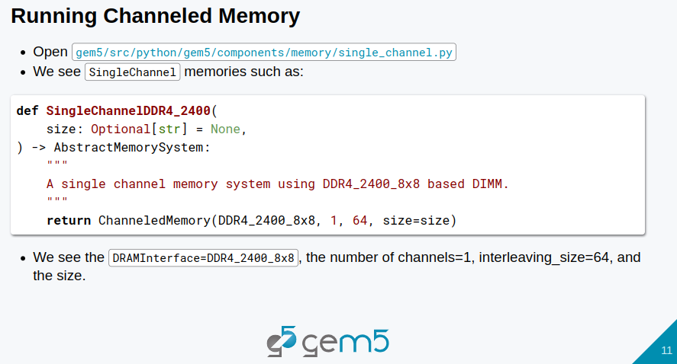
9.1 Memory Model: Slides
https://gem5bootcamp.github.io/2024/#02-Using-gem5/06-memory
Memory Model: Slides

Slide 13
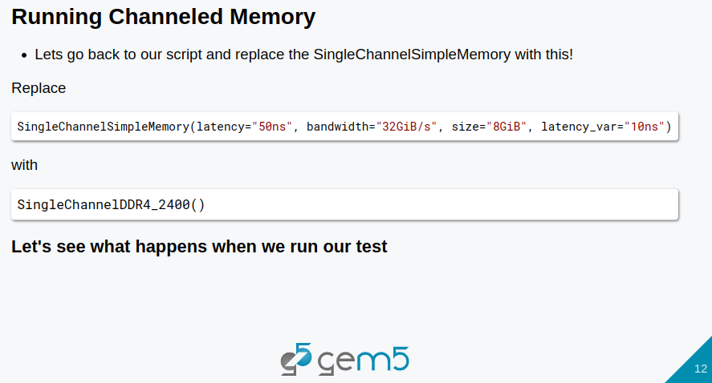
9.1 Memory Model: Slides
https://gem5bootcamp.github.io/2024/#02-Using-gem5/06-memory
Memory Model: Slides

Slide 14
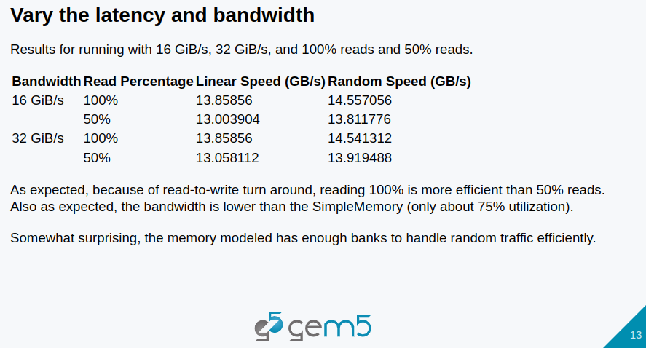
9.1 Memory Model: Slides
https://gem5bootcamp.github.io/2024/#02-Using-gem5/06-memory
Memory Model: Slides

Slide 15
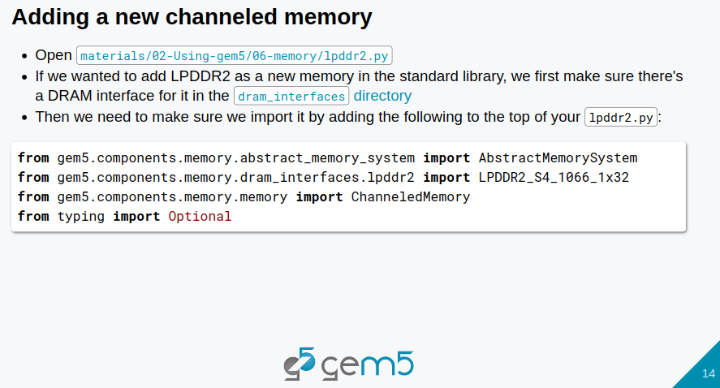
9.1 Memory Model: Slides
https://gem5bootcamp.github.io/2024/#02-Using-gem5/06-memory
Memory Model: Slides

Slide 16
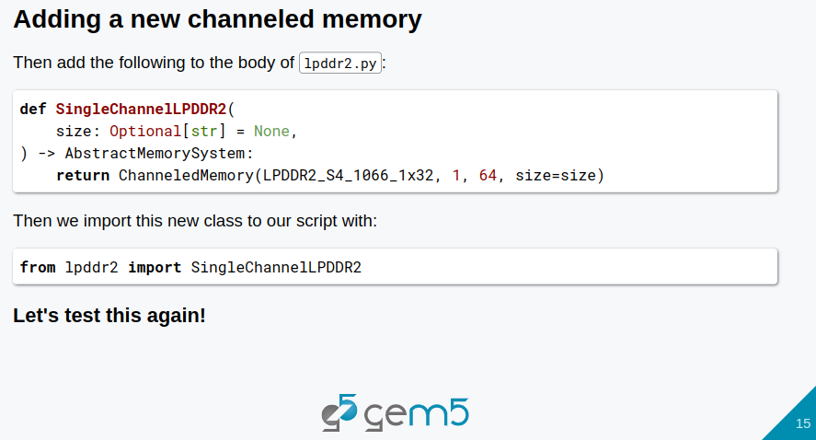
9.1 Memory Model: Slides
https://gem5bootcamp.github.io/2024/#02-Using-gem5/06-memory
Memory Model: Slides

Slide 17
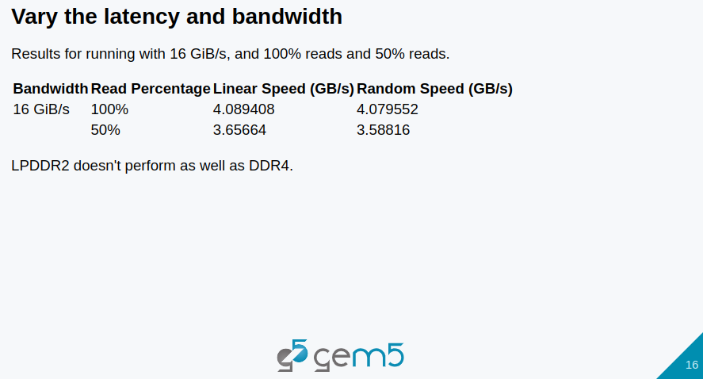
9.1 Memory Model: Slides
https://gem5bootcamp.github.io/2024/#02-Using-gem5/06-memory
Memory Model: Slides

Slide 18
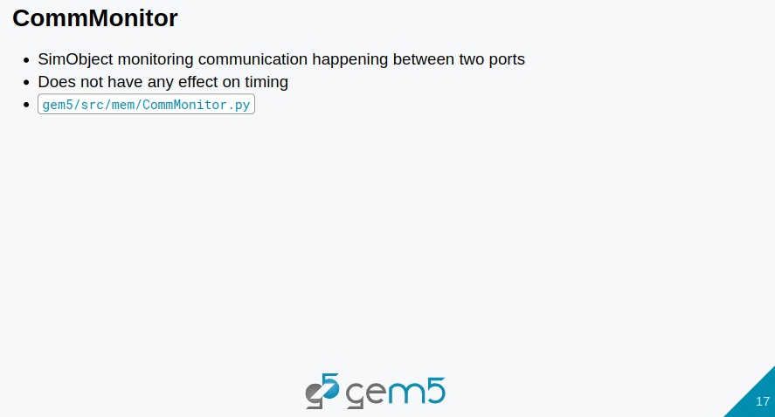
9.1 Memory Model: Slides
https://gem5bootcamp.github.io/2024/#02-Using-gem5/06-memory
Memory Model: Slides

Slide 19
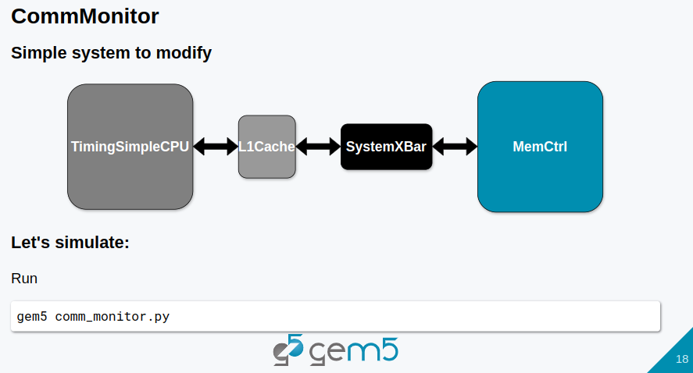
9.1 Memory Model: Slides
https://gem5bootcamp.github.io/2024/#02-Using-gem5/06-memory
Memory Model: Slides

Slide 20
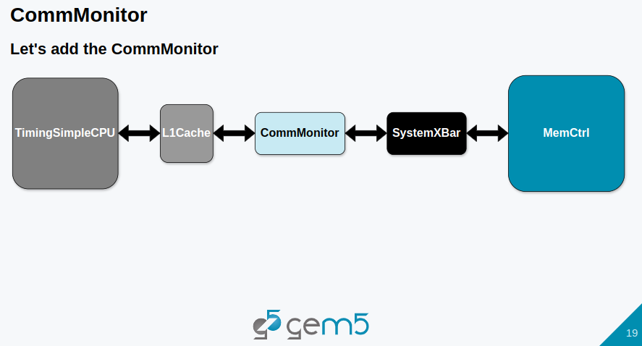
9.1 Memory Model: Slides
https://gem5bootcamp.github.io/2024/#02-Using-gem5/06-memory
Memory Model: Slides

Slide 21
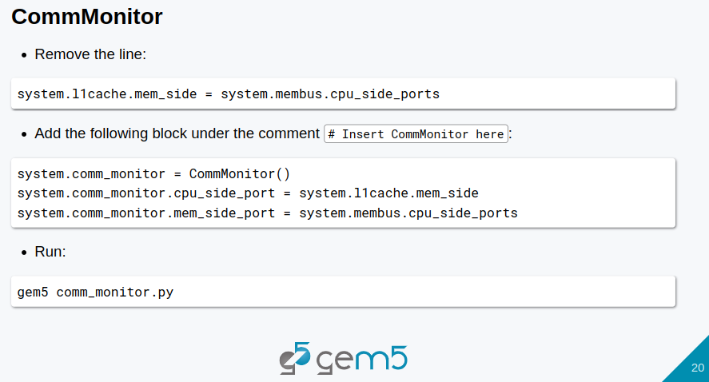
9.1 Memory Model: Slides
https://gem5bootcamp.github.io/2024/#02-Using-gem5/06-memory
Memory Model: Slides

Slide 22
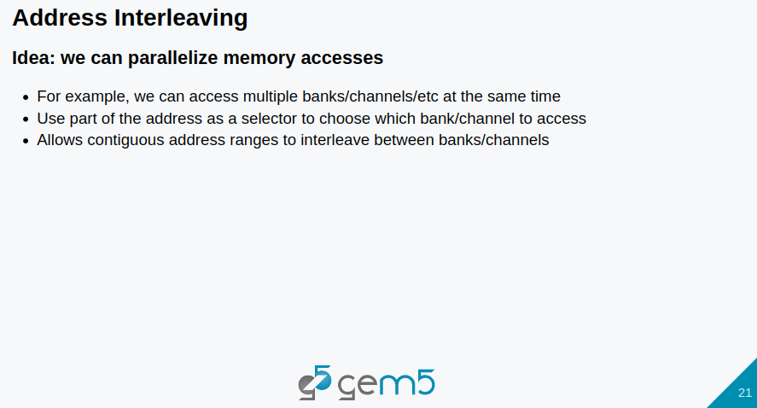
9.1 Memory Model: Slides
https://gem5bootcamp.github.io/2024/#02-Using-gem5/06-memory
Memory Model: Slides

Slide 23
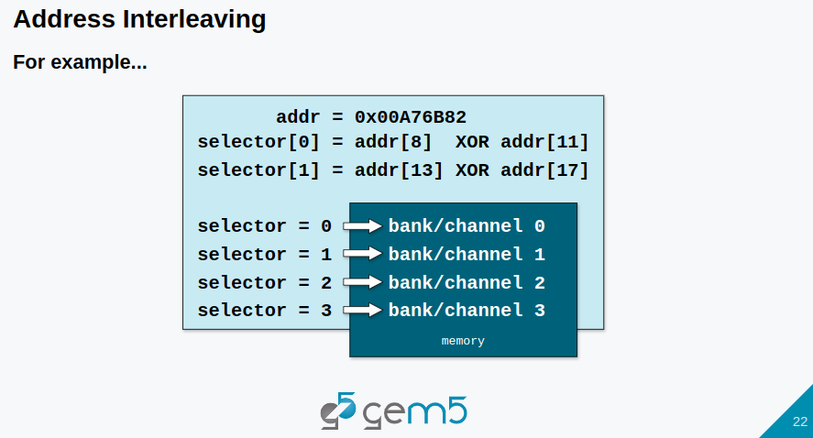
9.1 Memory Model: Slides
https://gem5bootcamp.github.io/2024/#02-Using-gem5/06-memory
Memory Model: Slides

Slide 24
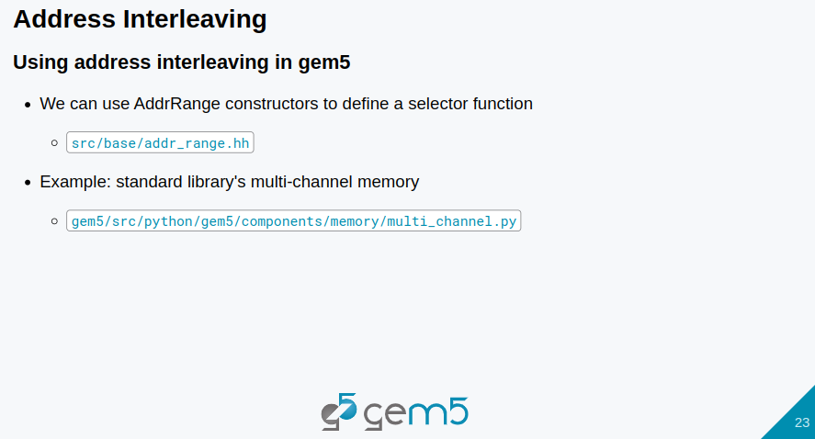
9.1 Memory Model: Slides
https://gem5bootcamp.github.io/2024/#02-Using-gem5/06-memory
Memory Model: Slides

Slide 25
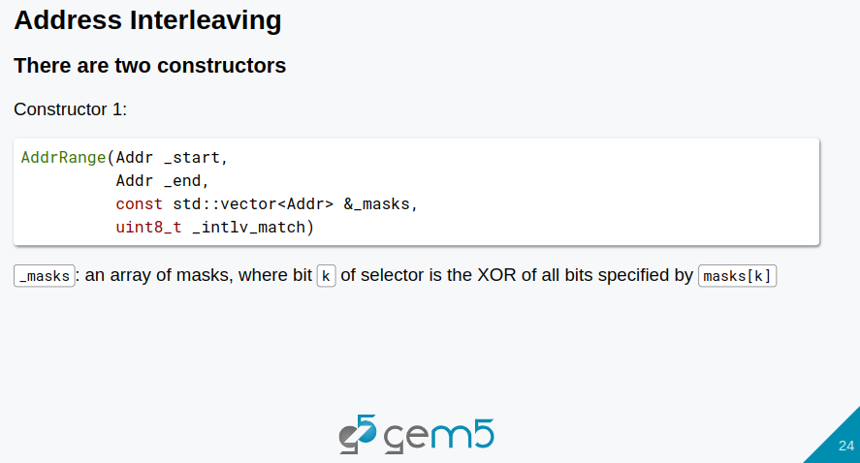
9.1 Memory Model: Slides
https://gem5bootcamp.github.io/2024/#02-Using-gem5/06-memory
Memory Model: Slides

Slide 26
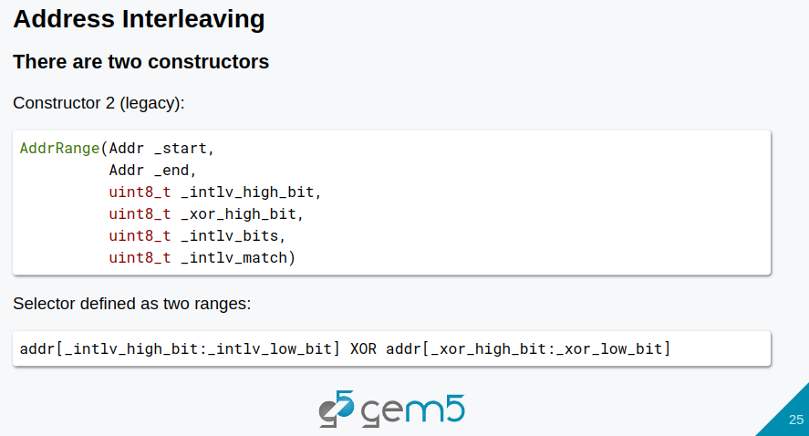
9.1 Memory Model: Slides
https://gem5bootcamp.github.io/2024/#02-Using-gem5/06-memory
Memory Model: Slides

Slide 27
End

