Slide 1

1 Aladdin Pre-RTL Simulator
Peter H. Chen

Slide 2
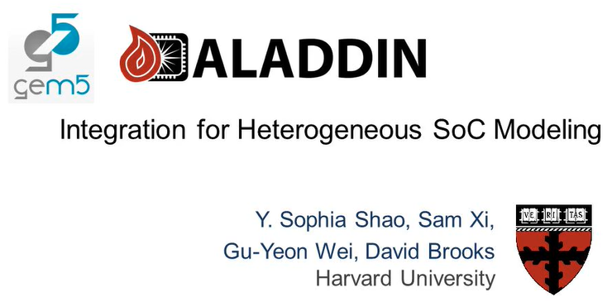
1 Aladdin Pre-RTL Simulator
https://slideplayer.com/slide/6343047/
Aladdin Pre-RTL Simulator

Slide 3
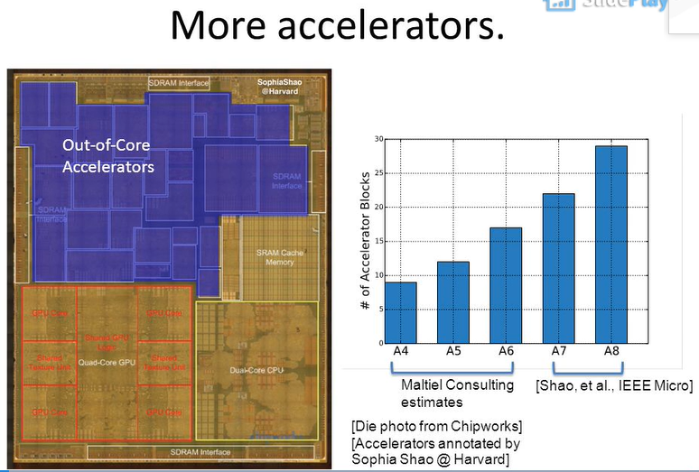
1 Aladdin Pre-RTL Simulator
https://slideplayer.com/slide/6343047/
Aladdin Pre-RTL Simulator

Slide 4
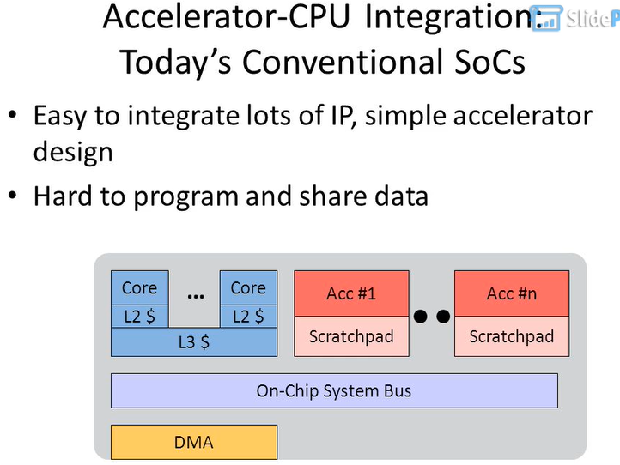
1 Aladdin Pre-RTL Simulator
https://slideplayer.com/slide/6343047/
Aladdin Pre-RTL Simulator

Slide 5
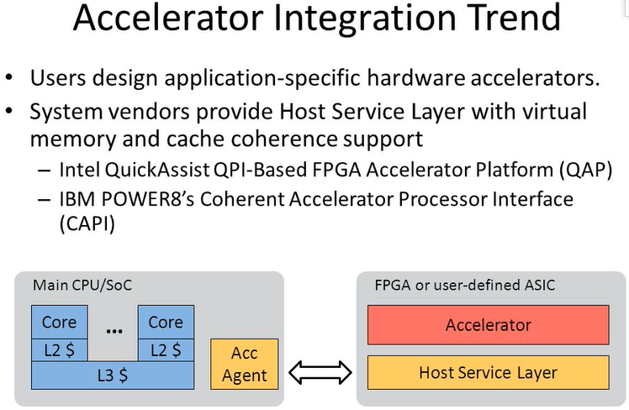
1 Aladdin Pre-RTL Simulator
https://slideplayer.com/slide/6343047/
Aladdin Pre-RTL Simulator

Slide 6
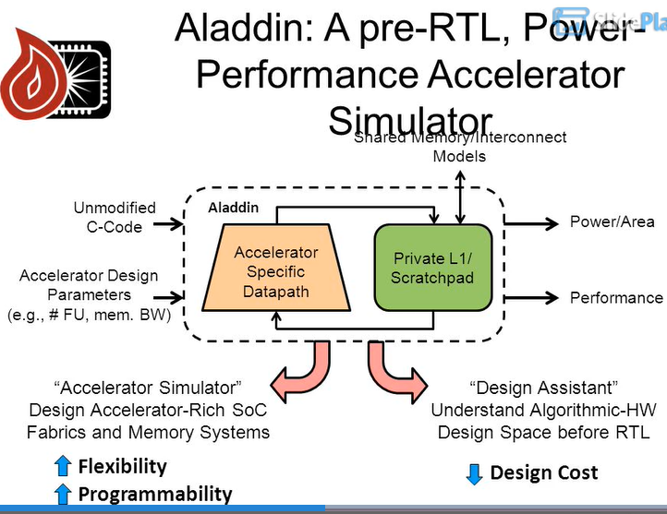
1 Aladdin Pre-RTL Simulator
https://slideplayer.com/slide/6343047/
Aladdin Pre-RTL Simulator

Slide 7
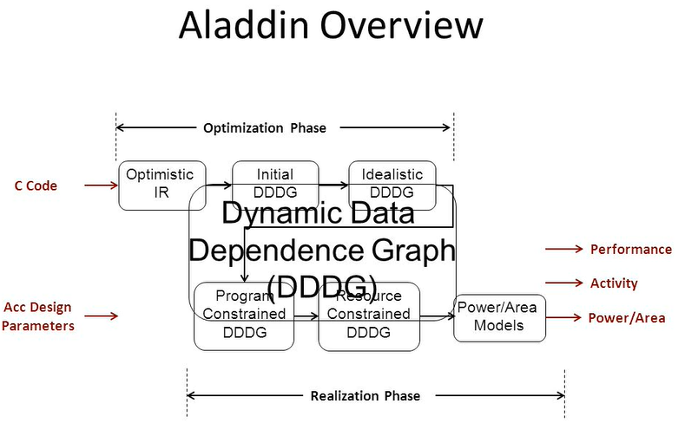
1 Aladdin Pre-RTL Simulator
https://slideplayer.com/slide/6343047/
Aladdin Pre-RTL Simulator

Slide 8
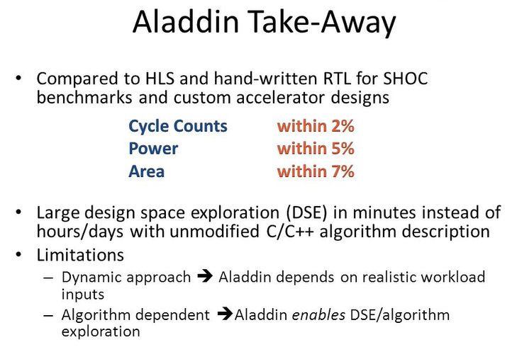
1 Aladdin Pre-RTL Simulator
https://slideplayer.com/slide/6343047/
Aladdin Pre-RTL Simulator

Slide 9
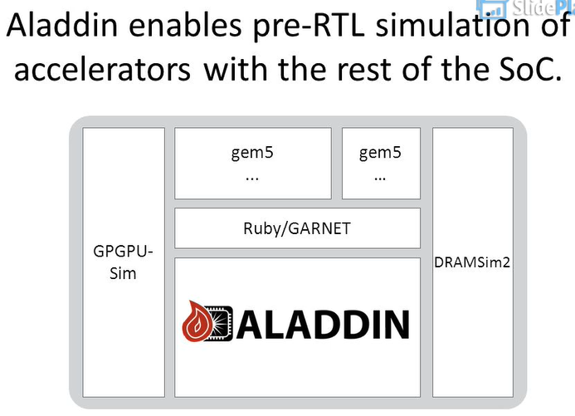
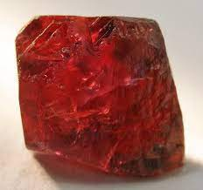

1 Aladdin Pre-RTL Simulator
https://slideplayer.com/slide/6343047/
Aladdin Pre-RTL Simulator
GPGPU (General Purpose Graphical Processing Unit): NVIDIA GeForce 8 Series (with CUDA, SDK, API) for parallel programming.
Ruby: Distinct red color
Garnet

Slide 10
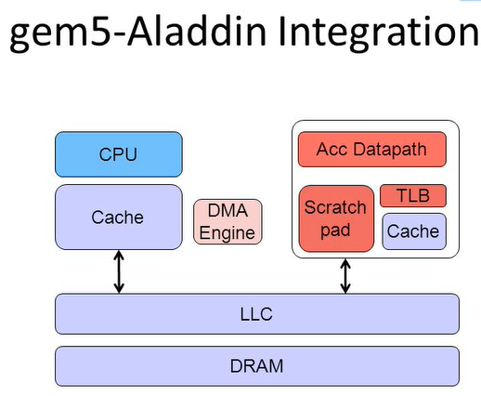
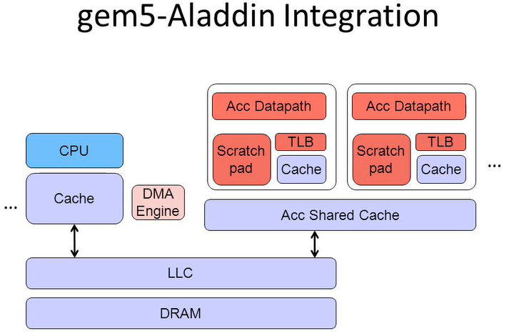
1 Aladdin Pre-RTL Simulator
https://slideplayer.com/slide/6343047/
Aladdin Pre-RTL Simulator
LLC (Load-Line Calibration)
TLB (Translation Lookaside Buffer): Memory Cache to access user memory. It is a part of MMU (Memory Management Unit).

Slide 11
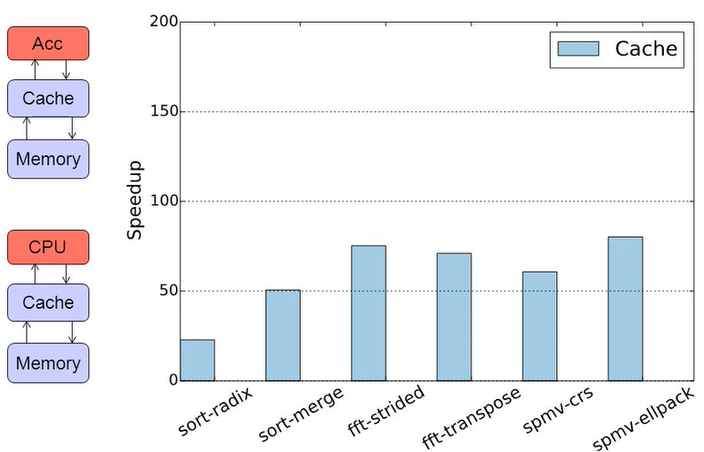
1 Aladdin Pre-RTL Simulator
https://slideplayer.com/slide/6343047/
Aladdin Pre-RTL Simulator

Slide 12
End of Chapter

