Slide 1

3 Eclipse Installation
Peter H. Chen

Slide 2
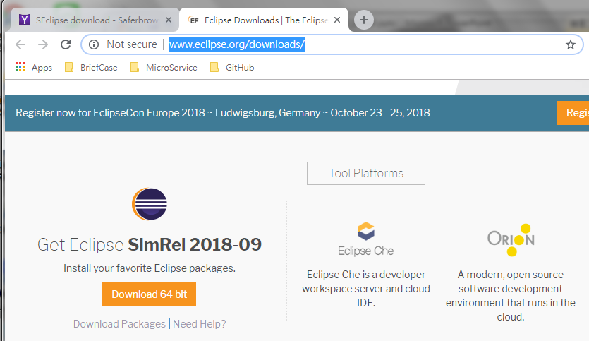
3 Eclipse Installation
https://www.tutorialspoint.com/eclipse/eclipse_installation.htm
Download Eclipse: http://www.eclipse.org/downloads/

Slide 3
End of Chapter

