Slide 1

5 Explore Menu
Peter H. Chen

Slide 2
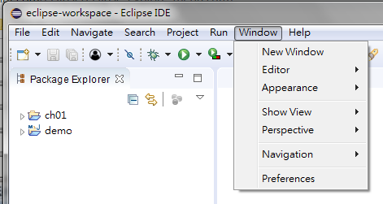
5 Explore Menu
https://www.tutorialspoint.com/eclipse/eclipse_explore_menus.htm
Typical Eclipse Menus
The typical menus available on the menu bar of an Eclipse window are −
File menu
Edit menu
Navigate menu
Search menu
Project menu
Run menu
Window menu
Help menu

Slide 3
5 Explore Menu
https://www.tutorialspoint.com/eclipse/eclipse_explore_menus.htm
Plug-ins can add new menus and menu items.
For example when the java editor is open you will see the Source menu and when the XML editor is open, you will see the Design menu.

Slide 4
5.1 Menu Description

Slide 5
5.1 Menu Description
https://www.tutorialspoint.com/eclipse/eclipse_explore_menus.htm
Menu Description
No | Menu Name & Description
1 | File The File menu allows you to open files for editing, close editors, save editor content and rename files. Among the other things, it also allows you to import and export workspace content and shutdown Eclipse.
2 | Edit The Edit menu presents items like copy & paste.
3 | Source The Source menu is visible only when a java editor is open. It presents a number of useful menu items related to editing java source code.
4 | Navigate The Navigate menu allows you to quickly locate resources and navigate to them.

Slide 6
5.1 Menu Description
https://www.tutorialspoint.com/eclipse/eclipse_explore_menus.htm
Menu Description
No | Menu Name & Description
5 | Search The Search menu presents items that allow you to search the workspace for files that contain specific data.
6 | Project The menu items related to building a project can be found on the Project menu.
7 | Run The menu items on the Run menu allow you to start a program in the run mode or debug mode. It also presents menu items that allow you to debug the code.
8 | Window The Window menu allows you to open and close views and perspectives. It also allows you to bring up the Preferences dialog.

Slide 7
5.1 Menu Description
https://www.tutorialspoint.com/eclipse/eclipse_explore_menus.htm
Menu Description
No | Menu Name & Description
9 | Help The Help menu can be used to bring up the Help window, Eclipse Marketplace view or Install new plug-ins. The about Eclipse menu item gives you version information.
Customizing Menus
The visible menu items on a menu depend on the installed plug-ins and customization done using the Customize Perspective dialog box.

Slide 8
End of Chapter

