Slide 1

6 Explore View
Peter H. Chen

Slide 2
6 Explore View
https://www.tutorialspoint.com/eclipse/eclipse_explore_views.htm
About Views
Eclipse views allow users to see a graphical representation of project metadata.
For example the project navigator view presents a graphical representation of the folders and files associated with a project and properties view presents a graphical representation of an element selected in another view or editor.
An eclipse perspective can show any number of views and editors.
All editor instances appear in a single editor area, whereas views are placed inside view folders.
A workbench window can display any number of view folders.
Each view folder can display one or more views.

Slide 3
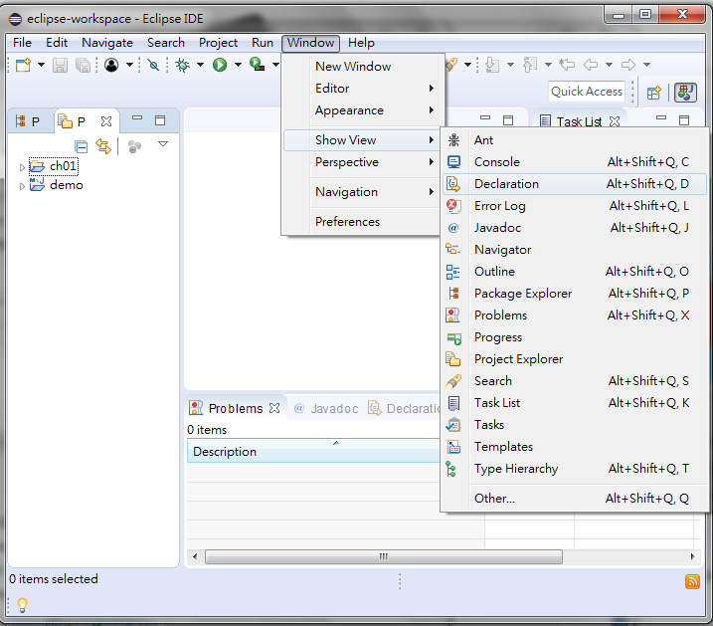
6 Explore View
https://www.tutorialspoint.com/eclipse/eclipse_explore_views.htm
To open a view, click on the Window menu and select the Show View menu item.

Slide 4
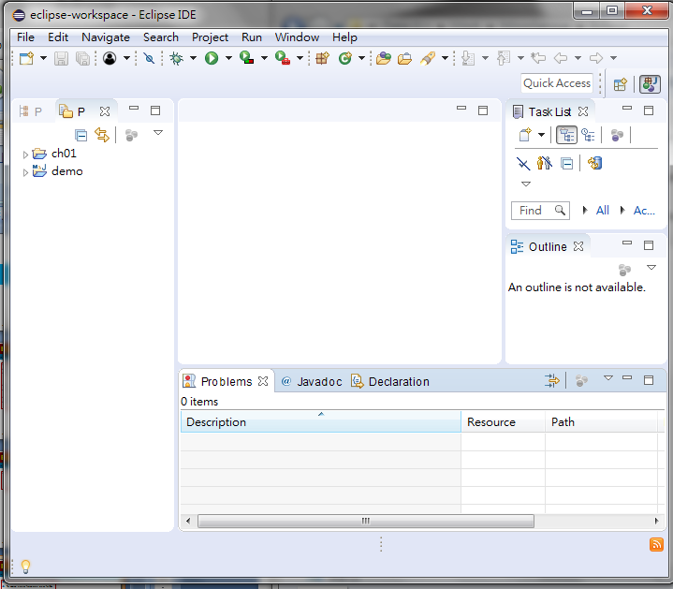
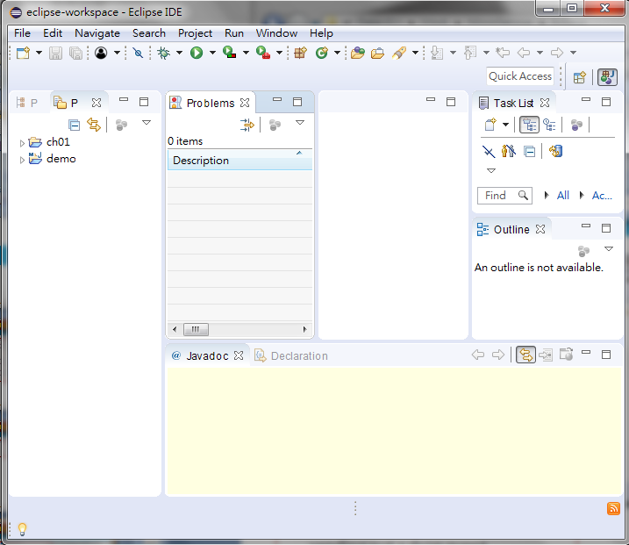
6 Explore View
https://www.tutorialspoint.com/eclipse/eclipse_explore_views.htm
Moving Views
To move a view from one view folder to another, just click on the view title and drag to the title bar area of another view folder.
Drag Problem view from one folder to other view folder

Slide 5
End of Chapter

