Slide 1

7 Prospective
Peter H. Chen

Slide 2
7 Prospective
https://www.tutorialspoint.com/eclipse/eclipse_perspectives.htm
What is a Perspective?
An eclipse perspective is the name given to an initial collection and arrangement of views and an editor area.
The default perspective is called java. An eclipse window can have multiple perspectives open in it but only one perspective is active at any point of time.
A user can switch between open perspectives or open a new perspective.
The active perspective controls what appears in some menus and tool bars.

Slide 3
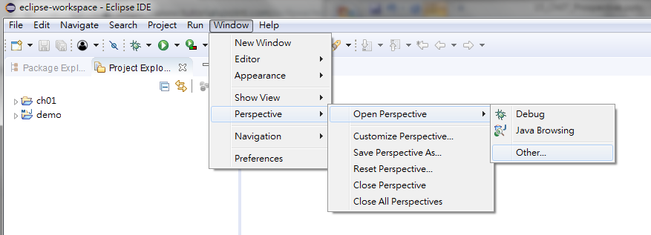
7 Prospective
https://www.tutorialspoint.com/eclipse/eclipse_perspectives.htm
Opening a Perspective
To open a new perspective, click on the Windows > Perspective > Open Perspective > Other …

Slide 4
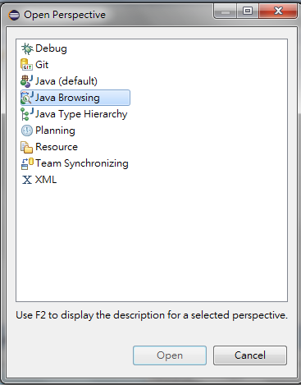
7 Prospective
https://www.tutorialspoint.com/eclipse/eclipse_perspectives.htm
Opening a Perspective
To open a new perspective, click on the Windows > Perspective > Open Perspective > Other …

Slide 5
End of Chapter

