Slide 1

3 Spring Boot REST
Peter H. Chen

Slide 2
3 Spring Boot REST
https://github.com/PacktPublishing/Hands-On-Full-Stack-Development-with-Spring-Boot-2.0-and-React
RESTful services are applications communicate over the internet using HTTP protocol.
There are many types of Web Service architectures, the main idea across all designs are the same.
Create RESTful Web Service
Use controller class
Use Spring Data REST to create RESTful web service
Implement CRUD functionality

Slide 3
3 Spring Boot REST
https://github.com/PacktPublishing/Hands-On-Full-Stack-Development-with-Spring-Boot-2.0-and-React
Uniform Interface:
Resource Identification: URI
Resource Manipulation: Server response formats are JSON and XML.
Self Descriptive Message: Message with enough information
HATEOAS (Hypermedia And The Engine of Application Site): Response contains links to other area of service.

Slide 4
3 Spring Boot REST
https://github.com/PacktPublishing/Hands-On-Full-Stack-Development-with-Spring-Boot-2.0-and-React
REST (Representational State Transfer) is an architectural style of creating web services.
REST is not a standard, but it defines 6-constraints by Roy Fielding.
Stateless
Client Server
Cacheable: Client site can use cache to improve performance.
Uniform Interface: Same requests for different browser and mobile.
Layered system architecture
Optional: Code on Demand.

Slide 5
3.1 Create RESTful Service
Peter H. Chen

Slide 6
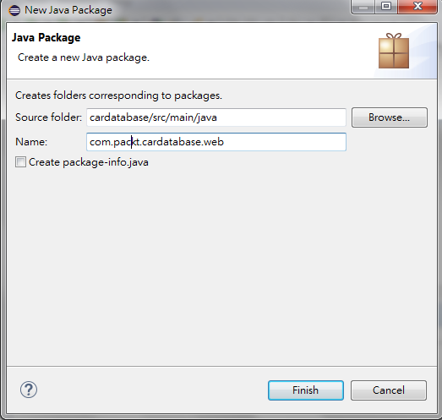
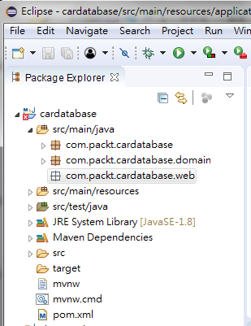
3.1 Create RESTful Service
https://github.com/PacktPublishing/Hands-On-Full-Stack-Development-with-Spring-Boot-2.0-and-React
Create REST Package:
New > Package
Source Folder: cardatabase/src/main/java
Name: com.packt.cardatabase.web

Slide 7
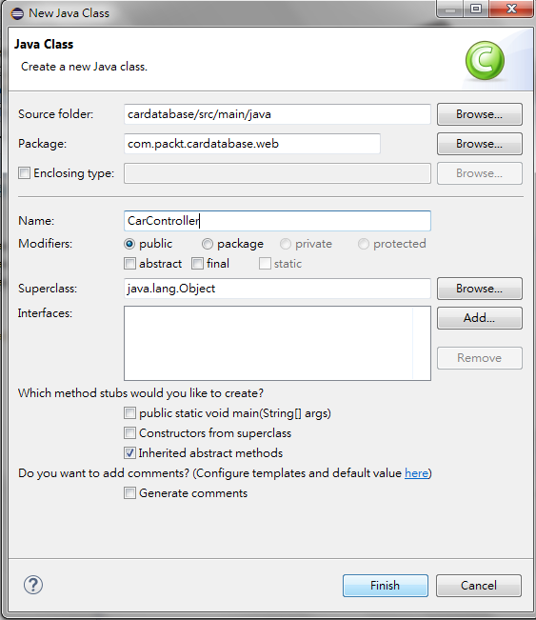
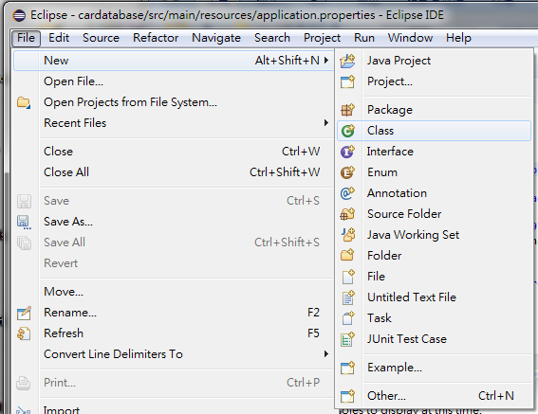
3.1 Create RESTful Service
https://github.com/PacktPublishing/Hands-On-Full-Stack-Development-with-Spring-Boot-2.0-and-React
Create class CarController:
Click/Active com.packt.cardatabase.web
New > Class
enter “CarController”

Slide 8
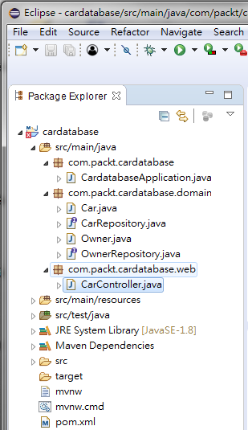
3.1 Create RESTful Service
https://github.com/PacktPublishing/Hands-On-Full-Stack-Development-with-Spring-Boot-2.0-and-React
Project Structure should be as follow:

Slide 9
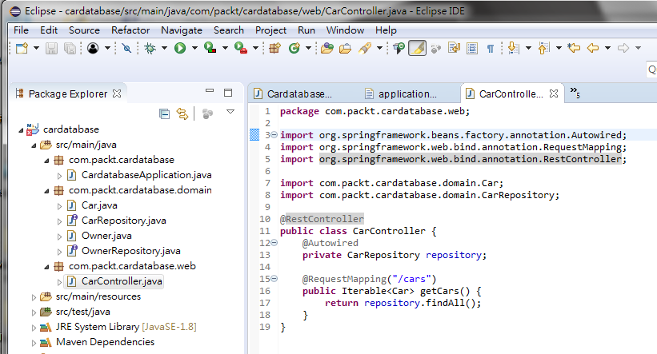
3.1 Create RESTful Service
https://github.com/PacktPublishing/Hands-On-Full-Stack-Development-with-Spring-Boot-2.0-and-React
CarController.java:

Slide 10
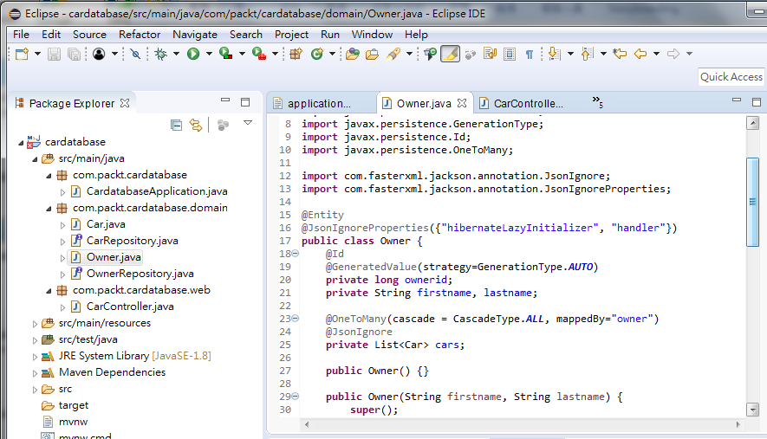
3.1 Create RESTful Service
https://github.com/PacktPublishing/Hands-On-Full-Stack-Development-with-Spring-Boot-2.0-and-React
Owner.java:

Slide 11
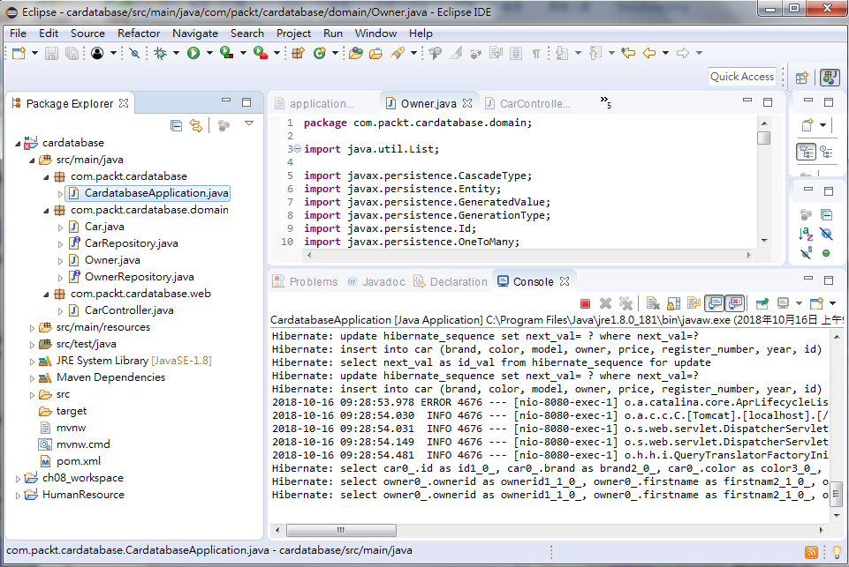
3.1 Create RESTful Service
https://github.com/PacktPublishing/Hands-On-Full-Stack-Development-with-Spring-Boot-2.0-and-React
Run As > Java Application

Slide 12
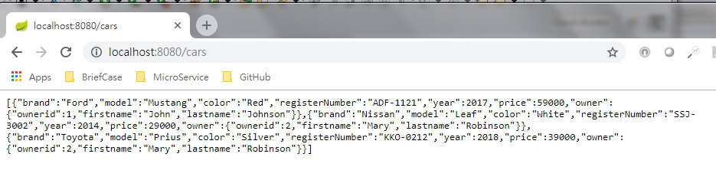
3.1 Create RESTful Service
https://github.com/PacktPublishing/Hands-On-Full-Stack-Development-with-Spring-Boot-2.0-and-React
Open Chrome.
Enter “localhost:8080/cars”
The JSON format are return.

Slide 13
3.2 Spring pom.xml
Peter H. Chen

Slide 14
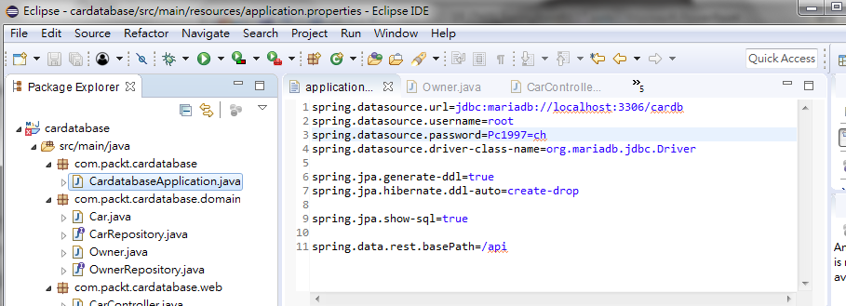
3.2 Spring pom.xml
https://github.com/PacktPublishing/Hands-On-Full-Stack-Development-with-Spring-Boot-2.0-and-React
In application.properties, you can define “api” and route “localhost:8080/cars” to “localhost:8080/api/cars”

Slide 15
End of Chapter

