Slide 1

1 Setup
Peter H. Chen

Slide 2
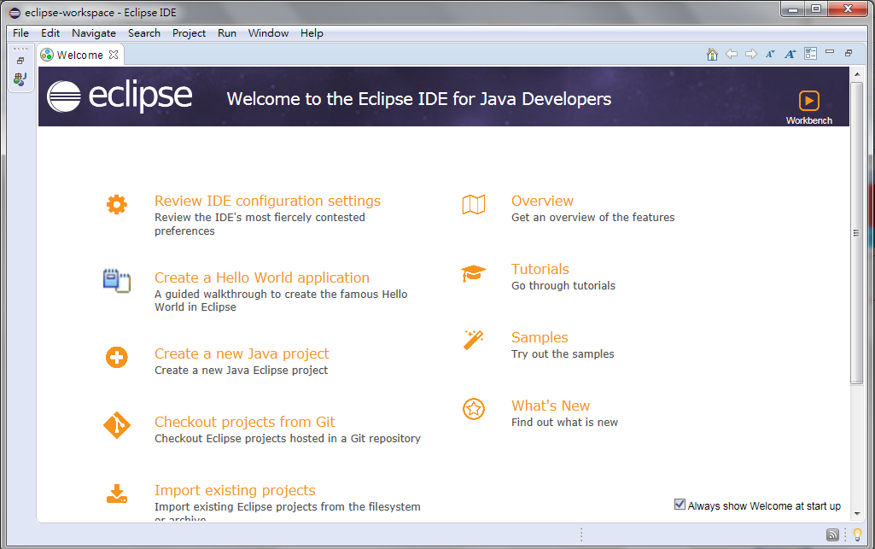
1 Setup
https://github.com/PacktPublishing/Hands-On-Full-Stack-Development-with-Spring-Boot-2.0-and-React
Download and Install Eclipse IDE
Start Eclipse IDE
Create a new Java Project

Slide 3
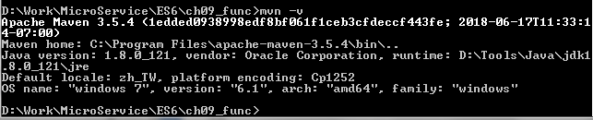
1 Setup
https://github.com/PacktPublishing/Hands-On-Full-Stack-Development-with-Spring-Boot-2.0-and-React
Check the maven
C:\> mvn –v
Note:
mvn.cmd is Windows version of mvn.
mvn.cmd is under C:\Program Files\apache=mvn-3.5.4\bin
%M2_HOME% = “C:\Program Files\apache=mvn-3.5.4\bin”
%PATH% = %M2_HOME%; …

Slide 4
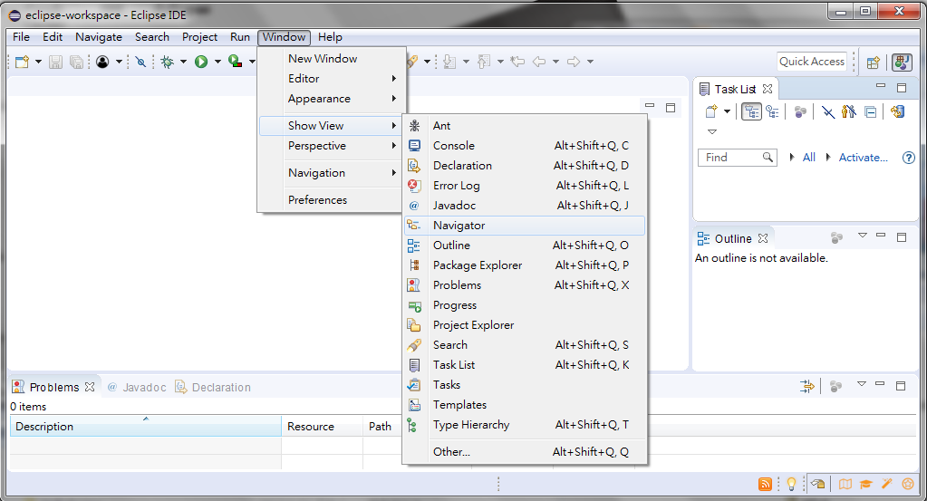
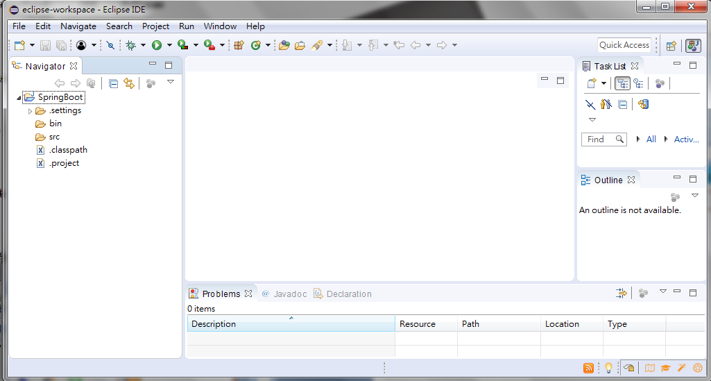
1 Setup
https://github.com/PacktPublishing/Hands-On-Full-Stack-Development-with-Spring-Boot-2.0-and-React
Window > Show View > Navigator to display the Project Explorer

Slide 5
1.1 Spring Initializr

Slide 6
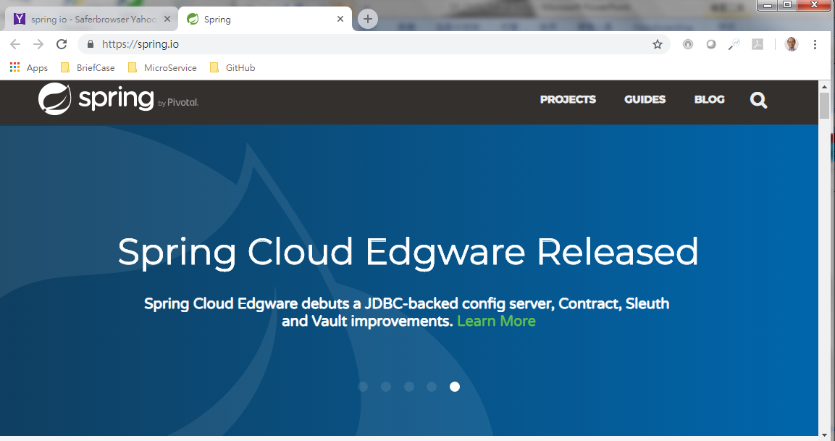
1.1 Spring Initializr
https://github.com/PacktPublishing/Hands-On-Full-Stack-Development-with-Spring-Boot-2.0-and-React
Start Spring Initializr: https//spring.io
Click “Projects”

Slide 7
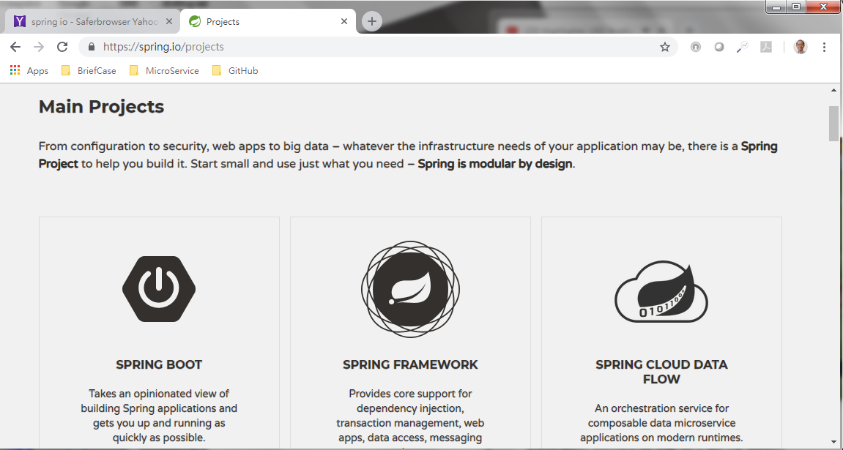
1.1 Spring Initializr
https://github.com/PacktPublishing/Hands-On-Full-Stack-Development-with-Spring-Boot-2.0-and-React
Click “Spring Boot”

Slide 8
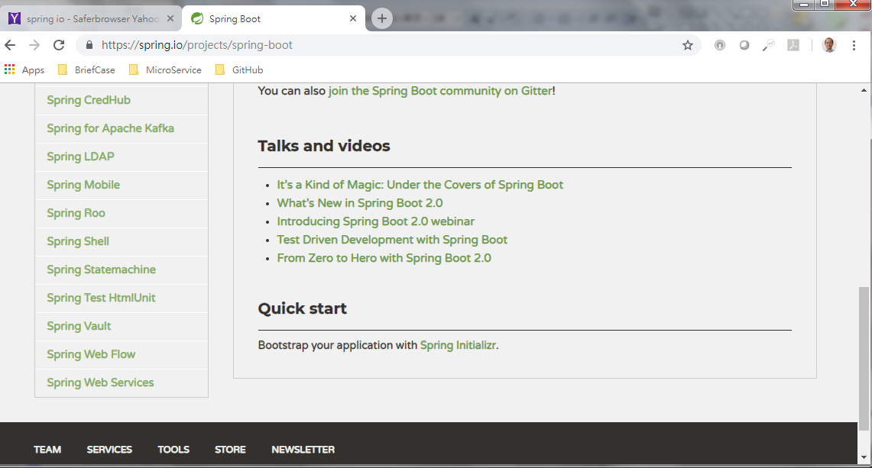
1.1 Spring Initializr
https://github.com/PacktPublishing/Hands-On-Full-Stack-Development-with-Spring-Boot-2.0-and-React
Click “Spring Initializr”

Slide 9
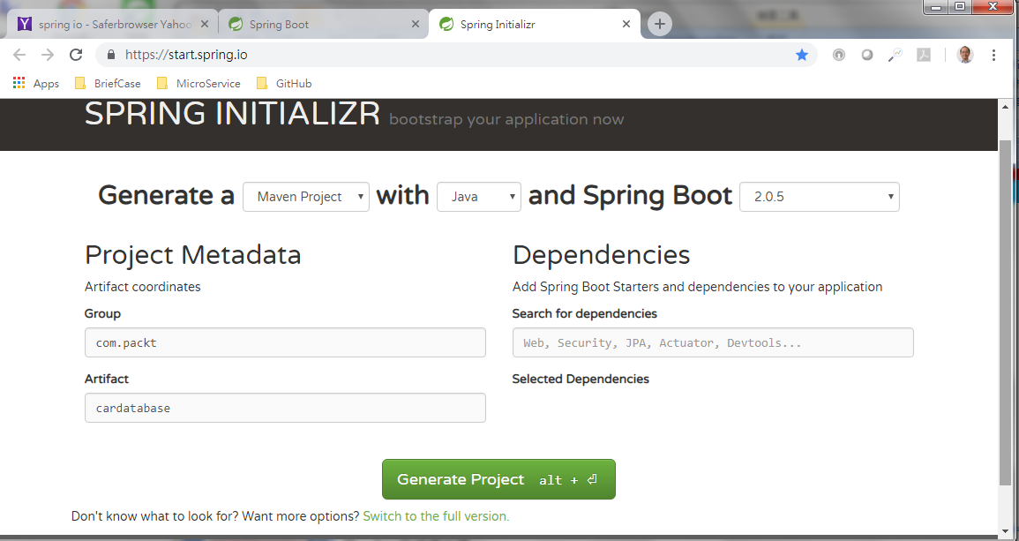
1.1 Spring Initializr
https://github.com/PacktPublishing/Hands-On-Full-Stack-Development-with-Spring-Boot-2.0-and-React
Generate a “Maven Project” with “Java” and Spring Boot “2.0.5”
Group “com.example”, Artifcat “cardatabase”
Click “Don’t know what to look for?”

Slide 10
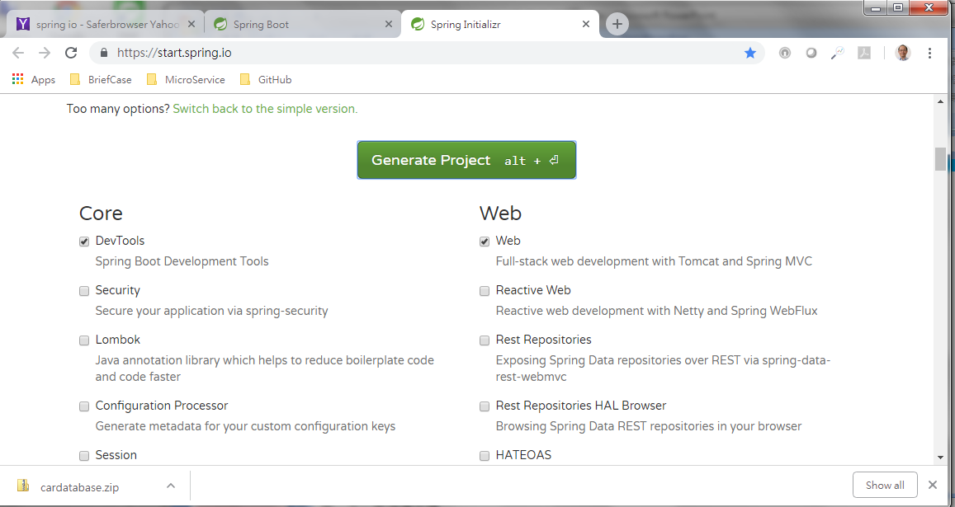
1.1 Spring Initializr
https://github.com/PacktPublishing/Hands-On-Full-Stack-Development-with-Spring-Boot-2.0-and-React
Select “DevTools” for Development tools.
Select “web” for Web development.
Click “Generate Project” to generate “cardatabase.zip” and automatically your download directory.

Slide 11
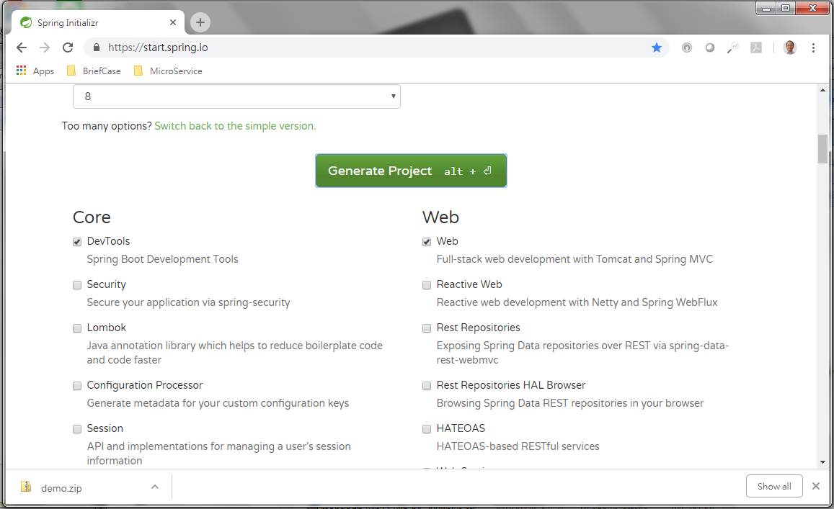
1.1 Spring Initializr
https://github.com/PacktPublishing/Hands-On-Full-Stack-Development-with-Spring-Boot-2.0-and-React
Select “DevTools” for Web and “web” for Web
Click “Generate Project” to generate “demo.zip” and automatically your download directory

Slide 12
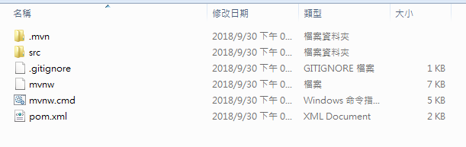
1.1 Spring Initializr
https://github.com/PacktPublishing/Hands-On-Full-Stack-Development-with-Spring-Boot-2.0-and-React
Unzip the cardatabase.zip as following files.

Slide 13
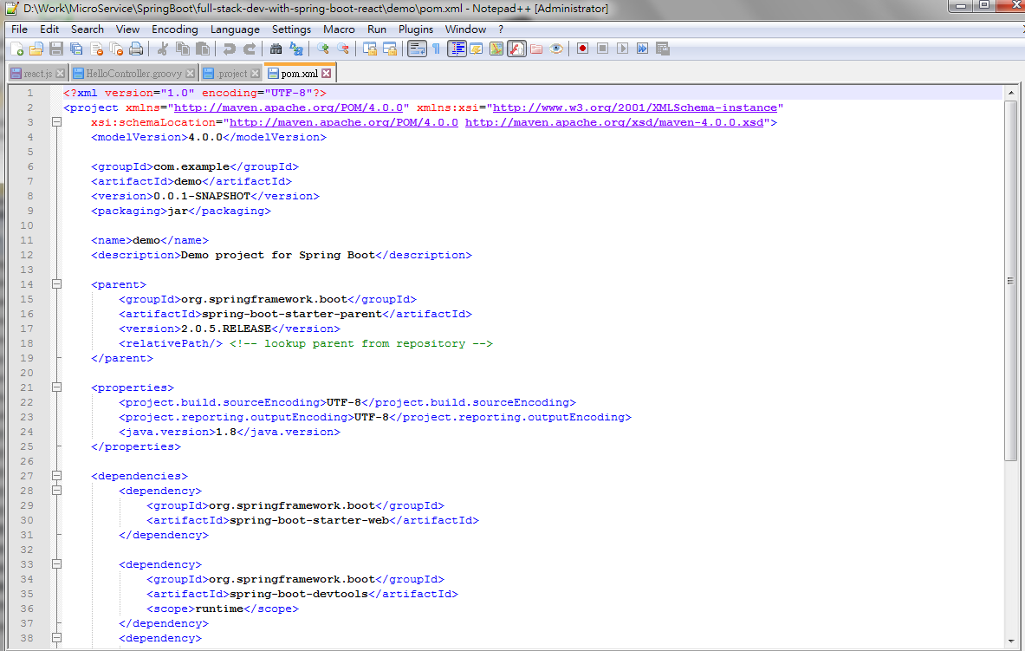
1.1 Spring Initializr
https://github.com/PacktPublishing/Hands-On-Full-Stack-Development-with-Spring-Boot-2.0-and-React
Pom.xml is as follow: modelVersiob, groupID, artifactID, and version.
<modelVersion>4.0.0</modelVersion>
<groupId>com.example</groupId>
<artifactId>demo</artifactId>
<version>0.0.1-SNAPSHOT</version>

Slide 14
1.2 Import pom.xml

Slide 15
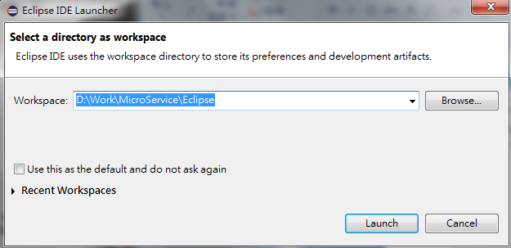
1.2 Import pom.xml
https://github.com/PacktPublishing/Hands-On-Full-Stack-Development-with-Spring-Boot-2.0-and-React
Start Eclipse.
Select a workspace.

Slide 16
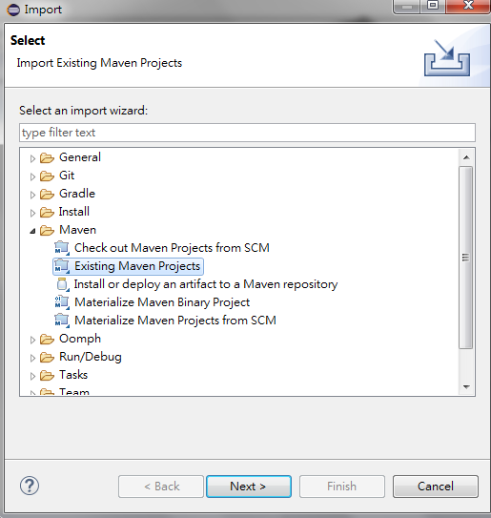
1.2 Import pom.xml
https://github.com/PacktPublishing/Hands-On-Full-Stack-Development-with-Spring-Boot-2.0-and-React
In Eclipse, File > Import, Maven > Exiting Maven Projectiles, click “Next”.

Slide 17
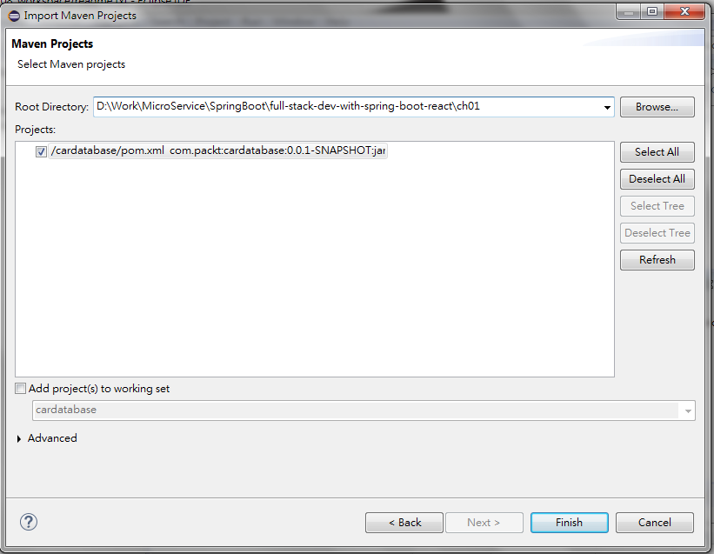
1.2 Import pom.xml
https://github.com/PacktPublishing/Hands-On-Full-Stack-Development-with-Spring-Boot-2.0-and-React
Select path “ch01” for “Root Directory”.
Eclipse will find “cardatabase/pom.xml” for project.
Click “Finish” button.

Slide 18
1.3 Run

Slide 19
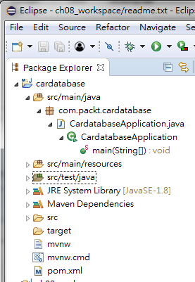
1.3 Run
https://github.com/PacktPublishing/Hands-On-Full-Stack-Development-with-Spring-Boot-2.0-and-React
Use Project Explorer to explore project “cardatabase”.
In project “cardatabase”, we have directory “src/main/java”.
Under the directory “src/main/java”, we have the package “com.packt.cardatabase”
Under the package “com.packt.cardatabase”, we have the main application class, “CardatabaseApplication.java”

Slide 20
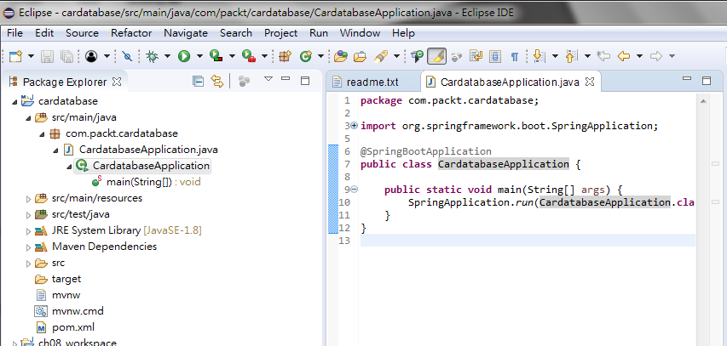
1.3 Run
https://github.com/PacktPublishing/Hands-On-Full-Stack-Development-with-Spring-Boot-2.0-and-React
Double click “CardatabaseApplication.java” on Project Explorer, we have the “CardatabaseApplication.java” display in the editor.

Slide 21
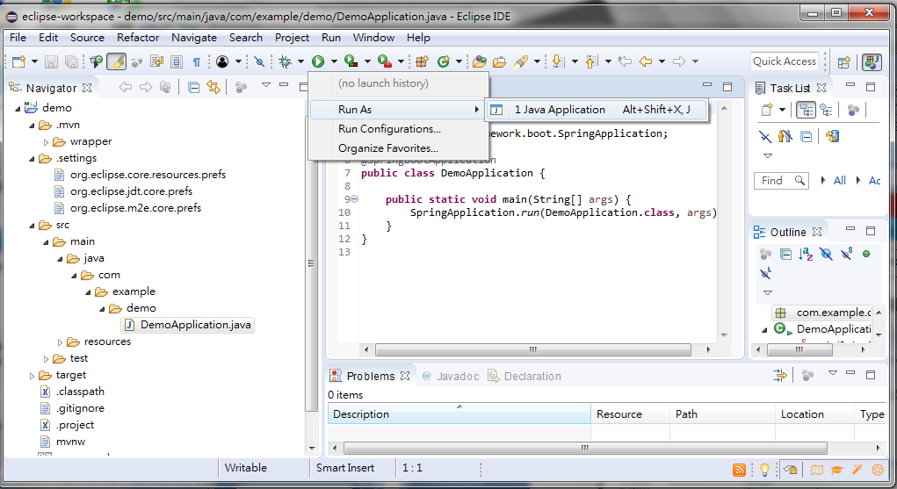
1.3 Run
https://github.com/PacktPublishing/Hands-On-Full-Stack-Development-with-Spring-Boot-2.0-and-React
> Run As > Java Application

Slide 22
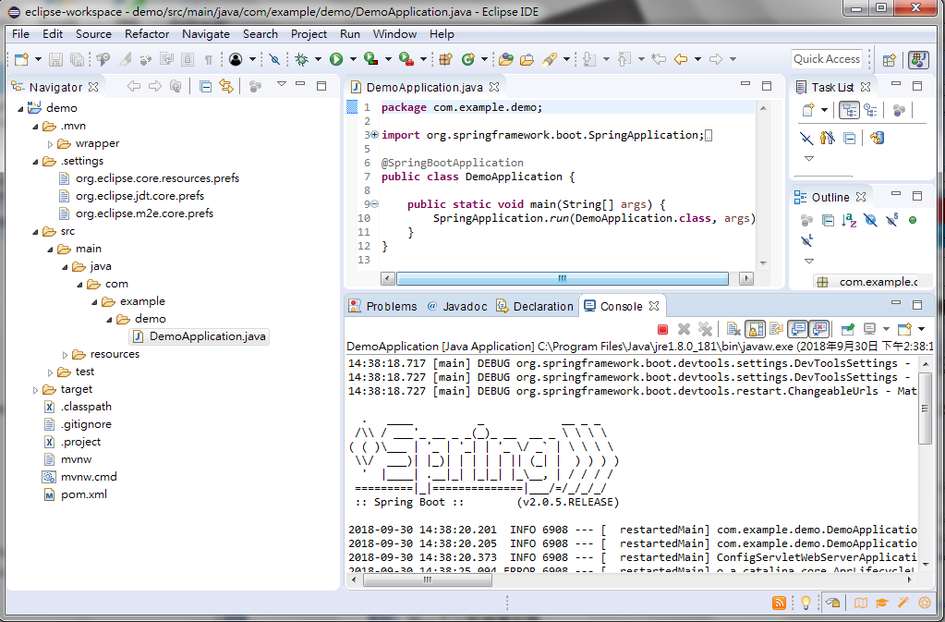
1.3 Run
https://github.com/PacktPublishing/Hands-On-Full-Stack-Development-with-Spring-Boot-2.0-and-React
Check the Console window.

Slide 23
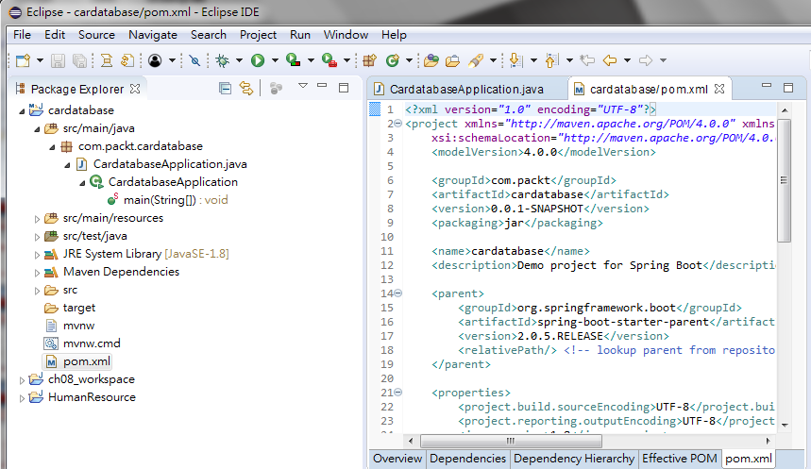
1.3 Run
https://github.com/PacktPublishing/Hands-On-Full-Stack-Development-with-Spring-Boot-2.0-and-React
Double click “pom.xml”, we display “pom.xml”.

Slide 24
1.3 Run
https://github.com/PacktPublishing/Hands-On-Full-Stack-Development-with-Spring-Boot-2.0-and-React
Check “pom.xml”, you can see the names “web” and “devtools”.
They are the dependencies you selected from “spring initializer”.
<dependencies>
<dependency>
<groupId>org.springframework.boot</groupId>
<artifactId>spring-boot-starter-web</artifactId>
</dependency>
<dependency>
<groupId>org.springframework.boot</groupId>
<artifactId>spring-boot-devtools</artifactId>
<scope>runtime</scope>
</dependency>
<dependency>
<groupId>org.springframework.boot</groupId>
<artifactId>spring-boot-starter-test</artifactId>
<scope>test</scope>
</dependency>
</dependencies>

Slide 25
1.3 Run
https://github.com/PacktPublishing/Hands-On-Full-Stack-Development-with-Spring-Boot-2.0-and-React
Check main class: DemoApplication.

Slide 26
1.3 Run
https://github.com/PacktPublishing/Hands-On-Full-Stack-Development-with-Spring-Boot-2.0-and-React
Check main method in class: CardatabaseApplication.
package com.example.demo;import org.springframework.boot.SpringApplication;import org.springframework.boot.autoconfigure.SpringBootApplication;
@SpringBootApplication
public class CardatabaseApplication {
public static void main (String[] args) { SpringApplication.run(CardatabaseApplication.class, args);
}
}

Slide 27
1.3 Run
https://github.com/PacktPublishing/Hands-On-Full-Stack-Development-with-Spring-Boot-2.0-and-React
The annotation “@SpringBootApplication” includes “EnableAutoConfiguration”, “@ComponentScan”, and “@Configure” for you.
Annotation | Description
@EnableAutoConfiguration | Auto Spring Boot Configuration
@ComponentScan | Scan and find components for Spring Boot.
@Configure | Defines class as a source for Bean

Slide 28
1.4 Display Log Message

Slide 29
1.4 Display Log Message
https://github.com/PacktPublishing/Hands-On-Full-Stack-Development-with-Spring-Boot-2.0-and-React
Modify CardatabaseApplicaiton.java as follow:
package com.example.Cardatabase;
import org.slf4j.Logger;
import org.slf4j.LoggerFactory;
import org.springframework.boot.SpringApplication;
import org.springframework.boot.autoconfigure.SpringBootApplication;
@SpringBootApplication
public class CardatabaseApplication {
private static final Logger logger =
LoggerFactory.getLogger (CardatabaseApplication.class);
public static void main(String[] args) {
SpringApplication.run (CardatabaseApplication.class, args);
logger.info("Hello Spring Boot");
}
}

Slide 30
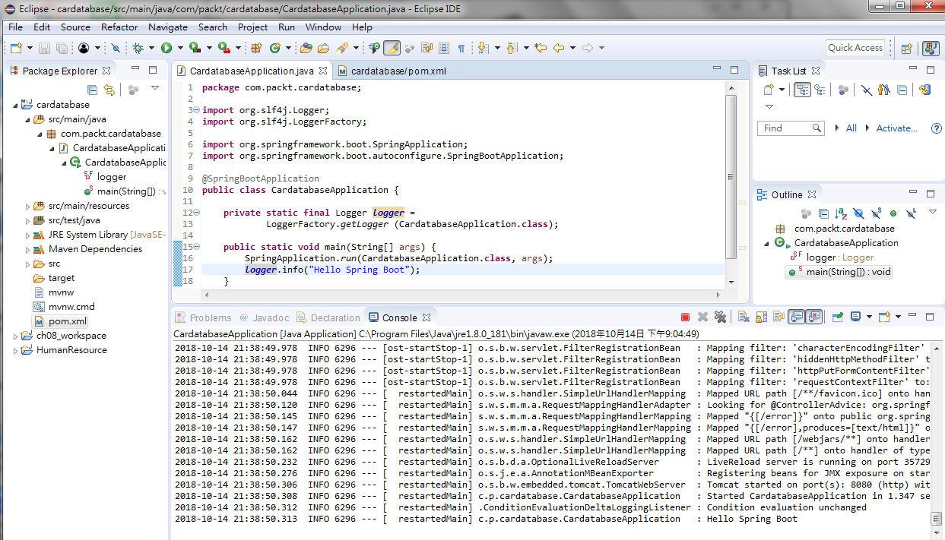
1.4 Display Log Message
https://github.com/PacktPublishing/Hands-On-Full-Stack-Development-with-Spring-Boot-2.0-and-React
Run As > CardatabaseApplication.java
You will see “Hello Spring Boot” in console window.

Slide 31
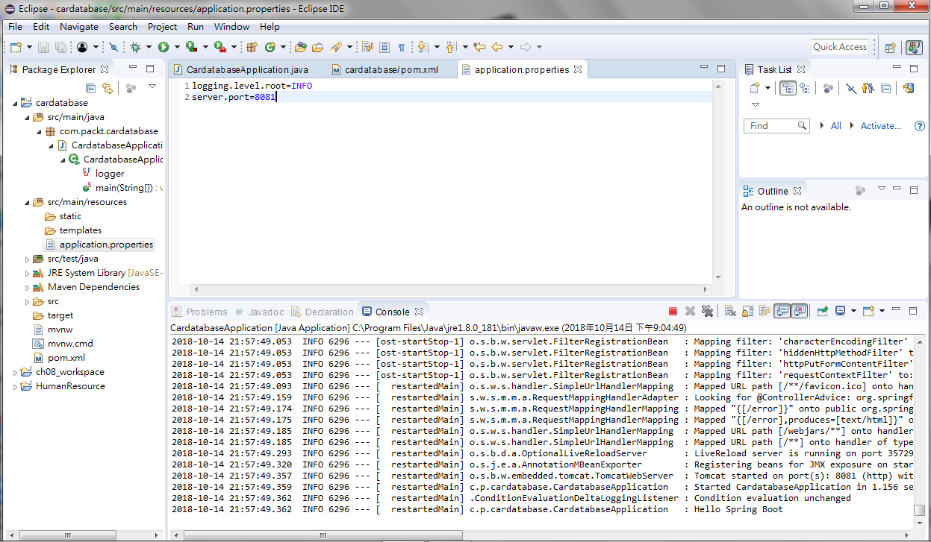
1.4 Display Log Message
https://github.com/PacktPublishing/Hands-On-Full-Stack-Development-with-Spring-Boot-2.0-and-React
In file Applicaiton.properties, add:
logging.level.root=INFO
server.port=8081

Slide 32
1.5 Install MariaDB

Slide 33
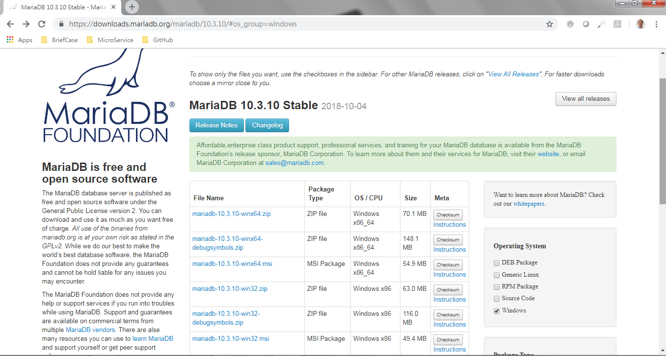
1.5 Install MariaDB
https://github.com/PacktPublishing/Hands-On-Full-Stack-Development-with-Spring-Boot-2.0-and-React
Go to: https://downloads.mariadb.org
Select the Windows version

Slide 34
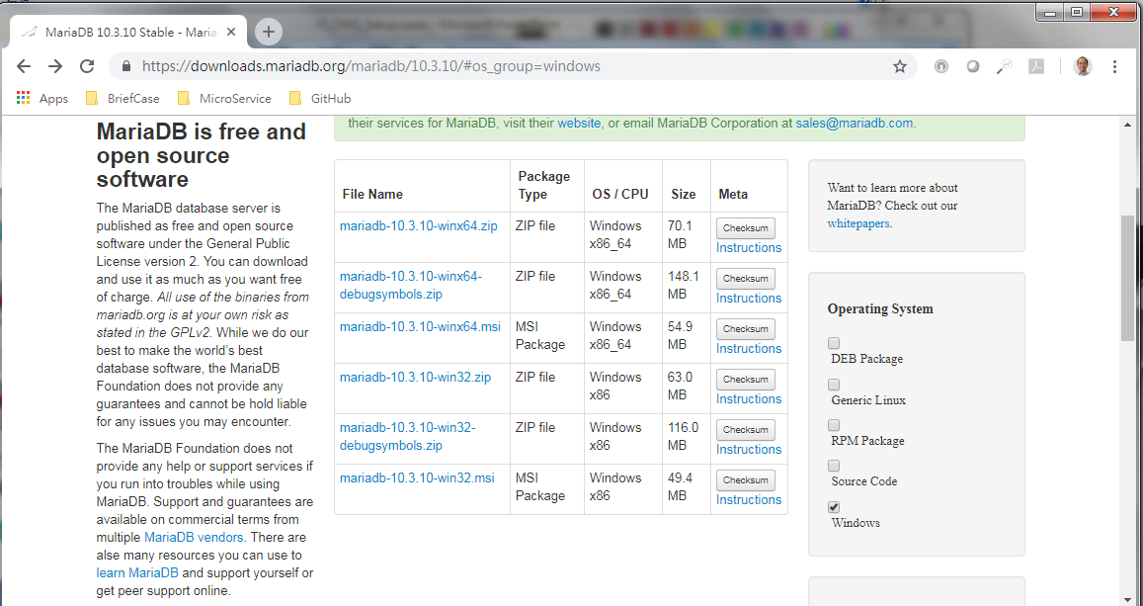
1.5 Install MariaDB
https://github.com/PacktPublishing/Hands-On-Full-Stack-Development-with-Spring-Boot-2.0-and-React
Download the msi version to install.

Slide 35
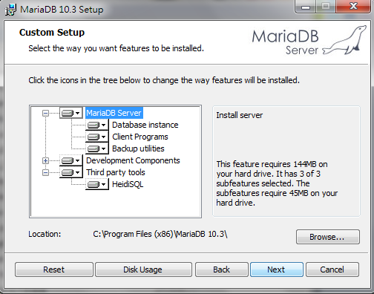
1.5 Install MariaDB
https://github.com/PacktPublishing/Hands-On-Full-Stack-Development-with-Spring-Boot-2.0-and-React
Install all features from Wizard.

Slide 36
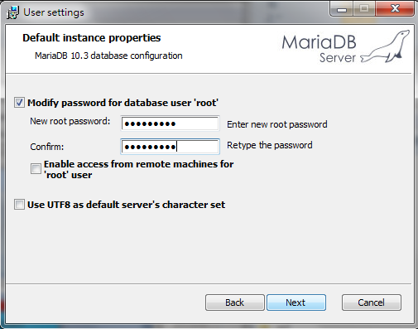
1.5 Install MariaDB
https://github.com/PacktPublishing/Hands-On-Full-Stack-Development-with-Spring-Boot-2.0-and-React
Password: Pcxxxx=ch

Slide 37
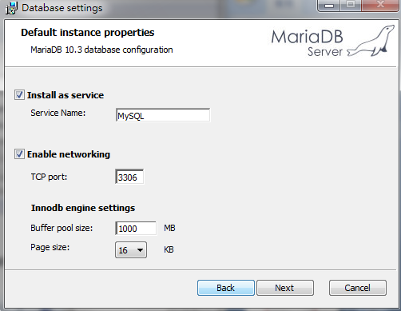
1.5 Install MariaDB
https://github.com/PacktPublishing/Hands-On-Full-Stack-Development-with-Spring-Boot-2.0-and-React
Size =1000MB.

Slide 38
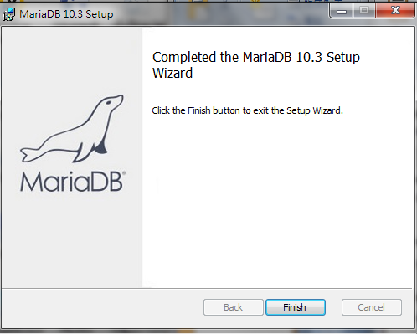
1.5 Install MariaDB
https://github.com/PacktPublishing/Hands-On-Full-Stack-Development-with-Spring-Boot-2.0-and-React
Complete

Slide 39
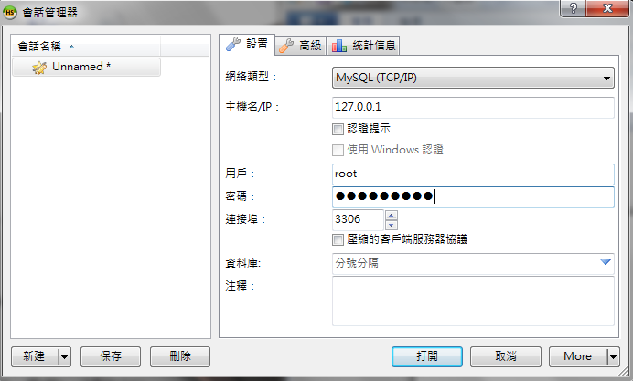

1.5 Install MariaDB
https://github.com/PacktPublishing/Hands-On-Full-Stack-Development-with-Spring-Boot-2.0-and-React
Double click “HeidiSQL” to start.
Pcxxxx=ch

Slide 40
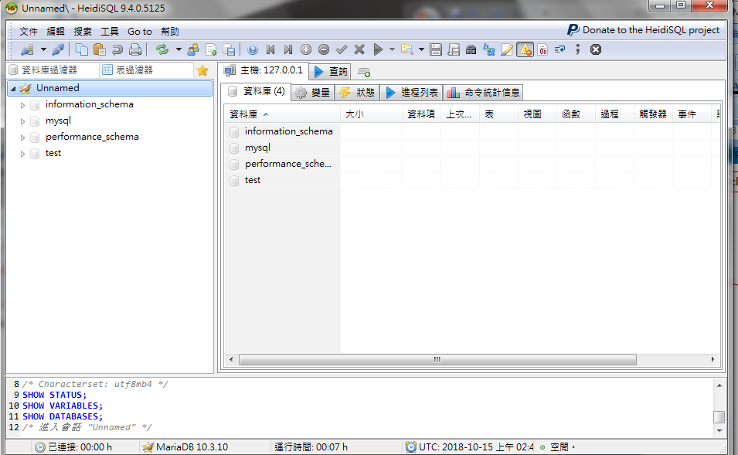
1.5 Install MariaDB
https://github.com/PacktPublishing/Hands-On-Full-Stack-Development-with-Spring-Boot-2.0-and-React
Use this to add new database.

Slide 41
End of Chapter

