Slide 1

1 Setup
Peter H. Chen

Slide 2
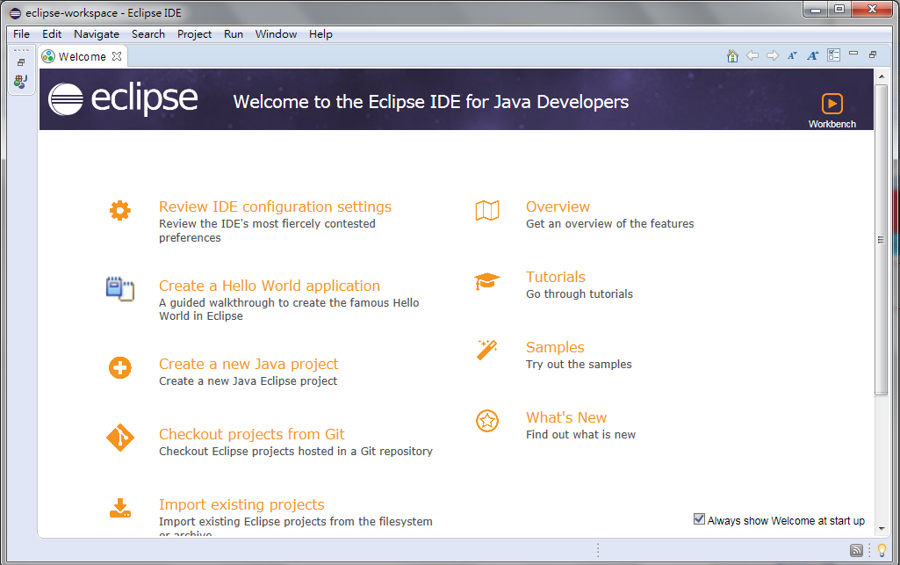
1 Setup
https://github.com/PacktPublishing/Hands-On-Full-Stack-Development-with-Spring-Boot-2.0-and-React
Download and Install Eclipse IDE
Start Eclipse IDE
Create a new Java Project

Slide 3
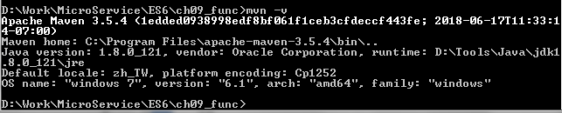
1 Setup
https://github.com/PacktPublishing/Hands-On-Full-Stack-Development-with-Spring-Boot-2.0-and-React
Check the maven
C:\> mvn –v
Note:
mvn.cmd is Windows version of mvn.
mvn.cmd is under C:\Program Files\apache=mvn-3.5.4\bin
%M2_HOME% = “C:\Program Files\apache=mvn-3.5.4\bin”
%PATH% = %M2_HOME%; …

Slide 4
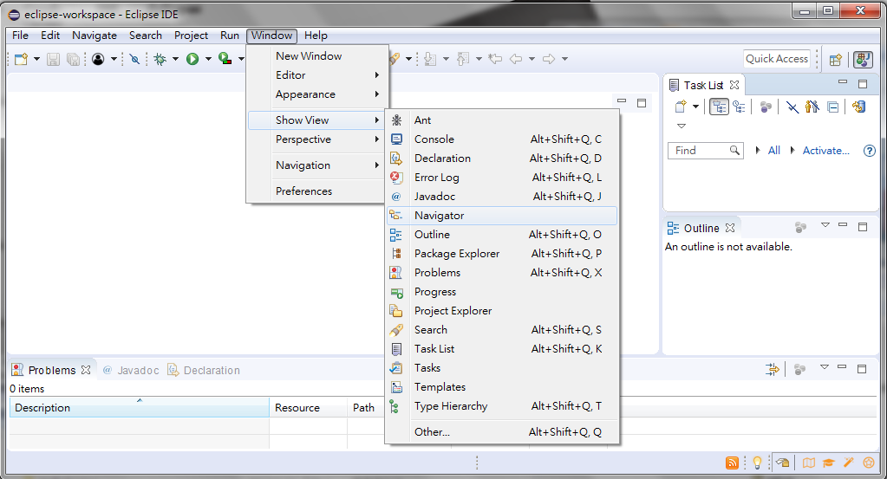
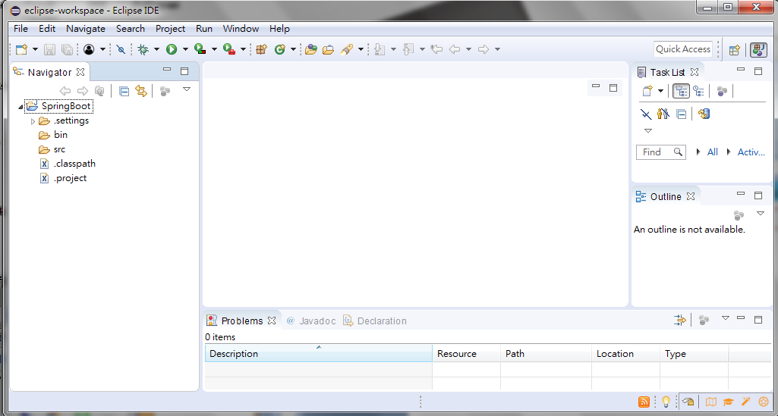
1 Setup
https://github.com/PacktPublishing/Hands-On-Full-Stack-Development-with-Spring-Boot-2.0-and-React
Window > Show View > Navigator to display the Project Explorer

Slide 5
1.1 Spring Initializr

Slide 6
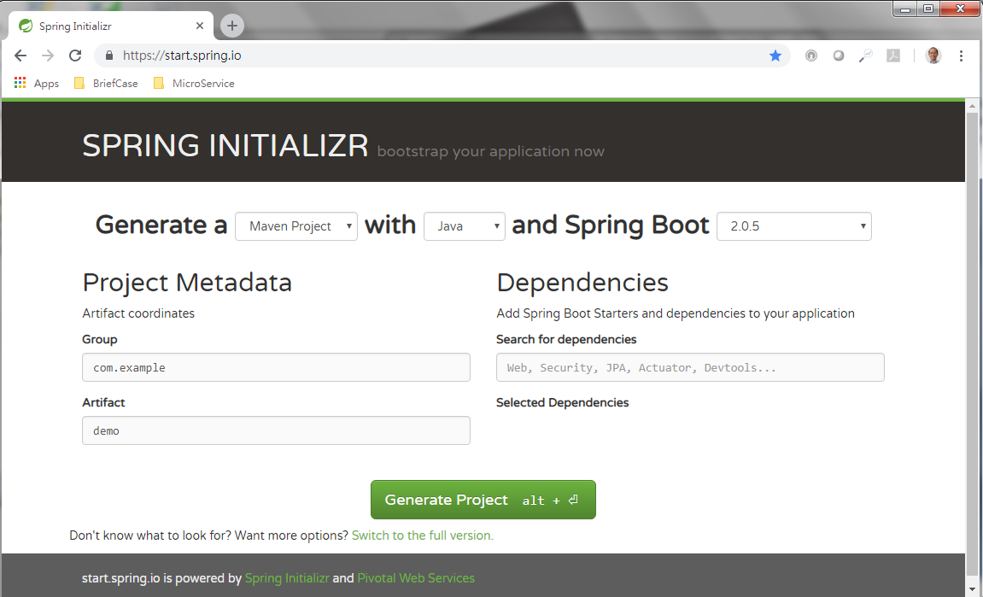
1.1 Spring Initializr
https://github.com/PacktPublishing/Hands-On-Full-Stack-Development-with-Spring-Boot-2.0-and-React
Start Spring Initializr: https//start.spring.io
Generate a “Maven Project” with “Java” and Spring Boot “2.0.5”
Group “com.example”, Artifcat “demo”
Click “Don’t know what to look for?”

Slide 7
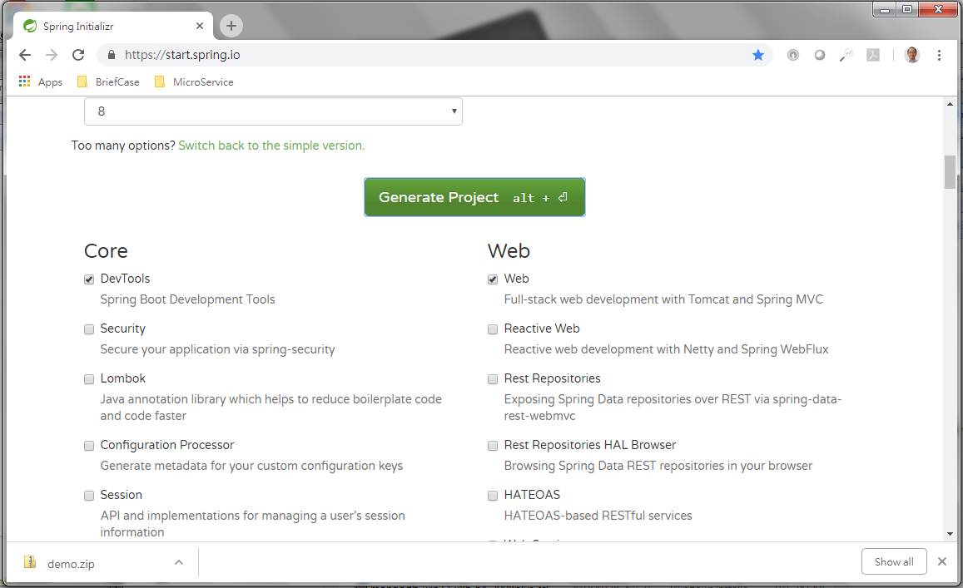
1.1 Spring Initializr
https://github.com/PacktPublishing/Hands-On-Full-Stack-Development-with-Spring-Boot-2.0-and-React
Select “DevTools” for Web and “web” for Web
Click “Generate Project” to generate “demo.zip” and automatically your download directory

Slide 8
1.1 Spring Initializr
https://github.com/PacktPublishing/Hands-On-Full-Stack-Development-with-Spring-Boot-2.0-and-React
Select “DevTools” for Web and “web” for Web
Click “Generate Project” to generate “demo.zip” and automatically your download directory

Slide 9
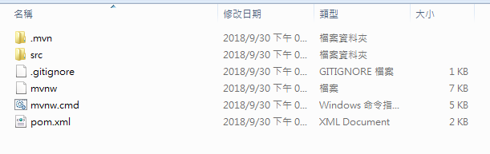
1.1 Spring Initializr
https://github.com/PacktPublishing/Hands-On-Full-Stack-Development-with-Spring-Boot-2.0-and-React
Unzip the demo.zip as following files.

Slide 10
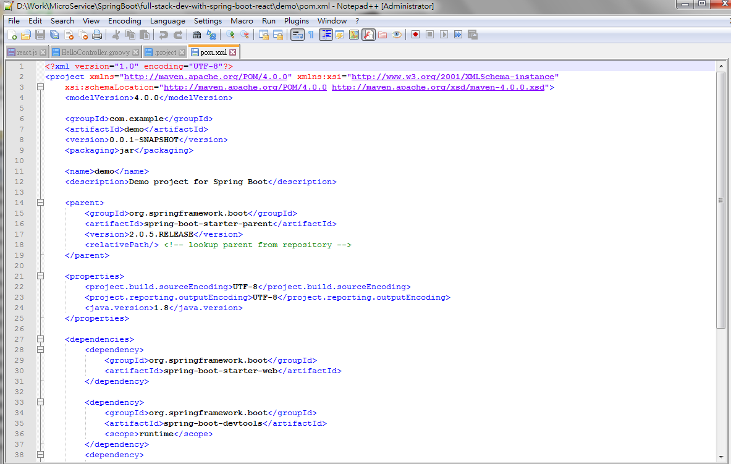
1.1 Spring Initializr
https://github.com/PacktPublishing/Hands-On-Full-Stack-Development-with-Spring-Boot-2.0-and-React
Pom.xml is as follow: modelVersiob, groupID, artifactID, and version.
<modelVersion>4.0.0</modelVersion>
<groupId>com.example</groupId>
<artifactId>demo</artifactId>
<version>0.0.1-SNAPSHOT</version>

Slide 11
1.2 Import pom.xml

Slide 12
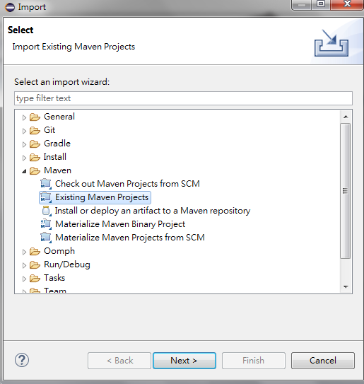
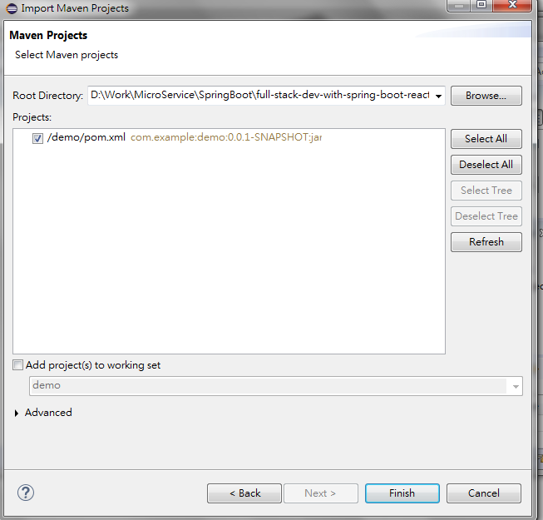
1.2 Import pom.xml
https://github.com/PacktPublishing/Hands-On-Full-Stack-Development-with-Spring-Boot-2.0-and-React
In Eclipse, File > Import, Maven > Exiting Maven Projectiles, click “Next”.
Select path for “Root Directory”. Eclipse will find “demo/pom.xml” for project.

Slide 13
1.3 Run

Slide 14
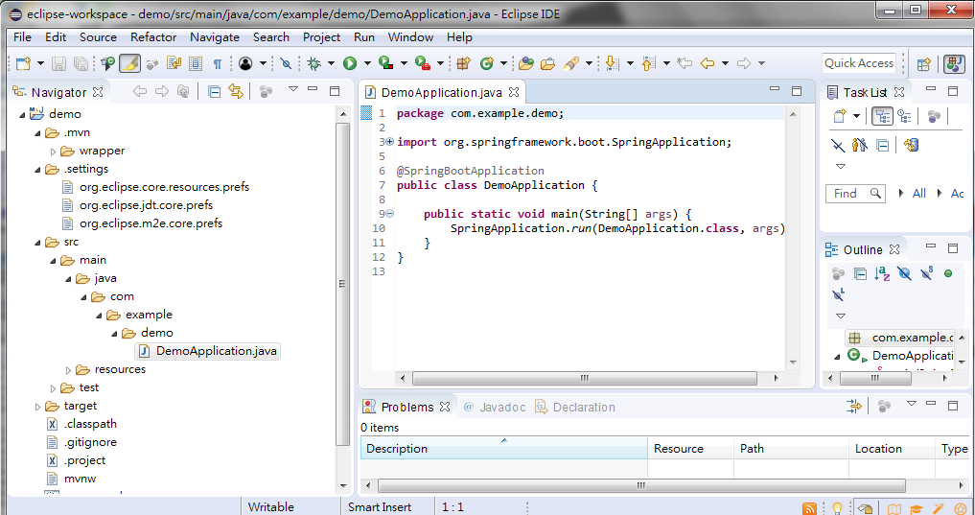
1.3 Run
https://github.com/PacktPublishing/Hands-On-Full-Stack-Development-with-Spring-Boot-2.0-and-React
Edit demo > src > main > java > com > example > demo > DemoApplication.java

Slide 15
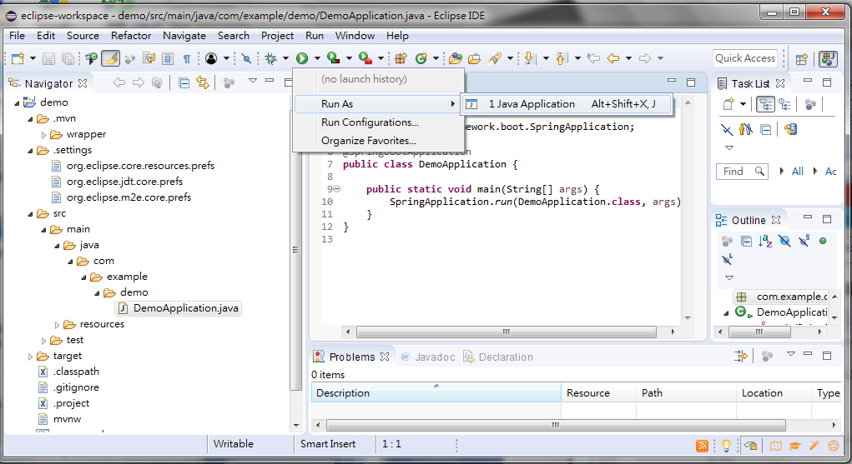
1.3 Run
https://github.com/PacktPublishing/Hands-On-Full-Stack-Development-with-Spring-Boot-2.0-and-React
> Run As > Java Application

Slide 16
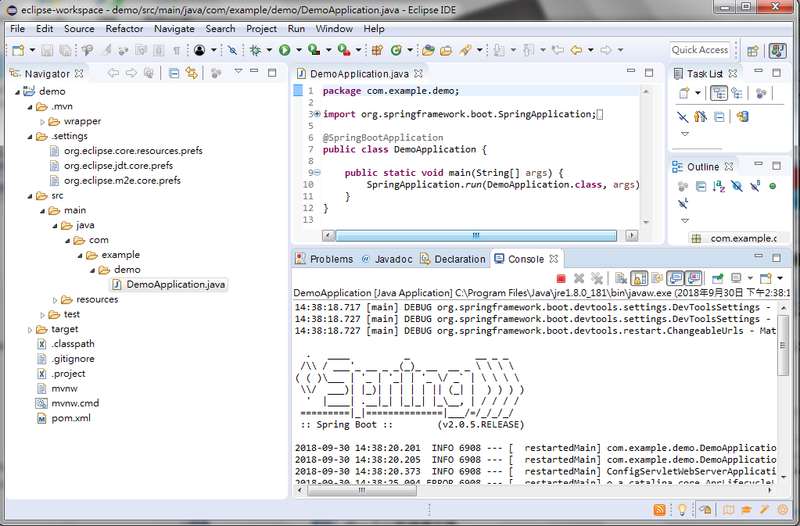
1.3 Run
https://github.com/PacktPublishing/Hands-On-Full-Stack-Development-with-Spring-Boot-2.0-and-React
Check the Console window.

Slide 17
1.3 Run
https://github.com/PacktPublishing/Hands-On-Full-Stack-Development-with-Spring-Boot-2.0-and-React
Check main class: DemoApplication.

Slide 18
1.3 Run
https://github.com/PacktPublishing/Hands-On-Full-Stack-Development-with-Spring-Boot-2.0-and-React
Check main method in class: DemoApplication.
package com.example.demo;import org.springframework.boot.SpringApplication;import org.springframework.boot.autoconfigure.SpringBootApplication;
@SpringBootApplication
public class DemoApplication {
public static void main (String[] args) { SpringApplication.run(DemoApplication.class, args);
}
}

Slide 19
1.3 Run
https://github.com/PacktPublishing/Hands-On-Full-Stack-Development-with-Spring-Boot-2.0-and-React
The annotation “@SpringBootApplication” includes “EnableAutoConfiguration”, “@ComponentScan”, and “@Configure” for you.
Annotation | Description
@EnableAutoConfiguration | Auto Spring Boot Configuration
@ComponentScan | Scan and find components for Spring Boot.
@Configure | Defines class as a source for Bean

Slide 20
1.4 Display Log Message

Slide 21
1.4 Display Log Message
https://github.com/PacktPublishing/Hands-On-Full-Stack-Development-with-Spring-Boot-2.0-and-React
Modify DemoApplicaiton.java as follow:
package com.example.demo;
import org.slf4j.Logger;
import org.slf4j.LoggerFactory;
import org.springframework.boot.SpringApplication;
import org.springframework.boot.autoconfigure.SpringBootApplication;
@SpringBootApplication
public class DemoApplication {
private static final Logger logger =
LoggerFactory.getLogger(DemoApplication.class);
public static void main(String[] args) {
SpringApplication.run(DemoApplication.class, args);
logger.info("Hello Spring Boot");
}
}

Slide 22
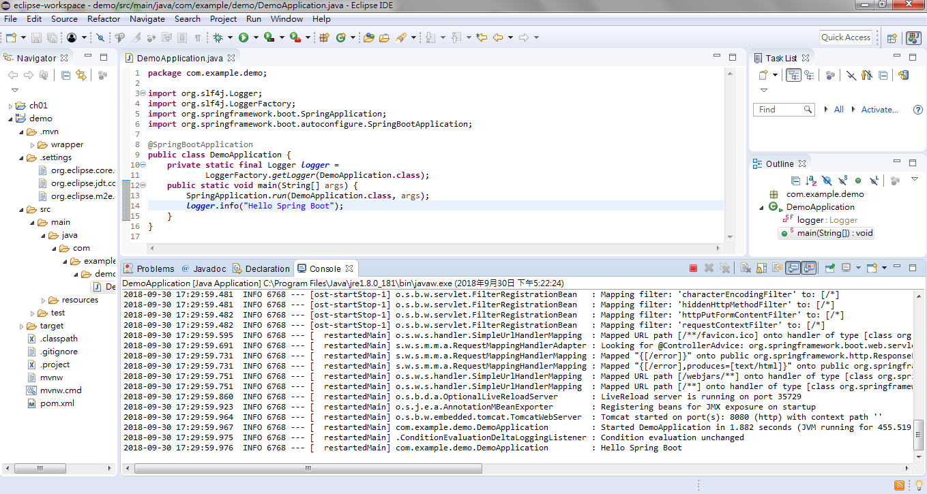
1.4 Display Log Message
https://github.com/PacktPublishing/Hands-On-Full-Stack-Development-with-Spring-Boot-2.0-and-React
> Run As > DemoApplication.java
You will see “Hello Spring Boot” in console window.

Slide 23
1.5 Install MariaDB

Slide 24
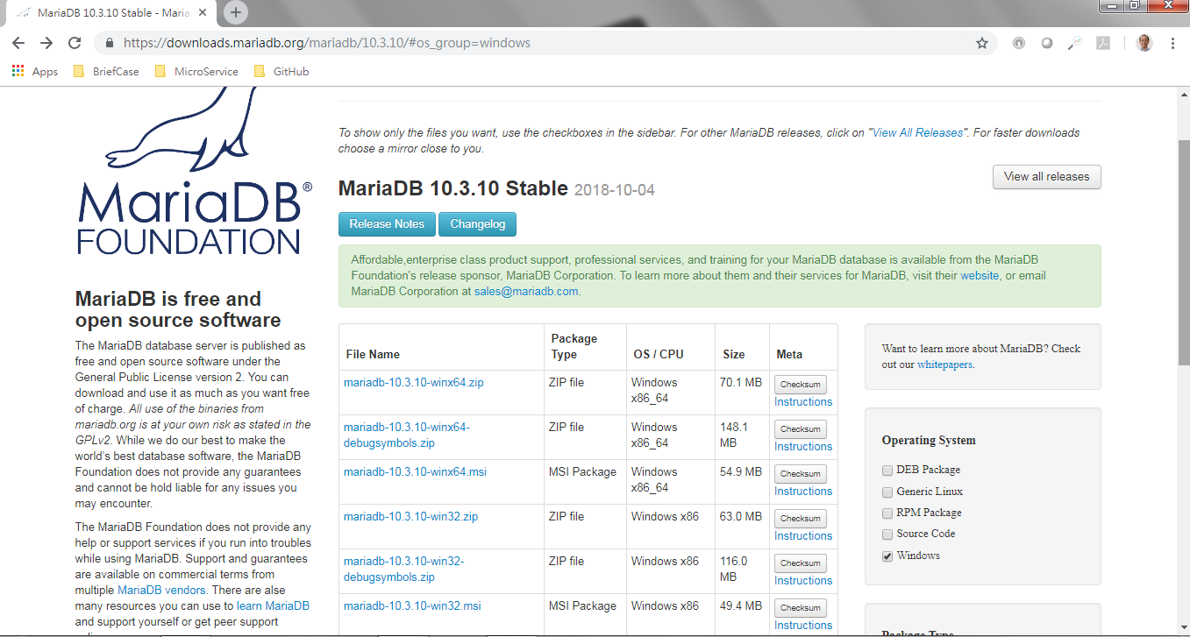
1.5 Install MariaDB
https://github.com/PacktPublishing/Hands-On-Full-Stack-Development-with-Spring-Boot-2.0-and-React
Go to: https://downloads.mariadb.org
Select the Windows version

Slide 25
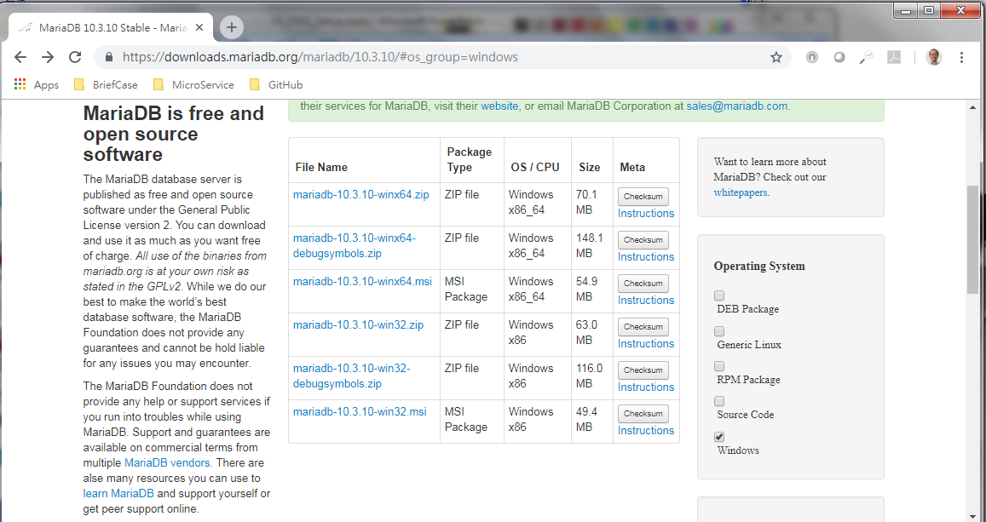
1.5 Install MariaDB
https://github.com/PacktPublishing/Hands-On-Full-Stack-Development-with-Spring-Boot-2.0-and-React
Download the msi version to install.

Slide 26
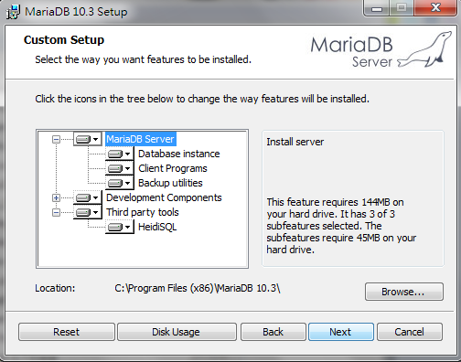
1.5 Install MariaDB
https://github.com/PacktPublishing/Hands-On-Full-Stack-Development-with-Spring-Boot-2.0-and-React
Install all features from Wizard.

Slide 27
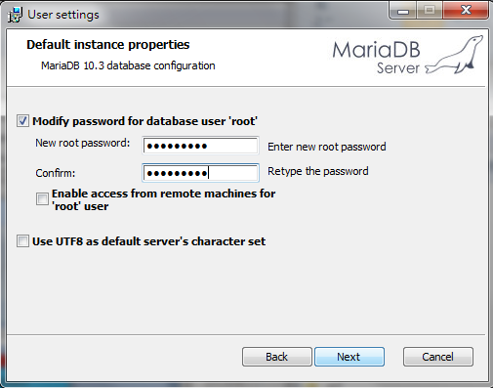
1.5 Install MariaDB
https://github.com/PacktPublishing/Hands-On-Full-Stack-Development-with-Spring-Boot-2.0-and-React
Password: Pcxxxx=ch

Slide 28
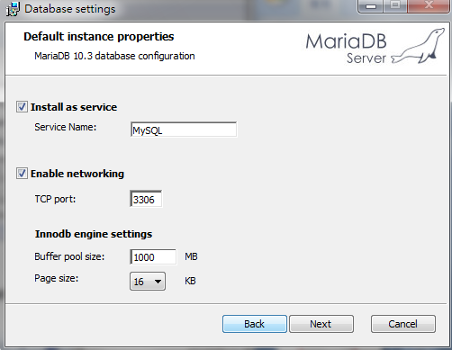
1.5 Install MariaDB
https://github.com/PacktPublishing/Hands-On-Full-Stack-Development-with-Spring-Boot-2.0-and-React
Size =1000MB.

Slide 29
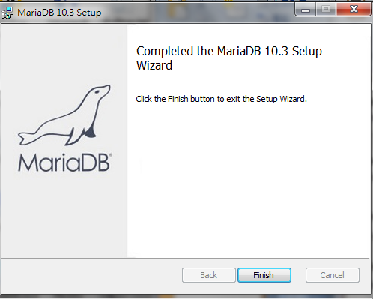
1.5 Install MariaDB
https://github.com/PacktPublishing/Hands-On-Full-Stack-Development-with-Spring-Boot-2.0-and-React
Complete

Slide 30
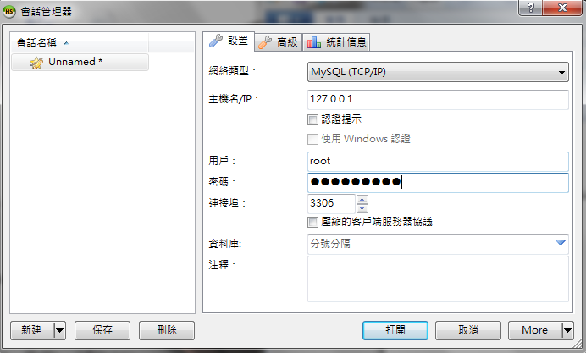

1.5 Install MariaDB
https://github.com/PacktPublishing/Hands-On-Full-Stack-Development-with-Spring-Boot-2.0-and-React
Double click “HeidiSQL” to start.
Pcxxxx=ch

Slide 31
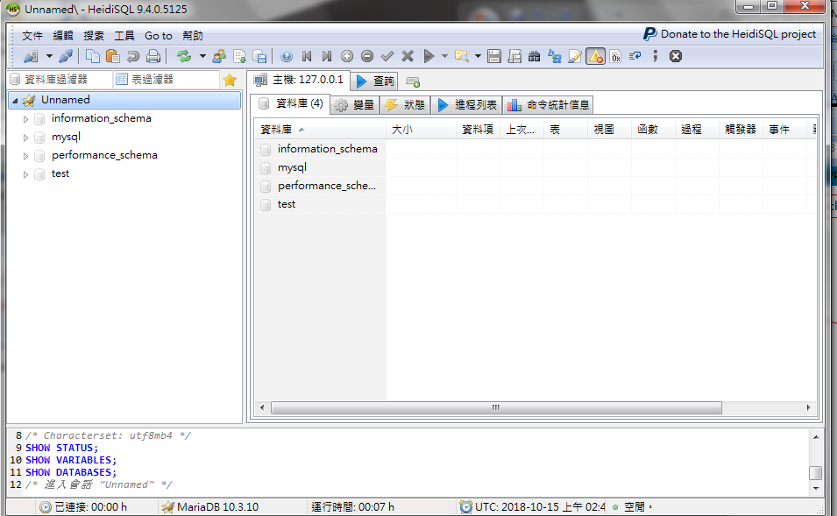
1.5 Install MariaDB
https://github.com/PacktPublishing/Hands-On-Full-Stack-Development-with-Spring-Boot-2.0-and-React
Use this to add new database.

Slide 32
End of Chapter

