Slide 1

2 JPA with Spring Boot
Peter H. Chen

Slide 2
2 JPA with Spring Boot
https://github.com/PacktPublishing/Hands-On-Full-Stack-Development-with-Spring-Boot-2.0-and-React
JPA (Java Persistent Application) with Spring Boot
Create H2 SQL in-memory database processing for persistent MariaDB database.
CRUD repositories for one-to-many connection to database.

Slide 3
2.1 pom.xml

Slide 4
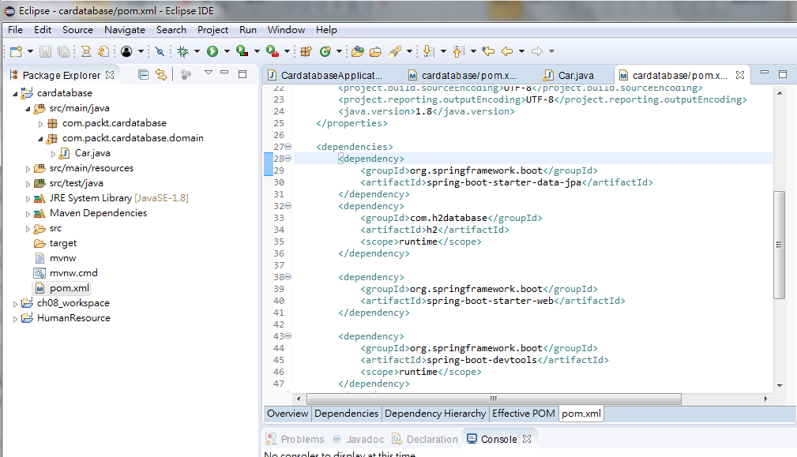
2.1 pom.xml
https://github.com/PacktPublishing/Hands-On-Full-Stack-Development-with-Spring-Boot-2.0-and-React
In pom.xml:
Add persistence database “jpa”
Add in-memory “h2” database.

Slide 5
2.2 ORM, JPA, and Hibernate

Slide 6
2.2 ORM, JPA, and Hibernate
https://github.com/PacktPublishing/Hands-On-Full-Stack-Development-with-Spring-Boot-2.0-and-React
ORM (Object-Relational Mapping): Fetch and map data from database to code (Object-Oriented Programming).
JPA (Java Persistence API): Provide Object-Relational Mapping for Java program.
Hibernate: Hibernate is provided by Spring and most popular JPA (Java Persistent API).

Slide 7
2.2 ORM, JPA, and Hibernate
https://github.com/PacktPublishing/Hands-On-Full-Stack-Development-with-Spring-Boot-2.0-and-React
ORM (Object-Relational Mapping): Fetch and map data from database to code (Object-Oriented Programming).
JPA (Java Persistence API): Provide Object-Relational Mapping for Java program.
Hibernate: Hibernate is provided by Spring and most popular JPA (Java Persistent API).

Slide 8
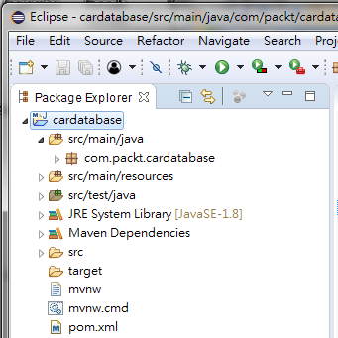
2.2 Create Package and Class
https://github.com/PacktPublishing/Hands-On-Full-Stack-Development-with-Spring-Boot-2.0-and-React
Start Eclipse and launch workspace.
The explorer shows the cardatabase workspace which we created previosly.

Slide 9
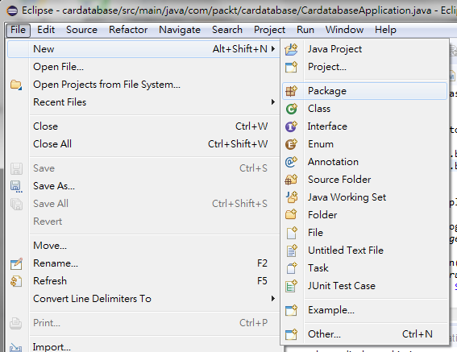
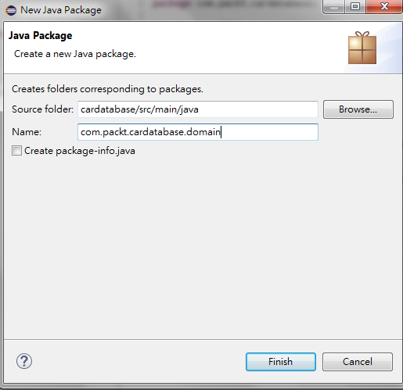
2.2 Create Package and Class
https://github.com/PacktPublishing/Hands-On-Full-Stack-Development-with-Spring-Boot-2.0-and-React
Create Package: File > New > Package.

Slide 10
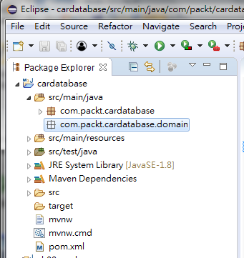
2.2 Create Package and Class
https://github.com/PacktPublishing/Hands-On-Full-Stack-Development-with-Spring-Boot-2.0-and-React
The new package “com.packt.cardatabase.domain” is created.

Slide 11
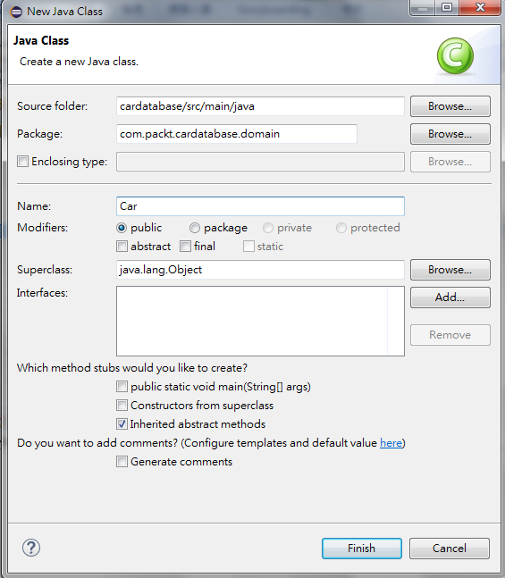
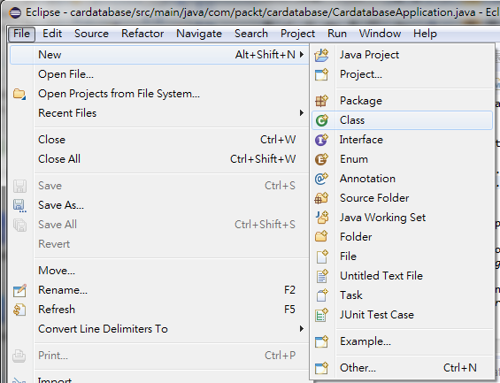
2.2 Create Package and Class
https://github.com/PacktPublishing/Hands-On-Full-Stack-Development-with-Spring-Boot-2.0-and-React
Create class: File > New > Class
Enter Class “Car”

Slide 12
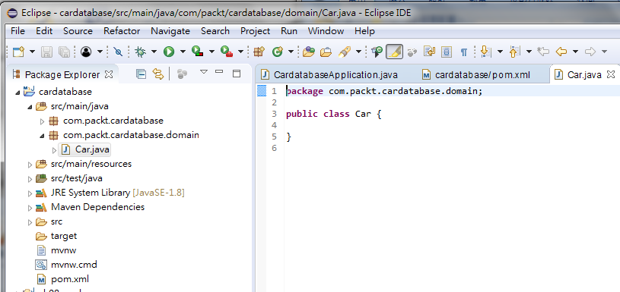
2.2 Create Package and Class
https://github.com/PacktPublishing/Hands-On-Full-Stack-Development-with-Spring-Boot-2.0-and-React
The class “Car” and package “com.packt.cardatabase.domain” are created.

Slide 13
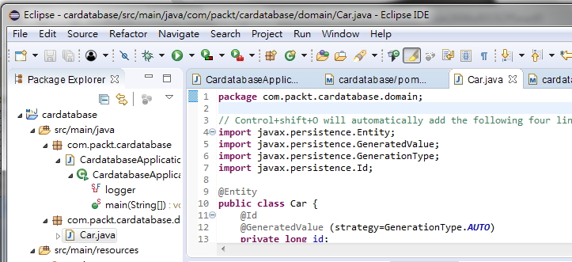
2.2 Create Package and Class
https://github.com/PacktPublishing/Hands-On-Full-Stack-Development-with-Spring-Boot-2.0-and-React
Control+Shift+O: Generate the following import lines
@Id: Primary key generation.
@generateValue: Define ID automatically generated by database.

Slide 14
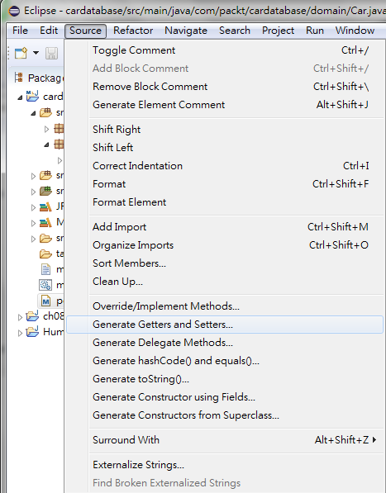
2.2 Create Package and Class
https://github.com/PacktPublishing/Hands-On-Full-Stack-Development-with-Spring-Boot-2.0-and-React
Source > Generate Getters and Setters …

Slide 15
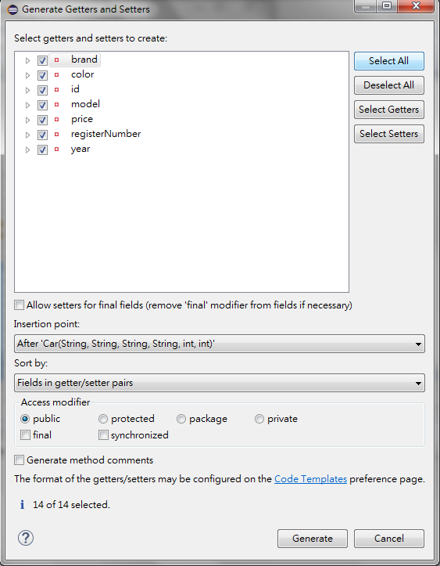
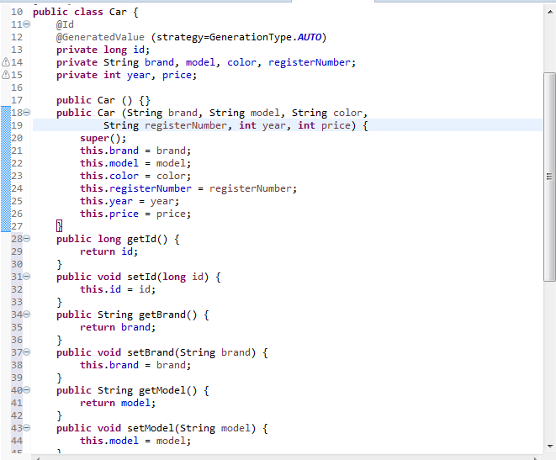
2.2 Create Package and Class
https://github.com/PacktPublishing/Hands-On-Full-Stack-Development-with-Spring-Boot-2.0-and-React
Source > Generate Getters and Setters …

Slide 16
2.2 Create Package and Class
https://github.com/PacktPublishing/Hands-On-Full-Stack-Development-with-Spring-Boot-2.0-and-React
Source > Generate Getters and Setters …

Slide 17
2.3 Run Car.java

Slide 18
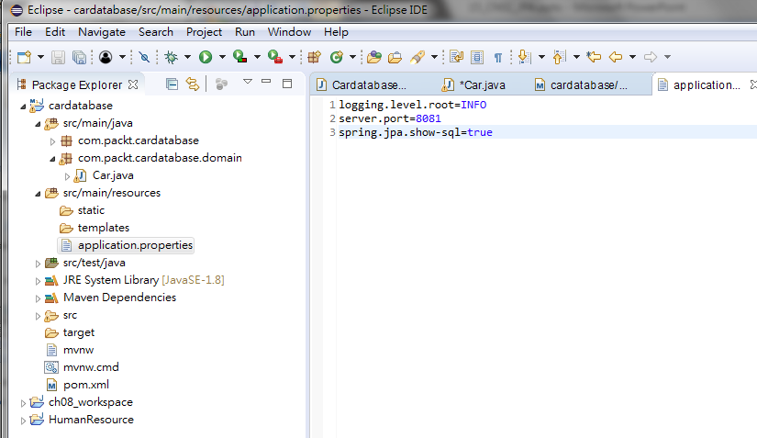
2.3 Run Car.java
https://github.com/PacktPublishing/Hands-On-Full-Stack-Development-with-Spring-Boot-2.0-and-React
The Table Car have to created in database.
Add “spring.jpa.show-sql=true” to File “Aplication.properties”.

Slide 19
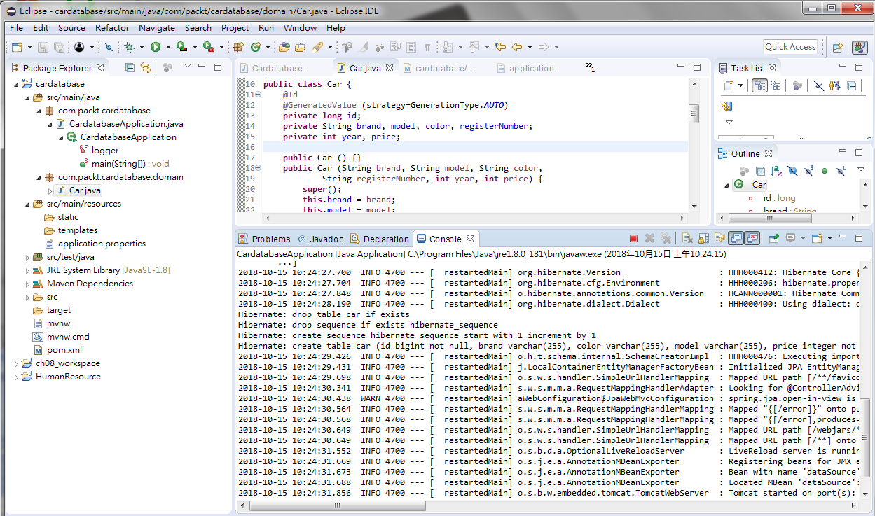
2.3 Run Car.java
https://github.com/PacktPublishing/Hands-On-Full-Stack-Development-with-Spring-Boot-2.0-and-React
Run “Car.java”

Slide 20
2.3 Run Car.java
https://github.com/PacktPublishing/Hands-On-Full-Stack-Development-with-Spring-Boot-2.0-and-React
The Table Car have to created in database.
Add “spring.jpa.show-sql=true” to File “Aplication.properties”.

Slide 21
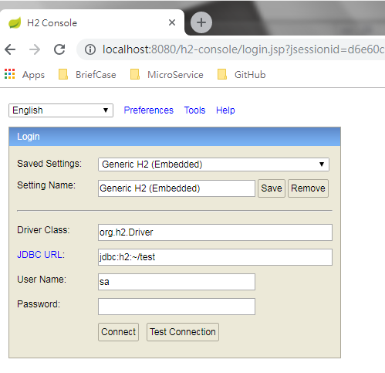
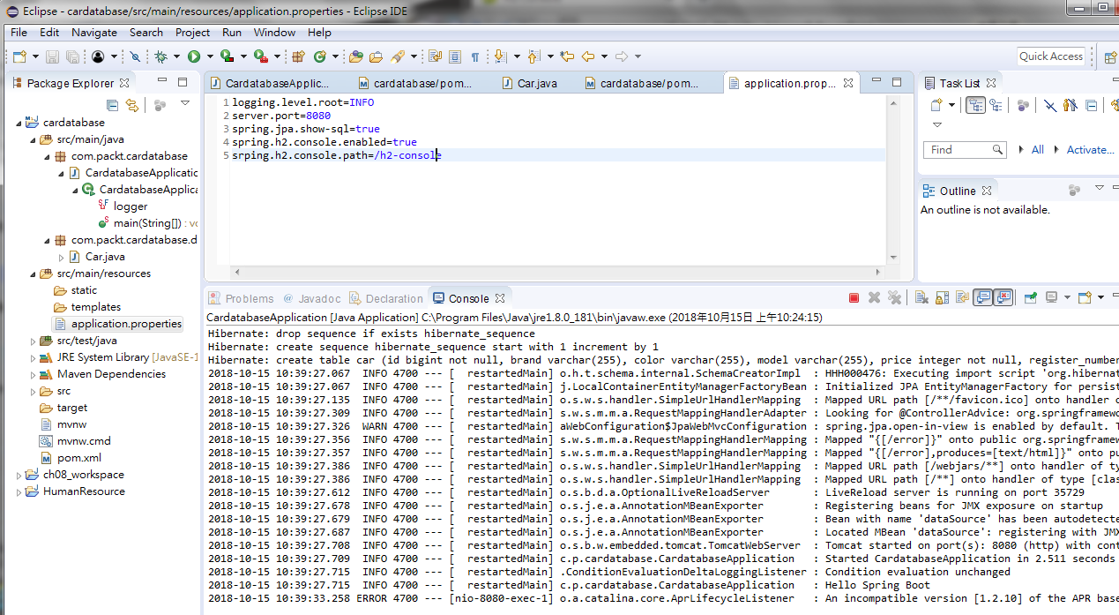
2.3 Run Car.java
https://github.com/PacktPublishing/Hands-On-Full-Stack-Development-with-Spring-Boot-2.0-and-React
Open browser and enter “localhost:8080/h2-console”
Note: Change the “server.port=8080” in application.properties.

Slide 22
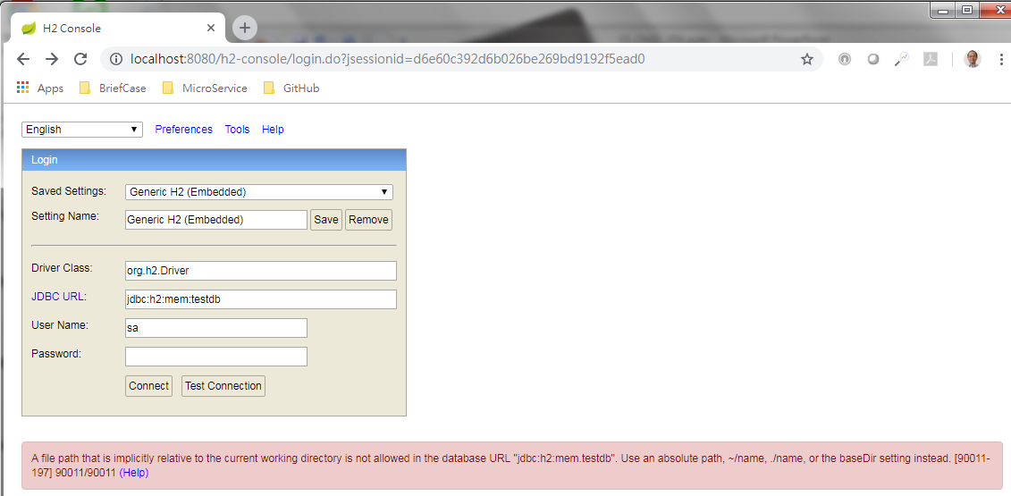
2.3 Run Car.java
https://github.com/PacktPublishing/Hands-On-Full-Stack-Development-with-Spring-Boot-2.0-and-React
Use “jdbc:h2:mem:testdb” as JDBC URI and leave PASSWORD empty

Slide 23
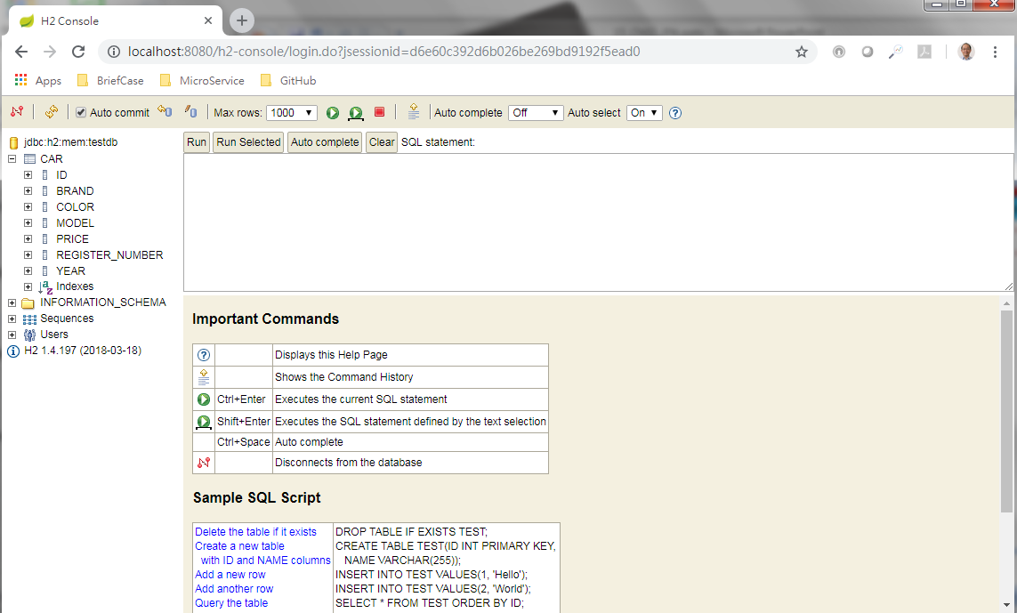
2.3 Run Car.java
https://github.com/PacktPublishing/Hands-On-Full-Stack-Development-with-Spring-Boot-2.0-and-React
Now, you can see “CAR” Table in the H2 database.
You also see the register number has an uderscore (_) between the words (REGISTER_NUMBER).
This is because of the Camel naming (registerNumber) conversion into underscore (_).

Slide 24
2.4 Java Code

Slide 25
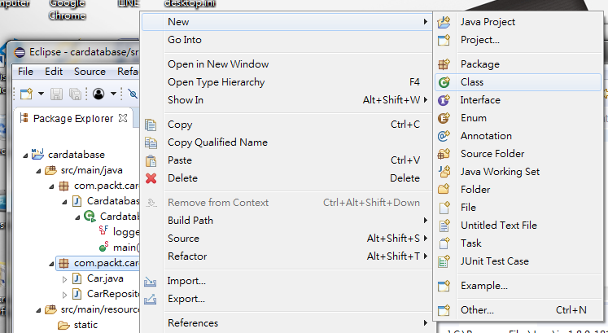
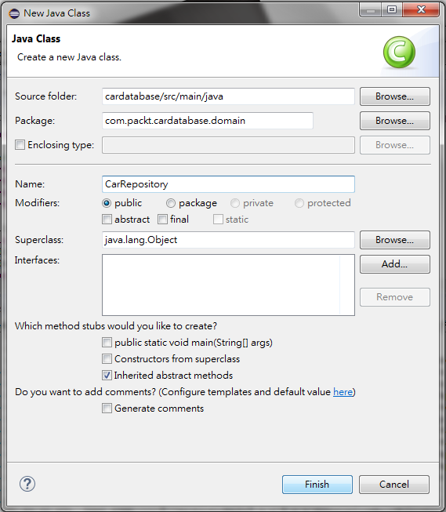
2.4 CRUD
https://github.com/PacktPublishing/Hands-On-Full-Stack-Development-with-Spring-Boot-2.0-and-React
Spring Boot Data JPA provides CrudRepository interface for CRUD operations.
Create repository in domain package:
Create new class CarRepository in com.packet.cardatabase.domain package.
Select Class
Class Name: CarRepository
RMB: com.packt.cardatabase.domain

Slide 26
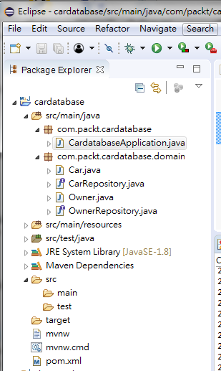
2.4 CRUD
https://github.com/PacktPublishing/Hands-On-Full-Stack-Development-with-Spring-Boot-2.0-and-React
The directory com.packt.carddatabase includes:
CardatabaseApplication.java
The directory com.packt.cardatabase.domain includes:
Car.java
CarRepository.java
Owner.java
OwnerRepository.java

Slide 27
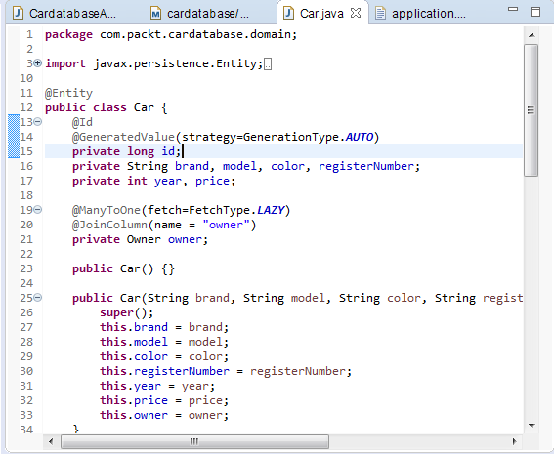
2.4 CRUD
https://github.com/PacktPublishing/Hands-On-Full-Stack-Development-with-Spring-Boot-2.0-and-React
Car.java:

Slide 28
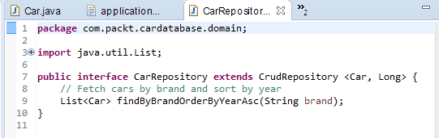
2.4 CRUD
https://github.com/PacktPublishing/Hands-On-Full-Stack-Development-with-Spring-Boot-2.0-and-React
CarRepository.java:

Slide 29
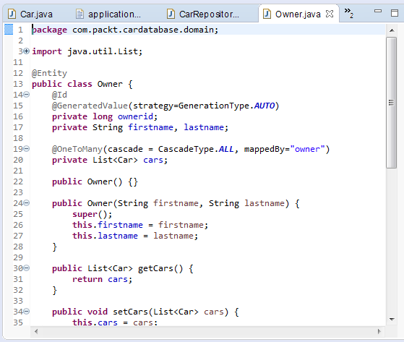
2.4 CRUD
https://github.com/PacktPublishing/Hands-On-Full-Stack-Development-with-Spring-Boot-2.0-and-React
Owner.java

Slide 30
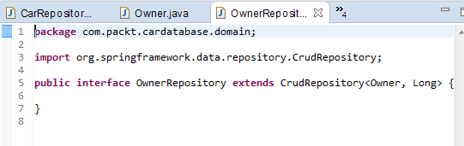
2.4 CRUD
https://github.com/PacktPublishing/Hands-On-Full-Stack-Development-with-Spring-Boot-2.0-and-React
OwnerRepository.java

Slide 31
2.5 Run H2-Console

Slide 32
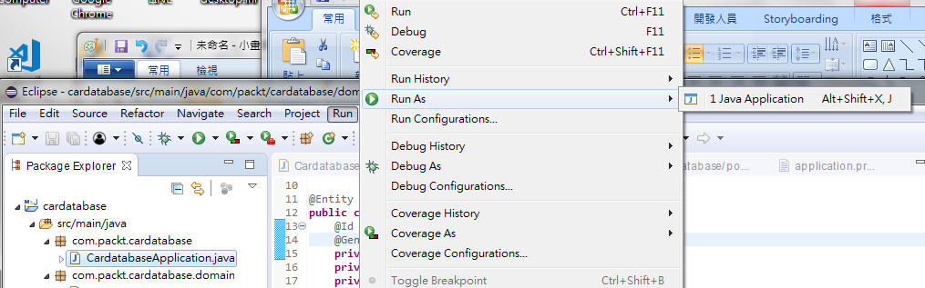
2.5 Run H2-Console
https://github.com/PacktPublishing/Hands-On-Full-Stack-Development-with-Spring-Boot-2.0-and-React
Click CardatabaseApplication.java, RMB: Run as > Java Application

Slide 33
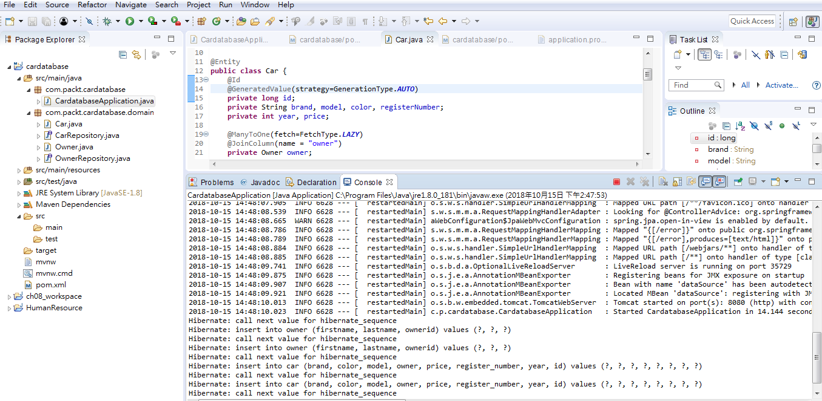
2.5 Run H2-Console
https://github.com/PacktPublishing/Hands-On-Full-Stack-Development-with-Spring-Boot-2.0-and-React
Output:

Slide 34
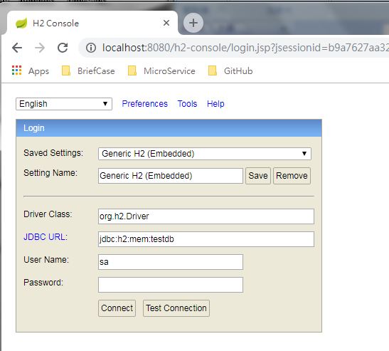
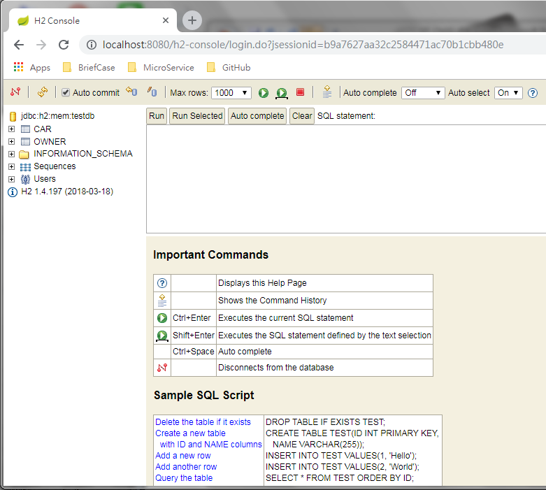
2.5 Run H2-Console
https://github.com/PacktPublishing/Hands-On-Full-Stack-Development-with-Spring-Boot-2.0-and-React
Open chrome. Enter “localhost:8080/h2-console”
Click “Connect” to display h2-database

Slide 35
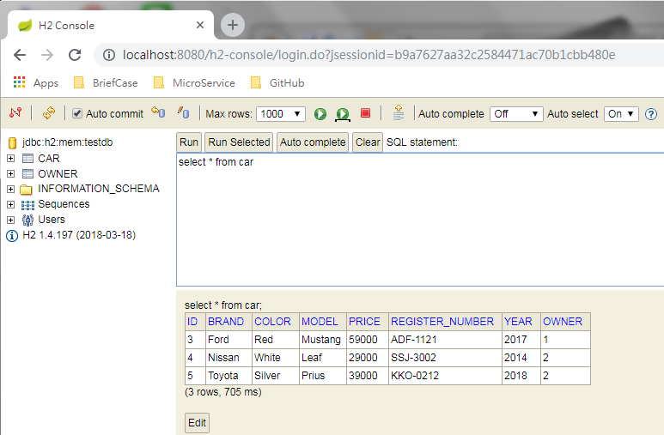
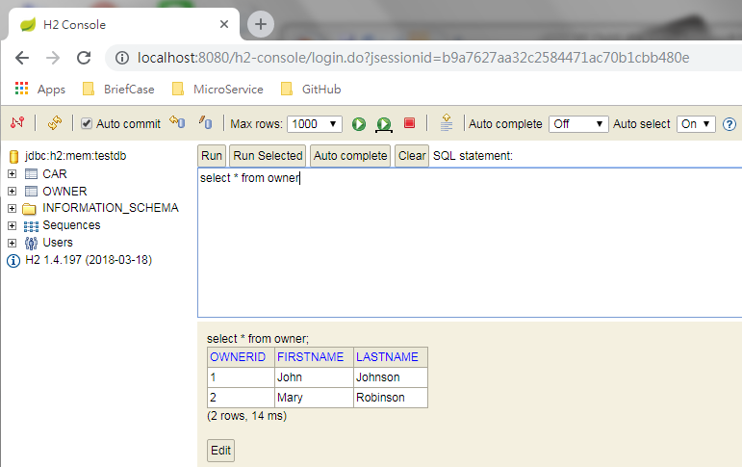
2.5 Run H2-Console
https://github.com/PacktPublishing/Hands-On-Full-Stack-Development-with-Spring-Boot-2.0-and-React
Select * from car
Select * from owner

Slide 36
2.6 Setup MariaDB Database

Slide 37
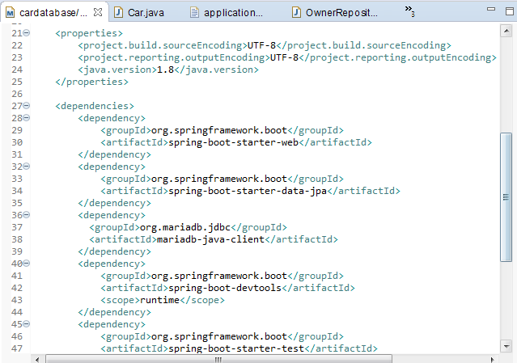
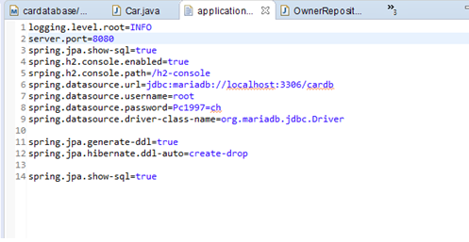
2.6 Setup MariabDB Database
https://github.com/PacktPublishing/Hands-On-Full-Stack-Development-with-Spring-Boot-2.0-and-React
Modify pom.xml:
Modify application.properties:

Slide 38

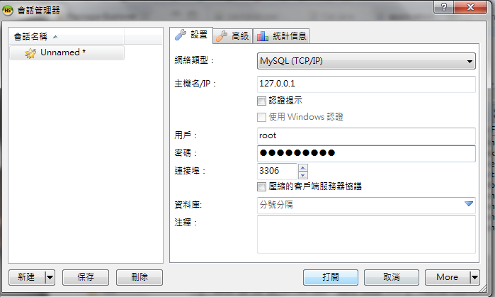
2.6 Setup MariabDB Database
https://github.com/PacktPublishing/Hands-On-Full-Stack-Development-with-Spring-Boot-2.0-and-React
Start HeidiSQL

Slide 39
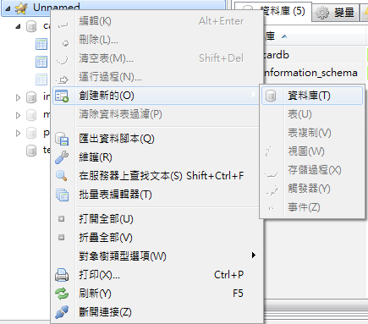
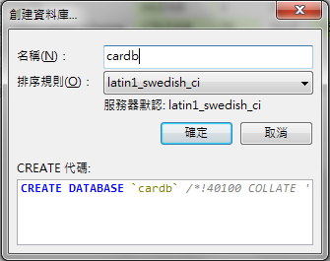
2.6 Setup MariabDB Database
https://github.com/PacktPublishing/Hands-On-Full-Stack-Development-with-Spring-Boot-2.0-and-React
Create cardb database:

Slide 40
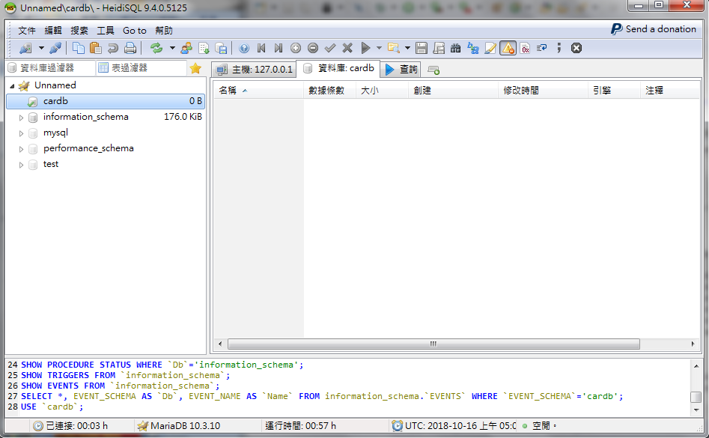
2.6 Setup MariabDB Database
https://github.com/PacktPublishing/Hands-On-Full-Stack-Development-with-Spring-Boot-2.0-and-React
Create cardb

Slide 41
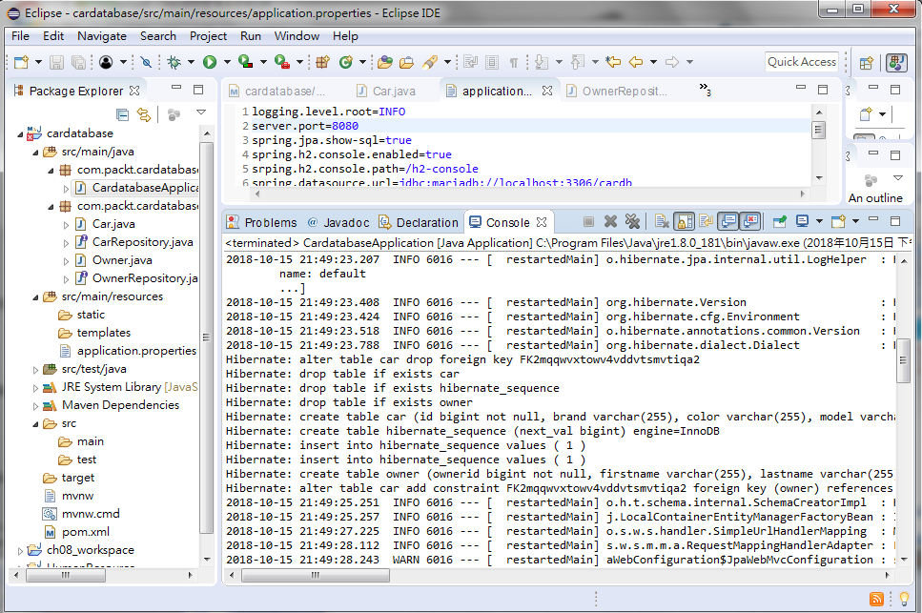
2.6 Setup MariabDB Database
https://github.com/PacktPublishing/Hands-On-Full-Stack-Development-with-Spring-Boot-2.0-and-React
Run As > Java Application
Run Hibernate for MariaDB Database insertion and drop

Slide 42
End of Chapter

