Slide 1

6 Start React
Peter H. Chen

Slide 2
6 Start React
https://github.com/PacktPublishing/Hands-On-Full-Stack-Development-with-Spring-Boot-2.0-and-React
This document describes the following:
Create React Components
Use state and props in Components
EC6 Features
JSX
Handle events and forms in React

Slide 3
6.1 Basic React Component
Peter H. Chen

Slide 4
6.1 Basic React Component
https://github.com/PacktPublishing/Hands-On-Full-Stack-Development-with-Spring-Boot-2.0-and-React
Basic React Components:
Search
Root
Component
ID
Description
Date
1
Shopping
01/27/2018
Search Component
Table Component
4
Exam
5/30/2018
7
Wash Car
6/21/2018
10
Coffee
10/15/2018
Table Row Component

Slide 5
6.2 Babel Compiler

Slide 6
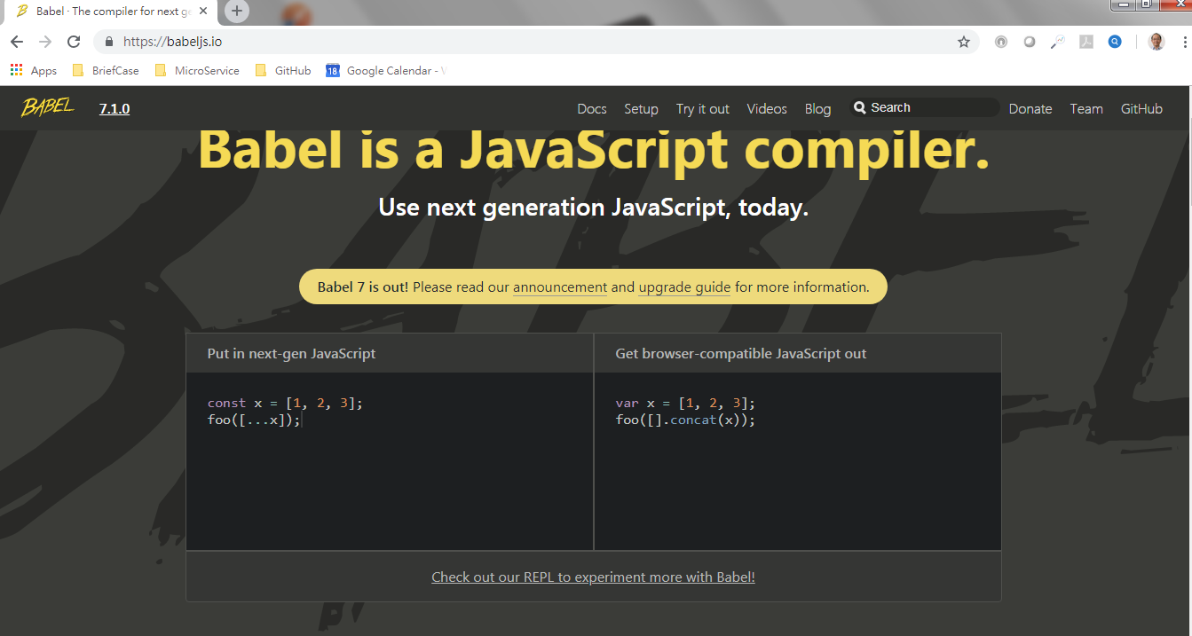
6.2 Babel Compiler
https://github.com/PacktPublishing/Hands-On-Full-Stack-Development-with-Spring-Boot-2.0-and-React
Babel Compiler: https://babeljs.io
Click bottom Link to start Babel.

Slide 7
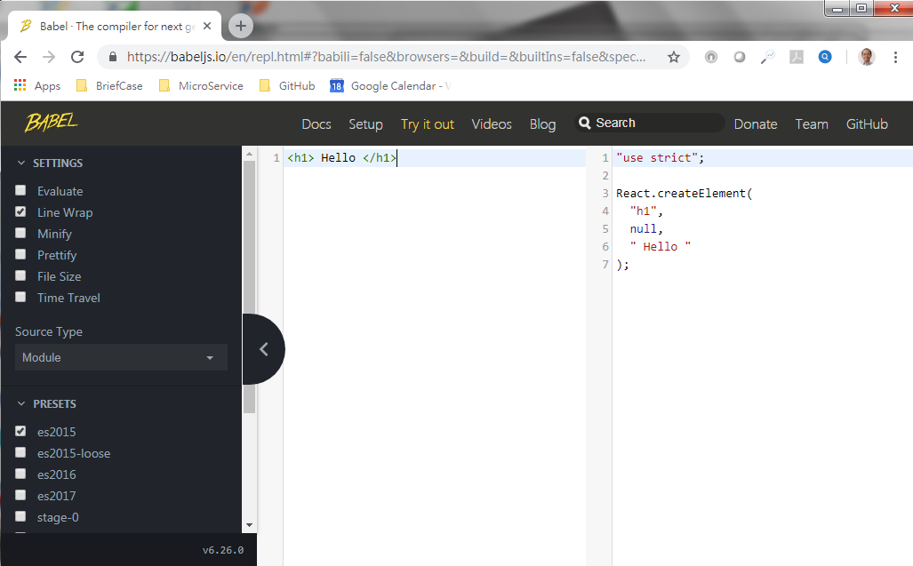
6.2 Babel Compiler
https://github.com/PacktPublishing/Hands-On-Full-Stack-Development-with-Spring-Boot-2.0-and-React
Type JSX on the left-hand window
Translate the JSX into JavaScript on the right-hand window.

Slide 8
End of Chapter

