Slide 1

8 React Third Party Component
Peter H. Chen

Slide 2
8 Third Party Component
https://github.com/PacktPublishing/Hands-On-Full-Stack-Development-with-Spring-Boot-2.0-and-React
This document describes the following:
How to find third-party component
How to install component
How to use React Table Component
How to use Modal Window Component
How to use Material UI Component Library
How to manage Routing in React

Slide 3
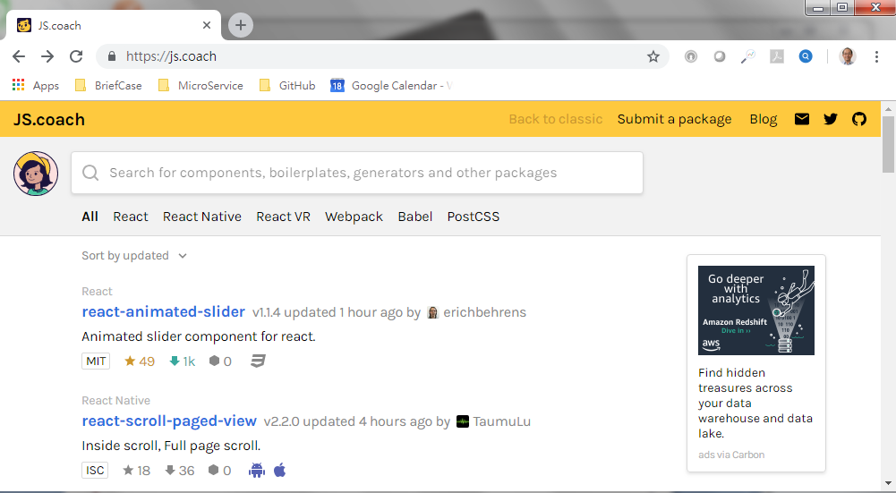
8 Third Party Component
https://github.com/PacktPublishing/Hands-On-Full-Stack-Development-with-Spring-Boot-2.0-and-React
https://js.coach

Slide 4
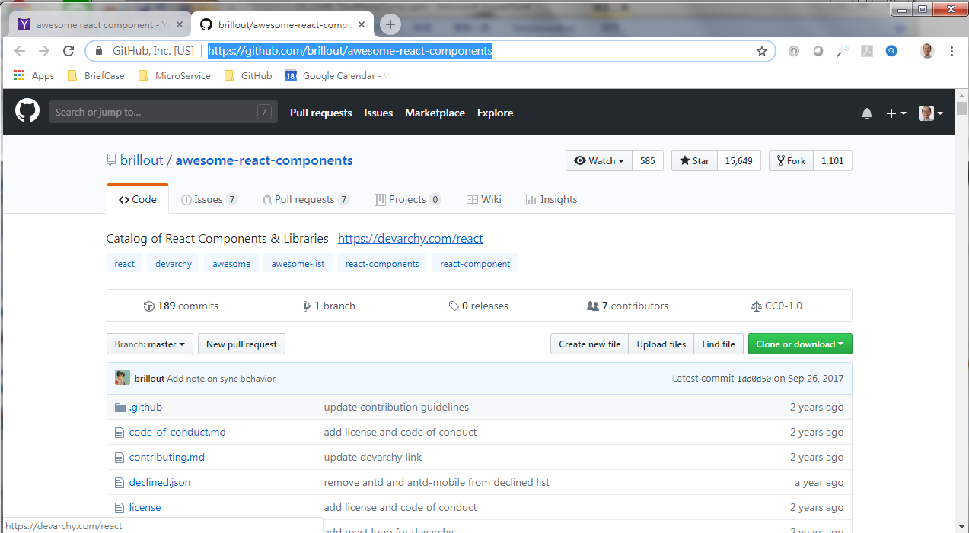
8 Third Party Component
https://github.com/PacktPublishing/Hands-On-Full-Stack-Development-with-Spring-Boot-2.0-and-React
https://github.com/brillout/awesome-rect-component

Slide 5
8.1 React Table Component
Peter H. Chen

Slide 6
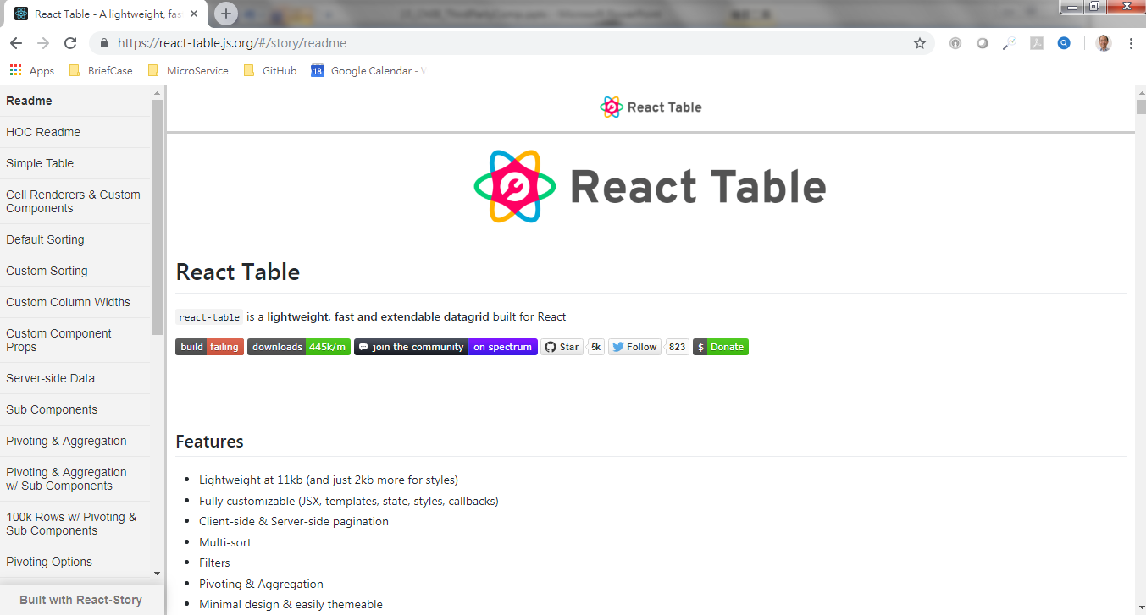
8.1 React Table Component
https://github.com/PacktPublishing/Hands-On-Full-Stack-Development-with-Spring-Boot-2.0-and-React
https://react-table.js.org

Slide 7
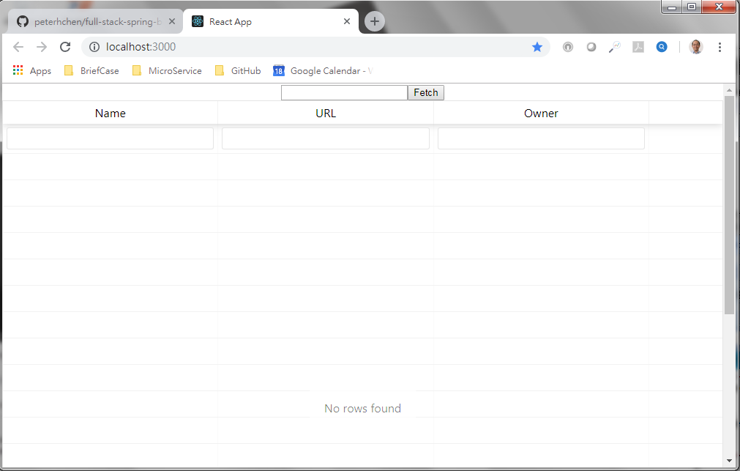
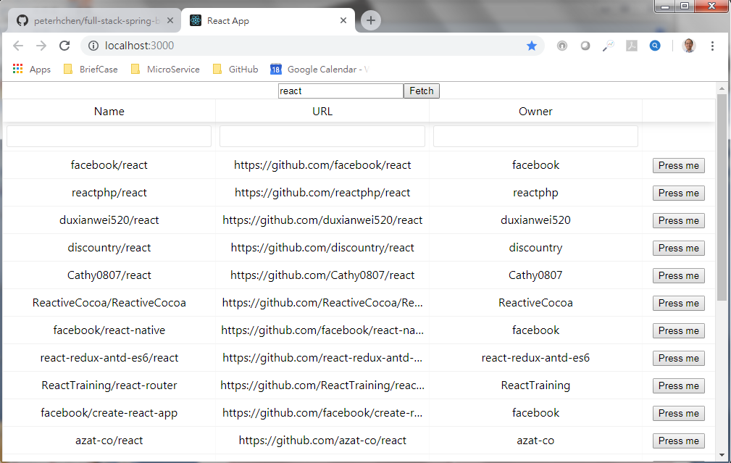
8.1 React Table Component
https://github.com/PacktPublishing/Hands-On-Full-Stack-Development-with-Spring-Boot-2.0-and-React
C:\> create-react-app ch0801-react-table
C:\> cd ch0801-react-table
C:\> npm install react-table --save;
C:\>npm start
Search “react”

Slide 8
8.2 Modal Window Component
Peter H. Chen

Slide 9
8.2 React Table Component
https://github.com/PacktPublishing/Hands-On-Full-Stack-Development-with-Spring-Boot-2.0-and-React
C:\> create-react-app ch0802-shopping-list
C:\> cd ch0801-shooping-list
C:\> npm install react-skylight --save
C:\> npm install @material-ui/core --save
C:\> npm install material-ui@next --save
C:\> npm install babel-runtime --save
C:\>npm start
Add item

Slide 10
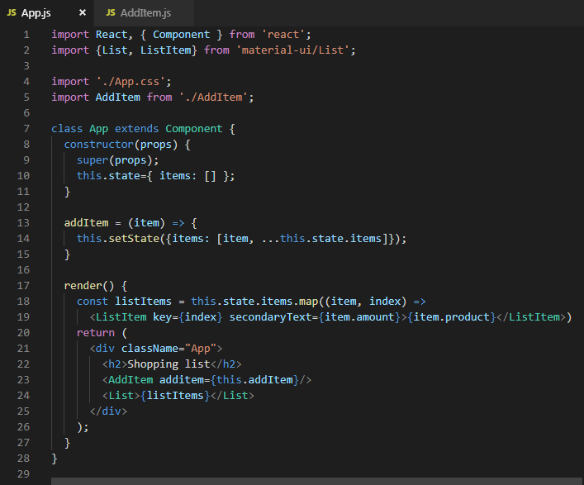
8.2 React Table Component
https://github.com/PacktPublishing/Hands-On-Full-Stack-Development-with-Spring-Boot-2.0-and-React
App.js

Slide 11
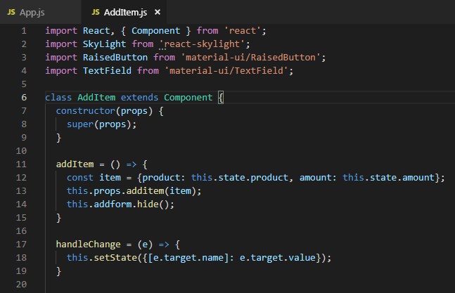
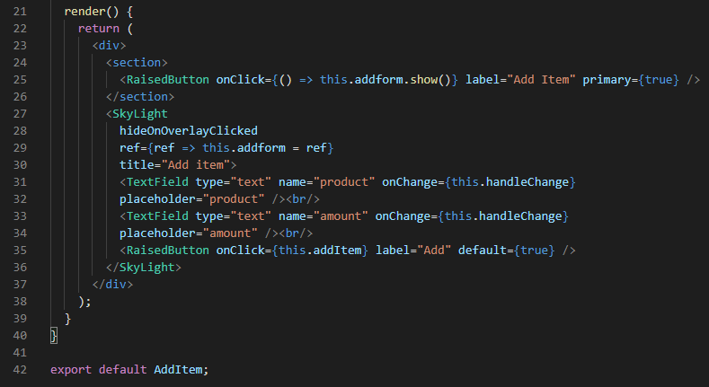
8.2 React Table Component
https://github.com/PacktPublishing/Hands-On-Full-Stack-Development-with-Spring-Boot-2.0-and-React
AddItem.js

Slide 12
8.3 React Router
Peter H. Chen

Slide 13
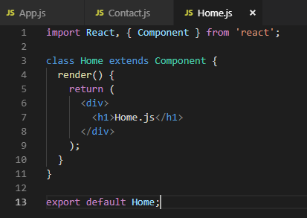
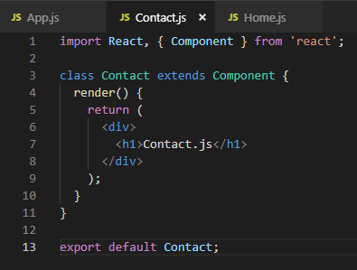
8.3 React Router
https://github.com/PacktPublishing/Hands-On-Full-Stack-Development-with-Spring-Boot-2.0-and-React
Home.js
Contact.js

Slide 14
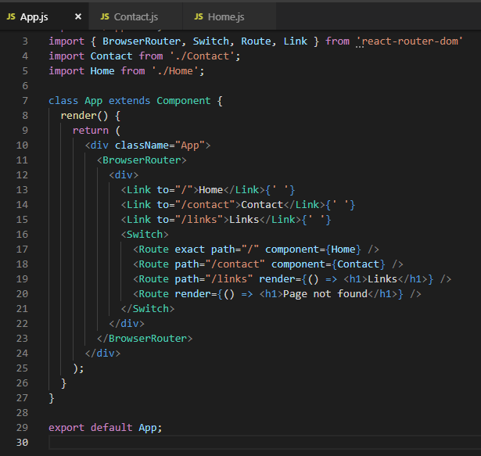
8.3 React Router
https://github.com/PacktPublishing/Hands-On-Full-Stack-Development-with-Spring-Boot-2.0-and-React
App.js

Slide 15
8.3 React Router
https://github.com/PacktPublishing/Hands-On-Full-Stack-Development-with-Spring-Boot-2.0-and-React
Home.js

Slide 16
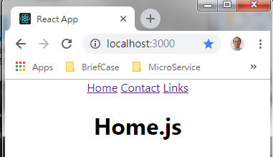
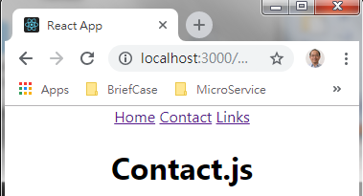
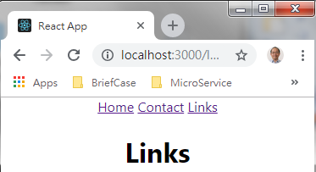
8.3 React Router
https://github.com/PacktPublishing/Hands-On-Full-Stack-Development-with-Spring-Boot-2.0-and-React
React Router

Slide 17
End of Chapter

