Slide 1

2 Overview
Peter H. Chen

Slide 2
2 Overview
https://www.tutorialspoint.com/java8/java8_overview.htm
Java 8 is a major feature release of Java programming language development.
Its initial version was released on 18 March 2014.
With the Java 8 release, Java provided supports for functional programming, new JavaScript engine, new APIs for date time manipulation, new streaming API, etc.

Slide 3
2.1 Feature

Slide 4
2.1 Feature
https://www.tutorialspoint.com/java8/java8_overview.htm
New Factures:
Lambda expression − Adds functional processing capability to Java.
Method references − Referencing functions by their names instead of invoking them directly. Using functions as parameter.
Default method − Interface to have default method implementation.
New tools − New compiler tools and utilities are added like ‘jdeps’ to figure out dependencies.
Stream API − New stream API to facilitate pipeline processing.
Date Time API − Improved date time API.
Optional − Emphasis on best practices to handle null values properly.
Nashorn, JavaScript Engine − A Java-based engine to execute JavaScript code.

Slide 5
2.1 Feature
https://www.tutorialspoint.com/java8/
Consider the following code snippet.
Here the sortUsingJava8() method uses sort function with a lambda expression as parameter to get the sorting criteria.
import java.util.Collections;
import java.util.List;
import java.util.ArrayList;
import java.util.Comparator; public class Java8Tester { public static void main(String args[]) {
List<String> names1 = new ArrayList<String>();
names1.add("Mahesh "); names1.add("Suresh ");
names1.add("Ramesh "); names1.add("Naresh ");
names1.add("Kalpesh ");
List<String> names2 = new ArrayList<String>();
names2.add("Mahesh "); names2.add("Suresh ");
names2.add("Ramesh "); names2.add("Naresh ");
names2.add("Kalpesh ");
Java8Tester tester = new Java8Tester();
System.out.println("Sort using Java 7 syntax: ");
tester.sortUsingJava7(names1);
System.out.println(names1);
System.out.println("Sort using Java 8 syntax: ");
tester.sortUsingJava8(names2);
System.out.println(names2);
}
//sort using java 7
private void sortUsingJava7(List<String> names) {
Collections.sort (names, new Comparator<String>() {
@Override
public int compare(String s1, String s2) {
return s1.compareTo(s2);
}
});
}
//sort using java 8
private void sortUsingJava8 (List<String> names) {
Collections.sort(names, (s1, s2) -> s1.compareTo(s2));
}
}

Slide 6
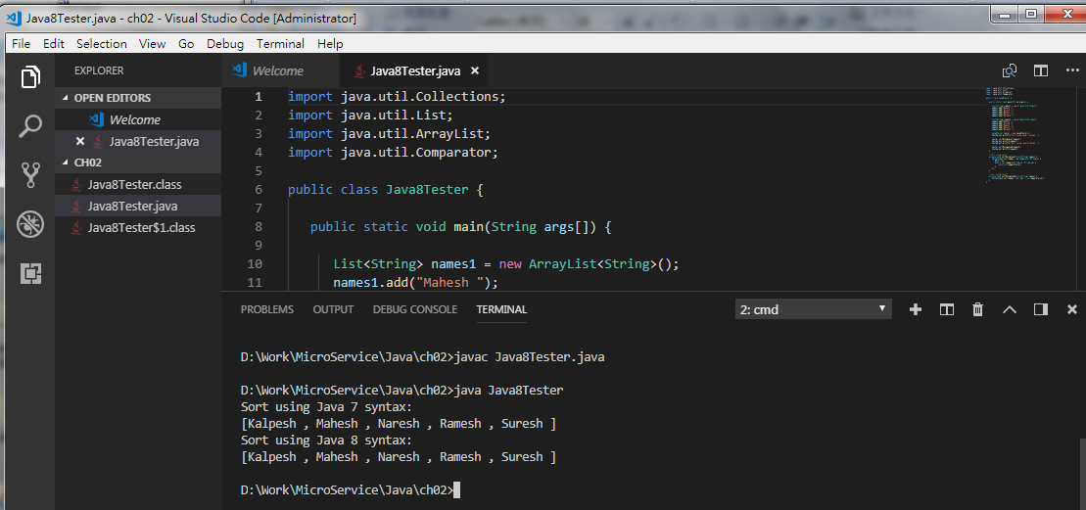
2.1 Feature
https://www.tutorialspoint.com/java8/java8_overview.htm
C:\> javac Java8Tester.java
C:\> java Java8Tester
Sort using Java 7 syntax:
[ Kalpesh Mahesh Naresh Ramesh Suresh ]
Sort using Java 8 syntax:
[ Kalpesh Mahesh Naresh Ramesh Suresh ]

Slide 7
End of Chapter

