Slide 1

3 Setup
Peter H. Chen

Slide 2
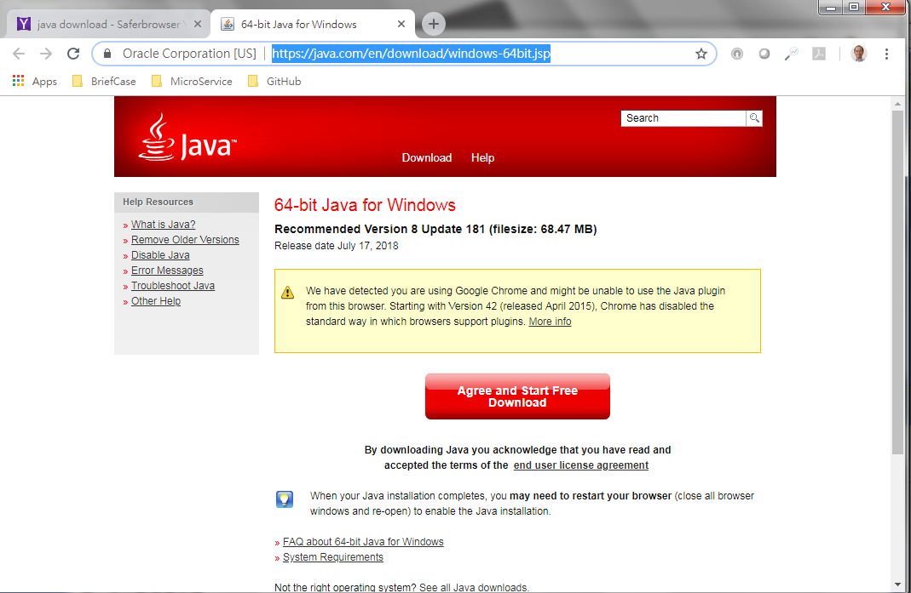
3 Setup
https://www.tutorialspoint.com/java8/java8_environment.htm
Download Java 8 and install.
https://java.com/en/download/windows-64bit.jsp.

Slide 3
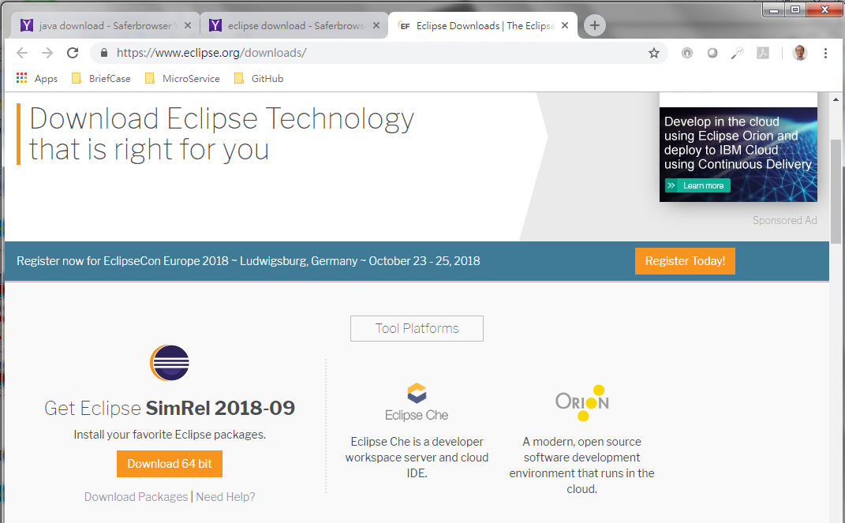
3 Setup
https://www.tutorialspoint.com/java8/java8_environment.htm
Download Eclipse and Install.
https://www.eclipse.org/downloads/

Slide 4
End of Chapter

