Slide 1
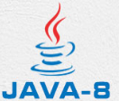
4 Lambda Expression
Peter H. Chen

Slide 2
4 Lambda Expression
https://www.tutorialspoint.com/java8/java8_lambda_expressions.htm
Lambda expressions are introduced in Java 8 and are touted to be the biggest feature of Java 8.
Lambda expression facilitates functional programming, and simplifies the development a lot.
Syntax
A lambda expression is characterized by the following syntax.
parameter -> expression body

Slide 3
4 Lambda Expression
https://www.tutorialspoint.com/java8/java8_lambda_expressions.htm
Following are the important characteristics of a lambda expression.
Optional type declaration − No need to declare the type of a parameter. The compiler can inference the same from the value of the parameter.
Optional parenthesis around parameter − No need to declare a single parameter in parenthesis. For multiple parameters, parentheses are required.
Optional curly braces − No need to use curly braces in expression body if the body contains a single statement.
Optional return keyword − The compiler automatically returns the value if the body has a single expression to return the value. Curly braces are required to indicate that expression returns a value.

Slide 4
4.1 Lambda Expression Example

Slide 5
4.1 Lambda Expression Example
https://www.tutorialspoint.com/java8/java8_lambda_expressions.htm
Lambda Expression Example:
public class Java8Tester01 {
public static void main(String args[]) {
Java8Tester01 tester = new Java8Tester01();
//with type declaration
MathOperation addition = (int a, int b) -> a + b;
//with out type declaration
MathOperation subtraction = (a, b) -> a - b;
//with return statement along with curly braces
MathOperation multiplication = (int a, int b) -> { return a * b; };
//without return statement and without curly braces
MathOperation division = (int a, int b) -> a / b;
System.out.println("10 + 5 = " + tester.operate(10, 5, addition));
System.out.println("10 - 5 = " + tester.operate(10, 5, subtraction));
System.out.println("10 x 5 = " + tester.operate(10, 5, multiplication));
System.out.println("10 / 5 = " + tester.operate(10, 5, division));
//without parenthesis
GreetingService greetService1 = message ->System.out.println("Hello " + message);
//with parenthesis
GreetingService greetService2 = (message) ->System.out.println("Hello " + message);
greetService1.sayMessage("Mahesh");
greetService2.sayMessage("Suresh");
}
interface MathOperation {
int operation(int a, int b);
}
interface GreetingService {
void sayMessage(String message);
}
private int operate(int a, int b, MathOperation mathOperation) {
return mathOperation.operation(a, b);
}
}

Slide 6
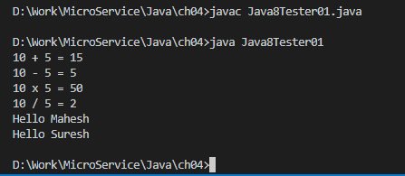
4.1 Lambda Expression Example
https://www.tutorialspoint.com/java8/java8_lambda_expressions.htm
C:\> javac Java8Tester01.java
C:\> java Java8Tester01

Slide 7
4.1 Lambda Expression Example
https://www.tutorialspoint.com/java8/java8_lambda_expressions.htm
Following are the important points to be considered in the above example.
Lambda expressions are used primarily to define inline implementation of a functional interface, i.e., an interface with a single method only.
In the above example, we've used various types of lambda expressions to define the operation method of MathOperation interface.
Then we have defined the implementation of sayMessage of GreetingService.
Lambda expression eliminates the need of anonymous class and gives a very simple yet powerful functional programming capability to Java.

Slide 8
4.2 Scope

Slide 9
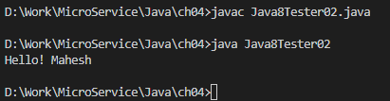
4.2 Scope
https://www.tutorialspoint.com/java8/java8_lambda_expressions.htm
Using lambda expression, you can refer to any final variable or effectively final variable (which is assigned only once). Lambda expression throws a compilation error, if a variable is assigned a value the second time.
Scope Example
Create the following Java program Java8Tester02.java
public class Java8Tester02 {
final static String salutation = "Hello! ";
public static void main(String args[]) {
GreetingService greetService1 = message -> System.out.println(salutation + message);
greetService1.sayMessage("Mahesh");
}
interface GreetingService {
void sayMessage(String message);
}
}

Slide 10
End of Chapter

