Slide 1

5 Method Reference
Peter H. Chen

Slide 2
5 Method Reference
https://www.tutorialspoint.com/java8/java8_method_references.htm
Method references help to point to methods by their names.
A method reference is described using "::" symbol.
A method reference can be used to point the following types of methods −
Static methods
Instance methods
Constructors using new operator (TreeSet::new)

Slide 3
5.1 Method Reference Example

Slide 4
5.1 Method Reference Example
https://www.tutorialspoint.com/java8/java8_method_references.htm
Java8Testerch05.java:
Here we have passed System.out::println method as a static method reference
import java.util.List;
import java.util.ArrayList;
public class Java8Testerch05 {
public static void main(String args[]) {
List names = new ArrayList();
names.add("Mahesh");
names.add("Suresh");
names.add("Ramesh");
names.add("Naresh");
names.add("Kalpesh");
names.forEach(System.out::println);
}
}

Slide 5
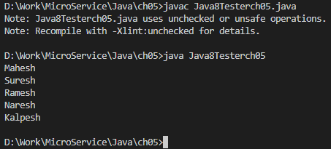
5.1 Method Reference Example
https://www.tutorialspoint.com/java8/java8_method_references.htm
Output:

Slide 6
End of Chapter

