Slide 1

6 Install Kafka
Peter H. Chen

Slide 2
6 Install Kafka
https://www.tutorialspoint.com/apache_kafka/apache_kafka_installation_steps.htm
Kafka requires:
Java
Zookeeper
Kafka

Slide 3
6.1 Install Java

Slide 4
6.1 Install Java
https://www.tutorialspoint.com/apache_kafka/apache_kafka_installation_steps.htm
Install Java: https://java.com/en/download/

Slide 5
6.2 Install Zookeeper

Slide 6
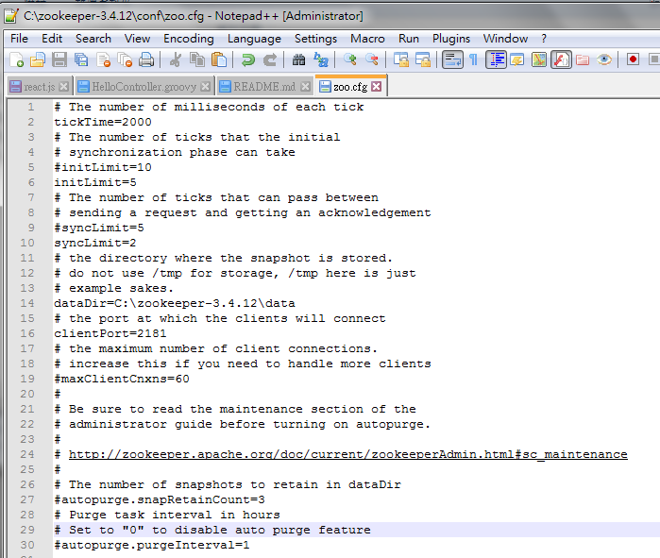
6.2 Install Zookeeper
https://www.tutorialspoint.com/apache_kafka/apache_kafka_installation_steps.htm
Install Zookeeper-3.4.1: http://zookeeper.apache.org/releases.html
Unzip and put C:\Zookeeper-3.4.1
mkdir C:\Zookeeper-3.4.12\data
Edit C:\Zookeeper-3.4.12\conf\zoo.cfg
tickTime=2000
dataDir=C:\zookeeper-3.4.1\data
clientPort=2181
initLimit=5
syncLimit=2

Slide 7
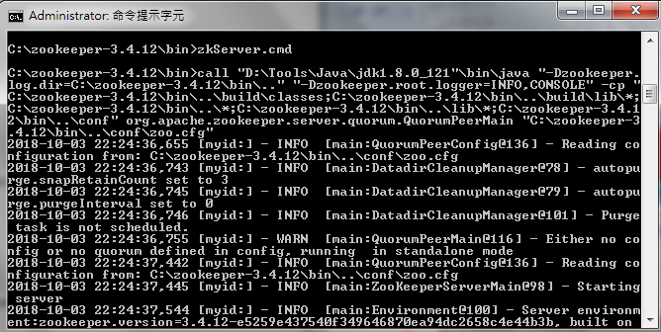
6.2 Install Zookeeper
https://www.tutorialspoint.com/apache_kafka/apache_kafka_installation_steps.htm
Start Zookeeper server:
C:\Zookeeper-3.4.12\bin\zkServer.cmd

Slide 8
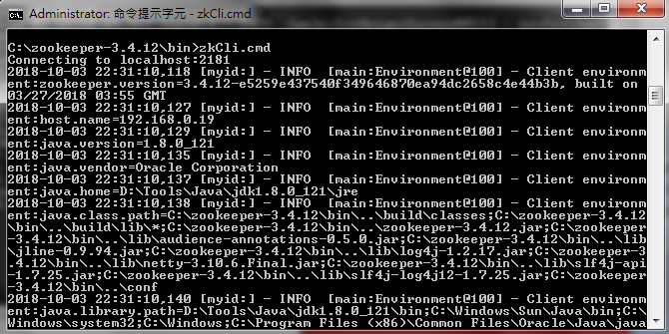
6.2 Install Zookeeper
https://www.tutorialspoint.com/apache_kafka/apache_kafka_installation_steps.htm
Start Zookeeper CLI:
C:\Zookeeper-3.4.12\bin\zkCli.cmd

Slide 9
6.3 Install Kafka

Slide 10
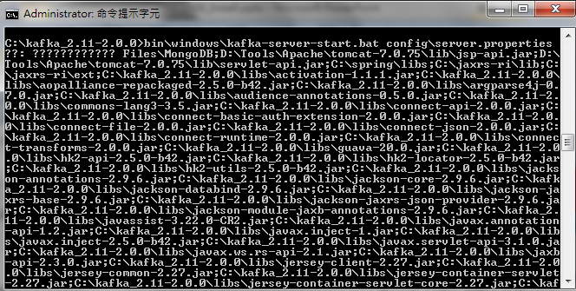
6.3 Install Kafka
https://www.tutorialspoint.com/apache_kafka/apache_kafka_workflow.htmx
Download Kafka:
https://www.apache.org/dyn/closer.cgi?path=/kafka/0.9.0.0/kafka_2.11-0.9.0.0.tgz
Unzip Kafka to “C:\kafka_2.11-2.0.0”
C:\cd kaffka_2.11-2.0.0
C:\kafka_2.11-2.0.0 > bin\windows\kafka-server-start.bat config\server.properties

Slide 11
6.3 Install Kafka
https://www.tutorialspoint.com/apache_kafka/apache_kafka_workflow.htmx
Stop Kafka server:
C:\kafka_2.11-2.0.0 > bin\windows\kafka-server-stop.bat config\server.properties

Slide 12
End of Chapter

