Slide 1

Chapter 4: MongoDB Environment
Peter H. Chen

Slide 2

4 MongoDB Environment
https://www.tutorialspoint.com/mongodb/mongodb_environment.htm
Make sure you get correct version of MongoDB depending upon your Windows version.
Use wmic (Window Management Interface Command) to check Windows version.
C:\>wmic os get osarchitecture
OSArchitecture
64-bit
C:\>

Slide 3
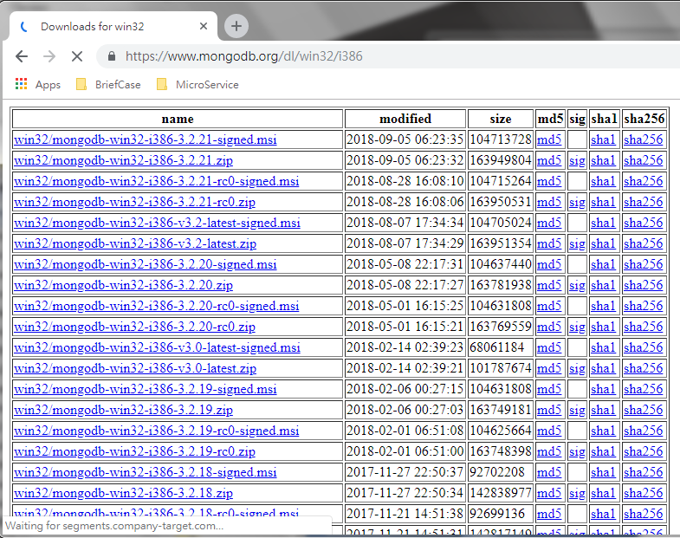
4 MongoDB Environment
https://www.tutorialspoint.com/mongodb/mongodb_environment.htm
Let us now see how to install MongoDB on Windows.
Install MongoDB On Windows
To install MongoDB on Windows, https://www.mongodb.org/dl/win32/i386
I cannot install 4.0.2 (mongodb-win32-x86_64-2008plus-ssl-4.0.2-signed.msi) in my Windows-7.
You can find other people have the same problem I have: https://stackoverflow.com/questions/49962591/installing-mongodb-compass-this-may-take-a-few-minutes
I picked 3.2 (mongodb-win32-x86_64-2008plus-ssl-v3.2-latest-signed.msi) which I tried and worked one year before.

Slide 4
4.1 MongoDB Installation

Slide 5
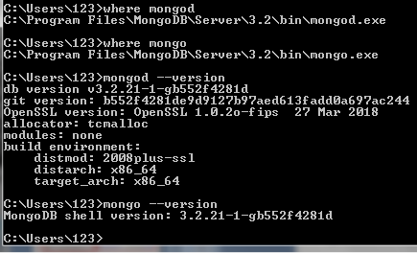
4.1 MongoDB Installation
https://www.tutorialspoint.com/mongodb/mongodb_environment.htm
Install the mongoDB with download msi file.
After installation, verify the mongod (MongoServer) and mong (Mongo command shell)
C:\where mongod
>> C:\Program Files\MongoDB\Server\3.2\bin\mongd.exe
C:\where mongo
>> C:\Program Files\MongoDB\Server\3.2\bin\mong.exe
C:\mongod --version
>> db version v3.2.21 …
C:\mongo --version
>> MongoDB shell version: 3.2.21

Slide 6
4.2 Start Mongo Server

Slide 7
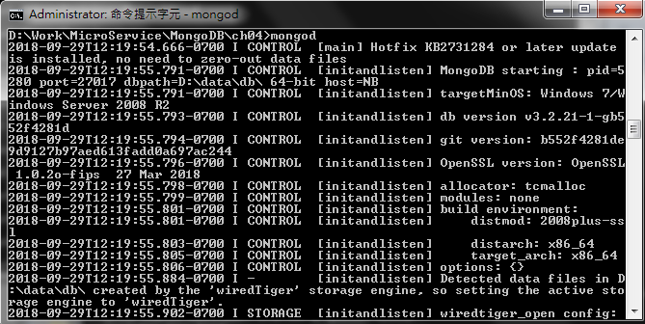
4.2 Start Mongo Server
https://www.tutorialspoint.com/mongodb/mongodb_environment.htm
Under any directory, start mongo Server (mongod):
C:\mongod

Slide 8
4.3 Start Mongo Shell

Slide 9
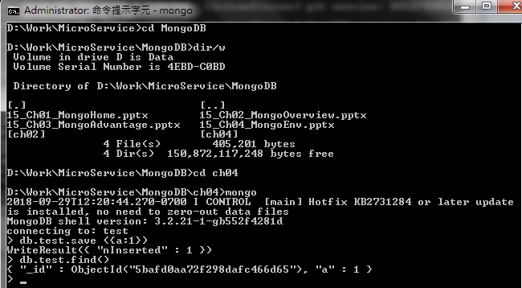
4.3 Start Mongo Shell
https://www.tutorialspoint.com/mongodb/mongodb_environment.htm
Change to target directory that you are going to work to save database, e.g., “d:\Work\MicroService\MongoDB\ch04”
Start mongo Shell (mongo):
D:\...> mongo
> db.test.save ({a:1})
>db.test.find()

Slide 10
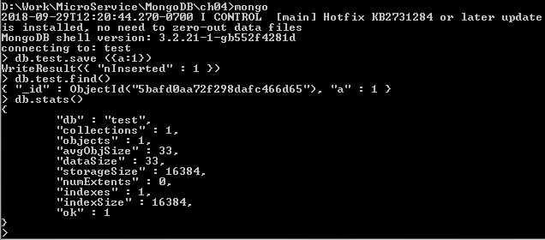
4.3 Start Mongo Shell
https://www.tutorialspoint.com/mongodb/mongodb_environment.htm
Check db.test.stats(): statistics of mongoDB
>db.test.stats()
# exit mongo shell
> exit

Slide 11
End of Chapter

