Slide 1

Chapter 7: Drop Database
Peter H. Chen

Slide 2
7 Drop Database
https://www.tutorialspoint.com/mongodb/mongodb_drop_database.htm
In this chapter, we will see how to drop a database using MongoDB command.
The dropDatabase() Method
MongoDB db.dropDatabase() command is used to drop a existing database.
Syntax
Basic syntax of dropDatabase() command is as follows
db.dropDatabase()
This will delete the selected database. If you have not selected any database, then it will delete default 'test' database.

Slide 3
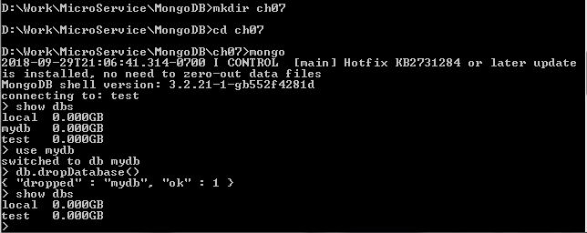
7 Drop Database
https://www.tutorialspoint.com/mongodb/mongodb_drop_database.htm
Example
First, check the list of available databases by using the command, show dbs.
> shows dbs
local 0.78125GB
mydb 0.23012GB
test 0.23012GB
>

Slide 4
7 Drop Database
https://www.tutorialspoint.com/mongodb/mongodb_drop_database.htm
If you want to delete new database <mydb>, then dropDatabase() command would be as follows
>use mydb
switched to db mydb
>db.dropDatabase()
>{ "dropped" : "mydb", "ok" : 1 }
>

Slide 5
7 Drop Database
https://www.tutorialspoint.com/mongodb/mongodb_drop_database.htm
If you want to delete new database <mydb>, then dropDatabase() command would be as follows
>show dbs
local 0.78125GB
test 0.23012GB
>

Slide 6
End of Chapter

