Slide 1

Chapter 8: Create Collection
Peter H. Chen

Slide 2
8 Create Collection
https://www.tutorialspoint.com/mongodb/mongodb_create_collection.htm
In this chapter, we will see how to create a collection using MongoDB.
The createCollection() Method
MongoDB db.createCollection(name, options) is used to create collection.
Syntax
Basic syntax of createCollection() command is as follows
db.createCollection(name, options)
In the command, name is name of collection to be created. Options is a document and is used to specify configuration of collection.
Parameter | Type | Description
Name | String | Name of the collection to be created
Options | Document | (Optional) Specify options about memory size and indexing

Slide 3
8 Create Collection
https://www.tutorialspoint.com/mongodb/mongodb_create_collection.htm
Options parameter is optional, so you need to specify only the name of the collection.
Following is the list of options you can use
Field | Type | Description
capped | Boolean | (Optional) If true, enables a capped collection. Capped collection is a fixed size collection that automatically overwrites its oldest entries when it reaches its maximum size. If you specify true, you need to specify size parameter also.
size | number | (Optional) Specifies a maximum size in bytes for a capped collection. If capped is true, then you need to specify this field also.
max | number | (Optional) Specifies the maximum number of documents allowed in the capped collection.

Slide 4
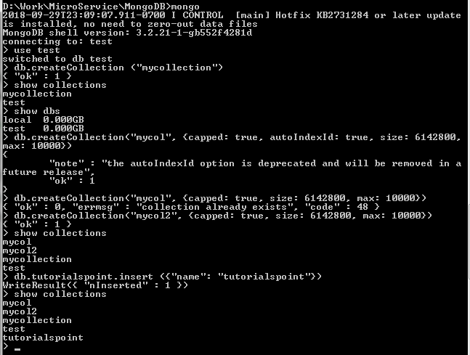
8 Create Collection
https://www.tutorialspoint.com/mongodb/mongodb_create_collection.htm
While inserting the document, MongoDB first checks size field of capped collection, then it checks max field.
Examples
Basic syntax of createCollection() method without options is as follows
> use test
switched to db test
> db.createCollection("mycollection")
{ "ok" : 1 }
>

Slide 5
8 Create Collection
https://www.tutorialspoint.com/mongodb/mongodb_create_collection.htm
The following example shows the syntax of createCollection()method with few important options
>db.createCollection("mycol", { capped : true, size : 6142800, max : 10000 } )
{ "ok" : 1 }
>

Slide 6
8 Create Collection
https://www.tutorialspoint.com/mongodb/mongodb_create_collection.htm
In MongoDB, you do not need to create collection. MongoDB creates collection automatically, when you insert some document.
>db.tutorialspoint.insert({"name" : "tutorialspoint"})
>show collections
mycol
mycollection
test
tutorialspoint
>

Slide 7
End of Chapter

