Slide 1

1 Login
Peter H. Chen

Slide 2
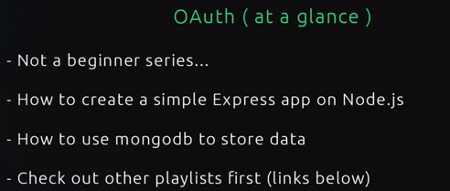
1 Login
https://www.youtube.com/watch?v=CHodPpqLqG8&index=2&list=PL4cUxeGkcC9jdm7QX143aMLAqyM-jTZ2x
This is not a beginner series:
Prerequisite:
Create s simple Express app on NodeJS.
A little bit of MongoDB knowledge will go along the way

Slide 3
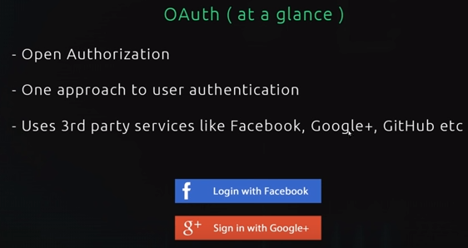
1 Login
https://www.youtube.com/watch?v=CHodPpqLqG8&index=2&list=PL4cUxeGkcC9jdm7QX143aMLAqyM-jTZ2x
What is OAuth?
OAuth stands for Open Authorization and it is just one approach to authenticate users inside the your application. It allows users to log into your app using third party services, such as, facebook, google, or gibhub.
When you see a website using this kinds of buttons as below, you can pretty sure they are using OAuth2 to authenticate user.
We can use third party services, such as, Google or Facebook.

Slide 4
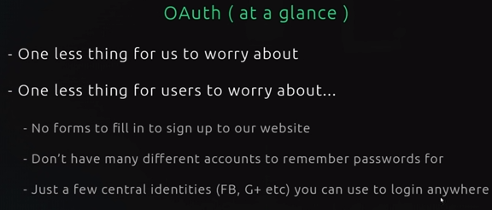
1 Login
https://www.youtube.com/watch?v=CHodPpqLqG8&index=2&list=PL4cUxeGkcC9jdm7QX143aMLAqyM-jTZ2x
This is a goo for couple of reasons: It is one less thing worry about as a developer. It frees up time for us to focus on the website or application. It is one less thing for the user to worry about as well.
They do not have to fill in any kind of forms to sign up to your website. They have to click a button and accept they are going to sign through Google or Facebook and then you signed up to your application as well.
So, it is really easy for users and we are not putting them off with all different forms and it means that a user can just have one or two central online identities through Facebook, GitHub, or Google+, or whatever social website they use.
The users can use OAuth to log in other applications.

Slide 5
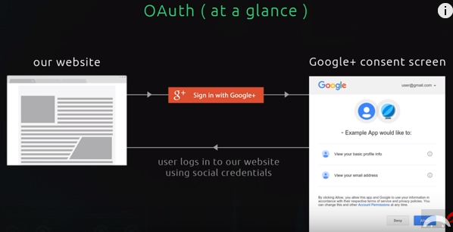
1 Login
https://www.youtube.com/watch?v=CHodPpqLqG8&index=2&list=PL4cUxeGkcC9jdm7QX143aMLAqyM-jTZ2x
When user sign in a website or using an OAuth, first of all, they land on our website and then they want to signup or login.
So, we find the Sign In with Google or Sign In with Facebook button.
Server website can create a profile and version in the database for the users.
We will use a library called passport.js and this is simplify the amount of code that we have to write and it handle a lot of the interaction between our application and the service, like Google. All the interaction here are handle by passport.js.

Slide 6
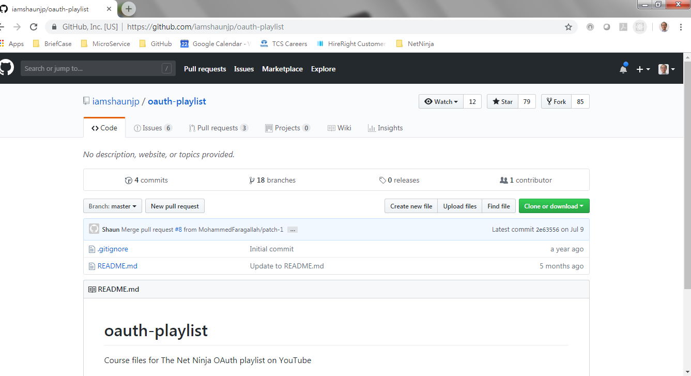
1 Login
https://www.youtube.com/watch?v=CHodPpqLqG8&index=2&list=PL4cUxeGkcC9jdm7QX143aMLAqyM-jTZ2x
We can just insert the passport in different sections in our application.
The codes can be found: https://github.com/iamshaunjp/oauth-playlist
Each section is store in different lesson.

Slide 7
End of Chapter

