Slide 1

2 OAuth Flow
Peter H. Chen

Slide 2
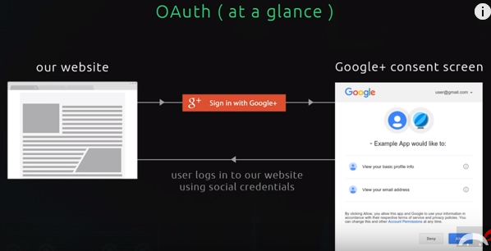
2 Auth Flow
https://www.youtube.com/watch?v=CHodPpqLqG8&index=2&list=PL4cUxeGkcC9jdm7QX143aMLAqyM-jTZ2x
The user login with our website and they want to sign in with social provider like Google+ or Facebook.
They click on red sign and we then redirect them to the Google service with the consent screen. The screen said “They will access your profile information with Google. Do you allow them to access this information so that they can use it on their website and sign you in.”

Slide 3
2 Auth Flow
https://www.youtube.com/watch?v=CHodPpqLqG8&index=2&list=PL4cUxeGkcC9jdm7QX143aMLAqyM-jTZ2x
If they click allow, we will redirect them back to our website where we now have access to their Google Profile information.
So we can take the information now and store in our own database and make our own record for our user.
The reason we want to do that is we can expand the data we have on that user.
For example, on our website, each user might have a point associated with that user. So we can add them to our database.

Slide 4
2 Auth Flow
https://www.youtube.com/watch?v=CHodPpqLqG8&index=2&list=PL4cUxeGkcC9jdm7QX143aMLAqyM-jTZ2x
It is nothing to do with Google, just our user.
We grab the information and store in own database.
So user can log in and use our website.
This is a simplified version of what is going on.

Slide 5
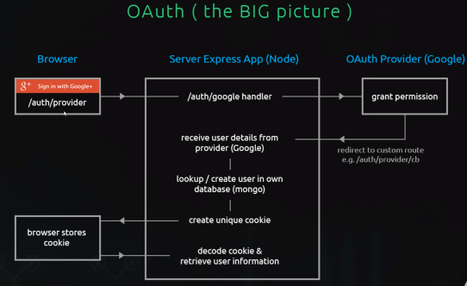
2 Auth Flow
https://www.youtube.com/watch?v=CHodPpqLqG8&index=2&list=PL4cUxeGkcC9jdm7QX143aMLAqyM-jTZ2x
User click the “g+ Sign in with Google” button. Redirect the route “/auth/provider” for our application, such as, “/auth/google” or “/auth/facebook”
Server Express App (Node): “/auth/google handeler” is used to handle our application.
OAuth provider (Google): “Grant permission” for the profile.
Redirect to “/auth/provider/cb” for callback route.

Slide 6
2 Auth Flow
https://www.youtube.com/watch?v=CHodPpqLqG8&index=2&list=PL4cUxeGkcC9jdm7QX143aMLAqyM-jTZ2x
Server Express App (Node): Receive user details from provider (Google).
Server Express App (Node): Create own version of database (mongoDB)
Server Express App (Node): Create Unique Cookie
Browser: Store Cookie
Server Express App (Node): Decode Cookie and retrieve User Information

Slide 7
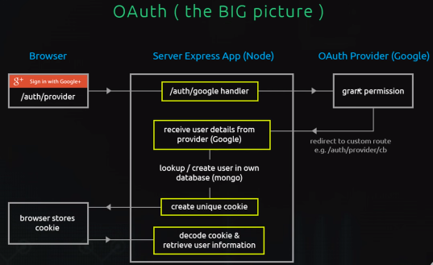
2 Auth Flow
https://www.youtube.com/watch?v=CHodPpqLqG8&index=2&list=PL4cUxeGkcC9jdm7QX143aMLAqyM-jTZ2x
The highlighted are these different with passport.js we will use here.

Slide 8
End of Chapter

