Slide 1

3 Express App
Peter H. Chen

Slide 2
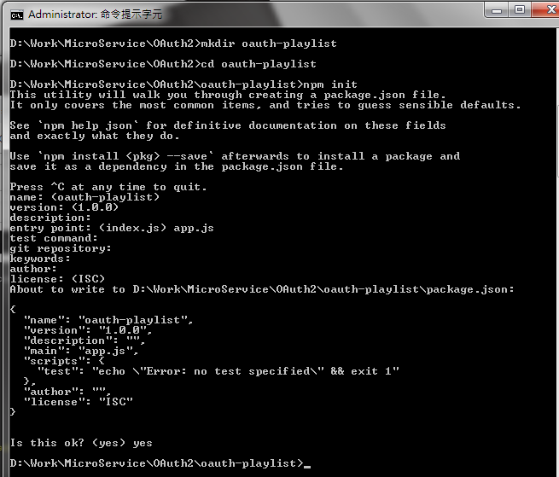
3 Express App
https://www.youtube.com/watch?v=CHodPpqLqG8&index=2&list=PL4cUxeGkcC9jdm7QX143aMLAqyM-jTZ2x
>npm install npm@latest # update latest npm
> npm init
> <Enter> except app.js for <index.js>

Slide 3
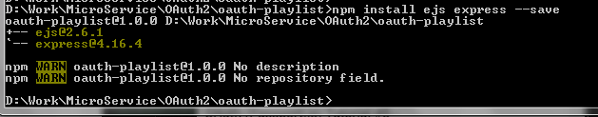
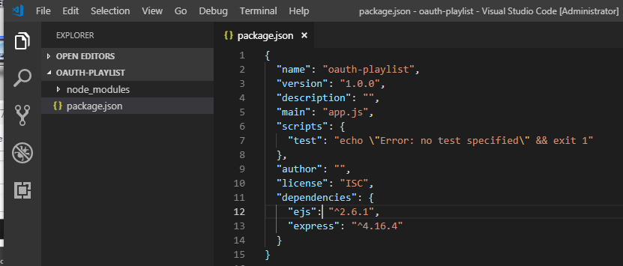
3 Express App
https://www.youtube.com/watch?v=CHodPpqLqG8&index=2&list=PL4cUxeGkcC9jdm7QX143aMLAqyM-jTZ2x
> npm install ejs express --save
# ejs: embedded JavaScript templates
# save into package.json

Slide 4
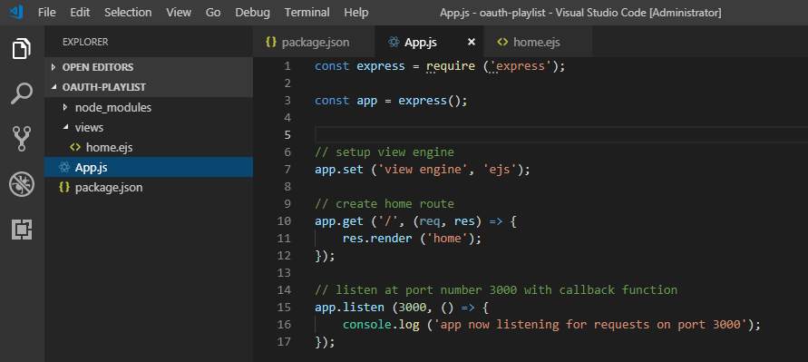
3 Express App
https://www.youtube.com/watch?v=CHodPpqLqG8&index=2&list=PL4cUxeGkcC9jdm7QX143aMLAqyM-jTZ2x
Create “oauth-playlist/App.js”

Slide 5
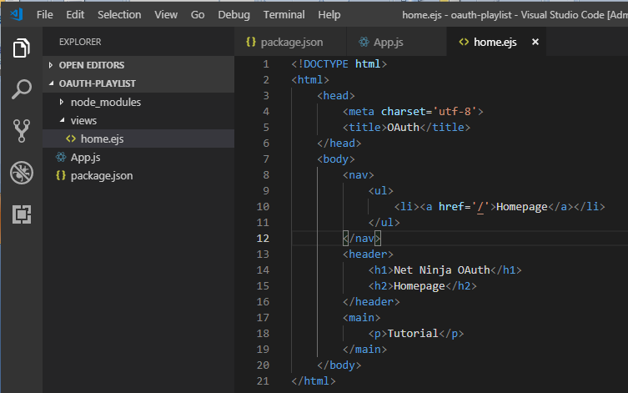
3 Express App
https://www.youtube.com/watch?v=CHodPpqLqG8&index=2&list=PL4cUxeGkcC9jdm7QX143aMLAqyM-jTZ2x
Create “oauth-playlist/views/home.ejs”

Slide 6
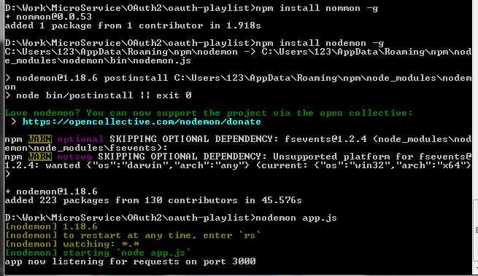
3 Express App
https://www.youtube.com/watch?v=CHodPpqLqG8&index=2&list=PL4cUxeGkcC9jdm7QX143aMLAqyM-jTZ2x
> npm install nodemon -g

Slide 7
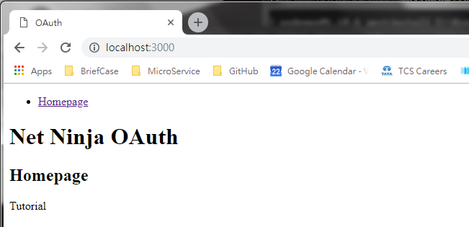
3 Express App
https://www.youtube.com/watch?v=CHodPpqLqG8&index=2&list=PL4cUxeGkcC9jdm7QX143aMLAqyM-jTZ2x
Open chrome and enter “localhost:3000”

Slide 8
End of Chapter

