Slide 1

4 Auth Route

Slide 2
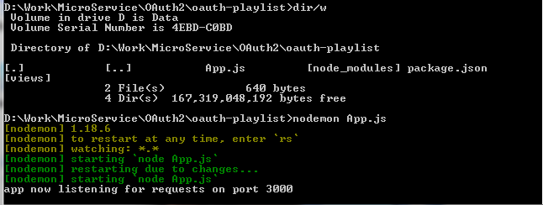
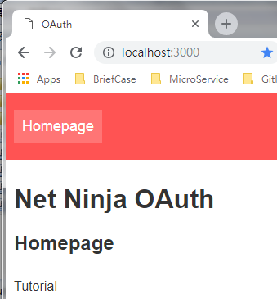
4 Auth Route
https://www.youtube.com/watch?v=CHodPpqLqG8&index=2&list=PL4cUxeGkcC9jdm7QX143aMLAqyM-jTZ2x
> cd oauth-playlist
> nodemon App.js
Open chrome and enter “localhost:3000”

Slide 3
4 Auth Route
https://www.youtube.com/watch?v=CHodPpqLqG8&index=2&list=PL4cUxeGkcC9jdm7QX143aMLAqyM-jTZ2x
We will use route ”localhost:3000/auth/google”, “localhost:3000/auth/facebook”, or “localhost:3000/auth/github” for google, facebook, github, respectively.
Where do we put google button? We will have a login page with three or four different signIn method, such as, Google, Facebook, or Github whatever other provider. We will put login button in header and when click, we will have another page with different options. When we click on google option, then it will redirect to “localhost:3000/auth/google”

Slide 4
4 Auth Route
https://www.youtube.com/watch?v=CHodPpqLqG8&index=2&list=PL4cUxeGkcC9jdm7QX143aMLAqyM-jTZ2x
Create “auth-playlist/routes/auth-routes.js” file.

Slide 5
4.1 Code of Auth Route

Slide 6
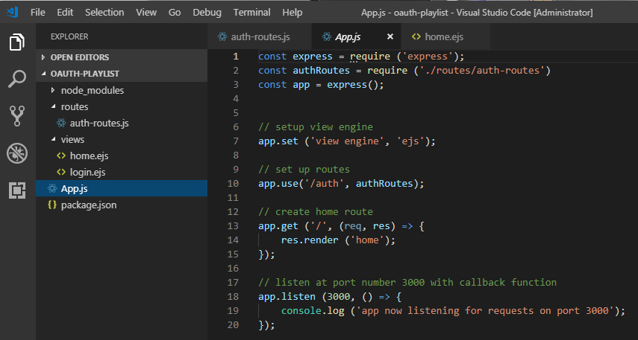
4.1 Code of Auth Route
https://www.youtube.com/watch?v=CHodPpqLqG8&index=2&list=PL4cUxeGkcC9jdm7QX143aMLAqyM-jTZ2x
Create “oauth-playlist/App.js” file.

Slide 7
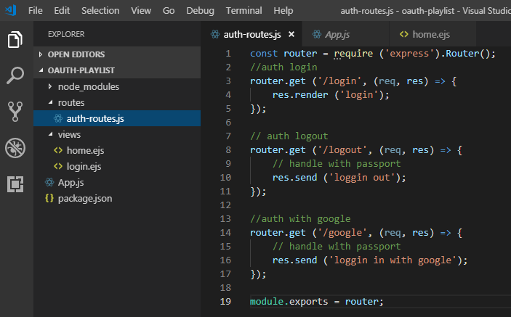
4.1 Code of Auth Route
https://www.youtube.com/watch?v=CHodPpqLqG8&index=2&list=PL4cUxeGkcC9jdm7QX143aMLAqyM-jTZ2x
Create “oauth-playlist/routes/auth-routes.js” file.

Slide 8
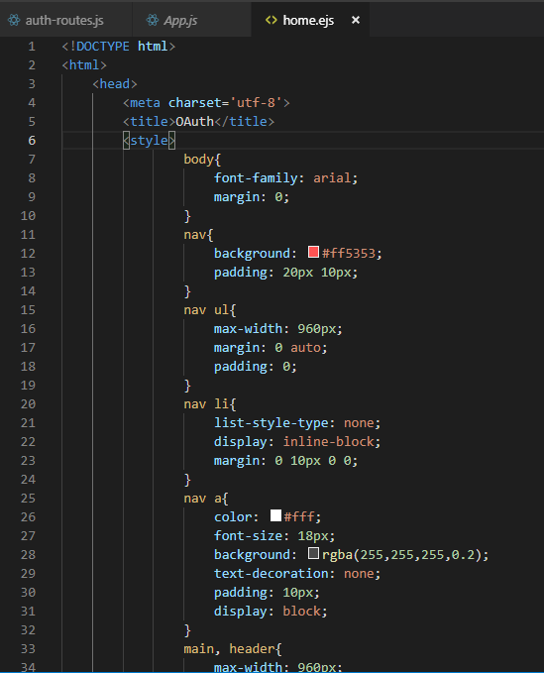
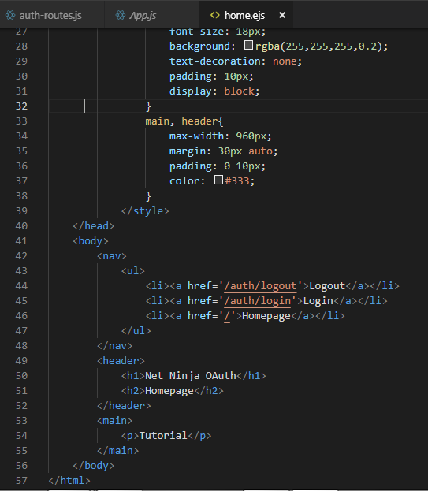
4.1 Code of Auth Route
https://www.youtube.com/watch?v=CHodPpqLqG8&index=2&list=PL4cUxeGkcC9jdm7QX143aMLAqyM-jTZ2x
Create “oauth-playlist/views/home.ejs” file.

Slide 9
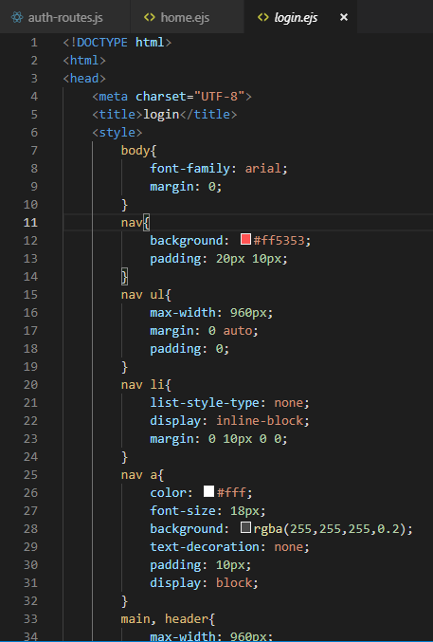
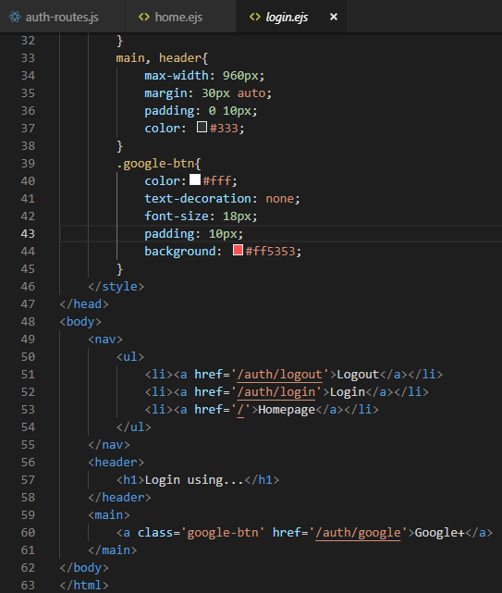
4.1 Code of Auth Route
https://www.youtube.com/watch?v=CHodPpqLqG8&index=2&list=PL4cUxeGkcC9jdm7QX143aMLAqyM-jTZ2x
Create “oauth-playlist/views/login.ejs” file.

Slide 10
4.2 Verify of Auth Route

Slide 11
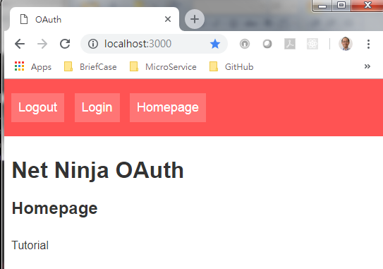
4.2 Verify of Auth Route
https://www.youtube.com/watch?v=CHodPpqLqG8&index=2&list=PL4cUxeGkcC9jdm7QX143aMLAqyM-jTZ2x
Home page: localhost:3000

Slide 12
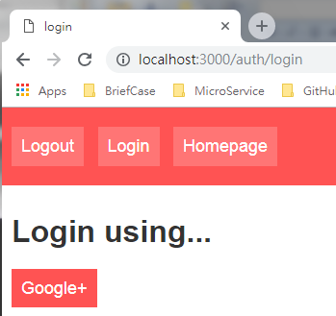
4.2 Verify of Auth Route
https://www.youtube.com/watch?v=CHodPpqLqG8&index=2&list=PL4cUxeGkcC9jdm7QX143aMLAqyM-jTZ2x
Login page: localhost:3000/auth/login

Slide 13
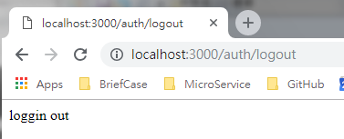
4.2 Verify of Auth Route
https://www.youtube.com/watch?v=CHodPpqLqG8&index=2&list=PL4cUxeGkcC9jdm7QX143aMLAqyM-jTZ2x
Login page: localhost:3000/auth/logout

Slide 14
End of Chapter

