Slide 1

5 Passport Setup
Peter H. Chen

Slide 2
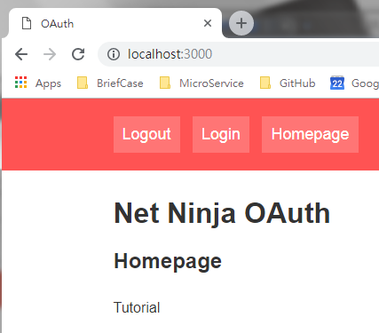
5 Passport Setup
https://www.youtube.com/watch?v=CHodPpqLqG8&index=2&list=PL4cUxeGkcC9jdm7QX143aMLAqyM-jTZ2x
Now, we have our express setup and running.
We created all different auth route, such as, login route, etc.
We want to install passport into our project.

Slide 3
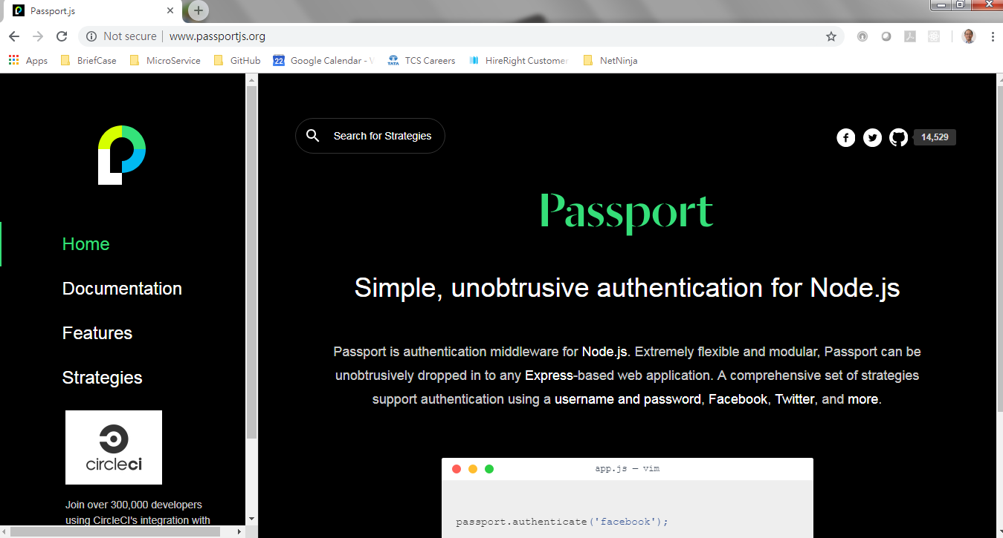
5 Passport Setup
https://www.youtube.com/watch?v=CHodPpqLqG8&index=2&list=PL4cUxeGkcC9jdm7QX143aMLAqyM-jTZ2x
Go to www.passportjs.org
How do you setup authentication by the passport.

Slide 4
5 Passport Setup
https://www.youtube.com/watch?v=CHodPpqLqG8&index=2&list=PL4cUxeGkcC9jdm7QX143aMLAqyM-jTZ2x
We will install two libraries:
First, passport core library with all the functionalities to authenticate user.
Second, install strategy. There are strategies over this website. Click “Strategies” to check. There are 502 ways to login.

Slide 5
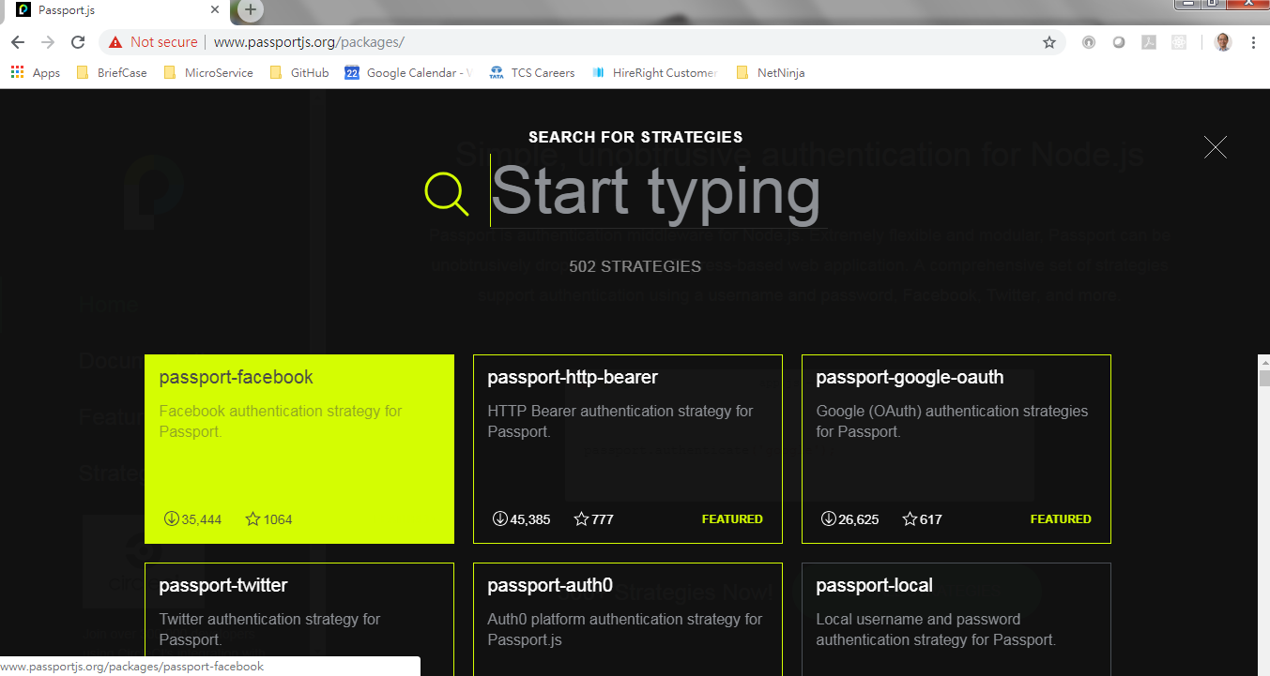
5 Passport Setup
https://www.youtube.com/watch?v=CHodPpqLqG8&index=2&list=PL4cUxeGkcC9jdm7QX143aMLAqyM-jTZ2x
We will install two libraries:
First, passport core library with all the functionalities to authenticate user.
Second, install strategy and all over this website. Click “Strategies” to check. There are 502 ways to login. There are facebook or google ways to login.

Slide 6
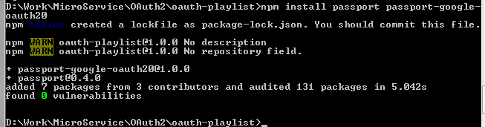
5 Passport Setup
https://www.youtube.com/watch?v=CHodPpqLqG8&index=2&list=PL4cUxeGkcC9jdm7QX143aMLAqyM-jTZ2x
We will use google way to log in.
> cd oauth-playlist
> npm install passport passport-google-auth20

Slide 7
5.1 Code of Auth Route
Peter H. Chen

Slide 8
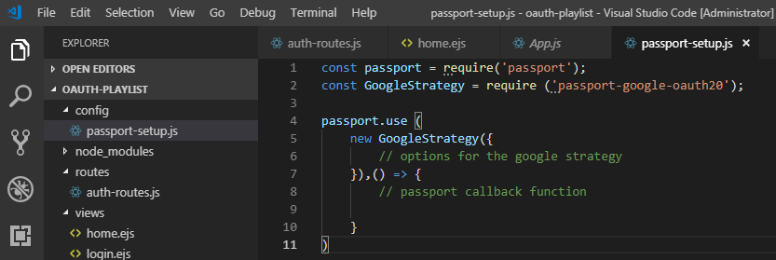
5.1 Code of Auth Route
https://www.youtube.com/watch?v=CHodPpqLqG8&index=2&list=PL4cUxeGkcC9jdm7QX143aMLAqyM-jTZ2x
Create “oauth-playlist/config/passport-setup.js” file.

Slide 9
End of Chapter

