Slide 1

2 Redux Application
Peter H. Chen

Slide 2
1 Redux Application
http://it-ebooks.info/book/1528285149-redux_in_action/
C:\> create-react-app ch0201
C:\> cd ch0201
C:\ch0201\> npm install react-redux
C:\ch0201\> npm install redux
Create src\components\Task.js, TaskList.js, TasksPage.js
Modify src\App.js
Modify src\index.js
Create src\reducers\index.js
Create src\constants\index.js
Create src\actions\index.js

Slide 3
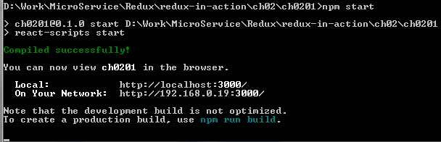
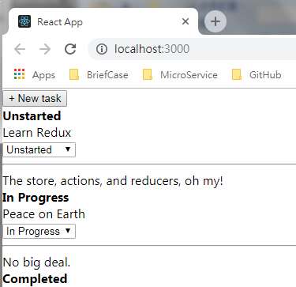
1 Redux Application
http://it-ebooks.info/book/1528285149-redux_in_action/
C:\ch0201\npm start

Slide 4
End of Chapter

