Slide 1

4 First App
Peter H. Chen

Slide 2
4 First App
https://www.tutorialspoint.com/restful/restful_first_application.htm
Download the Eclipse Dynamic Web Project
We will start writing the RESTful web services with Jersey Framework.
Make sure that you have setup your Jersey environment properly as explained in the chapter3.
We will write on by Eclipse IDE.
We will write Jersey Application with the server display the list of users in client site.

Slide 3
4.1 Install Eclipse J2EE

Slide 4
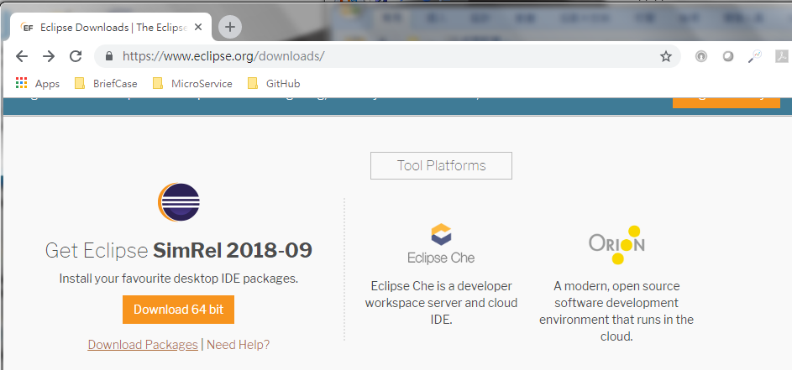
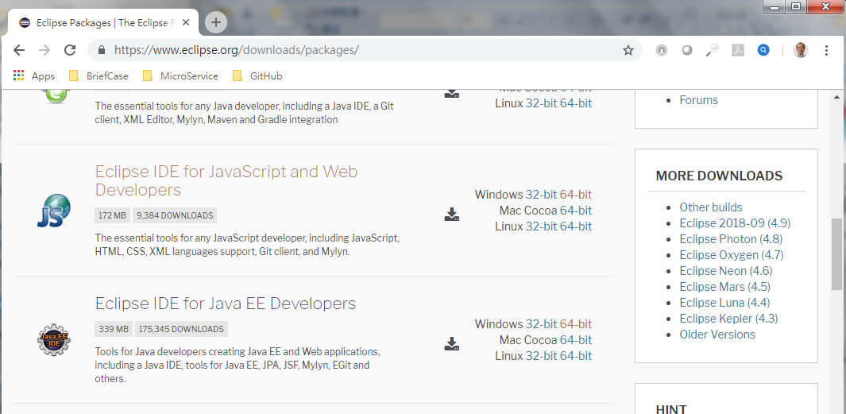
4.1 Install Eclipse J2EE
https://www.tutorialspoint.com/restful/restful_first_application.htm
Go to www.eclipse.org/dowloads.
Select “Download Packages”
Scroll down and select “Eclipse IDE for Java EE Developers” for download
Unzip it and copy the eclipse folder under “C:\>Spring”

Slide 5
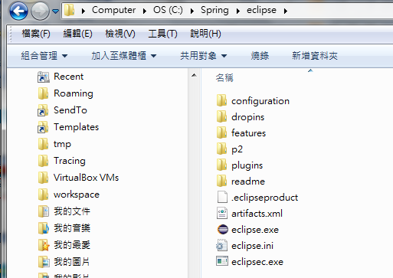

4.1 Install Eclipse J2EE
https://www.tutorialspoint.com/restful/restful_first_application.htm
Put “eclipse.exe” to desktop R
Rename “eclipse.exe” into “eclipse J2EE”

Slide 6
4.2 Create J2EE Project

Slide 7
4.2 Create J2EE Project
https://www.tutorialspoint.com/restful/restful_first_application.htm
Put “eclipse.exe” to desktop and rename it “eclipse J2EE”
Double click “Eclipse J2EE” to start “Eclipse Web Development”.

Slide 8
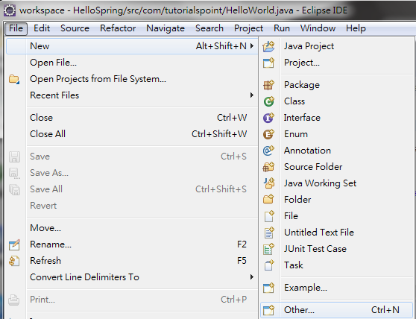
4.2 Create J2EE Project
https://www.tutorialspoint.com/restful/restful_first_application.htm
Launch Workspace
Click “Other…”

Slide 9
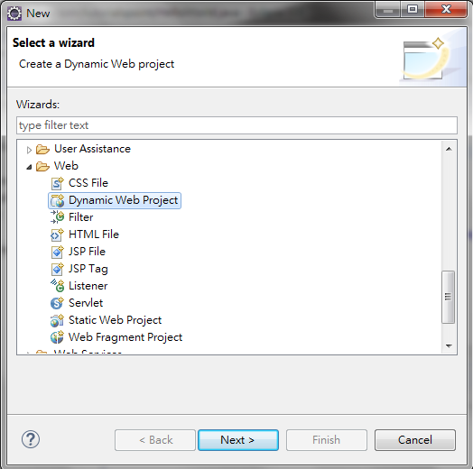
4.2 Create J2EE Project
https://www.tutorialspoint.com/restful/restful_first_application.htm
“Select a wizard”: Web >Dynamic Web Project
Click “Next” button.

Slide 10
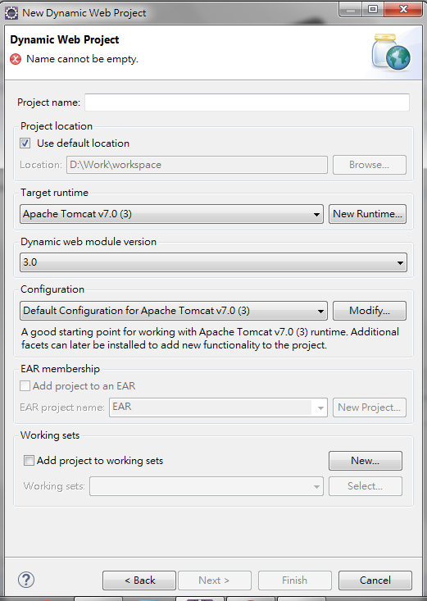
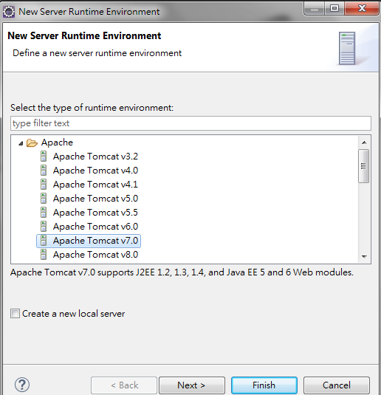
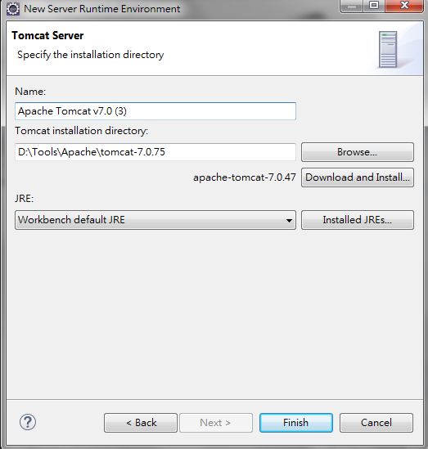
4.2 Create J2EE Project
https://www.tutorialspoint.com/restful/restful_first_application.htm
Select “tomcat” version
Select directory “D:\>Tools\Apache\tomcat-7.0.3” as follow.

Slide 11
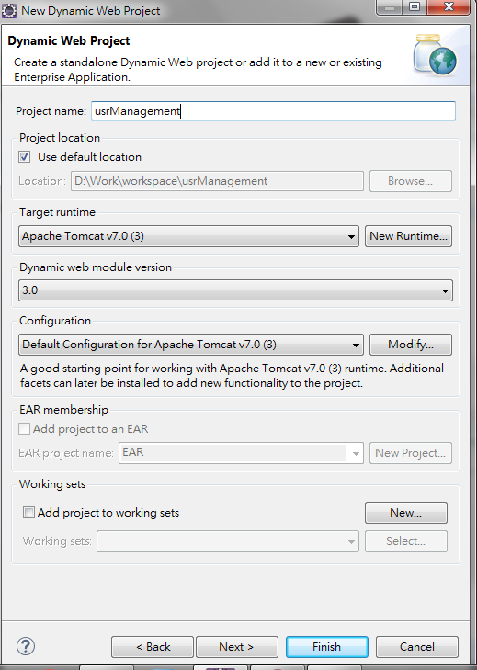
4.2 Create J2EE Project
https://www.tutorialspoint.com/restful/restful_first_application.htm
Specify Project Name: “UsrManagement”
Click Next button

Slide 12
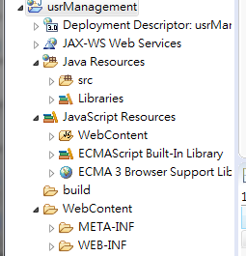
4.2 Create J2EE Project
https://www.tutorialspoint.com/restful/restful_first_application.htm
The Project “UsrManagement” is created as follow:

Slide 13
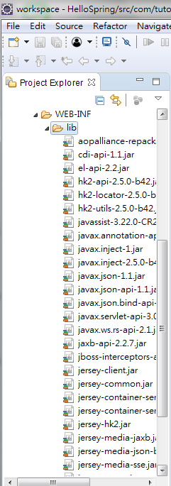
4.2 Create J2EE Project
https://www.tutorialspoint.com/restful/restful_first_application.htm
Copy all the Jersey libraries (api\*jars, ext\*jars, lib\*.jars) from unzip jersey folder into the WEB-INF/lib :
C:\>Spring\jaxrs-ri-2.27\jaxrs-ri\api\*.jars into WEB-INF\lib
C:\>Spring\jaxrs-ri-2.27\jaxrs-ri\ext\*.jars into WEB-INF\lib
C:\>Spring\jaxrs-ri-2.27\jaxrs-ri\lib\*.jars into WEB-INF\lib
The copied Jersey (jaxrs) libraries as shown on the right.

Slide 14
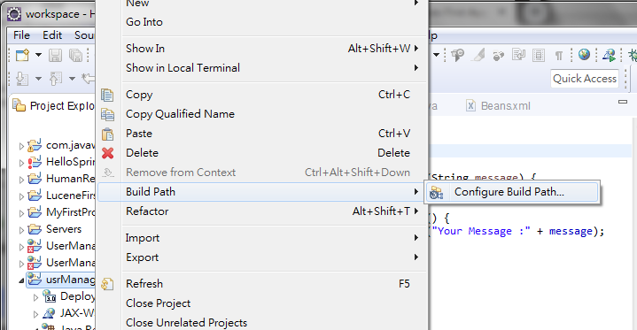
4.2 Create J2EE Project
https://www.tutorialspoint.com/restful/restful_first_application.htm
Click project “usrManagement”.
Right Mouse Button > Build Path > Configure Build Path …

Slide 15
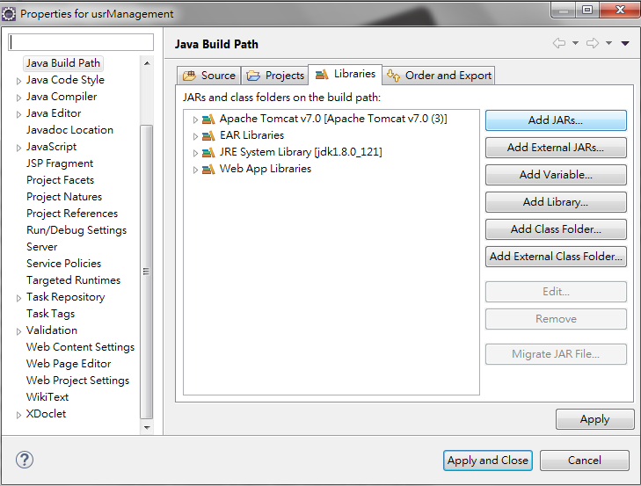
4.2 Create J2EE Project
https://www.tutorialspoint.com/restful/restful_first_application.htm
Click “Add JARS” under “Libraries” Tab
Right Mouse Button > Build Path > Configugre Build Path …

Slide 16
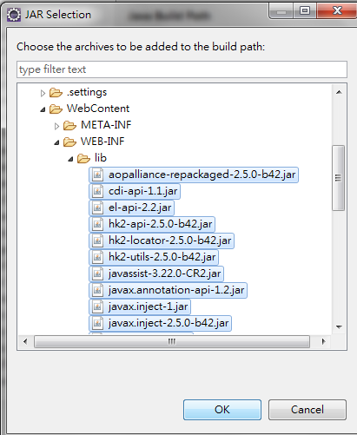
4.2 Create J2EE Project
https://www.tutorialspoint.com/restful/restful_first_application.htm
Select all JARS libraries under “usrManagement\Webcontent\WEB-INF\*.jars
Click OK button.

Slide 17
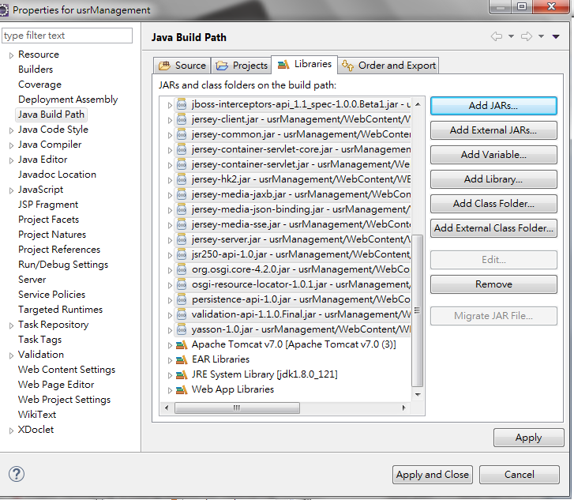
4.2 Create J2EE Project
https://www.tutorialspoint.com/restful/restful_first_application.htm
All Jersey (jaxrs-ri) libraries are added in Project usrManagement Libraries.

Slide 18
4.3 Create Java Code

Slide 19
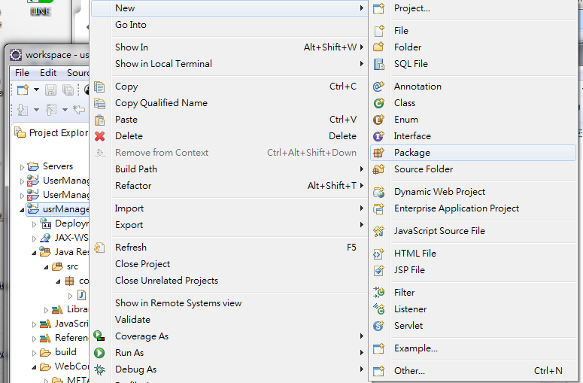
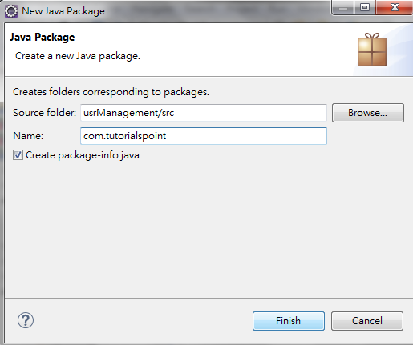
4.3 Create Java Code
https://www.tutorialspoint.com/restful/restful_first_application.htm
New > Package, Package Name: com.turotialspoint

Slide 20
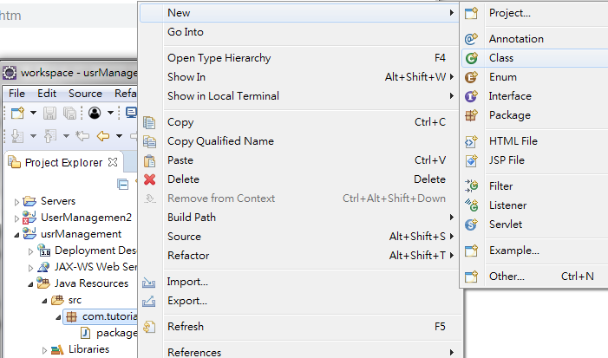
4.3 Create Java Code
https://www.tutorialspoint.com/restful/restful_first_application.htm
New > Class

Slide 21
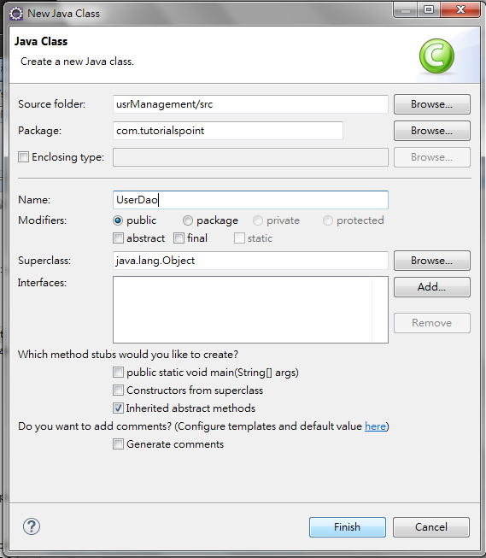
4.3 Create Java Code
https://www.tutorialspoint.com/restful/restful_first_application.htm
Class Name: UserDao

Slide 22
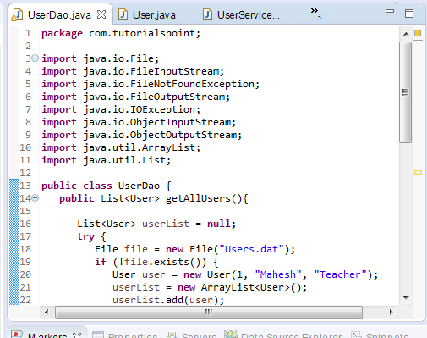
4.3 Create Java Code
https://www.tutorialspoint.com/restful/restful_first_application.htm
Java Codes: UserDao.java, User.java, UserService.java

Slide 23
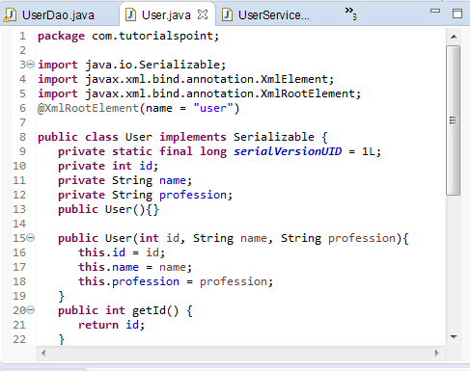
4.3 Create Java Code
https://www.tutorialspoint.com/restful/restful_first_application.htm
Java Codes: UserDao.java, User.java, UserService.java

Slide 24
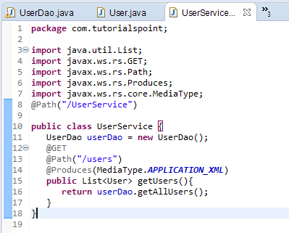
4.3 Create Java Code
https://www.tutorialspoint.com/restful/restful_first_application.htm
Java Codes: UserDao.java, User.java, UserService.java

Slide 25
4.4 Create pom.xml

Slide 26
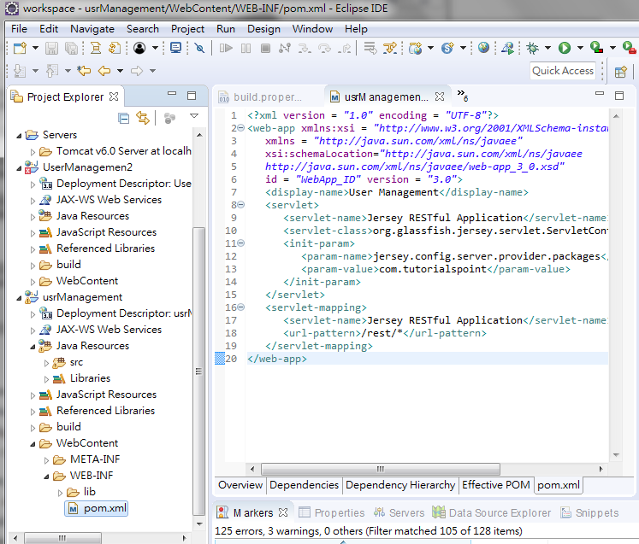
4.4 Create pom.xml
https://www.tutorialspoint.com/restful/restful_first_application.htm
Create WEB-INF\pom.xml as follow:

Slide 27
4.5 Deploy Program

Slide 28
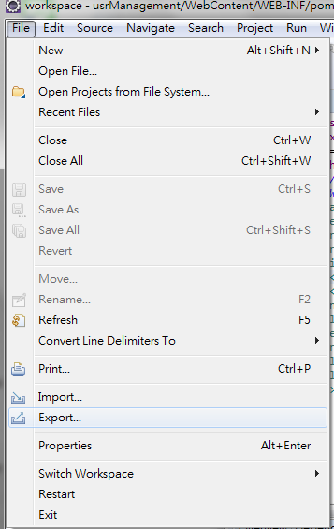
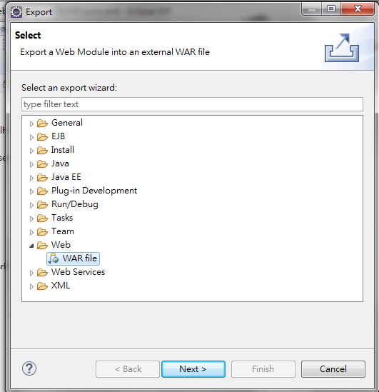
4.5 Deploy Program
https://www.tutorialspoint.com/restful/restful_first_application.htm
Create WAR file: File > Export …
Web > War File, Click Next

Slide 29
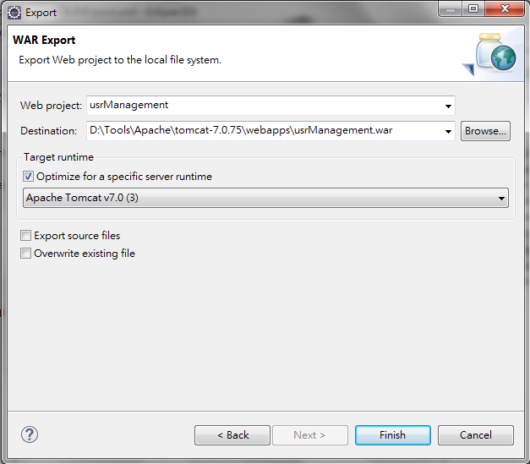
4.5 Deploy Program
https://www.tutorialspoint.com/restful/restful_first_application.htm
Web Project: usrManagement
Destination: D:\Tools\Apache\tomcat-7.0.7\webapp\usrManagement\war

Slide 30
4.6 Run Program

Slide 31
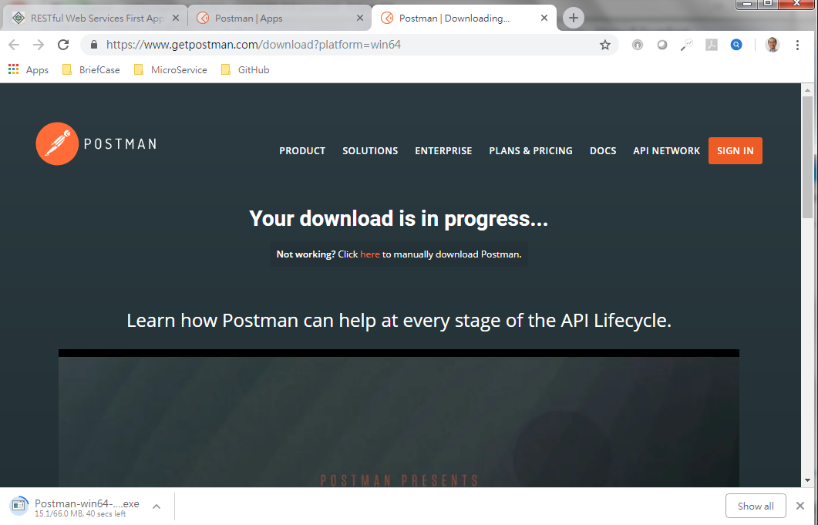

4.5 Deploy Program
https://www.tutorialspoint.com/restful/restful_first_application.htm
Use postman (https://www.getpostman.com/apps, Chrome extension) to test webservice.
Download the postman and install.

Slide 32
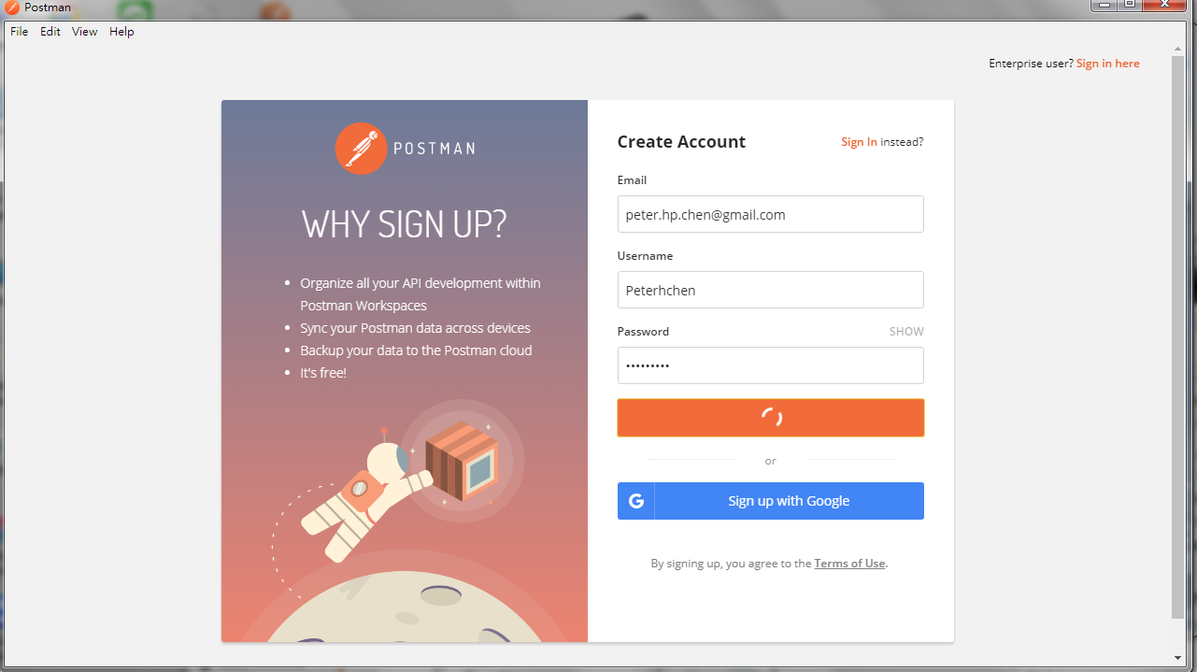
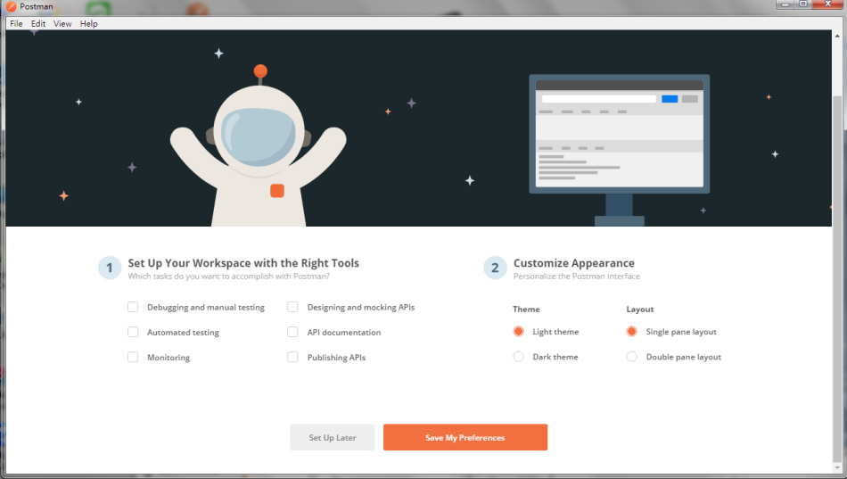
4.5 Deploy Program
https://www.tutorialspoint.com/restful/restful_first_application.htm
Email: peter.hp.chen@gmail.com
Username: peterhchen
Password: PCxxxx=ch

Slide 33
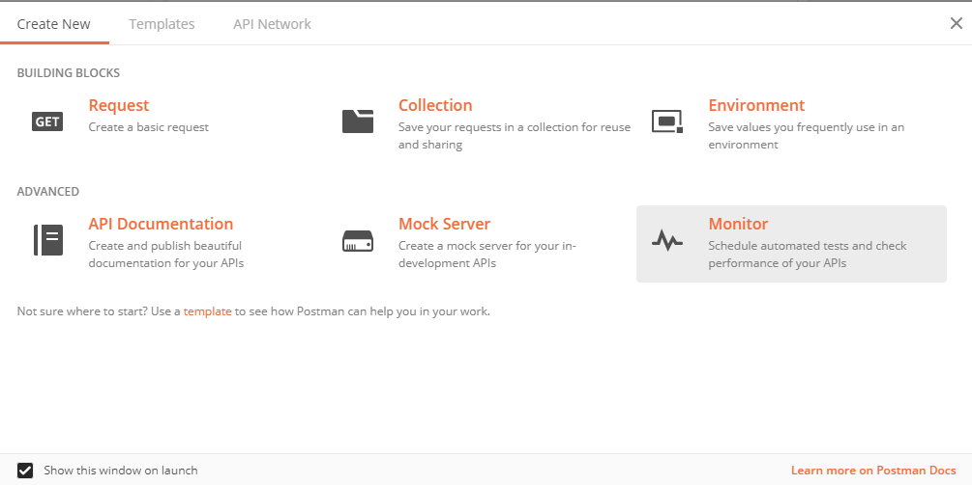
4.5 Deploy Program
https://www.tutorialspoint.com/restful/restful_first_application.htm
Create New

Slide 34
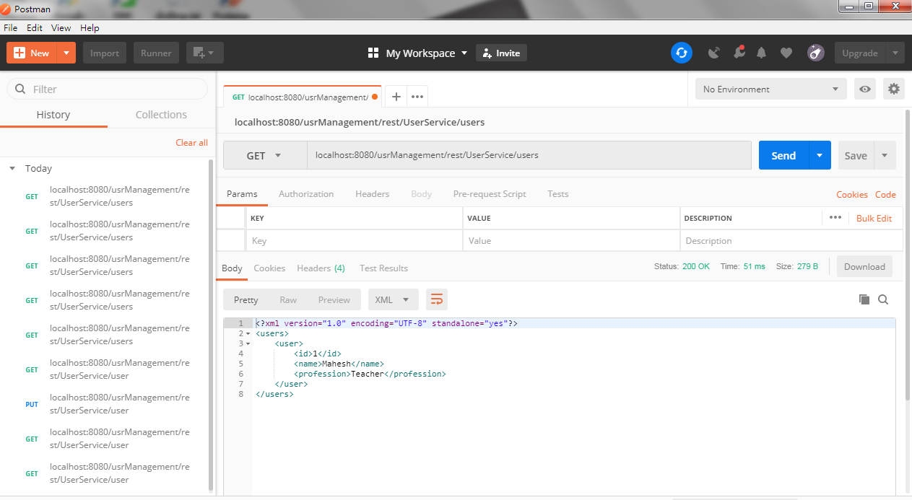
4.5 Deploy Program
https://www.tutorialspoint.com/restful/restful_first_application.htm
Start tomcat: startup
Run As: UserService.java

Slide 35
End of Chapter

