Slide 1

3 RESTful Setups
Peter H. Chen

Slide 2
3 RESTful Setup
https://www.tutorialspoint.com/restful/restful_environment.htm
We will setup Jersey Framework to create RESTful Web Services.
Jersey framework implements JAX-RS 2.0 API, which is a standard specification to create RESTful Web Services.
We will setup JDK, Eclipse, JAX-RS 2.0 API, and Tomcat before setup Jersey Framework.

Slide 3
3.1 Setup Java

Slide 4
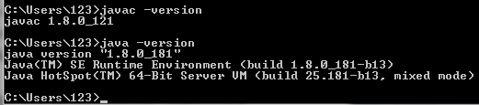
3.1 Setup Java
https://www.tutorialspoint.com/restful/restful_environment.htm
C:\javac –version
C:\java -version

Slide 5
3.2 Setup Eclipse

Slide 6

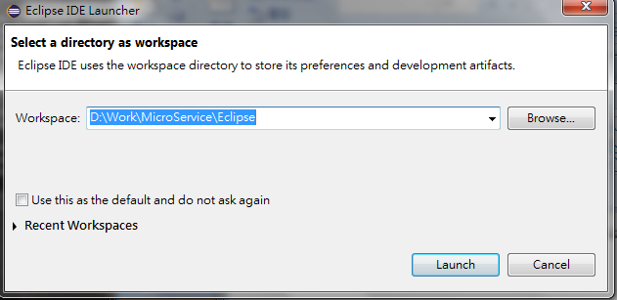
3.2 Setup Eclipse
https://www.tutorialspoint.com/restful/restful_environment.htm
Go to www.eclipse.org/downloads and install.
Double click Eclipse logo to start Eclipse.
Select the workspace and click Launch button.

Slide 7
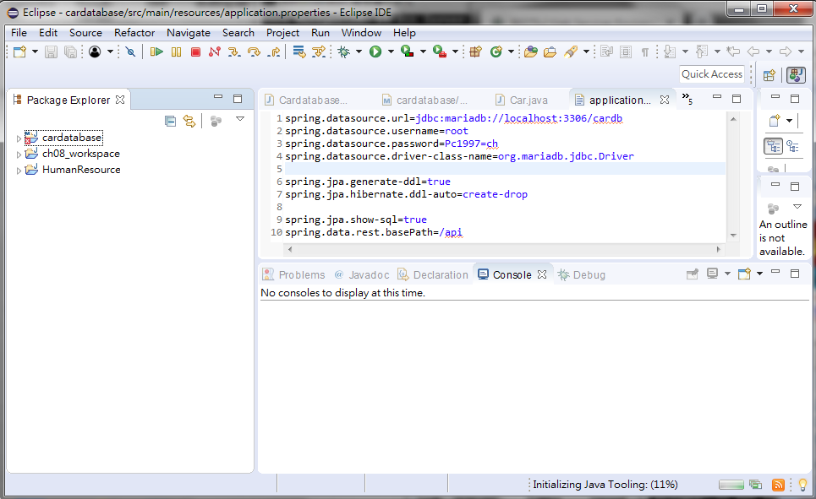
3.2 Setup Eclipse
https://www.tutorialspoint.com/restful/restful_environment.htm
Eclipse Main Window is displayed as below.

Slide 8
3.3 Setup Jersey

Slide 9
3.3 Setup Jersey
https://www.tutorialspoint.com/restful/restful_environment.htm
Go to https://jersey.github.io/download.html
Download Jersey 2.27 (jaxrs-ri-2.27.zip) which implements JAX-RS 2.1 API.
Unzip and put under C:\Spring directory.

Slide 10
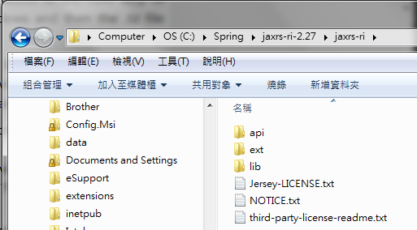
3.3 Setup Jersey
https://www.tutorialspoint.com/restful/restful_environment.htm
Jersey Libraries and Dependencies:
Jersey Libraries: “C:\Spring\jaxrs-ri-2.27\lib”
Jersey Dependencies: “C:\Spring\jaxrs-ri-2.27\ext”
For non-Eclipse user, setup CLASSPATH for Libraries and Dependencies.
For Eclipse user, you do not need to setup CLASSPATH for Jersey

Slide 11
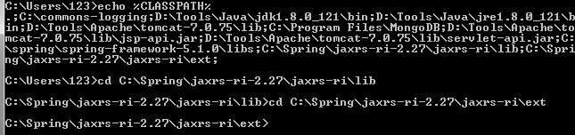
3.2 Setup Eclipse
https://www.tutorialspoint.com/restful/restful_environment.htm
Check %CLASSPATH% include the Jersey Libraries (lib) and Jersey Dependencies (ext)

Slide 12
3.4 Setup Tomcat

Slide 13

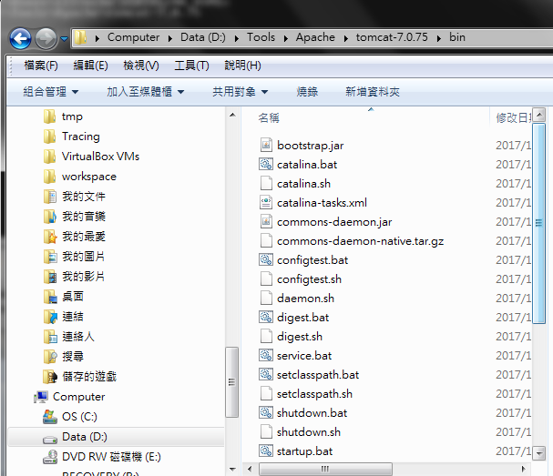
3.4 Setup Tomcat
https://www.tutorialspoint.com/restful/restful_environment.htm
Go to www.apache.org and download tomcat.
C:\> echo %CATALINA_HOME% = “D:\Tools\Apache\Tomcat-7.0.75\bin\startup.bat

Slide 14
3.5 Startup Tomcat

Slide 15
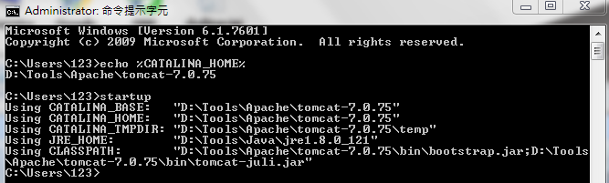
3.5 Startup Tomcat
https://www.tutorialspoint.com/restful/restful_environment.htm
Start tomcat: C:\> startup

Slide 16
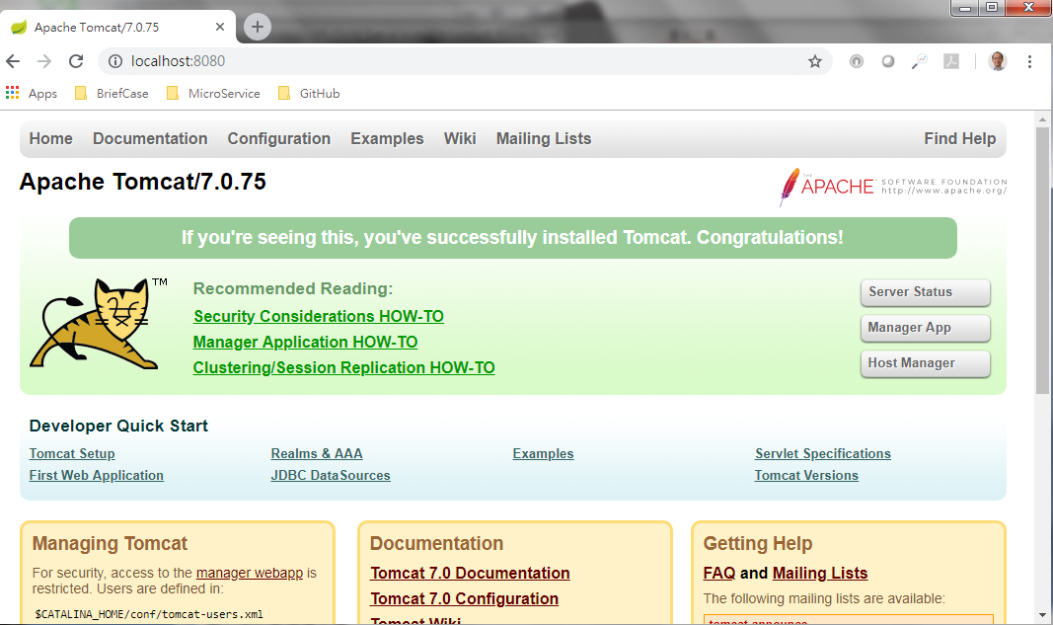
3.5 Startup Tomcat
https://www.tutorialspoint.com/restful/restful_environment.htm
Open Chrome: Enter “localhost:8080”

Slide 17
3.6 Shutdown Tomcat

Slide 18
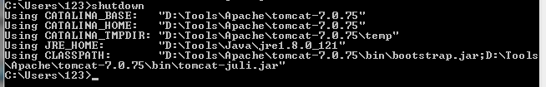
3.6 Shutdown Tomcat
https://www.tutorialspoint.com/restful/restful_environment.htm
Shutdown tomcat: C:\> shutdown

Slide 19
End of Chapter

