Slide 1
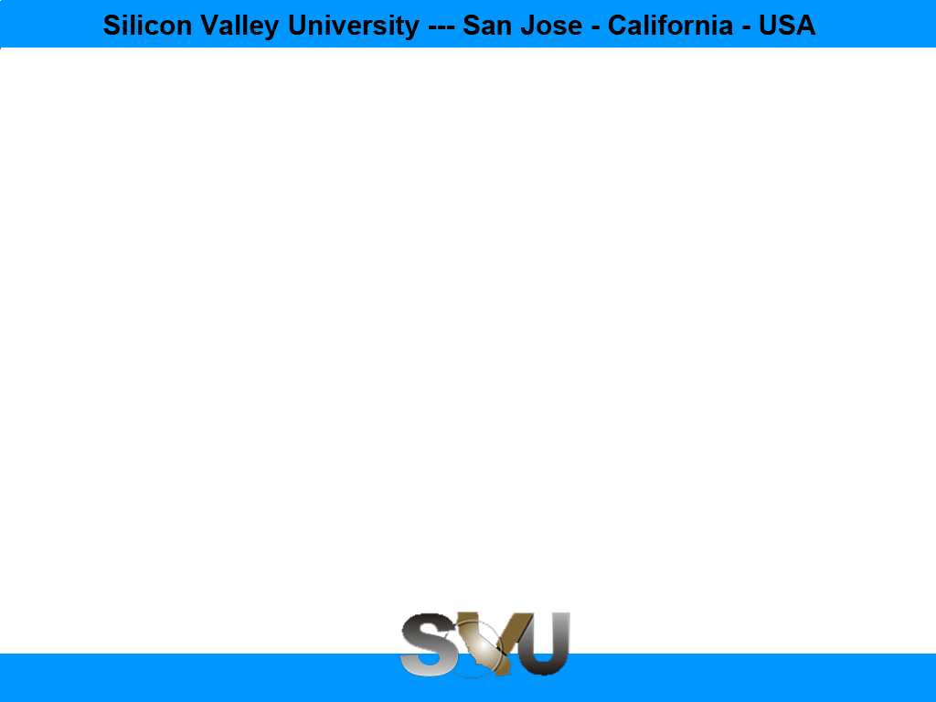
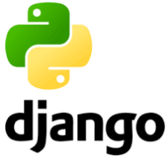
Python/Django Chapter 1: Introduction to Django
Peter H. Chen, PhDEE/EMBA

Slide 2

1 Django

Slide 3

1 Introduction to Django
Introduction
https://www.tutorialspoint.com/django/index.htm
Django is a web development framework that assists in building and maintaining quality web applications.
Django helps eliminate repetitive tasks making the development process an easy and time saving experience.
Django is a registered trademark of the Django Software Foundation, and is licensed under BSD License.
Python/Django - CS596

Slide 4
1 Introduction to Django
Introduction
https://www.tutorialspoint.com/django/django_basics.htm
Django is a high-level Python web framework that encourages rapid development and clean, pragmatic design. Django makes it easier to build better web apps quickly and with less code.
Note − Django is a registered trademark of the Django Software Foundation, and is licensed under BSD License.
Python/Django - CS596

Slide 5
1.1 Django History

Slide 6
1.1 Django History
Introduction
https://www.tutorialspoint.com/django/django_basics.htm
2003 − Started by Adrian Holovaty and Simon Willison as an internal project at the Lawrence Journal-World newspaper.
2005 − Released July 2005 and named it Django, after the jazz guitarist Django Reinhardt.
2005 − Mature enough to handle several high-traffic sites.
Current − Django is now an open source project with contributors across the world.
Python/Django - CS596

Slide 7
1.2 Django Design Philosophy

Slide 8
1.2 Django Design Philosophy
Introduction
https://www.tutorialspoint.com/django/django_basics.htm
Django comes with the following design philosophies −
Loosely Coupled − Django aims to make each element of its stack independent of the others.
Less Coding − Less code so in turn a quick development.
Don't Repeat Yourself (DRY) − Everything should be developed only in exactly one place instead of repeating it again and again.
Fast Development − Django's philosophy is to do all it can to facilitate hyper-fast development.
Clean Design − Django strictly maintains a clean design throughout its own code and makes it easy to follow best web-development practices.
Python/Django - CS596

Slide 9
1.3 Django Advantage

Slide 10
1.3 Django Advantage
Introduction
https://www.tutorialspoint.com/django/django_basics.htm
Here are few advantages of using Django which can be listed out here:
Object-Relational Mapping (ORM) Support − Django provides a bridge between the data model and the database engine, and supports a large set of database systems including MySQL, Oracle, Postgres, etc. Django also supports NoSQL database through Django-nonrel fork. For now, the only NoSQL databases supported are MongoDB and google app engine.
Multilingual Support − Django supports multilingual websites through its built-in internationalization system. So you can develop your website, which would support multiple languages.
Framework Support − Django has built-in support for Ajax, RSS, Caching and various other frameworks.
Administration GUI − Django provides a nice ready-to-use user interface for administrative activities.
Development Environment − Django comes with a lightweight web server to facilitate end-to-end application development and testing.
Python/Django - CS596

Slide 11
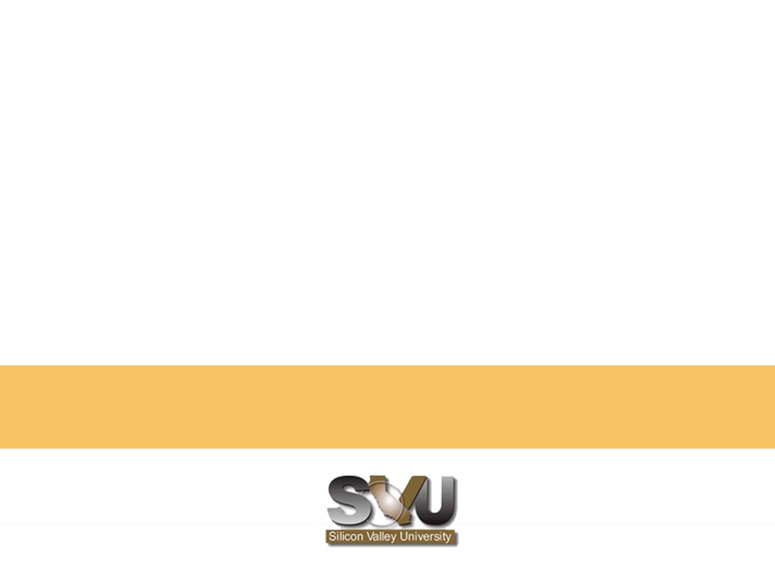
END of CHAPTER 1

