Slide 1

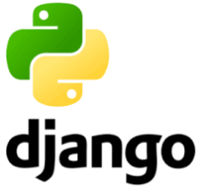
Python/Django Chapter 2: Setup Django
Peter H. Chen, PhDEE/EMBA

Slide 2

2 Setup Django

Slide 3

2 Setup Django
Introduction
https://www.tutorialspoint.com/django/django_environment.htm
Django development environment consists of installing and setting up Python, Django, and a Database System.
Since Django deals with web application, it's worth mentioning that you would need a web server setup as well.
Python/Django - CS596

Slide 4
2.1 Verify Python

Slide 5
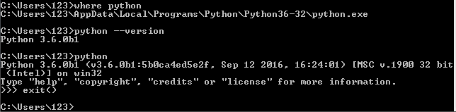
2.1 Verify Pyhton
Introduction
https://www.tutorialspoint.com/django/django_environment.htm
Django is written in 100% pure Python code, so you'll need to install Python on your system.
Latest Django version requires Python 2.6.5 or higher.
$ where python
$ python --version
$ python
>>> exit ()
Python/Django - CS596

Slide 6
2.2 Install Django

Slide 7
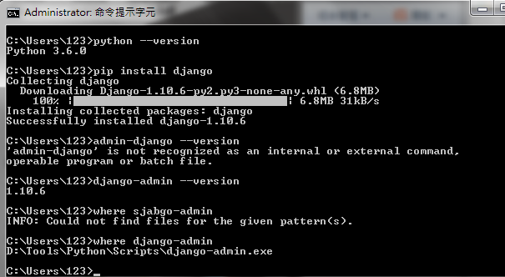
2.2 Install Django
Introduction
https://www.tutorialspoint.com/django/django_environment.htm
Install danjgo
$ pip install django
Python/Django - CS596

Slide 8
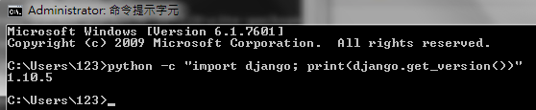
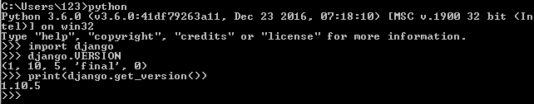
2.2 Install Django
Introduction
https://www.tutorialspoint.com/django/django_environment.htm
Check the Django installation.
$ python -c “import djano; print (django.get_version())”
$ python
>>> import django
>>> django.VERSION
>>> print (django.get_version())
Python/Django - CS596

Slide 9
2.3 Install Database: MongoDB

Slide 10

2.3 Install Database: MongoDB
Introduction
https://www.tutorialspoint.com/django/django_environment.htm
Django supports several major database engines and you can set up any of them based on your comfort.
MySQL (http://www.mysql.com/)
PostgreSQL (http://www.postgresql.org/)
SQLite 3 (http://www.sqlite.org/)
Oracle (http://www.oracle.com/)
MongoDb (https://django-mongodb-engine.readthedocs.org)
GoogleAppEngine Datastore (https://cloud.google.com/appengine/articles/django-nonrel)
Check mongoD
$ where mongo
$ where mongod
Python/Django - CS596

Slide 11
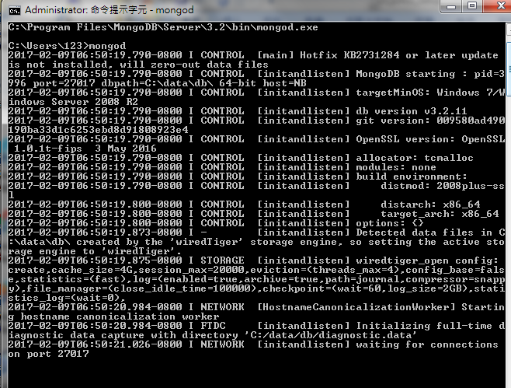
2.3 Install Database: MongoDB
Introduction
https://www.tutorialspoint.com/django/django_environment.htm
Open a terminal.
Run Server mongod.
$ mongod
Python/Django - CS596

Slide 12
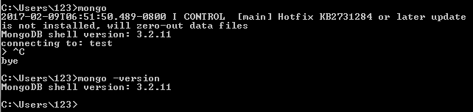
2.3 Install Database: MongoDB
Introduction
https://www.tutorialspoint.com/django/django_environment.htm
Open another terminal.
Run Client mongo.
Check mongo version
$ mongo
$ ^C (Control-C)
$ mongo -version
Python/Django - CS596

Slide 13
2.4 Verify Web Server

Slide 14
2.4 Verify Web Server
Introduction
https://www.tutorialspoint.com/django/django_environment.htm
Django comes with a lightweight web server for developing and testing applications. This server is pre-configured to work with Django, and more importantly, it restarts whenever you modify the code.
However, Django does support Apache and other popular web servers such as Lighttpd.
We will discuss both the approaches in coming chapters while working with different examples.
Python/Django - CS596

Slide 15
2.4 Verify Web Server
Introduction
https://www.tutorialspoint.com/django/django_environment.htm
Check Web Server
$ where tomcat7
Python/Django - CS596

Slide 16

END of CHAPTER 2

