Slide 1

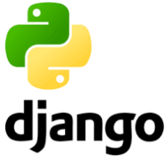
Python/Django Chapter 3: Create Django Project
Peter H. Chen, PhDEE/EMBA

Slide 2

3 Create Project

Slide 3

3 Create Django Project
Introduction
https://www.tutorialspoint.com/django/django_creating_project.htm
Now that we have installed Django, let's start using it.
In Django, every web app you want to create is called a project; and a project is a sum of applications.
An application is a set of code files relying on the MVT (Model-View-Template) pattern.
As example let's say we want to build a website, the website is our project and, the forum, news, contact engine are applications.
This structure makes it easier to move an application between projects since every application is independent.
Python/Django - CS596

Slide 4
3.1 Create Project

Slide 5
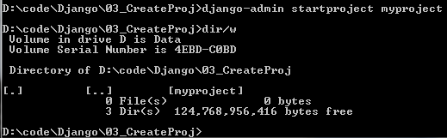
3.1 Create Project
Introduction
https://www.tutorialspoint.com/django/django_creating_project.htm
Whether you are on Windows or Linux, just get a terminal or a cmd prompt and type “django-admin startproject <project-name>”
$ django-admin startproject myproject
Python/Django - CS596

Slide 6
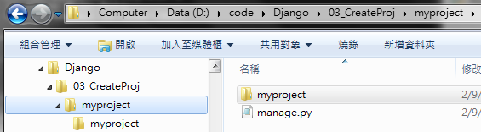
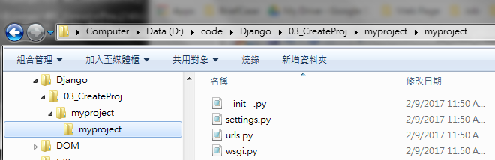
3.1 Create Project
Introduction
https://www.tutorialspoint.com/django/django_creating_project.htm
Navigate to the place you want your project to be created, then use this code.
myproject/
manage.py
myproject/
__init__.py
settings.py
urls.py
wsgi.py
Python/Django - CS596

Slide 7
3.2 Project Structure

Slide 8
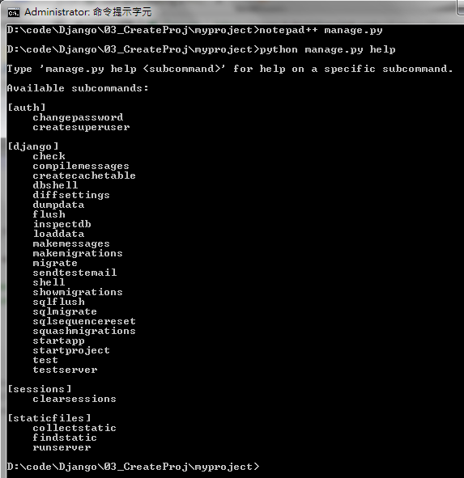
3.2 Project Structure
Introduction
https://www.tutorialspoint.com/django/django_creating_project.htm
The “myproject” folder is just your project container, it actually contains two elements:
manage.py − This file is kind of your project local django-admin for interacting with your project via command line (start the development server, sync db...).
To get a full list of command accessible via manage.py you can use the code.
$ python manage.py help
Python/Django - CS596

Slide 9
3.2 Project Structure
Introduction
https://www.tutorialspoint.com/django/django_creating_project.htm
The “myproject” subfolder − This folder is the actual python package of your project.
The project folder contains four files:
__init__.py − Just for python, treat this folder as package.
settings.py − As the name indicates, your project settings.
urls.py − All links of your project and the function to call. A kind of ToC of your project.
wsgi.py − If you need to deploy your project over WSGI (Web Server Gateway Interface).
Python/Django - CS596

Slide 10
3.3 Setup Project

Slide 11
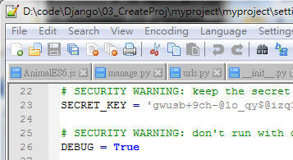
3.3 Setup Project
Introduction
https://www.tutorialspoint.com/django/django_creating_project.htm
Your project is set up in the subfolder myproject/settings.py.
Following are some important options you might need to set
DEBUG = True
Python/Django - CS596

Slide 12
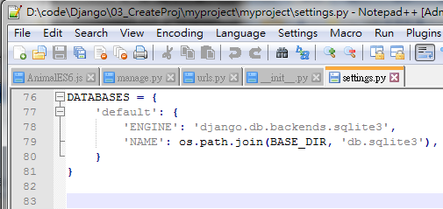
3.3 Setup Project
Introduction
https://www.tutorialspoint.com/django/django_creating_project.htm
This option lets you set if your project is in debug mode or not.
Debug mode lets you get more information about your project's error.
Never set it to ‘True’ for a live project.
However, this has to be set to ‘True’ if you want the Django light server to serve static files.
Do it only in the development mode.
DATABASES = {
'default': {
'ENGINE': 'django.db.backends.sqlite3',
'NAME': 'database.sql', 'USER': '',
'PASSWORD': '',
'HOST': '',
'PORT': '',
}
}
Python/Django - CS596

Slide 13
3.3 Setup Project
Introduction
https://www.tutorialspoint.com/django/django_creating_project.htm
Database is set in the ‘Database’ dictionary.
The example above is for SQLite engine. As stated earlier, Django also supports:
MySQL (django.db.backends.mysql)
PostGreSQL (django.db.backends.postgresql_psycopg2)
Oracle (django.db.backends.oracle) and NoSQL DB
MongoDB (django_mongodb_engine)
Before setting any new engine, make sure you have the correct db driver installed.
You can also set others options like: TIME_ZONE, LANGUAGE_CODE, TEMPLATE…
Python/Django - CS596

Slide 14
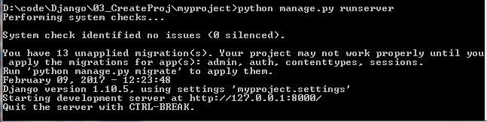
3.3 Setup Project
Introduction
https://www.tutorialspoint.com/django/django_creating_project.htm
Now that your project is created and configured make sure it's working
$ python manage.py runserver
You will get something like the following on running the above code
Validating models...
0 errors found
September 03, 2015 - 11:41:50
Django version 1.6.11, using settings 'myproject.settings'
Starting development server at http://127.0.0.1:8000/
Quit the server with CONTROL-C.
Python/Django - CS596

Slide 15
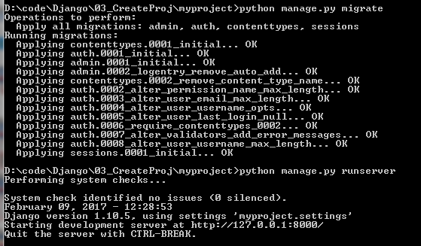
3.3 Setup Project
Introduction
https://www.tutorialspoint.com/django/django_creating_project.htm
Your project maybe not work properly.
First, run “python manage.py migrate”
The, run “python manage.py runserver”
$ python manage.py migrate
$ pytho manage.py runserver
Python/Django - CS596

Slide 16

END of CHAPTER 3

