Slide 1


Python/Django Chapter 4: Create Django Application
Peter H. Chen, PhDEE/EMBA

Slide 2

4 Create Django Application

Slide 3

4 Create Django Application
Introduction
https://www.tutorialspoint.com/django/django_apps_life_cycle.htm
A project is a sum of many applications.
Every application has an objective and can be reused into another project, like the contact form on a website can be an application, and can be reused for others.
See it as a module of your project.
Python/Django - CS596

Slide 4
4.1 Create Application

Slide 5
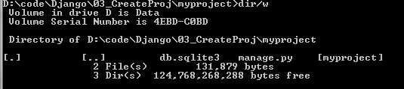
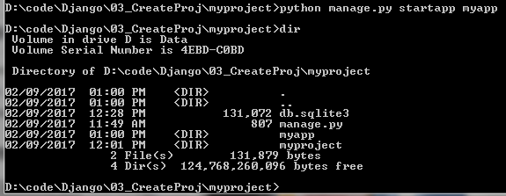
4.1 Create Application
Introduction
https://www.tutorialspoint.com/django/django_apps_life_cycle.htm
We assume you are in your project folder. In our main “myproject” folder, the same folder than manage.py
$ python manage.py startapp myapp
Python/Django - CS596

Slide 6
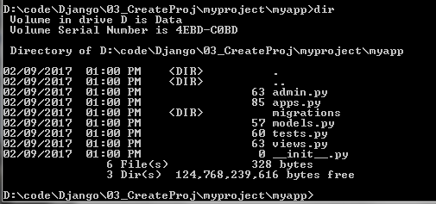
4.1 Create Application
Introduction
https://www.tutorialspoint.com/django/django_apps_life_cycle.htm
You just created myapp application and like project, Django create a “myapp” folder with the application structure.
__init__.py − Just to make sure python handles this folder as a package.
admin.py − This file helps you make the app modifiable in the admin interface.
models.py − This is where all the application models are stored.
tests.py − This is where your unit tests are.
views.py − This is where your application views are.
myapp/
__init__.py
admin.py
models.py
tests.py
views.py
Python/Django - CS596

Slide 7
4.2 Project Knows Your Application

Slide 8
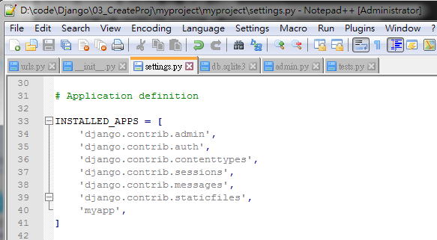
4.2 Get Project Know Your Application
Introduction
https://www.tutorialspoint.com/django/django_apps_life_cycle.htm
At this stage we have our "myapp" application, now we need to register it with our Django project "myproject".
To do so, update INSTALLED_APPS list in the settings.py file of your project (add your app name) :
$ cd myproject
$ notepad++ settings.py
INSTALLED_APPS = [
'django.contrib.admin',
'django.contrib.auth',
'django.contrib.contenttypes',
'django.contrib.sessions',
'django.contrib.messages',
'django.contrib.staticfiles',
'myapp',
]
Python/Django - CS596

Slide 9

END of CHAPTER 4

