Slide 1
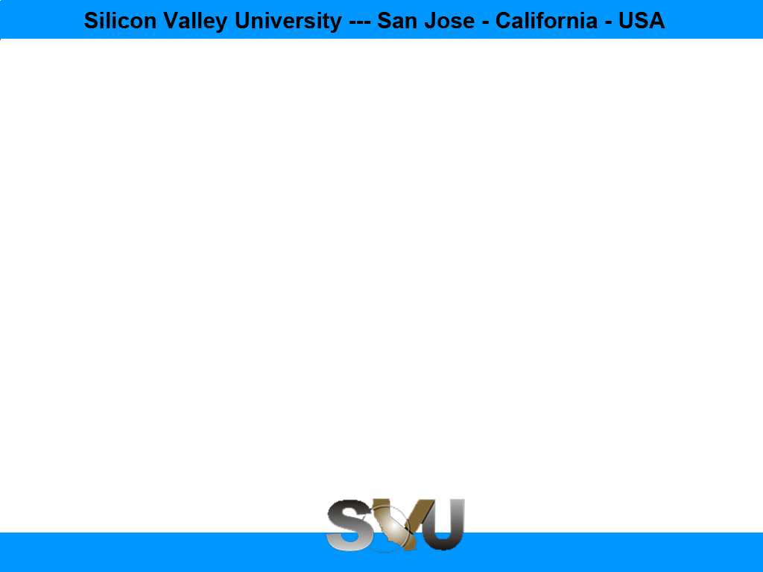
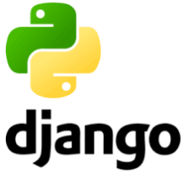
Python/Django Chapter 5: Admin Interface
Peter H. Chen, PhDEE/EMBA

Slide 2

5 Admin Interface

Slide 3

5 Admin Interface
Introduction
https://www.tutorialspoint.com/django/django_admin_interface.htm
Django provides a ready-to-use user interface for administrative activities.
We all know how an admin interface is important for a web project.
Django automatically generates admin UI based on your project models.
Python/Django - CS596

Slide 4
5.1 Start Admin Interface

Slide 5
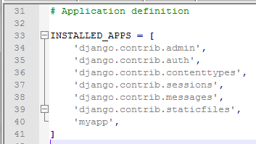
5.1 Start Admin Interface
Introduction
https://www.tutorialspoint.com/django/django_admin_interface.htm
The Admin interface depends on the django.countrib module.
To have it working you need to make sure some modules are imported in the INSTALLED_APPS and MIDDLEWARE_CLASSES tuples of the myproject/settings.py file.
For INSTALLED_APPS make sure you have
INSTALLED_APPS = [
'django.contrib.admin',
'django.contrib.auth',
'django.contrib.contenttypes',
'django.contrib.sessions',
'django.contrib.messages',
'django.contrib.staticfiles',
'myapp',
]
Python/Django - CS596

Slide 6
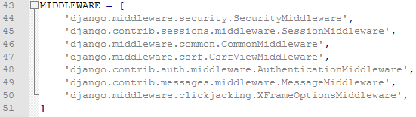
5.1 Start Admin Interface
Introduction
https://www.tutorialspoint.com/django/django_admin_interface.htm
For MIDDLEWARE_CLASSES:
MIDDLEWARE_CLASSES = [
'django.contrib.sessions.middleware.SessionMiddleware',
'django.middleware.common.CommonMiddleware',
'django.middleware.csrf.CsrfViewMiddleware',
'django.contrib.auth.middleware.AuthenticationMiddleware',
'django.contrib.messages.middleware.MessageMiddleware',
'django.middleware.clickjacking.XFrameOptionsMiddleware',
]
Python/Django - CS596

Slide 7

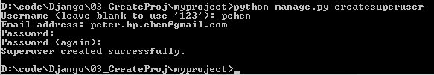
5.1 Start Admin Interface
Introduction
https://www.tutorialspoint.com/django/django_admin_interface.htm
Before launching your server, to access your Admin Interface, you need to initiate the database.
$ python manage.py migrate
syncdb will create necessary tables or collections depending on your db type, necessary for the admin interface to run.
Even if you don't have a superuser, you will be prompted to create one.
If you already have a superuser or have forgotten it, you can always create one using the following code.
$ python manage.py createsuperuser
Python/Django - CS596

Slide 8
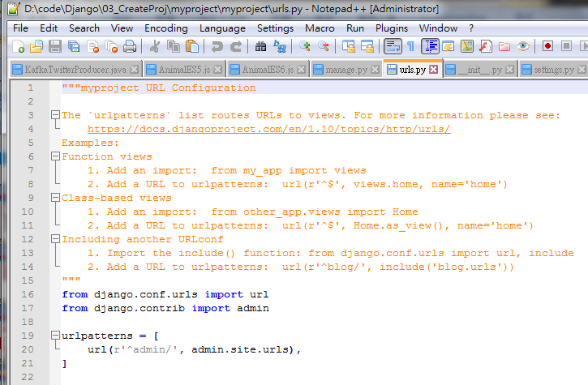
5.1 Start Admin Interface
Introduction
https://www.tutorialspoint.com/django/django_admin_interface.htm
Now to start the Admin Interface, we need to make sure we have configured a URL for our admin interface.
Open the myproject/url.py and you should have something like:
from django.conf.urls import patterns, include, url
from django.contrib import admin
admin.autodiscover()
urlpatterns = ['',
url(r'^admin/', include(admin.site.urls)),
]
‘’’
urlpatterns = patterns('',
# Examples:
# url(r'^$', 'myproject.views.home', name = 'home'),
# url(r'^blog/', include('blog.urls')),
url(r'^admin/', include(admin.site.urls)),
)
‘’’
Error
Python/Django - CS596

Slide 9
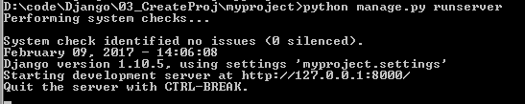
5.1 Start Admin Interface
Introduction
https://www.tutorialspoint.com/django/django_admin_interface.htm
Now just run the server.
$ python manage.py runserver
Python/Django - CS596

Slide 10
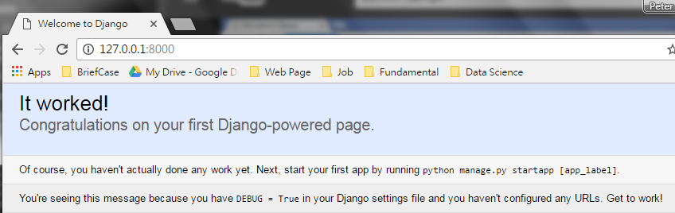
5.1 Start Admin Interface
Introduction
https://www.tutorialspoint.com/django/django_admin_interface.htm
Open browser and enter “http://127.0.0.1:8000”
Python/Django - CS596

Slide 11
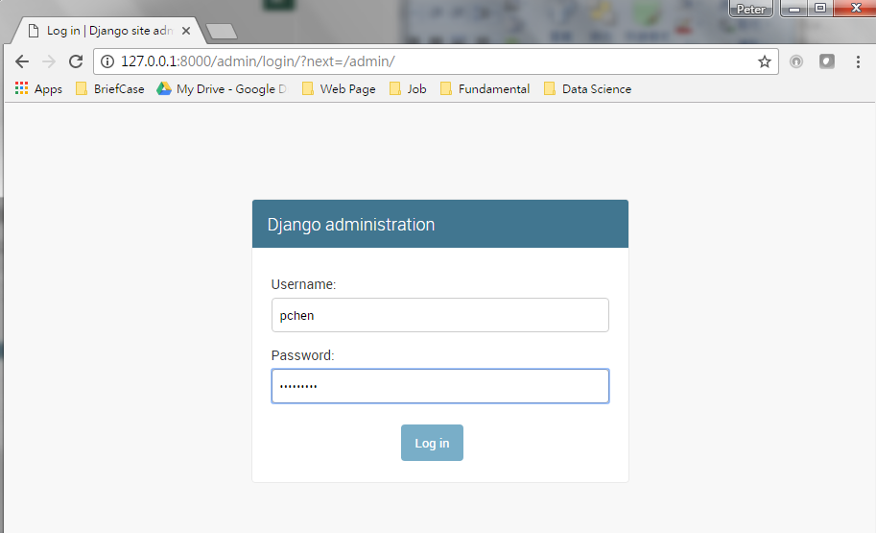
5.1 Start Admin Interface
Introduction
https://www.tutorialspoint.com/django/django_admin_interface.htm
Open browser.
And your admin interface is accessible at: http://127.0.0.1:8000/admin/
Type user name: “pchen”
Password: “Pc1997=ch”
Python/Django - CS596

Slide 12
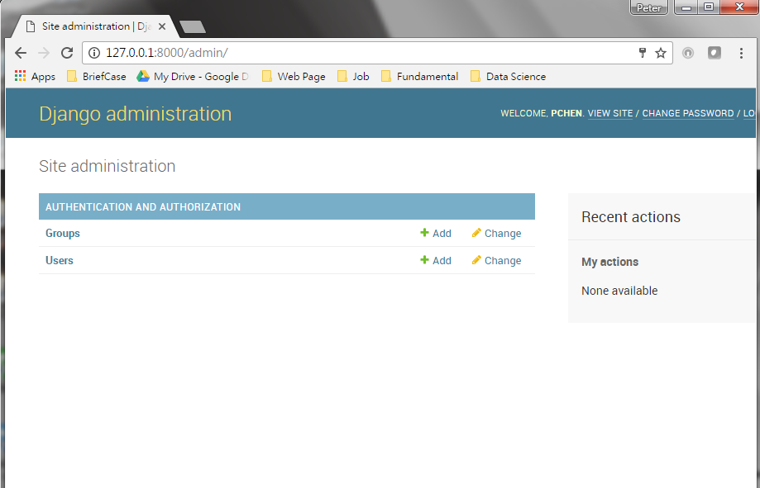
5.1 Start Admin Interface
Introduction
https://www.tutorialspoint.com/django/django_admin_interface.htm
Once connected with your superuser account, you will see the following screen:
Python/Django - CS596

Slide 13
5.1 Start Admin Interface
Introduction
https://www.tutorialspoint.com/django/django_admin_interface.htm
That interface will let you administrate Django groups and users, and all registered models in your app.
The interface gives you the ability to do at least the "CRUD" (Create, Read, Update, Delete) operations on your models.
Python/Django - CS596

Slide 14
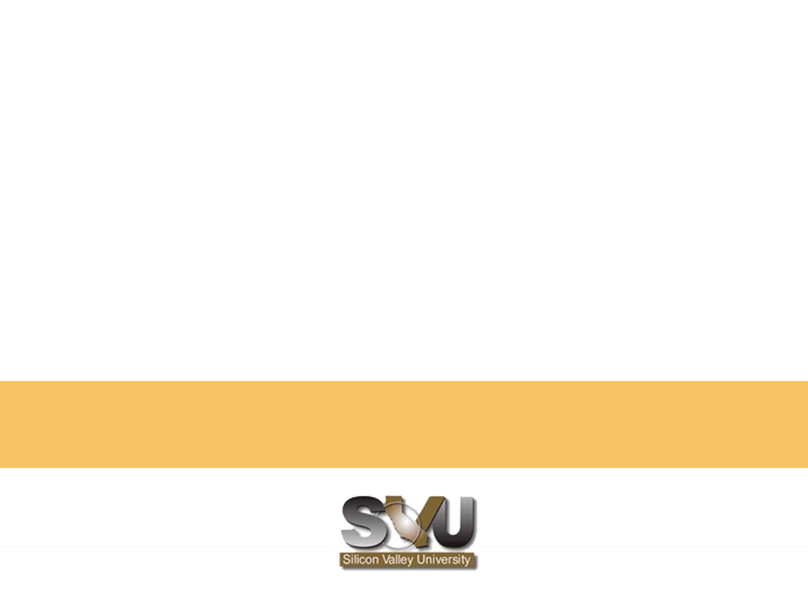
END of CHAPTER 5

