Slide 1
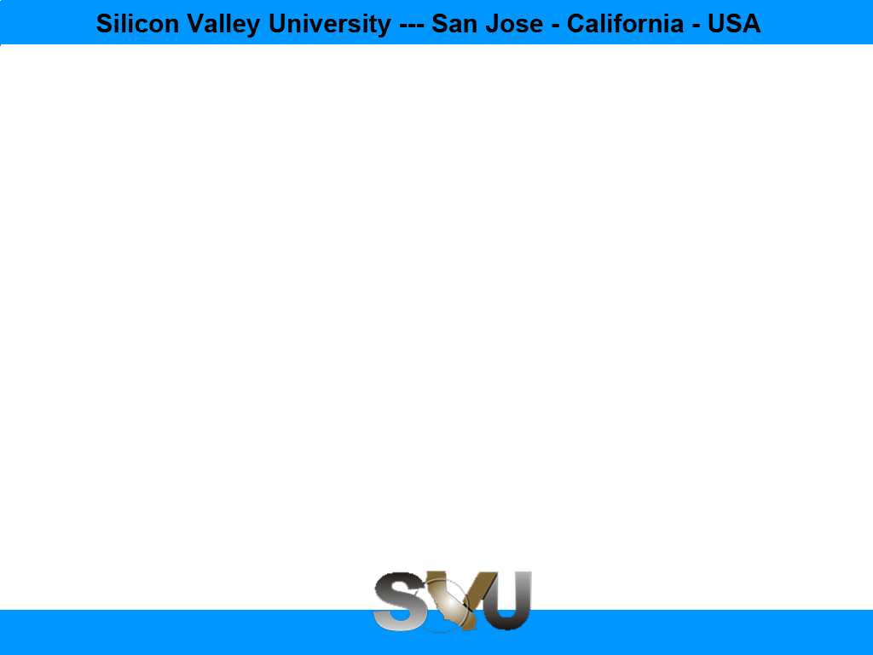

Python/Django Chapter 6: Create View
Peter H. Chen, PhDEE/EMBA

Slide 2

6 Create View

Slide 3
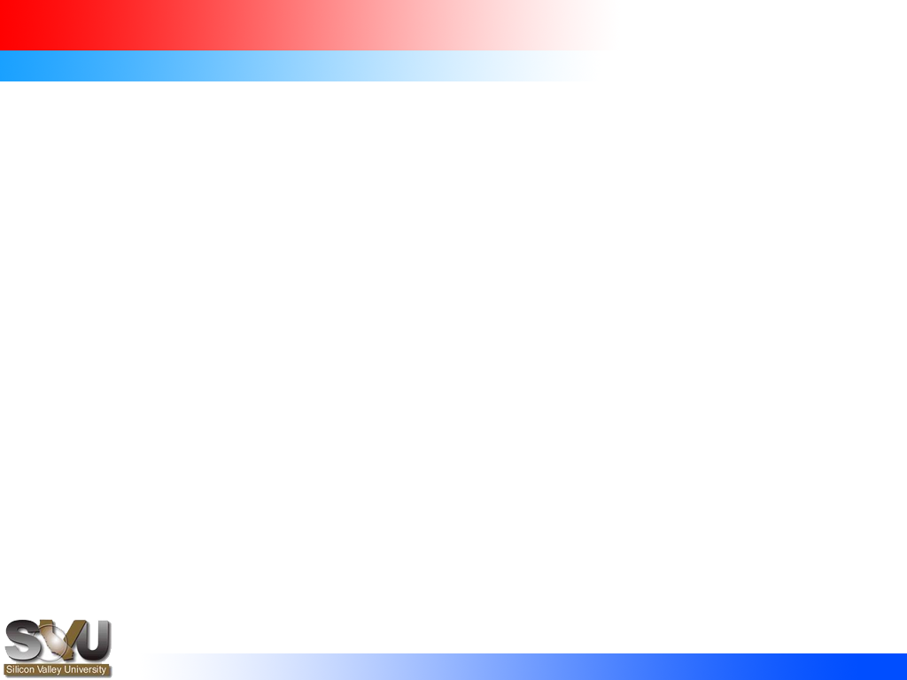
6 Create View
Introduction
https://www.tutorialspoint.com/django/django_creating_views.htm
A view function, or “view” for short, is simply a Python function that takes a web request and returns a web response.
This response can be the HTML contents of a Web page, or a redirect, or a 404 error, or an XML document, or an image, etc. Example: You use view to create web pages, note that you need to associate a view to a URL to see it as a web page.
In Django, views have to be created in the app views.py file.
Python/Django - CS596

Slide 4
6.1 Simple View

Slide 5
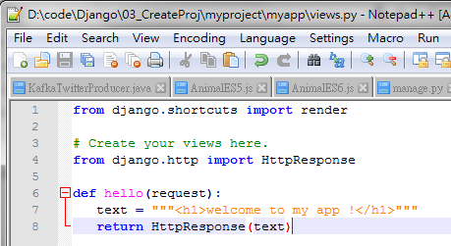
6.1 Simple View
Introduction
https://www.tutorialspoint.com/django/django_creating_views.htm
We will create a simple view in myapp to say "welcome to my app!“
See the following view.
Note: Triple quote (“””) is used for multiple lines.
from django.http import HttpResponse
def hello(request):
text = """<h1>welcome to my app !</h1>"""
return HttpResponse(text)
Python/Django - CS596

Slide 6
6.1 Simple View
Introduction
https://www.tutorialspoint.com/django/django_creating_views.htm
In this view, we use HttpResponse to render the HTML (as you have probably noticed we have the HTML hard coded in the view).
To see this view as a page we just need to map it to a URL (this will be discussed in an upcoming chapter).
We used HttpResponse to render (give) the HTML in the view before.
This is not the best way to render pages.
Django supports the MVT (Model View Template) pattern so to make the precedent view, Django - MVT like, we will need:
A template: myapp/templates/hello.html
And now our view will look like
from django.shortcuts import render
def hello(request):
return render(request, "myapp/template/hello.html", {})
Python/Django - CS596

Slide 7
6.1 Simple View
Introduction
https://www.tutorialspoint.com/django/django_creating_views.htm
Views can also accept parameters
from django.http import HttpResponse
def hello(request, number):
text = "<h1>welcome to my app number %s!</h1>"% number
return HttpResponse(text)
When linked to a URL, the page will display the number passed as a parameter.
Note that the parameters will be passed via the URL (discussed in the next chapter).
Python/Django - CS596

Slide 8

END of CHAPTER 6

