Slide 1
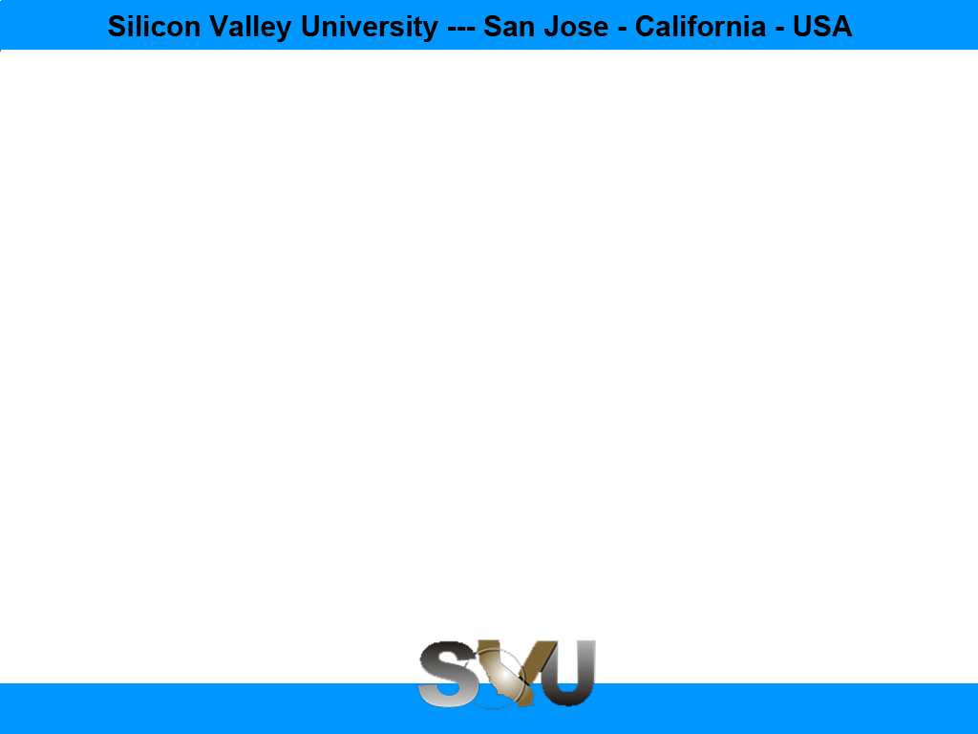
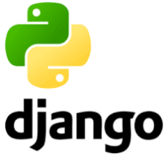
Python/Django Chapter 7: URL Mapping
Peter H. Chen, PhDEE/EMBA

Slide 2

7 URL Mapping

Slide 3

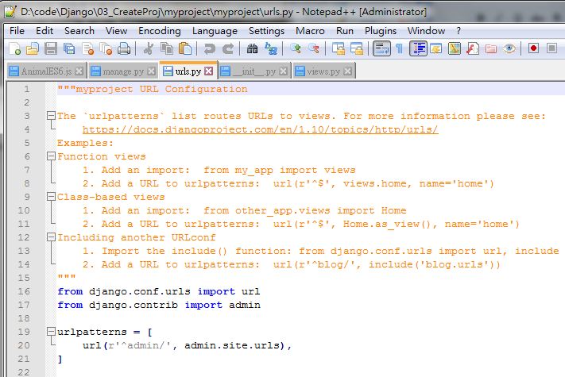
7 URL Mapping
Introduction
https://www.tutorialspoint.com/django/django_url_mapping.htm
Now that we have a working view as explained in the previous chapters.
We want to access that view via a URL.
Django has his own way for URL mapping and it's done by editing your project url.py file (myproject/url.py).
The urls.py file looks like.
Note:
DO NOT use url.py example in tutoritalpoint.
Use default generate by Django as below.
from django.contrib import admin
admin.autodiscover()
urlpatterns = ['',
url(r'^admin/', include(admin.site.urls)),
]
Python/Django - CS596

Slide 4
7 URL Mapping
Introduction
https://www.tutorialspoint.com/django/django_url_mapping.htm
website = myproject
music = myapp
Note:
Because the music is too popular (too crowded), we need another director (or app) to handle downloading.
Python/Django - CS596

Slide 5
7.1 website (mypeoject)

Slide 6
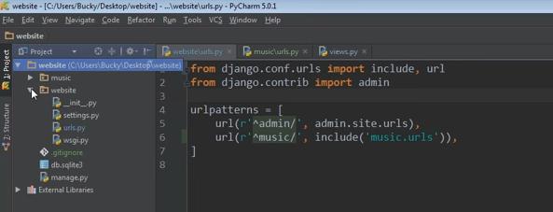
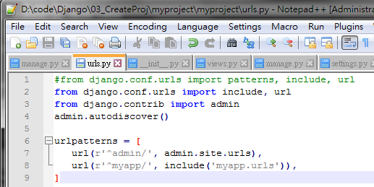
7 URL Mapping
Introduction
https://www.youtube.com/watch?v=nAn1KpPlN2w&list=PL6gx4Cwl9DGBlmzzFcLgDhKTTfNLfX1IK&index=5
rul (r’…’): r means regular expression.
website/urls.py
myproject/urls.py
from django.conf.urls import admin include, url
from django.contrib import admin
urlpatterns = [
url(r'^admin/', include(admin.site.urls)),
url(r‘^music/', include(‘music.urls’)),
]
from django.conf.urls import admin include, url
from django.contrib import admin
urlpatterns = [
url(r'^admin/', include(admin.site.urls)),
url(r‘^myapp/', include(‘myapp.urls’)),
]
Python/Django - CS596

Slide 7
7.2 music (myapp)

Slide 8
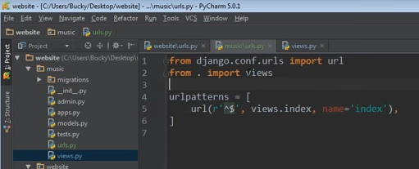
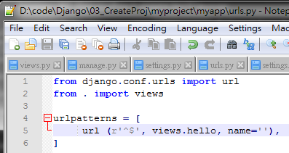
7 URL Mapping
Introduction
https://www.youtube.com/watch?v=nAn1KpPlN2w&list=PL6gx4Cwl9DGBlmzzFcLgDhKTTfNLfX1IK&index=5
music/urls.py (myapp/urls.py)
Note:
$ means match any string.
index is the name of response function.
Specify function name in views.py
from django.conf.urls import url
from . import views
urlpatterns = [
url (r’^$’, views.index, name = ‘index’)
]
from django.conf.urls import url
from . import views
urlpatterns = [
url (r’^$’, views.hello, name = ‘’)
]
Python/Django - CS596

Slide 9
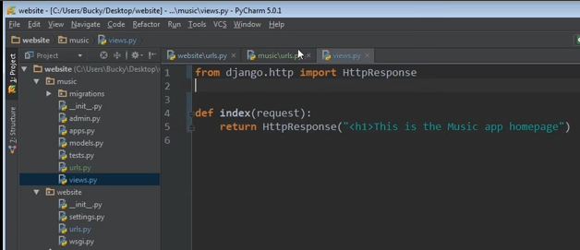
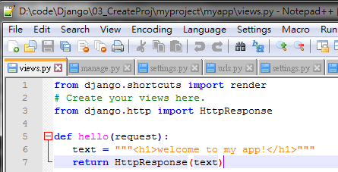
7 URL Mapping
Introduction
https://www.youtube.com/watch?v=nAn1KpPlN2w&list=PL6gx4Cwl9DGBlmzzFcLgDhKTTfNLfX1IK&index=5
music/views.py
Function name in views.py
from django.http import HTTPResponse
def index (request):
return HttpResponse (“<h1>This is the Music app Homepage</h1>”)
from django.http import HTTPResponse
def hello (request):
return HttpResponse (“””<h1>Welcome to my app! </h1>”””)
Python/Django - CS596

Slide 10
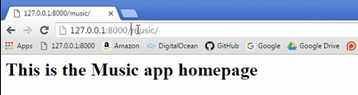
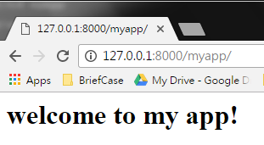
7 URL Mapping
Introduction
https://www.youtube.com/watch?v=nAn1KpPlN2w&list=PL6gx4Cwl9DGBlmzzFcLgDhKTTfNLfX1IK&index=5
Type “127.0.0.1:8000/music/”
Type “127.0.0.1:8000/myapp/”
Python/Django - CS596

Slide 11
7 URL Mapping
Introduction
https://www.tutorialspoint.com/django/django_url_mapping.htm
When a user makes a request for a page on your web app, Django controller takes over to look for the corresponding view via the url.py file, and then return the HTML response or a 404 not found error, if not found.
In urls.py, the most important thing is the "urlpatterns" list.
It’s where you define the mapping between URLs and views.
A mapping is a tuple in URL patterns like:
from django.contrib import admin
admin.autodiscover()
urlpatterns = ['',
url(r'^admin/', include(admin.site.urls)),
url(r'^$', 'views.hello', name = 'hello')
]
Python/Django - CS596

Slide 12
7 URL Mapping
Introduction
https://www.tutorialspoint.com/django/django_url_mapping.htm
The marked line maps the URL "/home" to the hello view created in myapp/view.py file.
As you can see above a mapping is composed of three elements −
The pattern − A regexp matching the URL you want to be resolved and map. Everything that can work with the python 're' module is eligible for the pattern (useful when you want to pass parameters via url).
The python path to the view − Same as when you are importing a module.
The name − In order to perform URL reversing, you’ll need to use named URL patterns as done in the examples above. Once done, just start the server to access your view via :http://127.0.0.1/hello
Python/Django - CS596

Slide 13
7.3 Organize your URL

Slide 14
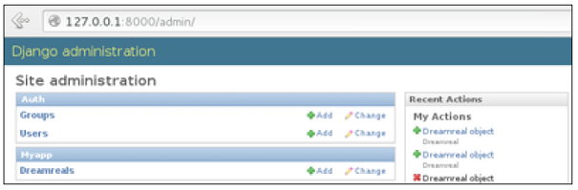
7.3 Organize Your URL
Introduction
https://www.tutorialspoint.com/django/django_url_mapping.htm
So far, we have created the URLs in “myprojects/url.py” file, however as stated earlier about Django and creating an app, the best point was to be able to reuse applications in different projects.
You can easily see what the problem is, if you are saving all your URLs in the “projecturl.py” file.
So best practice is to create an “url.py” per application and to include it in our main projects url.py file (we included admin URLs for admin interface before).
Python/Django - CS596

Slide 15

END of CHAPTER 7

