Slide 1
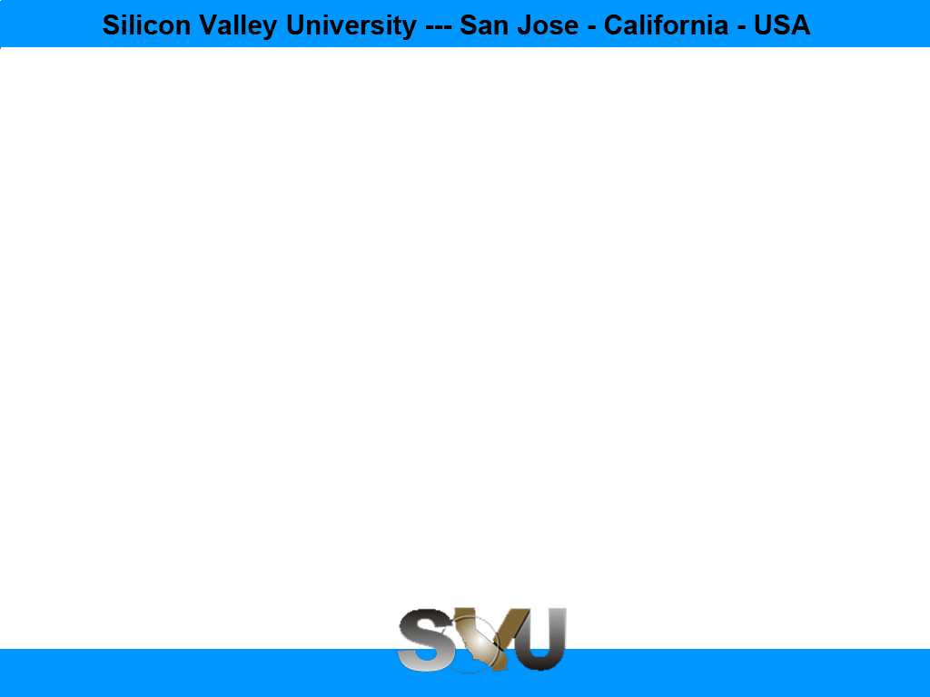

Python/Django Chapter 10: Page Redirection
Peter H. Chen, PhDEE/EMBA

Slide 2

10 Page Redirection

Slide 3

10 Page Redirection
Introduction
https://www.tutorialspoint.com/django/django_page_redirection.htm
Page redirection is needed for many reasons in web application. You might want to redirect a user to another page when a specific action occurs, or basically in case of error. For example, when a user logs in to your website, he is often redirected either to the main home page or to his personal dashboard. In Django, redirection is accomplished using the 'redirect' method.
The 'redirect' method takes as argument: The URL you want to be redirected to as string A view's name.
Python/Django - CS596

Slide 4
10 Page Redirection
Introduction
https://www.tutorialspoint.com/django/django_page_redirection.htm
The myapp/views looks like the following so far:
def hello(request):
today = datetime.datetime.now().date()
daysOfWeek = ['Mon', 'Tue', 'Wed', 'Thu', 'Fri', 'Sat', 'Sun']
return render(request, "hello.html", {"today" : today, "days_of_week" : daysOfWeek})
def viewArticle(request, articleId):
""" A view that display an article based on his ID"""
text = "Displaying article Number : %s" %articleId
return HttpResponse(text)
def viewArticles(request, year, month):
text = "Displaying articles of : %s/%s"%(year, month)
return HttpResponse(text)
Python/Django - CS596

Slide 5
10 Page Redirection
Introduction
https://www.tutorialspoint.com/django/django_page_redirection.htm
Let's change the hello view to redirect to djangoproject.com and our viewArticle to redirect to our internal '/myapp/articles'.
Python/Django - CS596

Slide 6
10 Page Redirection
Introduction
https://www.tutorialspoint.com/django/django_page_redirection.htm
To do so the myapp/view.py will change to
from django.shortcuts import render, redirect
from django.http import HttpResponse
import datetime
# Create your views here.
def hello(request):
today = datetime.datetime.now().date()
daysOfWeek = ['Mon', 'Tue', 'Wed', 'Thu', 'Fri', 'Sat', 'Sun']
return redirect("https://www.djangoproject.com")
def viewArticle(request, articleId):
""" A view that display an article based on his ID"""
text = "Displaying article Number : %s" %articleId
return redirect(viewArticles, year = "2045", month = "02")
def viewArticles(request, year, month):
text = "Displaying articles of : %s/%s"%(year, month)
return HttpResponse(text)
Python/Django - CS596

Slide 7
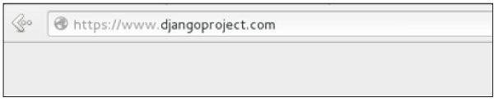
10 Page Redirection
Introduction
https://www.tutorialspoint.com/django/django_page_redirection.htm
In the above example, first we imported redirect from django.shortcuts and for redirection to the Django official website. We just pass the full URL to the 'redirect' method as string.
For the second example (the viewArticle view), the 'redirect' method takes the view name and his parameters as arguments.
Accessing /myapp/hello, will give you the following screen
Python/Django - CS596

Slide 8
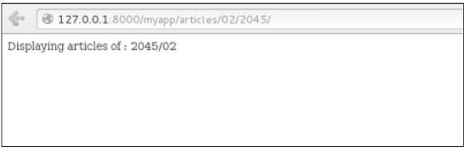
10 Page Redirection
Introduction
https://www.tutorialspoint.com/django/django_page_redirection.htm
And accessing /myapp/article/42, will give you the following screen
Python/Django - CS596

Slide 9
10 Page Redirection
Introduction
https://www.tutorialspoint.com/django/django_page_redirection.htm
It is also possible to specify whether the 'redirect' is temporary or permanent by adding permanent = True parameter. The user will see no difference, but these are details that search engines take into account when ranking of your website.
Also remember that 'name' parameter we defined in our url.py while mapping the URLs
url(r'^articles/(?P\d{2})/(?P\d{4})/', 'viewArticles', name = 'articles'),
Python/Django - CS596

Slide 10
10 Page Redirection
Introduction
https://www.tutorialspoint.com/django/django_page_redirection.htm
That name (here article) can be used as argument for the 'redirect' method, then our viewArticle redirection can be changed from −
def viewArticle(request, articleId):
""" A view that display an article based on his ID""“
text = "Displaying article Number : %s" %articleId
return redirect(viewArticles, year = "2045", month = "02")
Python/Django - CS596

Slide 11
10 Page Redirection
Introduction
https://www.tutorialspoint.com/django/django_page_redirection.htm
To −
def viewArticle(request, articleId):
""" A view that display an article based on his ID"""
text = "Displaying article Number : %s" %articleId
return redirect(articles, year = "2045", month = "02")
Note − There is also a function to generate URLs; it is used in the same way as redirect; the 'reverse' method (django.core.urlresolvers.reverse). T
his function does not return a HttpResponseRedirect object, but simply a string containing the URL to the view compiled with any passed argument.
Python/Django - CS596

Slide 12

END of CHAPTER 10

