Slide 1
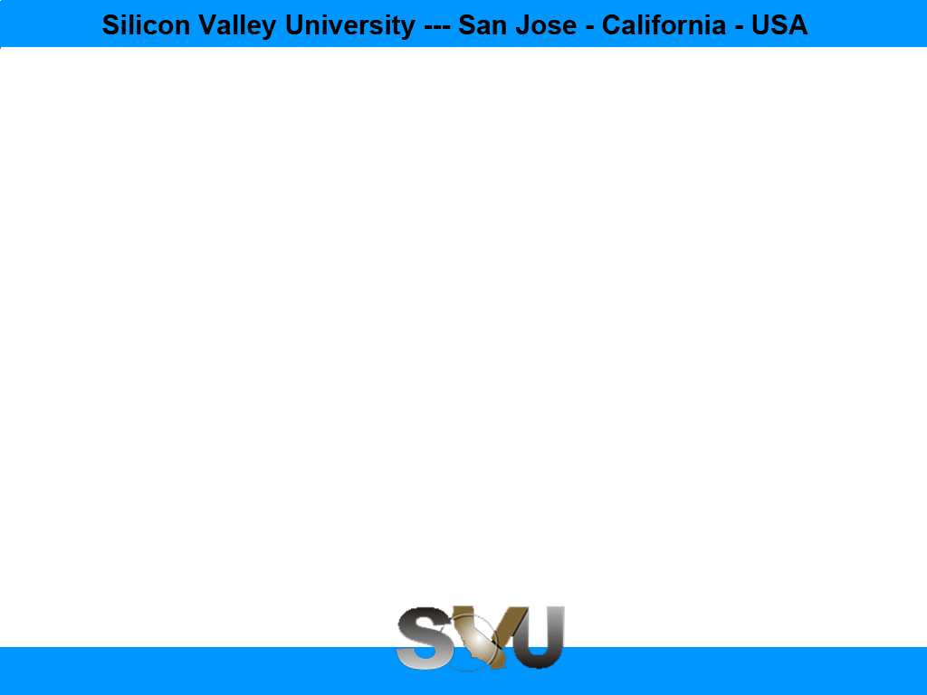

Python Chapter 1: Python
Peter H. Chen, PhDEE/EMBA

Slide 2

1 Python

Slide 3

1 Python
Introduction
https://www.tutorialspoint.com/python3/python_variable_types.htm
Python is a general-purpose interpreted, interactive, object-oriented, and high-level programming language.
Like Perl, Python source code is also available under the GNU General Public License (GPL).
It was created by Guido van Rossum during 1985- 1990.
Python was developed at the National Research Institute for Mathematics and Computer Science in the Netherlands.
Python is derived from many other languages, including ABC, Modula-3, C, C++, Algol-68, SmallTalk, and Unix shell and other scripting languages.
Python is copyrighted by the GNU General Public License (GPL).
Python - CS596

Slide 4
1 Python
Introduction
https://www.tutorialspoint.com/python3/python_variable_types.htm
Python is a high-level, interpreted, interactive and object-oriented scripting language.
Python is designed to be highly readable.
It uses English keywords frequently where as other languages use punctuation, and it has fewer syntactical constructions than other languages.
Python is Interpreted: Python is processed at runtime by the interpreter. You do not need to compile your program before executing it. This is similar to PERL and PHP.
Python is Interactive: You can actually sit at a Python prompt and interact with the interpreter directly to write your programs.
Python is Object-Oriented: Python supports Object-Oriented style or technique of programming that encapsulates code within objects.
Python is a Beginner's Language: Python is a great language for the beginner-level programmers and supports the development of a wide range of applications from simple text processing to WWW browsers to games.
Python - CS596

Slide 5
1 Python
Introduction
https://www.tutorialspoint.com/python3/python_variable_types.htm
Python's features include:
Easy-to-learn: Python has few keywords, simple structure, and a clearly defined syntax. This allows the student to pick up the language quickly.
Easy-to-read: Python code is more clearly defined and visible to the eyes.
Easy-to-maintain: Python's source code is fairly easy-to-maintain.
A broad standard library: Python's bulk of the library is very portable and cross-platform compatible on UNIX, Windows, and Macintosh.
Interactive Mode: Python has support for an interactive mode which allows interactive testing and debugging of snippets of code.
Portable: Python can run on a wide variety of hardware platforms and has the same interface on all platforms.
Extendable: You can add low-level modules to the Python interpreter. These modules enable programmers to add to or customize their tools to be more efficient.
Python - CS596

Slide 6
1 Python
Introduction
https://www.tutorialspoint.com/python3/python_variable_types.htm
Python's features include (Continue):
Databases: Python provides interfaces to all major commercial databases.
GUI Programming: Python supports GUI applications that can be created and ported to many system calls, libraries and windows systems, such as Windows MFC, Macintosh, and the X Window system of Unix.
Scalable: Python provides a better structure and support for large programs than shell scripting.
IT supports functional and structured programming methods as well as OOP.
It can be used as a scripting language or can be compiled to byte-code for building large applications.
It provides very high-level dynamic data types and supports dynamic type checking.
IT supports automatic garbage collection.
It can be easily integrated with C, C++, COM, ActiveX, CORBA, and Java.
Python - CS596

Slide 7
1.1 Setup Environment

Slide 8
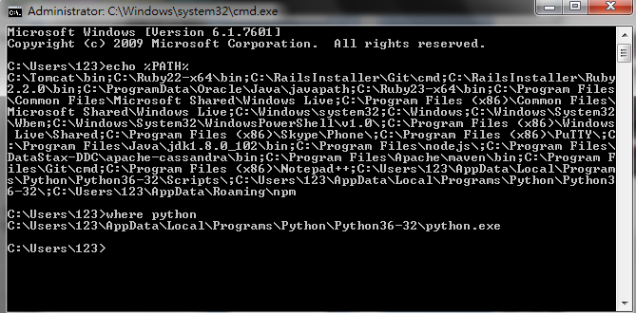
1.1 Setup Environment
Introduction
https://www.tutorialspoint.com/python/python_environment.htm
In Linux, Ubuntu already installed Python. Just type “python --version”.
Use “echo %PATH%” and “where python” to make sure Python installation properly.
$ python --version
Python - CS596

Slide 9


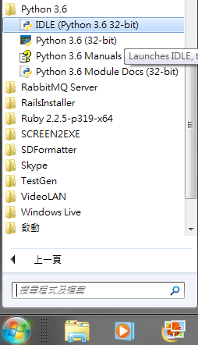
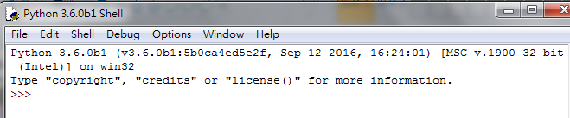
1.1 Setup Environment
Introduction
https://www.tutorialspoint.com/python/python_environment.htm
In Windows, download and install from
https://www.python.org/downloads/windows/
Python - CS596

Slide 10
1.2 Run Interpreter Program

Slide 11
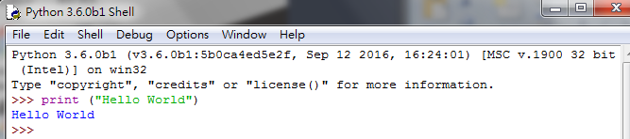
1.2 Interpreter Program
Introduction
https://www.tutorialspoint.com/python/python_basic_syntax.htm
Interactive Program:
>>> print (“Hello World”)
Hello World
Python - CS596

Slide 12
1.3 Git for Python File

Slide 13
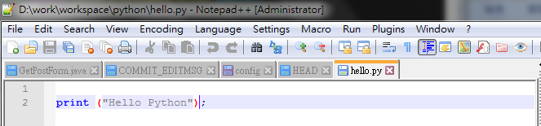
1.3 Git for Python File
Edit Python File
https://www.tutorialspoint.com/python/python_basic_syntax.htm
Edit python “notepad++ hello.py”.
$ notepad++ hello.py
Python - CS596

Slide 14
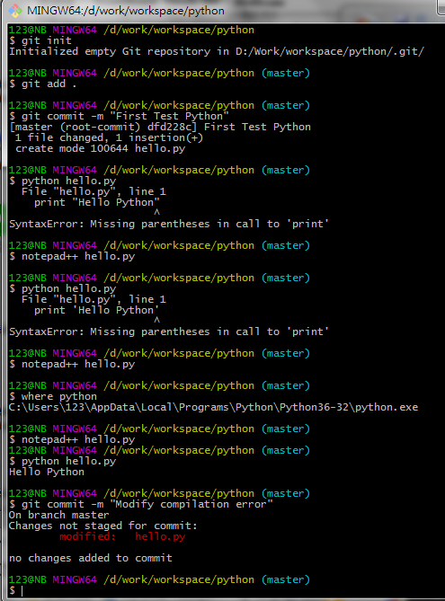
1.3 Git for Python File
Interpret and Check in Python File
https://www.tutorialspoint.com/python/python_basic_syntax.htm
Interpret hello.py
$ python hello.py
Check in python code by Git.
$ git init
$ git add .
$ git commit -m “initial python code”
# notepad++ hello.py
# Modify hello.py
# Check in heloo.py again.
$ git commit -m “Modify error.”
Python - CS596

Slide 15

END of CHAPTER 1

