Slide 1

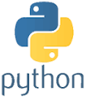
Python Chapter 2: Syntax
Peter H. Chen, PhDEE/EMBA

Slide 2

2 Syntax

Slide 3
2.1 Syntax

Slide 4

2.1 Identifier
Introduction
https://www.tutorialspoint.com/python3/python_basic_syntax.htm
A Python identifier is a name used to identify a variable, function, class, module or other object.
An identifier starts with a letter A to Z or a to z or an underscore (_) followed by zero or more letters, underscores and digits (0 to 9).
Python does not allow punctuation characters such as @, $, and % within identifiers.
Python is a case sensitive programming language.
Thus, Manpower and manpower are two different identifiers in Python.
Here are naming conventions for Python identifiers:
Class names start with an uppercase letter. All other identifiers start with a lowercase letter.
Starting an identifier with a single leading underscore indicates that the identifier is private.
Starting an identifier with two leading underscores indicates a strongly private identifier.
If the identifier also ends with two trailing underscores, the identifier is a language-defined special name.
Python - CS596

Slide 5
2.2 Reserved Word

Slide 6
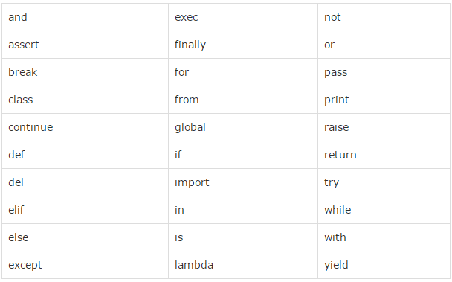
2.2 Reserved Word
Introduction
https://www.tutorialspoint.com/python3/python_basic_syntax.htm
Python keywords (30 keywrds) are reserved words and you cannot use them as constant or variable or any other identifier names.
All the Python keywords contain lowercase letters only.
Python - CS596

Slide 7
2.3 Indentation

Slide 8
2.3 Indentation
Introduction
https://www.tutorialspoint.com/python3/python_basic_syntax.htm
Python has no braces to indicate blocks of code for class and function definitions or flow control.
Blocks of code are denoted by line indentation.
All statements in the block must be indented the same amount of spaces (indentation).
# OK
if True:
print "True"
else:
print "False"
# NG
if True:
print "Answer“
print "True"
else:
print "Answer“
print "False"
Python - CS596

Slide 9
2.4 Multi-Line Statement

Slide 10
2.4 Multi-Line Statement
Introduction
https://www.tutorialspoint.com/python3/python_basic_syntax.htm
Statements in Python typically end with a new line.
Use the line continuation character (\) to denote that the line should continue.
total = item_one + \
item_two + \
item_three
Statements contained within the [], {}, or () brackets do not need to use the line continuation character.
days = ['Monday', 'Tuesday', 'Wednesday',
'Thursday', 'Friday']
Python - CS596

Slide 11
2.5 Quotation

Slide 12
2.5 Quotation
Introduction
https://www.tutorialspoint.com/python3/python_basic_syntax.htm
Python accepts single ('), double (") and triple (''' or """) quotes to denote string literals, as long as the same type of quote starts and ends the string.
The triple quotes are used to span the string across multiple lines.
word = 'word'
sentence = "This is a sentence."
paragraph = """This is a paragraph. It is
made up of multiple lines and sentences."""
Python - CS596

Slide 13
2.6 Comment

Slide 14
2.6 Comment
Introduction
https://www.tutorialspoint.com/python3/python_basic_syntax.htm
A hash sign (#) that is not inside a string literal begins a comment.
All characters after the # and up to the end of the physical line are part of the comment and the Python interpreter ignores them.
#!/usr/bin/python
# First comment
print "Hello, Python!" # second comment
Python - CS596

Slide 15
2.7 Blank Line

Slide 16
2.7 Blank Line
Introduction
https://www.tutorialspoint.com/python3/python_basic_syntax.htm
A line containing only whitespace is known as a blank line. Python ignores it.
In an interactive interpreter session, enter an empty physical line to terminate a multiline statement.
Python - CS596

Slide 17
2.8 Wait for User Input

Slide 18
2.8 Wait for User Input
Introduction
https://www.tutorialspoint.com/python3/python_basic_syntax.htm
Displays the prompt saying “Press the enter key to exit”.
"\n\n" is two new lines before displaying the actual line.
Once the user presses the key, the program ends.
#!/usr/bin/python
raw_input("\n\nPress the enter key to exit.")
Python - CS596

Slide 19
2.9 Multi-Statements on One Line

Slide 20
2.9 Multi-Statements on one Line
Introduction
https://www.tutorialspoint.com/python3/python_basic_syntax.htm
The semicolon ( ; ) allows multiple statements on the single line given that neither statement starts a new code block.
import sys; x = 'foo'; sys.stdout.write(x + '\n')
Python - CS596

Slide 21
2.10 Suite

Slide 22
2.10 Suite
Introduction
https://www.tutorialspoint.com/python3/python_basic_syntax.htm
A group of individual statements, which make a single code block are called suites in Python.
Compound or complex statements, such as if, while, def, and class require a header line and a suite.
Header lines begin the statement (with the keyword) and terminate with a colon ( : ) and are followed by one or more lines which make up the suite.
if expression :
suite
elif expression :
suite
else :
suite
Python - CS596

Slide 23
2.11 Command Line Argument

Slide 24
2.11 Command Line Arguement
Introduction
https://www.tutorialspoint.com/python3/python_basic_syntax.htm
Many programs can be run to provide you with some basic information about how they should be run.
Python enables you to do this with -h −
$ python -h
usage: python [option] ... [-c cmd | -m mod | file | -] [arg] ...
Options and arguments (and corresponding environment variables):
-c cmd : program passed in as string (terminates option list)
-d : debug output from parser (also PYTHONDEBUG=x)
-E : ignore environment variables (such as PYTHONPATH)
-h : print this help message and exit
[ etc. ]
Python - CS596

Slide 25

END of CHAPTER 2

