Slide 1

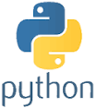
Python Chapter 3: Variable Type
Peter H. Chen, PhDEE/EMBA

Slide 2

3 Variable Type

Slide 3

3 Variable Type
Introduction
https://www.tutorialspoint.com/python3/python_variable_types.htm
Variables are reserved memory locations to store values.
When you create a variable you reserve some space in memory.
Based on the data type of a variable, the interpreter allocates memory and decides what can be stored in the reserved memory.
Therefore, by assigning different data types to variables, you can store integers, decimals or characters in these variables.
Python - CS596

Slide 4
3.1 Assign Values to Variable

Slide 5
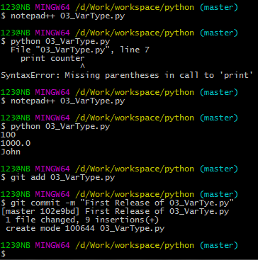
3.1 Assign Value to Variable
Introduction
https://www.tutorialspoint.com/python3/python_variable_types.htm
Python variables do not need explicit declaration to reserve memory space.
The declaration happens automatically when you assign a value to a variable.
The equal sign (=) is used to assign values to variables.
The operand to the left of the = operator is the name of the variable and the operand to the right of the = operator is the value stored in the variable.
#!/usr/bin/python
counter = 100 # An integer assignment
miles = 1000.0 # A floating point
name = "John" # A string
print (counter)
print (miles)
print (name)
Python - CS596

Slide 6
3.2 Multiple Assignment

Slide 7
3.2 Multiple Assignment
Introduction
https://www.tutorialspoint.com/python3/python_variable_types.htm
Python allows you to assign a single value to several variables simultaneously.
Here, an integer object is created with the value 1, and all three variables are assigned to the same memory location.
a = b = c = 1
You can also assign multiple objects to multiple variables.
Here, two integer objects with values 1 and 2 are assigned to variables a and b respectively, and one string object with the value "john" is assigned to the variable c
a, b, c = 1, 2, "john"
Python - CS596

Slide 8
3.3 Standard Data Type

Slide 9
3.3 Standard Data Type
Introduction
https://www.tutorialspoint.com/python3/python_variable_types.htm
The data stored in memory can be of many types.
For example, a person's age is stored as a numeric value and his or her address is stored as alphanumeric characters.
Python has various standard data types that are used to define the operations possible on them and the storage method for each of them.
Python has five standard data types −
Numbers
String
List
Tuple
Dictionary
Python - CS596

Slide 10
3.4 Number

Slide 11
3.4 Number
Introduction
https://www.tutorialspoint.com/python3/python_variable_types.htm
Number data types store numeric values.
Number objects are created when you assign a value to them.
var1 = 1
var2 = 10
You can also delete the reference to a number object by using the del statement.
del var1[,var2[,var3[....,varN]]]]
You can delete a single object or multiple objects by using the del statement. .
del var
del var_a, var_b
Python - CS596

Slide 12
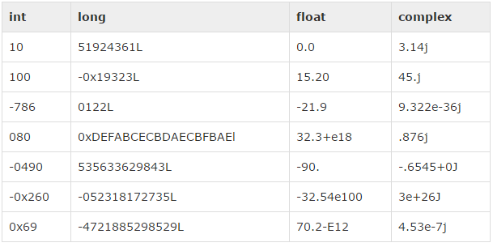
3.4 Number
Introduction
https://www.tutorialspoint.com/python3/python_variable_types.htm
Python supports four different numerical types −
int (signed integers)
long (long integers, they can also be represented in octal and hexadecimal)
float (floating point real values)
complex (complex numbers)
Examples:
Python - CS596

Slide 13
3.4 Number
Introduction
https://www.tutorialspoint.com/python3/python_variable_types.htm
Python allows you to use a lowercase l with long, but it is recommended that you use only an uppercase L to avoid confusion with the number 1.
Python displays long integers with an uppercase L.
A complex number consists of an ordered pair of real floating-point numbers denoted by x + yj, where x and y are the real numbers and j is the imaginary unit.
Python - CS596

Slide 14
3.5 String

Slide 15
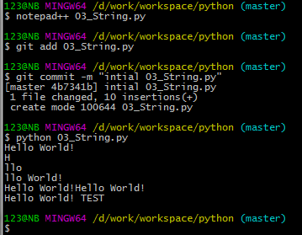
3.5 String
Introduction
https://www.tutorialspoint.com/python3/python_variable_types.htm
Strings in Python are identified as a contiguous set of characters represented in the quotation marks.
Python allows for either pairs of single or double quotes.
Subsets of strings can be taken using the slice operator ([ ] and [:] ) with indexes starting at 0 in the beginning of the string and working their way from -1 at the end.
The plus (+) sign is the string concatenation operator and the asterisk (*) is the repetition operator. For example
#!/usr/bin/python
str = 'Hello World!'
print (str) # Prints complete string
print (str[0]) # Prints first character of the string
print (str[2:5]) # Prints characters starting from 2nd to (5th-1)
print (str[2:]) # Prints string starting from 2nd character
print (str * 2) # Prints string two times
print (str + ' TEST') # Print Contcate String
Python - CS596

Slide 16
3.6 List

Slide 17
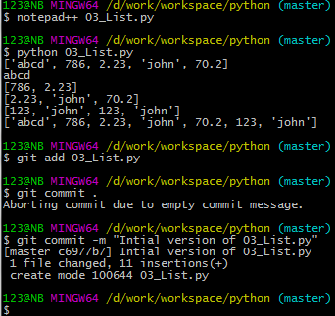
3.6 List
Introduction
https://www.tutorialspoint.com/python/python_basic_syntax.htm
A list contains items separated by commas and enclosed within square brackets ([]).
To some extent, lists are similar to arrays in C. One difference between them is that all the items belonging to a list can be of different data type.
The values stored in a list can be accessed using the slice operator ([ ] and [:]) with indexes starting at 0 in the beginning of the list and working their way to end -1.
The plus (+) sign is the list concatenation operator, and the asterisk (*) is the repetition operator.
#!/usr/bin/python
list = [ 'abcd', 786 , 2.23, 'john', 70.2 ]
tinylist = [123, 'john']
print (list) # Prints complete list
print (list[0]) # Prints first element of the list
print (list[1:3]) # Prints elements starting from 1st till (3-1)
print (list[2:]) # Prints elements starting from 2nd element
print (tinylist * 2) # Prints list two times
print (list + tinylist) # Prints concatenated lists
Python - CS596

Slide 18
3.7 Tuple

Slide 19
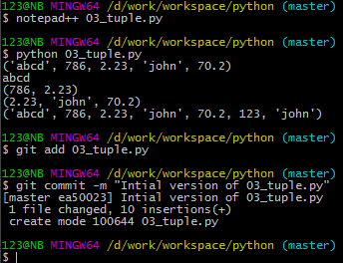
3.7 Tuple
Introduction
https://www.tutorialspoint.com/python/python_basic_syntax.htm
A tuple is another sequence data type that is similar to the list. A tuple consists of a number of values separated by commas.
The main differences between lists and tuples are:
Lists are enclosed in brackets ( [ ] ) and their elements and size can be changed, while tuples are enclosed in parentheses ( ( ) ) and cannot be updated.
Tuples can be thought of as read-only lists.
#!/usr/bin/python
tuple = ( 'abcd', 786 , 2.23, 'john', 70.2 )
tinytuple = (123, 'john')
print (tuple) # Prints complete list
print (tuple[0]) # Prints first element of the list
print (tuple[1:3]) # Prints elements starting from 2nd till 3rd
print (tuple[2:]) # Prints elements starting from 3rd element print (tinytuple * 2) # Prints list two times
print (tuple + tinytuple) # Prints concatenated lists
Python - CS596

Slide 20
3.7 Tuple
Introduction
https://www.tutorialspoint.com/python/python_basic_syntax.htm
The following code is invalid with tuple, because we attempted to update a tuple.
Tuple is read-only.
#!/usr/bin/python
tuple = ( 'abcd', 786 , 2.23, 'john', 70.2 )
list = [ 'abcd', 786 , 2.23, 'john', 70.2 ]
tuple[2] = 1000 # Invalid syntax with tuple
list[2] = 1000 # Valid syntax with list
Python - CS596

Slide 21
3.8 Dictionary

Slide 22
3.8 Dictionary
Introduction
https://www.tutorialspoint.com/python/python_basic_syntax.htm
The dictionaries are kind of hash table type.
They work like associative arrays or hashes found in Perl and consist of key-value pairs.
A dictionary key can be almost any Python type, but are usually numbers or strings. Values, on the other hand, can be any arbitrary Python object.
Dictionaries are enclosed by curly braces ({ }) and values can be assigned and accessed using square braces ([]).
Python - CS596

Slide 23
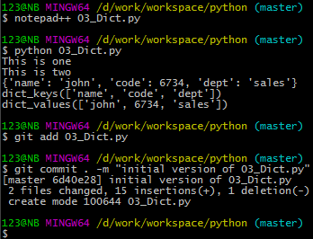
3.8 Dictionary
Introduction
https://www.tutorialspoint.com/python/python_basic_syntax.htm
The dictionary example:
#!/usr/bin/python
dict = {}
dict['one'] = "This is one"
dict[2] = "This is two"
tinydict = {'name': 'john','code':6734, 'dept': 'sales'}
print (dict['one']) # Prints value for 'one' key
print (dict[2]) # Prints value for 2 key
print (tinydict) # Prints complete dictionary
print (tinydict.keys()) # Prints all the keys
print (tinydict.values()) # Prints all the values
Python - CS596

Slide 24
3.9 Data Type Conversion

Slide 25
3.9 Data Type Conversion
Introduction
https://www.tutorialspoint.com/python/python_basic_syntax.htm
Sometimes, you may need to perform conversions between the built-in types.
To convert between types, you simply use the type name as a function.
There are several built-in functions to perform conversion from one data type to another.
Python - CS596

Slide 26
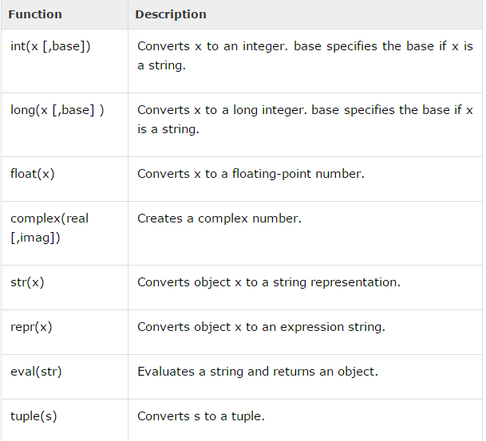
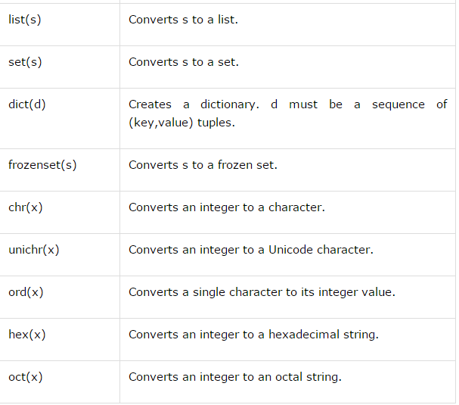
3.9 Data Type Conversion
Introduction
https://www.tutorialspoint.com/python/python_basic_syntax.htm
The built-in functions return a new object representing the converted value.
Python - CS596

Slide 27
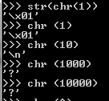

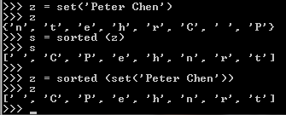
3.9 Data Type Conversion
Introduction
https://www.tutorialspoint.com/python/python_basic_syntax.htm
Python 3 use char() instead of unichr().
Create a List.
>>> x = list (‘Peter’)
>>> y = list (‘Peter Chen’)
Create a Set.
>>> z = set (‘Peter Chen’)
>>> z
{‘n’, ‘t’, ‘e’, ‘h’, ‘r’, ‘C’, ‘ ‘, ‘P’}
>>> sorted (z)
>>> z
[‘ ‘, ‘C’, ‘P’, ‘e’, ‘h’, ‘r’, ‘t’]
Python - CS596

Slide 28
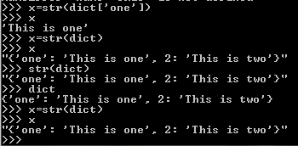

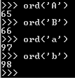
3.9 Data Type Conversion
Introduction
https://www.tutorialspoint.com/python/python_basic_syntax.htm
Convert an object into a string.
Convert a number into hex and oct format.
Convert a character into ASCII format.
Python - CS596

Slide 29

END of CHAPTER 3

