Slide 1


Python Chapter 4: Operator
Peter H. Chen, PhDEE/EMBA

Slide 2

4 Operator

Slide 3

4 Operator
Introduction
https://www.tutorialspoint.com/python3/python_basic_operators.htm
Operators are the constructs which can manipulate the value of operands.
Consider the expression 4 + 5 = 9. Here, 4 and 5 are called operands and + is called operator.
Python - CS596

Slide 4
4.1 Type of Operator

Slide 5
4.1 Type of Operator
Introduction
https://www.tutorialspoint.com/python3/python_basic_operators.htm
Python language supports the following types of operators.
Arithmetic Operators
Comparison (Relational) Operators
Assignment Operators
Logical Operators
Bitwise Operators
Membership Operators
Identity Operators
Let us have a look on all operators one by one.
Python - CS596

Slide 6
4.2 Arithmetic Operator

Slide 7
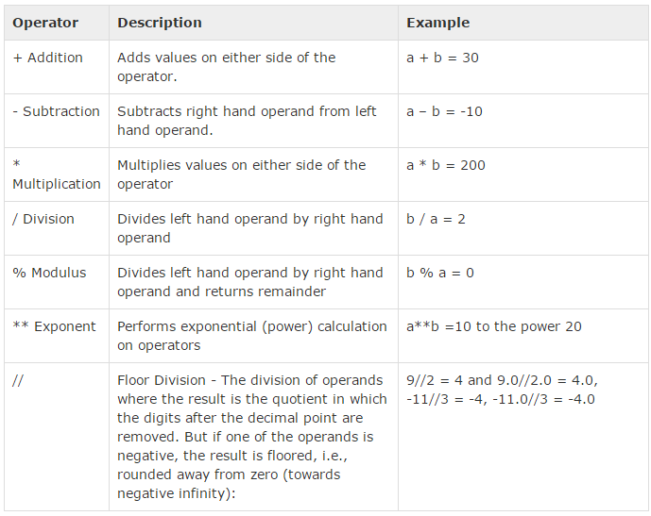
4.2 Arithmetic Operator
Introduction
https://www.tutorialspoint.com/python3/python_basic_operators.htm
Assume variable a holds 10 and variable b holds 20, then:
Python - CS596

Slide 8
4.3 Comparison Operator

Slide 9
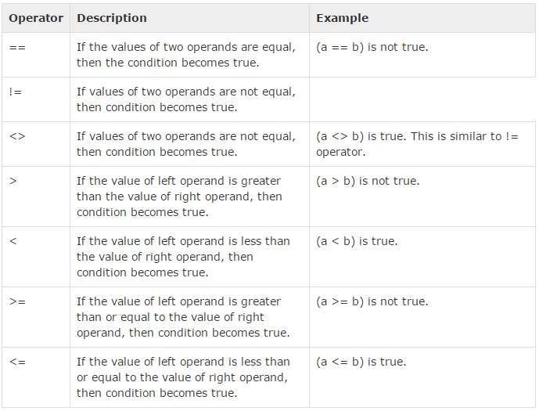
4.3 Comparison Operator
Introduction
https://www.tutorialspoint.com/python3/python_basic_operators.htm
The comparison operators compare the values on either sides of them and decide the relation among them. They are also called Relational operators.
Assume variable a holds 10 and variable b holds 20, then:
Python - CS596

Slide 10
4.4 Assignment Operator

Slide 11
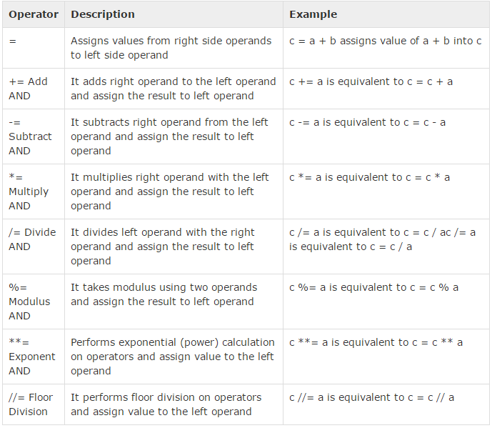
4.4 Assignment Operator
Introduction
https://www.tutorialspoint.com/python3/python_basic_operators.htm
Assume variable a holds 10 and variable b holds 20, then:
Python - CS596

Slide 12
4.5 Bitwise Operator

Slide 13
4.5 Bitwise Operator
Introduction
https://www.tutorialspoint.com/python3/python_basic_operators.htm
Bitwise operator works on bits and performs bit by bit operation. Assume if a = 60; and b = 13; Now in binary format they will be as follows:
a = 0011 1100
b = 0000 1101
-----------------
a&b = 0000 1100
a|b = 0011 1101
a^b = 0011 0001
~a = 1100 0011
Python - CS596

Slide 14
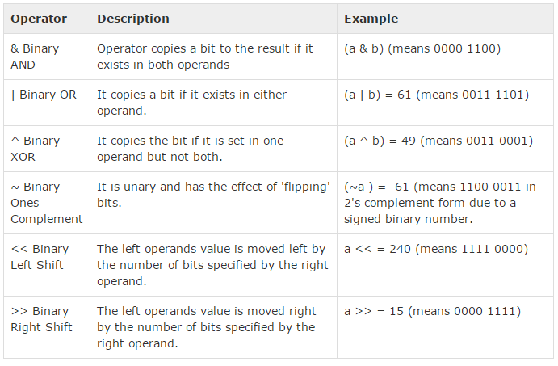
4.5 Bitwise Operator
Introduction
https://www.tutorialspoint.com/python3/python_basic_operators.htm
There are following Bitwise operators supported by Python language.
Python - CS596

Slide 15
4.6 Logical Operator

Slide 16
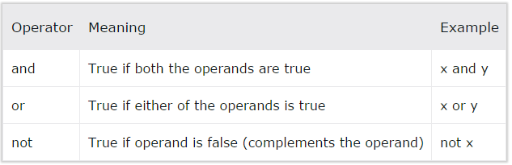
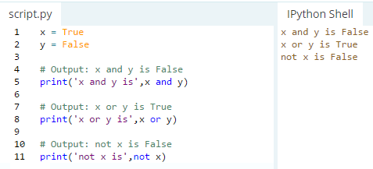
4.6 Logical Operator
Introduction
http://www.programiz.com/python-programming/operators#logical_operators
Logical operators are the and, or, not operators.
Python - CS596

Slide 17
4.7 Membership Operator

Slide 18
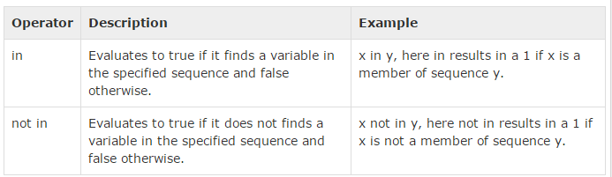
4.7 Membership Operator
Introduction
https://www.tutorialspoint.com/python3/python_basic_operators.htm
Python’s membership operators test for membership in a sequence, such as strings, lists, or tuples. There are two membership operators as explained below.
Python - CS596

Slide 19
4.8 Identity Operator

Slide 20
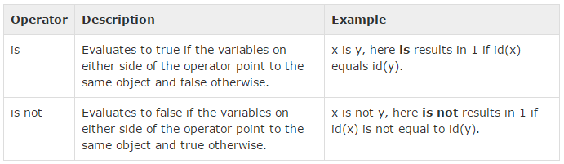
4.8 Identity Operator
Introduction
https://www.tutorialspoint.com/python3/python_basic_operators.htm
Identity operators compare the memory locations of two objects. There are two Identity operators explained below:
Python - CS596

Slide 21
4.9 Operator Precedence

Slide 22
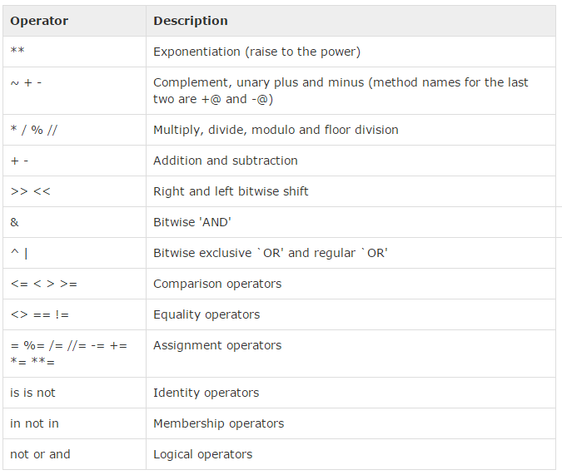
4.9 Identity Operator
Introduction
https://www.tutorialspoint.com/python3/python_basic_operators.htm
The following table lists all operators from highest precedence to lowest
Python - CS596

Slide 23

END of CHAPTER 4

