Slide 1


Python Chapter 5: Decision
Peter H. Chen, PhDEE/EMBA

Slide 2

5 Decision

Slide 3

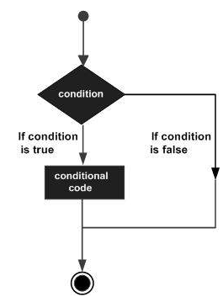
5 Decision
Introduction
https://www.tutorialspoint.com/python3/python_decision_making.htm
Decision making is anticipation of conditions occurring while execution of the program and specifying actions taken according to the conditions. Decision structures evaluate multiple expressions which produce TRUE or FALSE as outcome. You need to determine which action to take and which statements to execute if outcome is TRUE or FALSE otherwise.
Following is the general form of a typical decision making structure found in most of the programming languages.
Python - CS596

Slide 4
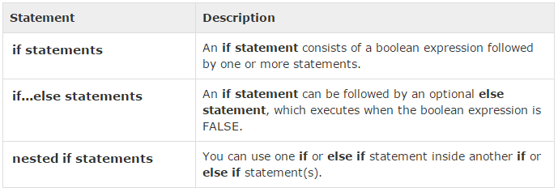
5 Decision
Introduction
https://www.tutorialspoint.com/python3/python_decision_making.htm
Python programming language assumes any non-zero and non-null values as TRUE, and if it is either zero or null, then it is assumed as FALSE value.
Python programming language provides following types of decision making statements. Click the following links to check their detail.
Python - CS596

Slide 5
5.1 Single Statement Suite

Slide 6
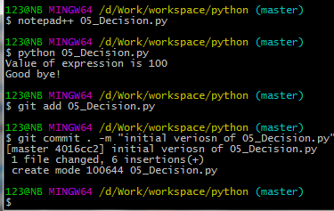
5 Decision
Introduction
https://www.tutorialspoint.com/python3/python_decision_making.htm
If the suite of an if clause consists only of a single line, it may go on the same line as the header statement.
Here is an example of a one-line if clause
#!/usr/bin/python
var = 100
if ( var == 100 ) : print ("Value of expression is 100“)
print ("Good bye!“)
Python - CS596

Slide 7

END of CHAPTER 5

