Slide 1

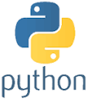
Python Chapter 6: Loop
Peter H. Chen, PhDEE/EMBA

Slide 2

6 Loop

Slide 3

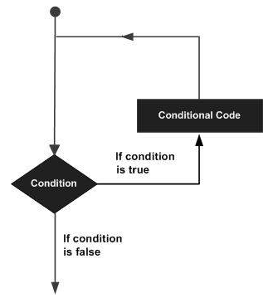
6 Loop
Introduction
https://www.tutorialspoint.com/python3/python_loops.htm
In general, statements are executed sequentially: The first statement in a function is executed first, followed by the second, and so on. There may be a situation when you need to execute a block of code several number of times.
Programming languages provide various control structures that allow for more complicated execution paths.
A loop statement allows us to execute a statement or group of statements multiple times. The following diagram illustrates a loop statement.
Python - CS596

Slide 4
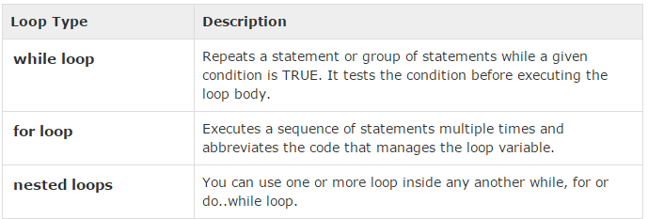
6 Loop
Introduction
https://www.tutorialspoint.com/python3/python_loops.htm
Python programming language provides following types of loops to handle looping requirements.
Python - CS596

Slide 5
6.1 Loop Control Statement

Slide 6
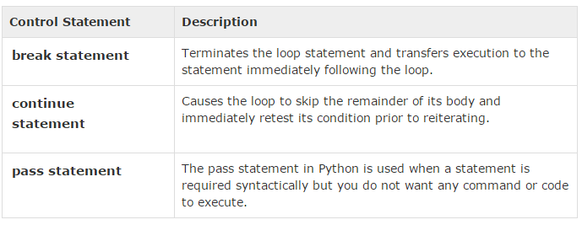
6.1 Loop Control Statement
Introduction
https://www.tutorialspoint.com/python3/python_loops.htm
Loop control statements change execution from its normal sequence. When execution leaves a scope, all automatic objects that were created in that scope are destroyed.
Python supports the following control statements.
Python - CS596

Slide 7
6.2 Loop Break Statement

Slide 8
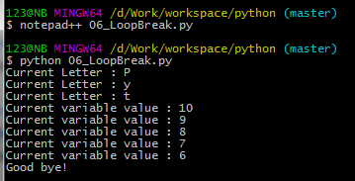
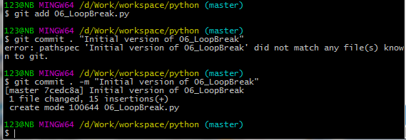
6.2 Break Statement
Introduction
https://www.tutorialspoint.com/python3/python_loops.htm
The break statement in Python terminates the current loop and resumes execution at the next statement, just like the traditional break found in C.
The most common use for break is when some external condition is triggered requiring a hasty exit from a loop. The break statement can be used in both while and for loops.
#!/usr/bin/python
for letter in 'Python': # First Example
if letter == 'h':
break
print ('Current Letter :', letter)
var = 10 # Second Example
while var > 0:
print ('Current variable value :', var)
var = var -1
if var == 5:
break
print ("Good bye!")
Python - CS596

Slide 9
6.3 Continue Statement

Slide 10
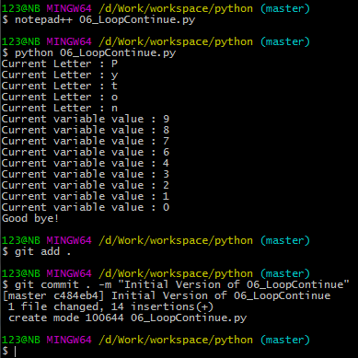
6.3 Continue Statement
Introduction
https://www.tutorialspoint.com/python3/python_loops.htm
The continue statement in Python returns the control to the beginning of the while loop. The continue statement rejects all the remaining statements in the current iteration of the loop and moves the control back to the top of the loop.
The continue statement can be used in both while and for loops.
#!/usr/bin/python
for letter in 'Python': # First Example if
if letter == 'h':
continue
print ('Current Letter :', letter)
var = 10 # Second Example
while var > 0:
var = var -1
if var == 5:
continue
print ('Current variable value :', var)
print ("Good bye!")
Python - CS596

Slide 11
6.4 Loop Pass Statement

Slide 12
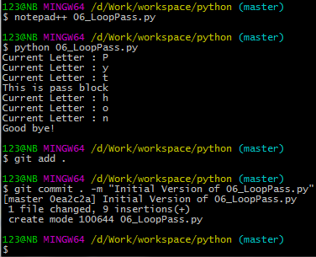
6.4 Pass Statement
Introduction
https://www.tutorialspoint.com/python3/python_loops.htm
The pass statement in Python is used when a statement is required syntactically but you do not want any command or code to execute.
The pass statement is a null operation; nothing happens when it executes.
The pass is also useful in places where your code will eventually go, but has not been written yet.
#!/usr/bin/python
for letter in 'Python':
if letter == 'h':
pass
print ('This is pass block')
print ('Current Letter :', letter)
print ("Good bye!")
Python - CS596

Slide 13
6.5 Loop Control Statement

Slide 14
6.5 Loop Control Statement
Introduction
https://www.tutorialspoint.com/python3/python_loops.htm
Loop control statements change execution from its normal sequence. When execution leaves a scope, all automatic objects that were created in that scope are destroyed.
Python supports the following control statements.
Python - CS596

Slide 15

END of CHAPTER 6

